Slide 1
ACUTE DACRYOCYSTITIS
BY MBBSPPT.COM

Slide 2
Acute suppurative inflammation of the lacrimal sac.
ETIOLOGY
1. As an acute exacerbation of chronic dacryocystitis.
2. As an acute peridacryocystitis due to direct involvement from the neighbouring infected structures such as paranasal sinuses, surrounding bones and dental abscess or caries teeth in upper jaw.

Slide 3
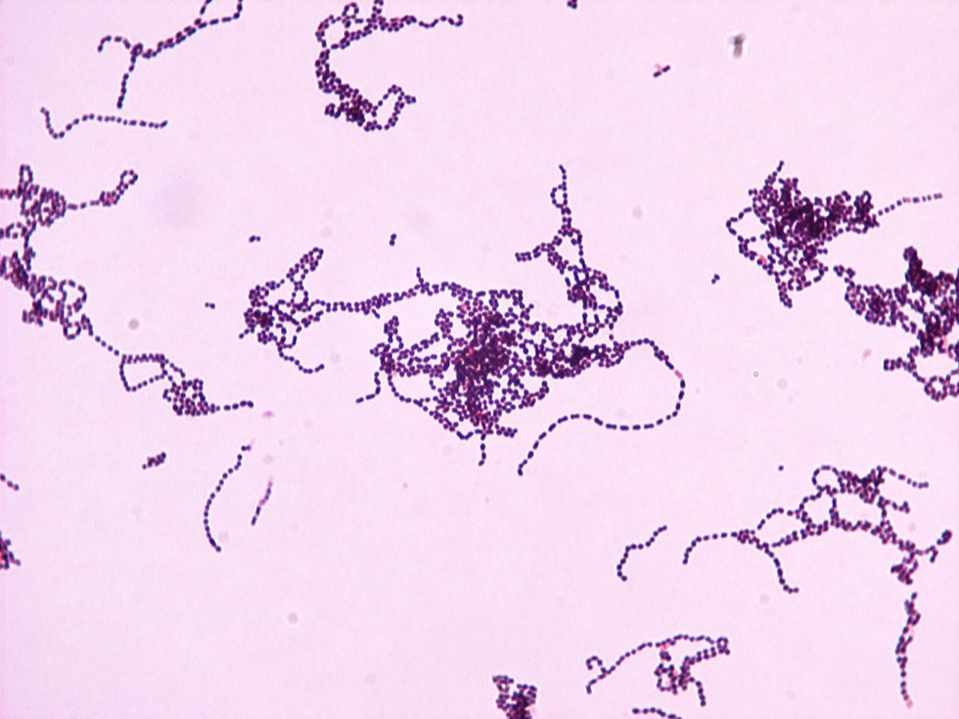
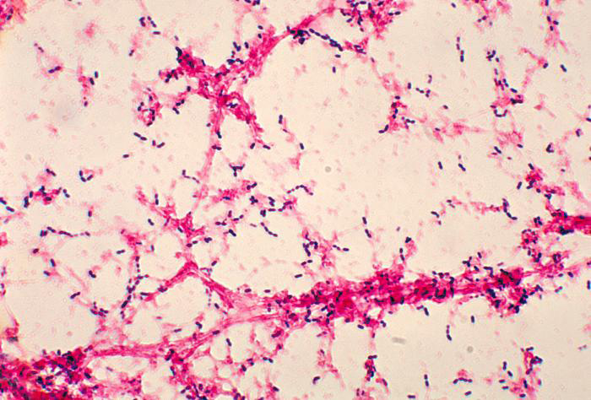
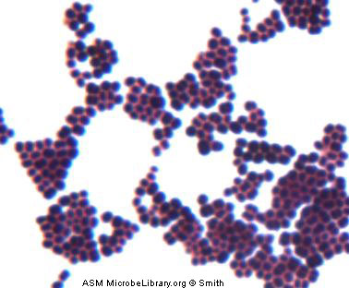
CAUSATIVE ORGANISMS
Streptococcus haemolyticus, Pneumococcus and Staphylococcus.

Slide 4
SYMPTOMS
1. Severe pain. 2. Fever and malaise. 3. Epiphora.
SIGNS
1. Tender swelling of the lacrimal sac. 2. Marked edema & redness of the skin over the sac. 3. Regurgitation test: Reflux of pus 4. Abscess formation with fluctuation.

Slide 5
CLINICAL PICTURE
STAGE OF CELLULITIS
STAGE OF LACRIMAL ABSCESS
STAGE OF FISTULA FORMATION

Slide 6
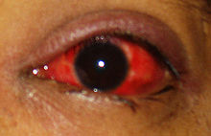
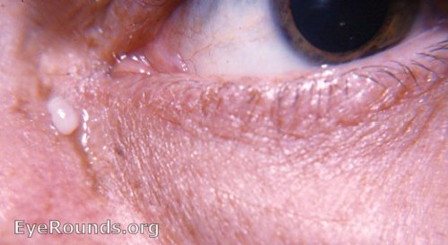
COMPLICATIONS
Acute conjunctivitis
2.Lacrimal fistula

Slide 7
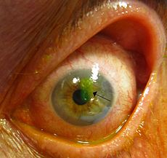
3.Corneal abrasioisn which may lead to corneal ulceration
4.Lid abscess

Slide 8
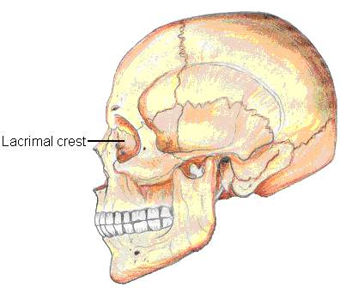
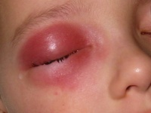
5.Osteomyelitis of lacrimal bone
6.Orbital cellulitis

Slide 9
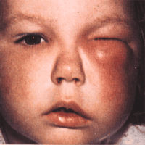
7.Facial cellulitis and acute ethmoiditis
8.Rarely cavernous sinus thrombosis

Slide 10
TREATMENT
During cellulitis stage
a. systemic and topical antibiotics to control
infection
b. anti-inflammatory drugs
c. hot fermentation
During lacrimal abscess stage
a. draining of pus with small incision and
dressing with betadine
b. if necessary DCT or DCR
3.During external lacrimal fistula stage
- fistulectomy along with DCT or DCR

Slide 11
Dacryocystorhinostomy (DCR) is a surgical procedure to restore the flow of tears into the nose from the lacrimal sac when the nasolacrimal duct does not function.
3 approaches
-external approach
-endonasal approach
-endocanalicular laser

Slide 12
Thank You

