Slide 1
Acute Meningitis BY MBBSPPT.COM

Slide 2
Acute meningitis is a serious illness and may be caused by a variety of infection agents-bacterial, viral and fungal.
Certain non-infective conditions like maligancy (carcinoma, lymphoma,leukaemia) or sarcoidosis may sometimes present as acute meningitis
Of greatest concern is bacterial meningitis, which can be fatal, if treatment is delayed.

Slide 3
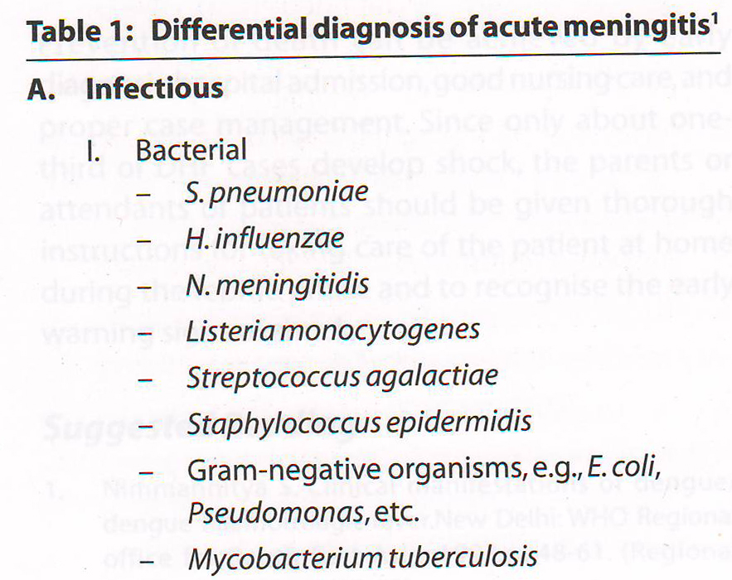

Slide 4
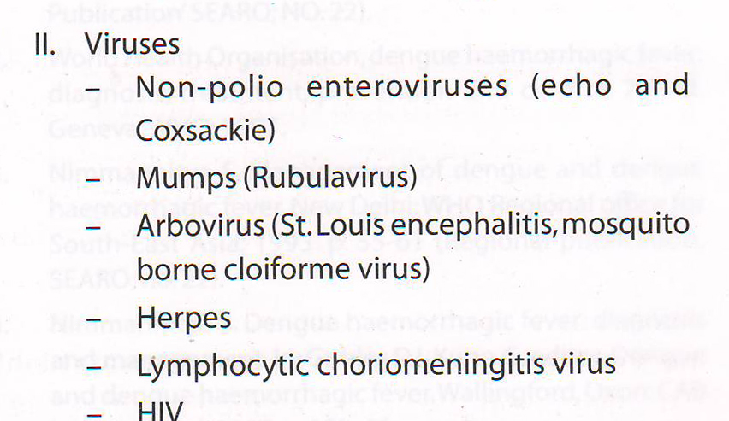

Slide 5
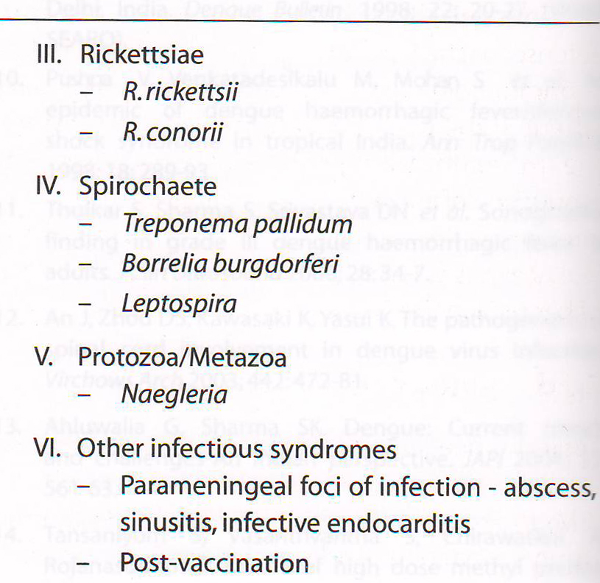

Slide 6
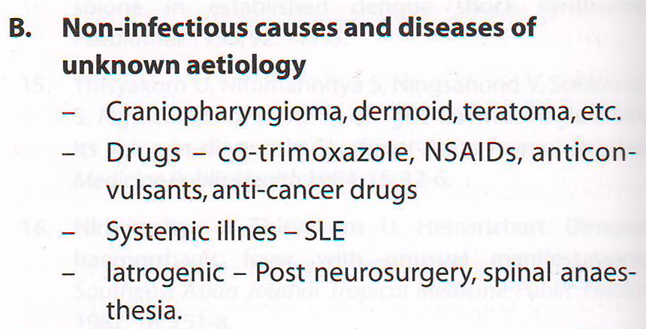

Slide 7
Bacterial Meningitis
Bacterial meningitis is the most common infection of CNS
The mortality is high (between 5% & 40%) even after adequate and appropriate antimicrobials
Neurological sequelae seen in up to 30% survivors

Slide 8
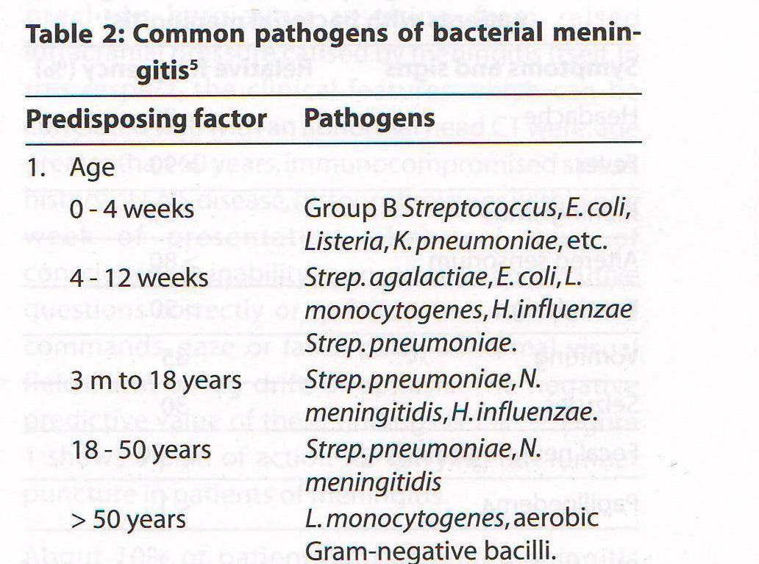

Slide 9
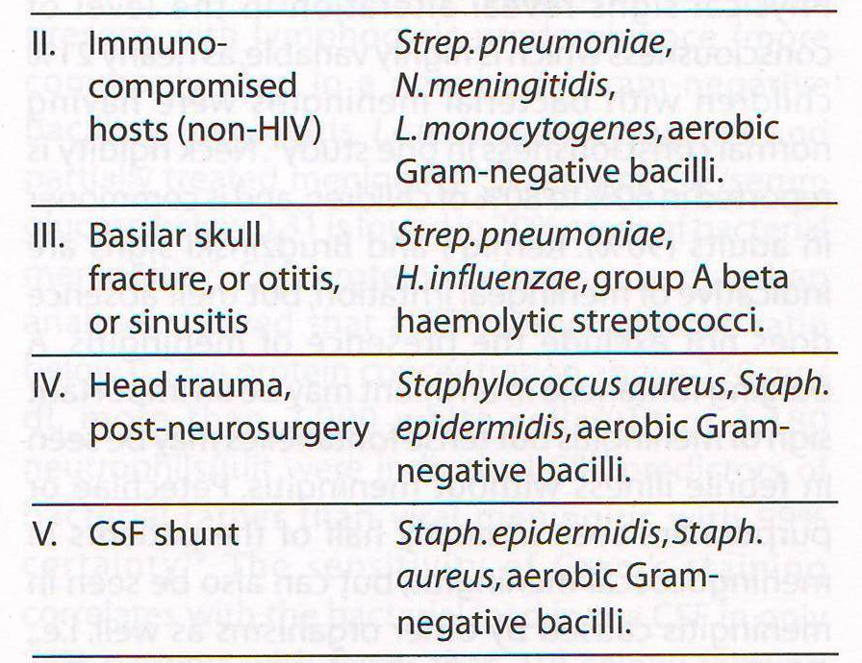

Slide 10
Clinical Features
Though Fever, Headache, Meningismus and signs of Cerebral dysfunction (confusion, delirium, declining consciousness) are typical features of bacterial meningitis, yet meningitis remain a laboratory diagnosis based on CSF analysis

Slide 11
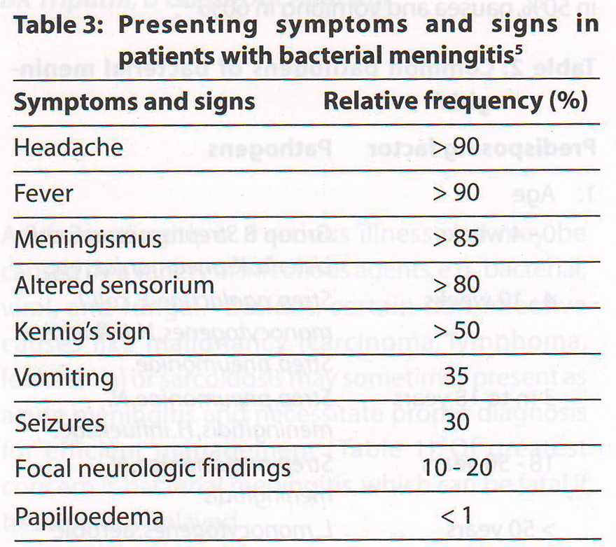

Slide 12
Several studies have shown that fever, neck stiffness and change in mental status are highly sensitive findings in acute meningitis, therefore a diagnosis of acute meningitis can be excluded in a patient without these symptoms
Petechiae or purpura are seen in nearly half of meningococcal meningitis cases, but may be seen in meningitis caused by other organisms as well.
Seizures are more common in extremes of ages.

Slide 13
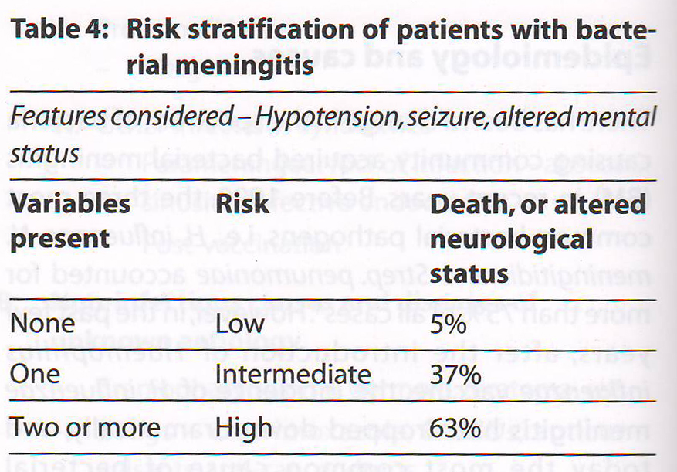

Slide 14
Diagnosis
The laboratory diagnosis of untreated bacterial meningitis is straight forward once the CSF sample has been obtained
Gram’s staining, a rapid and useful technique for initial laboratory assessment of CSF in suspected case of bacterial meningitis

Slide 15
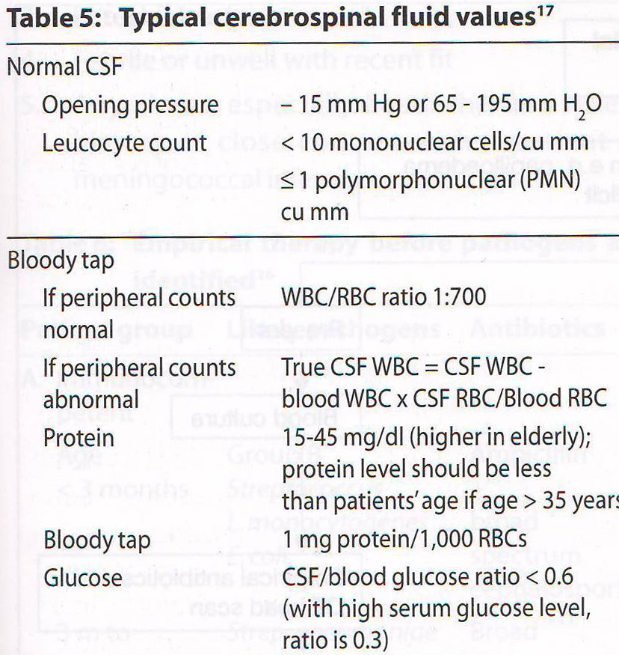

Slide 16
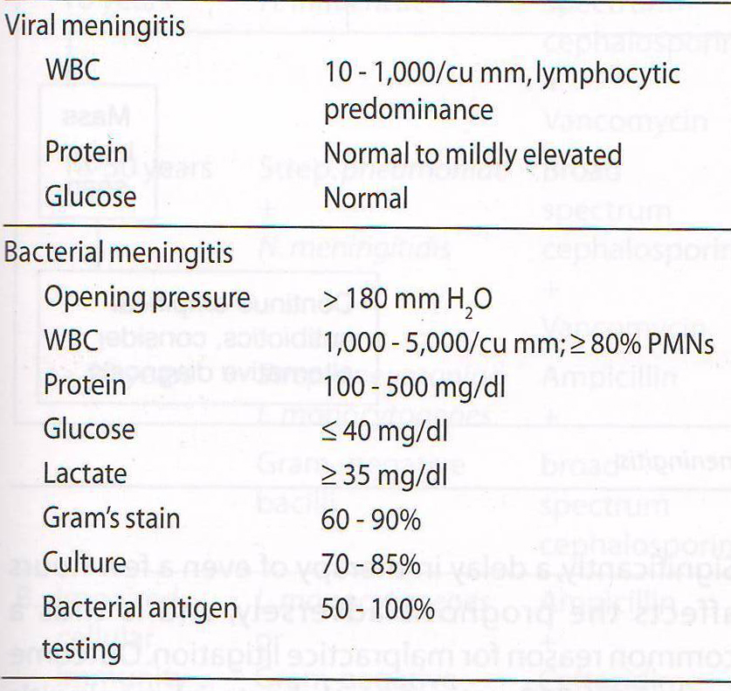

Slide 17
Lumber punccture should be performed immediately in a patient who does not have:
Bleeding diathesis
Focal neurological signs
A prior CT-head before LP is controversial, and all available evidences confirm the view that only a very small proportion of patients with meningitis are at risk of brain hernination following LP

Slide 18
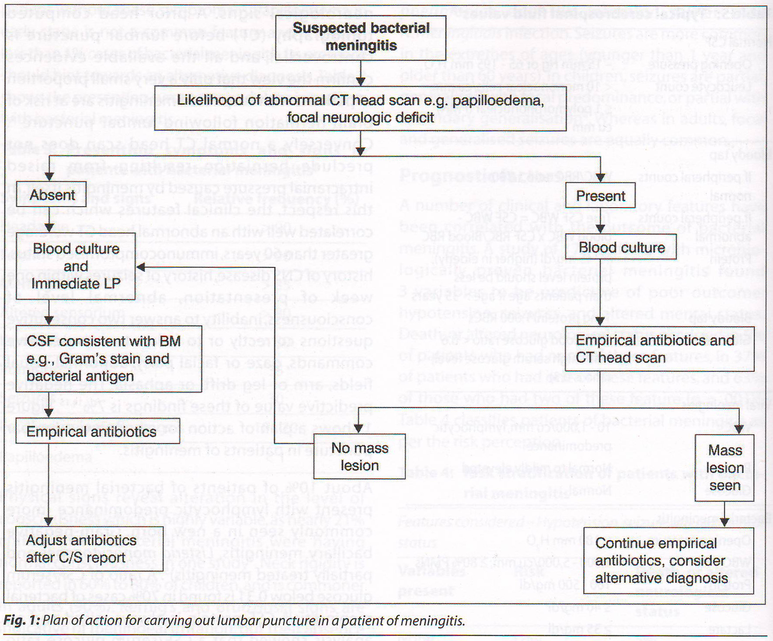

Slide 19
Management
While the diagnosis of meningitis is straight forward, the problem arises while differentiating a life threating illness (BM) from self-limiting viral infection
Urgent hospital admission in mandatory if there is strong suspicion of meningitis
(signs of meninged irritation, impaired consciousness level, petechial rash, febrile or unwell with headache/recent fit)

Slide 20
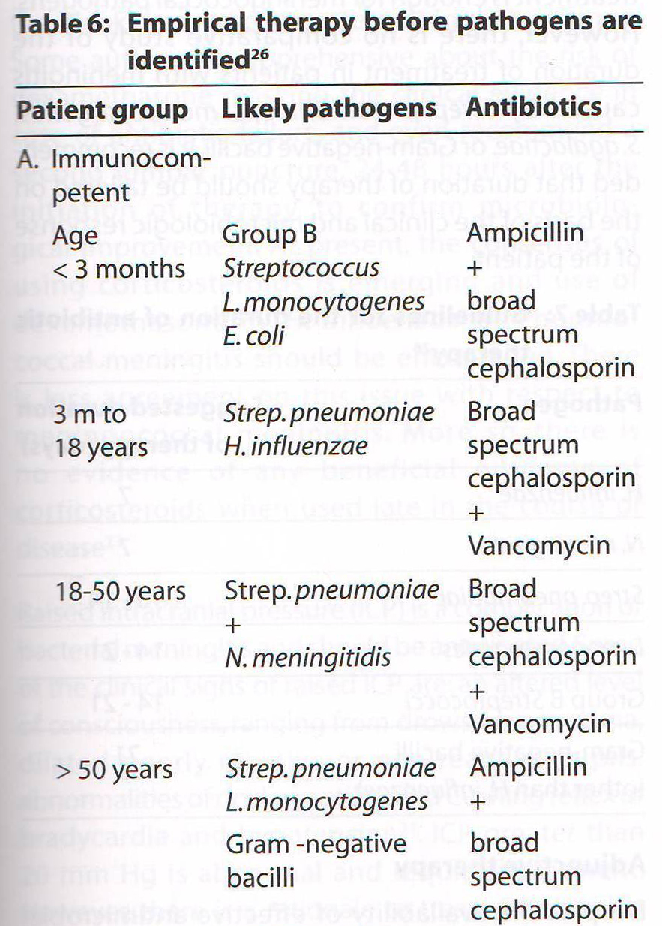

Slide 21
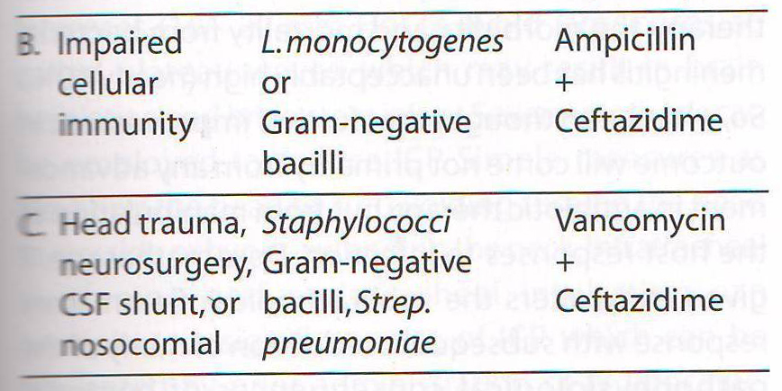

Slide 22
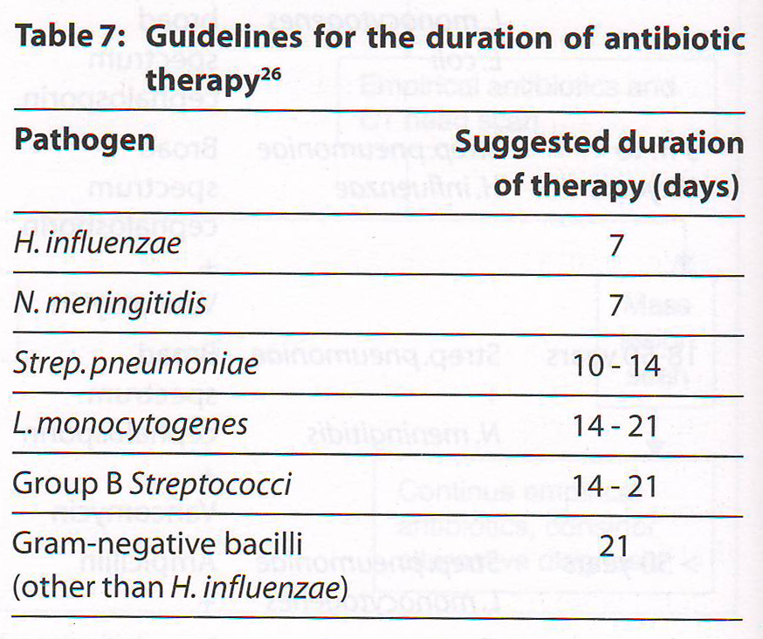
Duration of Antimicrobial Therapy

Slide 23
Adjunctive Therapy
Corticosteroids reduce inflammation caused by infection. The inflammation is known to aggravatc damage to nervous system
Dexamethasone leads to a reduction in hearing loss and other neurological sequelae in cases of BM.
However, dexamethasone may increases the rate of recurrent fever

Slide 24
Raised ICP is a complication of bacterial meningitis. Features of ↑ ICP are- altered level of consciousness, dilated poorly reactive or non-reactive pupil, abnormalities of ocular motility, and Cushing reflex of bradycardia and hypotension

Slide 25
I/V Mannitol
Oral Glycerol
Parenteral Dexamethasone
High dose Barbiturates

Slide 26
Tuberculous Meningitis
Tuberculous meningitis, usually a subacute or chronic meningitis. At times, particularly in children and adolescents, the presentation may be acute or hyperacute.

Slide 27
Viral Meningitis
Viral infection is the most common cause of aseptic meningitis.
The syndrome of viral meningitis consists of fever, headache, and meningeal irritation along with inflammatory CSF profile.
The mental status derangement is seen to range from lethargy to drowsiness.
Seizures, cranial nerve palsies, focal neurological deficits are not encountered in uncomplicated viral meningitis.

Slide 28
Enteroviruses account for 75 to 90% of all viral meningitis cases
Using CSF polymerase chain reaction, culture, serology, a specific viral cause can be established in 75-90% of cases
Nevertheless, CSF examination (cell count, biochemical) is the most important tool
Treatment is largely symptomatic
Acyclovir is recommended in HSV-1 or 2 and cases of severe EBV or varicella viruses

Slide 29
Thank You

