Slide 1
ALKALOSIS

Slide 2
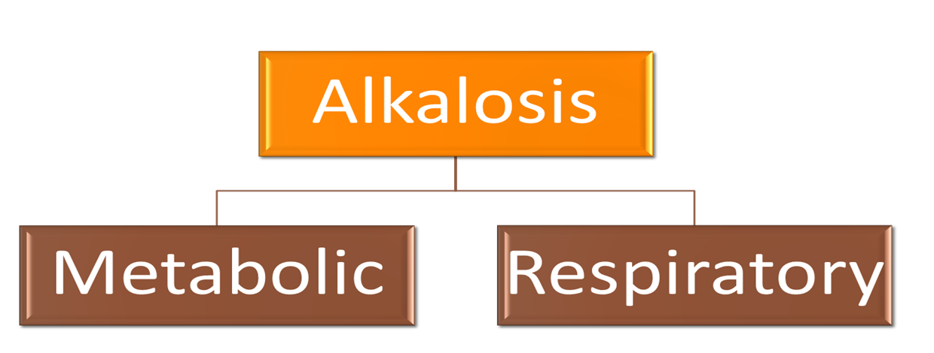
Introduction

Slide 3
Respiratory Alkalosis
Respiratory alkalosis is caused by hyperventilation,
which results in excessive loss of CO2.
Hyperventilation can be caused by direct stimulation of the medullary respiratory center, by hypoxemia or by mechanical ventilation. The arterial blood profile seen in respiratory alkalosis is:
Increase in pH
Decrease in HCO3-
Decrease in PCO2

Slide 4
Mechanism
Respiratory alkalosis generally occurs when some stimulus makes a person hyperventilate. The increased breathing produces increased alveolar respiration, expelling CO2 from the circulation. This alters the dynamic chemical equilibrium of carbon dioxide in the circulatory system. Circulating hydrogen ions and bicarbonate are shifted through the carbonic acid (H2CO3) intermediate to make more CO2 via the enzyme carbonic anhydrase.

Slide 5
Renal Compensation
Renal compensation is a mechanism by which the kidneys can regulate the plasma pH.
Renal compensation for respiratory alkalosis consists of decreased excretion of H+ as titratable acid and NH4+ and decreased synthesis and reabsorption of new HCO3-.

Slide 6
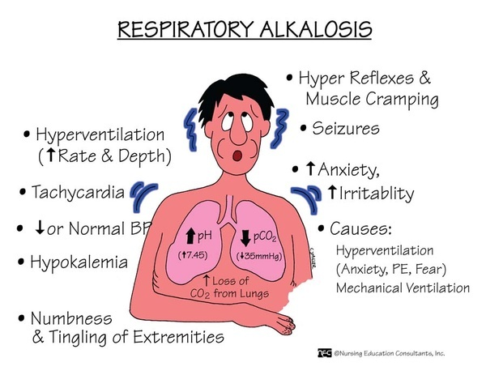
Symptoms

Slide 7
Metabolic Alkalosis
Metabolic alkalosis is caused by an increased HCO3-
concentration in the blood. Metabolic alkalosis is the result of loss of fixed H+ from the gastrointestinal tract; loss of fixed H+ from the kidney (e.g., hyperaldosteronism); administration of solutions containing HCO3-; or ECF volume contraction (e.g., administration of diuretics). The arterial blood profile seen in metabolic alkalosis is
Increase in pH
Increase in HCO3-
Increase in PCO2

Slide 8
Mechanism
Vomiting: cells produce H+ and HCO3− from CO2 and H2O. The H+ is secreted with Cl− into the lumen of the stomach to aid in digestion, and the HCO3− enters the blood. In normal persons, the secreted H+ moves from the stomach to the small intestine, where a low pH triggers the secretion of HCO3− by the pancreas. Thus, normally, the HCO3− added to blood by the parietal cells is later removed from blood in the pancreatic secretions. However, when vomiting occurs, H+ is lost from the stomach and never reaches the small intestine. HCO3− secretion from the pancreas, therefore, is not stimulated, and the HCO3− remains in the blood, resulting in an increase in which HCl is lost from the stomach.

Slide 9
Respiratory Compensation
Respiratory compensation is a mechanism by which plasma pH can be altered by varying the respiratory rate.
Increased arterial pH inhibits the peripheral chemoreceptors, which respond by causing hypoventilation. In turn, hypoventilation produces an increased PCO2.

Slide 10
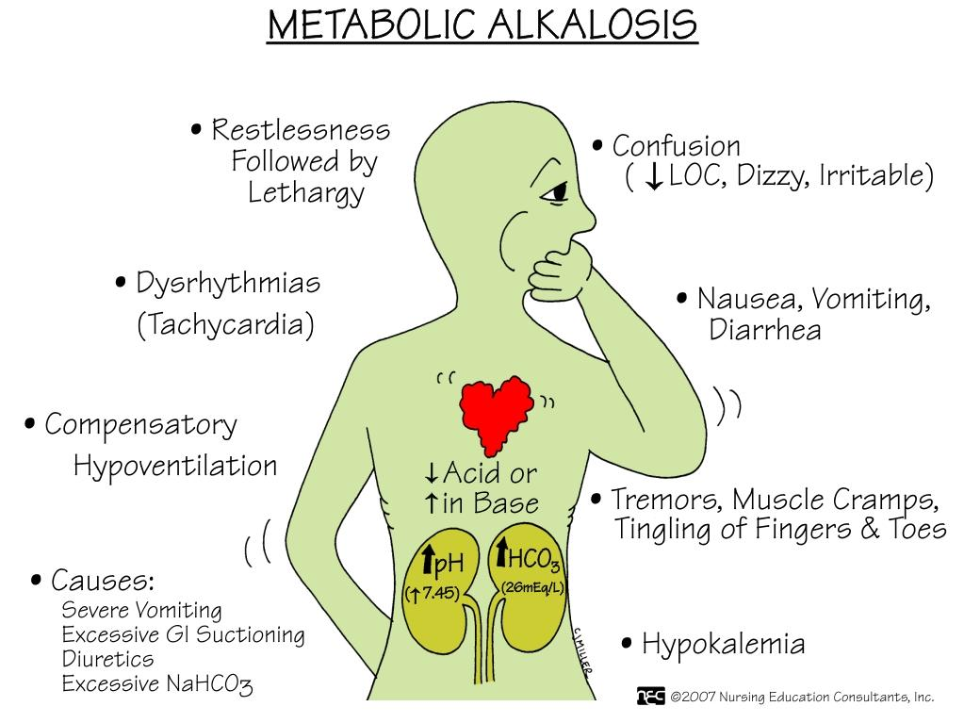
Symptoms

Slide 11
THANKYOU!

