Slide 1
ANATOMY OF CLAVICLE

Slide 2
ANATOMY
Long, Tubular and Somewhat S-shaped Bone.
Transmits the Weight of The Limb to The Sternum.
Immediately Above the First Rib
The Bone has a Cylindrical Part Called Shaft, and Two Ends, Lateral and Medial.
Articulates Medially with The Manubrium Sterni and Laterally with The Acromion of The Scapula

Slide 3
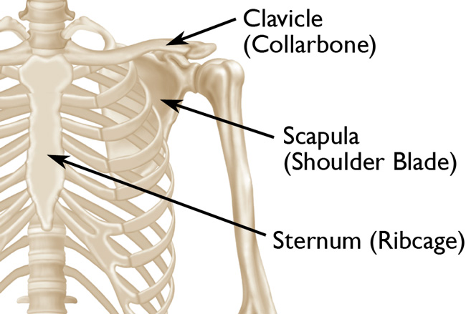

Slide 4
SHAFT
Divided Into The Lateral One- Third and The Medial Two- Thirds.
Lateral One- Third:
Flattened From Above Downwards
Has Two Borders, Anterior and Posterior.
Anterior Border:
Concave
Thin
Attachment To Deltoid
Posterior Border:
Convex Backwards
Rough and Thick
Attachment To Trapezius

Slide 5
Two Surfaces: Superior and Inferior Surface
Superior Surface: Flat, Rough Attachment For The Deltoid In Front and Trapezius Behind
Inferior Surface: Flat, Presents An Elevation Called The Conoid Tubercle (Coracoid Tuberosity) and A Ridge Called Trapezoid Ridge (Runs Forward and Lateralward)
Medial Two- Thirds:
Rounded and Have Four Surfaces
Anterior Surface:
Convex Forwards
Included Between The Superior and Anterior Borders
Continuous With The Superior Surface
Posterior Surface: Smooth
Limited above by the Superior Border; Below by The Subclavian Border; Medially by The Margins Of The Sternal Extremity and Laterally by The Coracoid Tuberoisty
Concave Medio- Laterally

Slide 6
Superior Surface: Rough In Its Medial Part
Inferior Surface:
Narrow Medially
Gradually Increases In Width Laterally
Continuous With The Under Surface Of The Flat Portion
Medial Part Is A Broad Rough Surface, The Costal Tuberosity
Has Longitudinal Subclavian Groove
Has Three Borders Anterior, Superior and Posterior

Slide 7
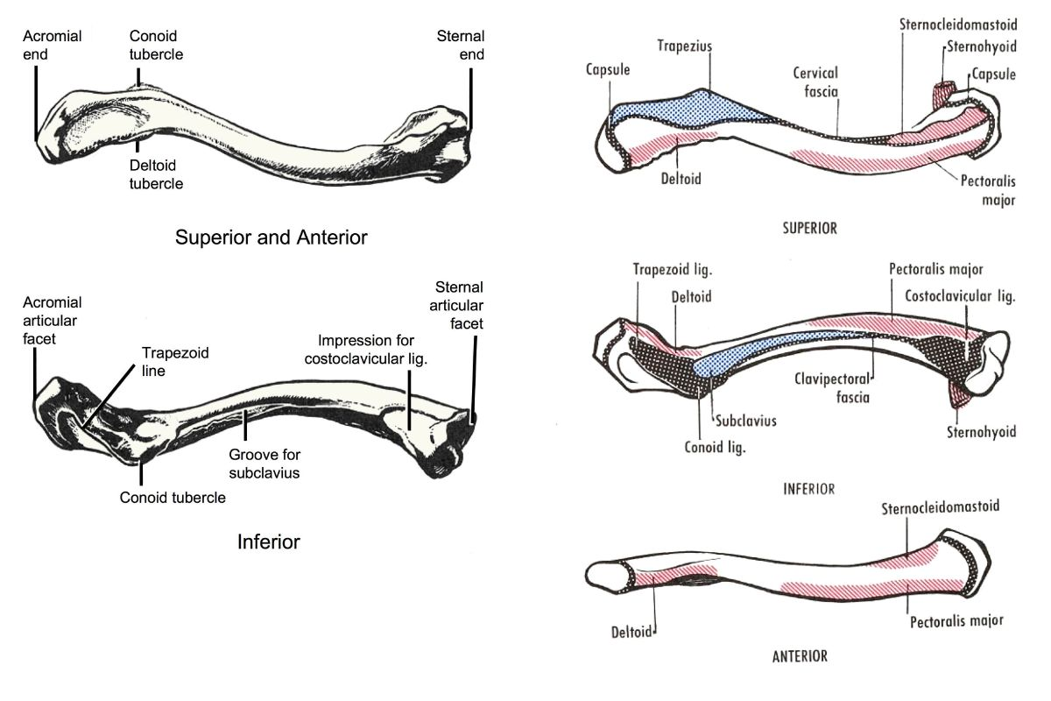

Slide 8
LATERAL AND MEDIAL ENDS
Lateral End:
Small
Flattened
Oval Surface Directed Obliquely Downwards
Bears a Facet That Articulates with the Acromion Process Of The Scapula to Form The AC Joint
In Females The Clavicle is Generally Shorter, Thinner, Less Curved and Smoother Than Male

Slide 9
Medial End:
Quadrangular
Directed Medialward and A Little Downward and Forward
Articulates With The Clavicular Notch Of The Manubrium Sterni to Form The SC Joint
Articular Surface Extends To The Inferior Aspect, For Articulation With The First Costal Cartilage

Slide 10
ATTACHMENTS
The Lateral End The Margin of The Articular Surface For The AC Joint Gives Attachment To The Joint Capsule
The Medial End The Margin of The Articular Surface For The Sternum Gives Attachment To The Fibrous Capsule All Round; Articular Disc Posterosuperiorly and The Interclavicular Ligament Superiorly
Lateral One- Third Of Shaft:
Origin: Deltoid (Anterior Border)
Insertion: Trapezius (Posterior Border)
Coracoclavicular Ligament (Conoid and Trapezoid Parts)

Slide 11
Medial Two- Thirds:
Origin: Pectoralis Major (Anterior Surface)
Insertion: SCM (Superior Surface; Clavicular Head), Subclavius (Subclavian Groove)
Costoclavicular Ligament: Inferior Surface; Medial End

Slide 12
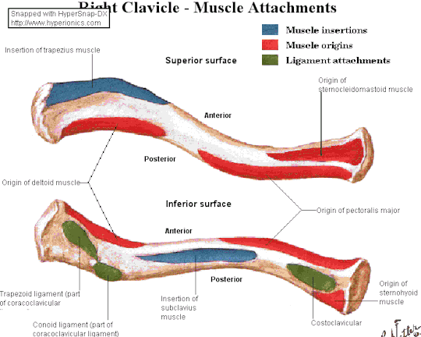

Slide 13
SIDE DETERMINATION
Lateral End Is Flat; Medial End Is Large and Quadrilateral
Shaft Is Slightly Curved; Convex Forwards In Its Medial Two-thirds and Concave Forwards In Its Lateral One- Third
Inferior Surface Is Grooved Longitudinally In Its Middle One- Third

Slide 14
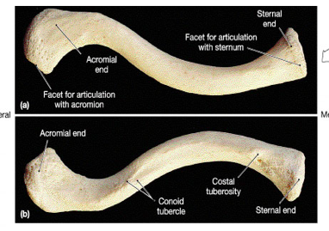

Slide 15
PECULARITIES
Only Long Bone That Lies Horizontally
Subcutaneous Throughout
First Bone To Start Ossifying
Only Long Bone Which Ossifies In Membrane
Only Long Bone Which Has Two Primary Centres Of Ossification
Occasionally Pierced by The Middle Supraclavicular Nerve

Slide 16
Costal Tuberosity:
Lies on The Medial End
Inferior Surface of The Clavicle
Broad, Rough Surface
Anchors The Costoclavicular Ligament
Strengthens The SC Joint
Subclavian Groove:
Runs Along the Posteroinferior Quadrant of The Midshaft
Provides Attachment For the Subclavius Muscle
Conoid Tubercle:
Lateral End of the Clavicle
Posteriorly
Attachment Point For The Conoid Ligament

Slide 17
Trapezoid Ridge:
Leads Laterally From The Conoid Tubercle
Attachment Site For The Trapezoid Ligament

Slide 18
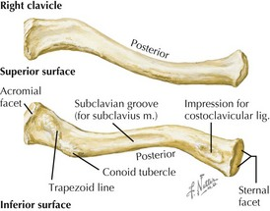

Slide 19
THANK YOU

