Slide 1
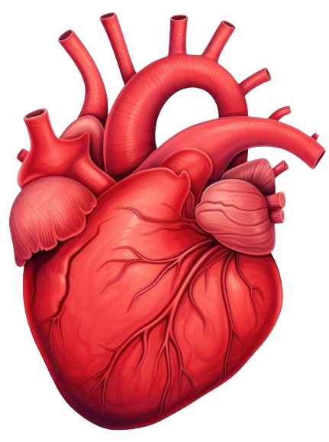
ANATOMY OF HEART
BY MBBSPPT.COM

Slide 2
Heart
The heart is a hollow, cone-shaped, muscular pump. The heart beats about 2.5 billion times in an average lifetime.
The left side of the heart pumps blood through an estimated 120,000 km of blood vessels, which is equivalent to traveling around the earth’s equator about 3 times.
The right side of the heart pumps blood through the lungs, enabling blood to pick up oxygen and unload carbon dioxide. Heart pumps more than about 14,000 liters of blood in a day, or 5 million liters in a year

Slide 3
Dimensions of Heart
The heart is a small Organ, it is about 12 cm (5 in.) long, 9 cm (3.5 in.) wide at its broadest point, and 6 cm (2.5 in.) thick, with an average mass of 250 g in adult females and 300 g in adult males.
The heart rests on the diaphragm, near the midline of the thoracic cavity.

Slide 4
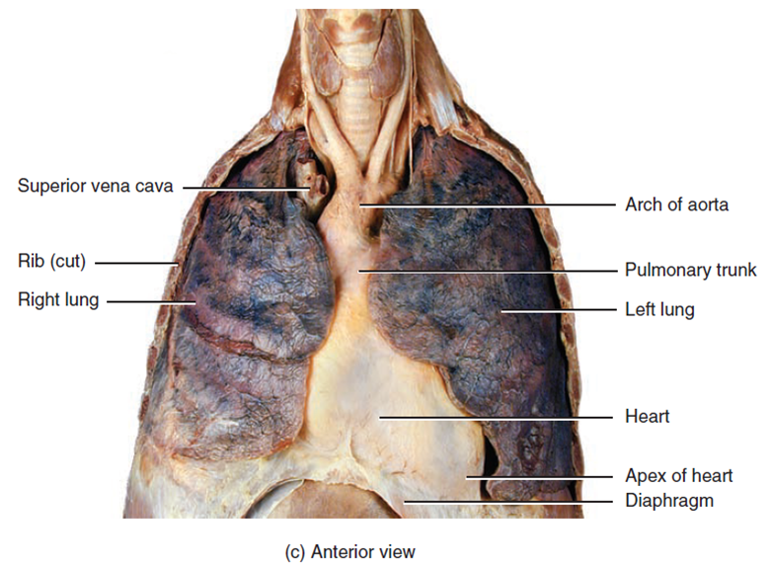
The heart lies in the mediastinum an anatomical region that extends from the sternum to the vertebral column, from the first rib to the diaphragm, and between the lungs

Slide 5
Relations of Heart
Superiorly – the aorta, superior vena cava, P artery and pulmonary vein.
Inferiorly – the diaphragm
Anteriorly – the ribs and intercostal muscles.
Posteriorly – the esophagus, trachea, left and right bronchus, descending aorta, inferior vena cava and thoracic vertebrae
Laterally – the lungs

Slide 6
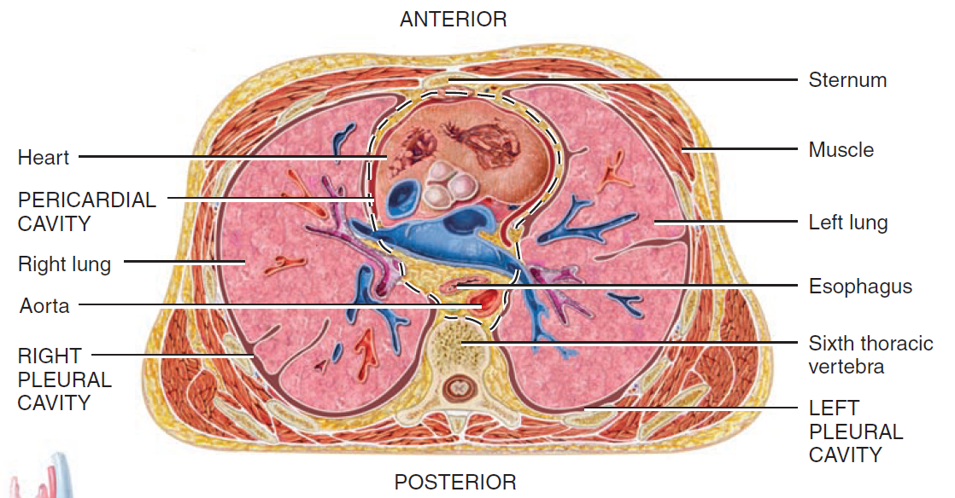

Slide 7
The pointed apex is formed by the tip of the left ventricle and rests on the diaphragm. It is directed anteriorly, inferiorly, and to the left.
The base of the heart is its posterior surface. It is formed by the atria of the heart.

Slide 8
Surfaces
The sternocostal or anterior surface is deep to the sternum and ribs.
The diaphragmatic or inferior surface is the part of the heart between the apex and right border.
The pulmonary or left surface is occupies the cardiac notch of the left lung.

Slide 9
Borders
The right border is formed by right atrium and it faces the right lung and extends from the inferior surface to the base.
The inferior border is formed by right ventricle and partly left ventricle.
The left border also called the pulmonary border, is formed by left ventricle and the left auricle and it faces the left lung and extends from the base to the apex.
The superior border is formed by both atria.

Slide 10
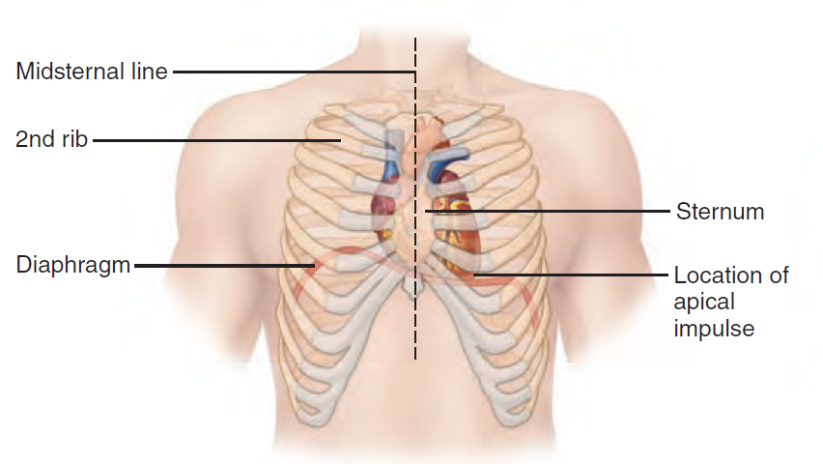

Slide 11
Sulci of Heart
It is a groove on the outer surface of the heart marking the division between the atria and the ventricles.
Atrioventricular sulcus
Anterior interventricular sulcus
Posterior interventricular sulcus

Slide 12
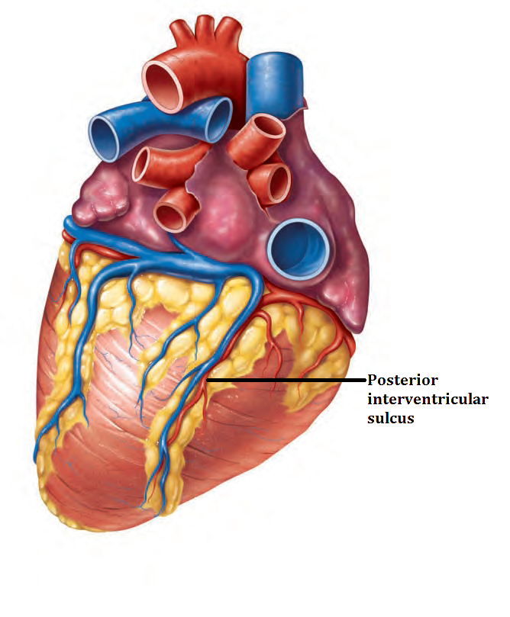
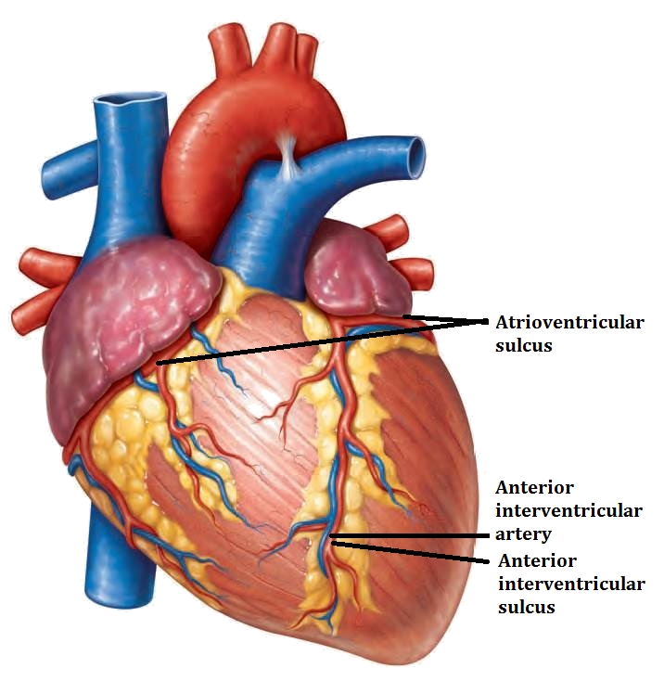

Slide 13
Atrioventricular sulcus: Separates atria from ventricles, it contains right coronary artery, left coronary artery, circumflex artery, coronary sinus.
Anterior interventricular sulcus : lies between left ventricle and right ventricle on the anterior surface, marks location of interventricular septum contains left anterior descending artery, great cardiac vein.
Posterior interventricular sulcus:lies between left ventricle and right ventricle on posterior surface, contains posterior interventricular artery and middle cardiac vein

Slide 14
Pericardial Sinuses
The lines of reflection between visceral and parietal pericardium form two pericardial sinuses
The transverse pericardial sinus lies anterior to the superior vena cava and posterior to the ascending aorta and pulmonary trunk.
The oblique pericardial sinus lies posterior to the heart in the pericardial sac.

Slide 15
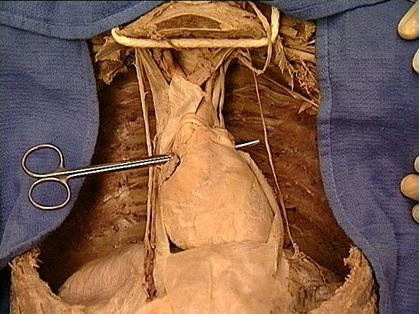
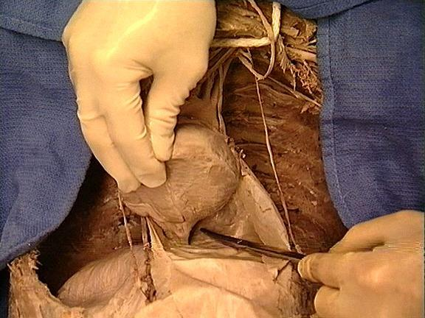
The transverse pericardial sinus
The oblique pericardial sinus

Slide 16
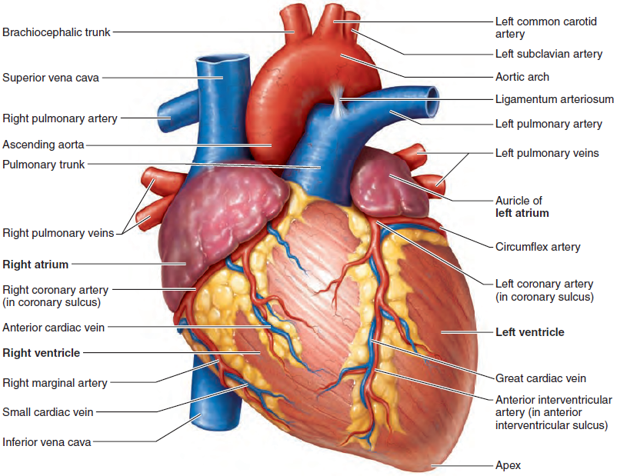
Anterior Surface of heart

Slide 17
AURICLE
Anterior surface of each atrium is a wrinkled pouch like structure called an auricle. Each auricle slightly increases the capacity of an atrium so that it can hold a greater volume of blood.

Slide 18
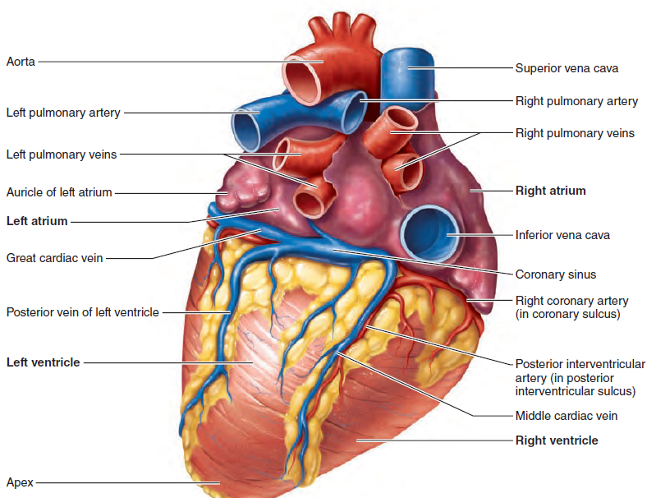
Posterior Surface of Heart

Slide 19
Coverings of the Heart
Pericardium
The heart is enclosed in a double-walled sac called the pericardium
It consists of two main parts:
The fibrous pericardium
The serous pericardium
The fibrous pericardium is composed of tough, inelastic, dense irregular connective tissue. The functions of fibrous pericardium is to
Prevent overstretching of the heart
Protection of heart
Anchors the heart in the mediastinum

Slide 20
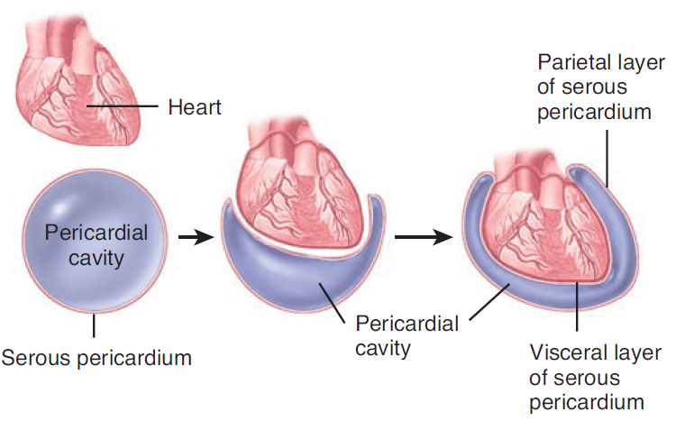
Relationship of serous pericardium to heart

Slide 21
The serous pericardium is a thinner membrane that forms a double layer around the heart
The outer parietal layer: it is fused to the fibrous pericardium.
The inner visceral layer is also called the epicardium helps the layers of the heart wall to adheres tightly to the surface of the heart.

Slide 22
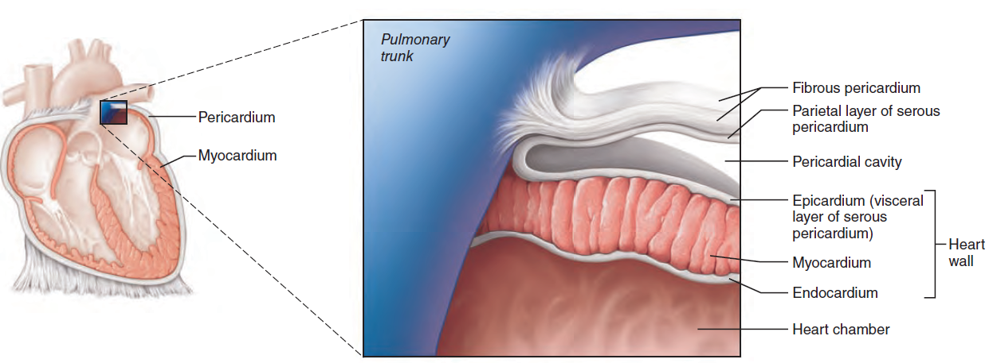
The pericardial layers and layers of the heart wall.

Slide 23
A slippery fluid is present in between the parietal and visceral layers helps to give lubrication and reduces friction while the heart beats is the pericardial fluid.
The space between the two layers are called the pericardial cavity.

Slide 24
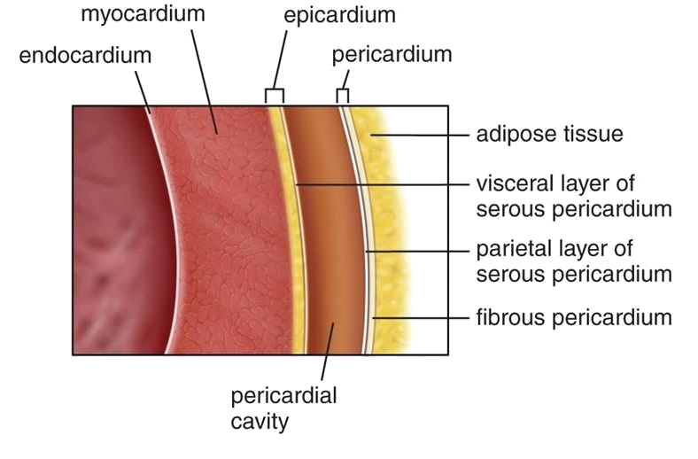
Layers of the Heart Wall
The wall of the heart consists of three layers
The epicardium (external layer)
The myocardium (middle layer)
The endocardium (inner layer)

Slide 25
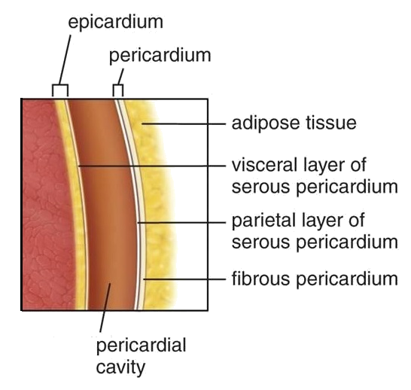
Epicardium
It is a thin transparent outer layer of the heart wall is composed of mesothelium (membrane composed of simple squamous cells)
The epicardium contains blood vessels, lymphatics, and vessels that supply the myocardium.

Slide 26
Myocardium
The myocardium is responsible for the pumping action of the heart and is composed of cardiac muscle tissue. The muscle fibers are wrapped and bundled with connective tissue sheaths composed of endomysium and perimysium.
The cardiac muscle fibers are organized in bundles that swirl diagonally around the heart and generate the strong pumping actions of the heart

Slide 27
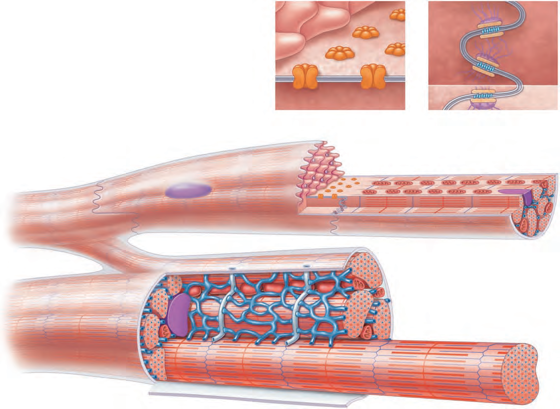
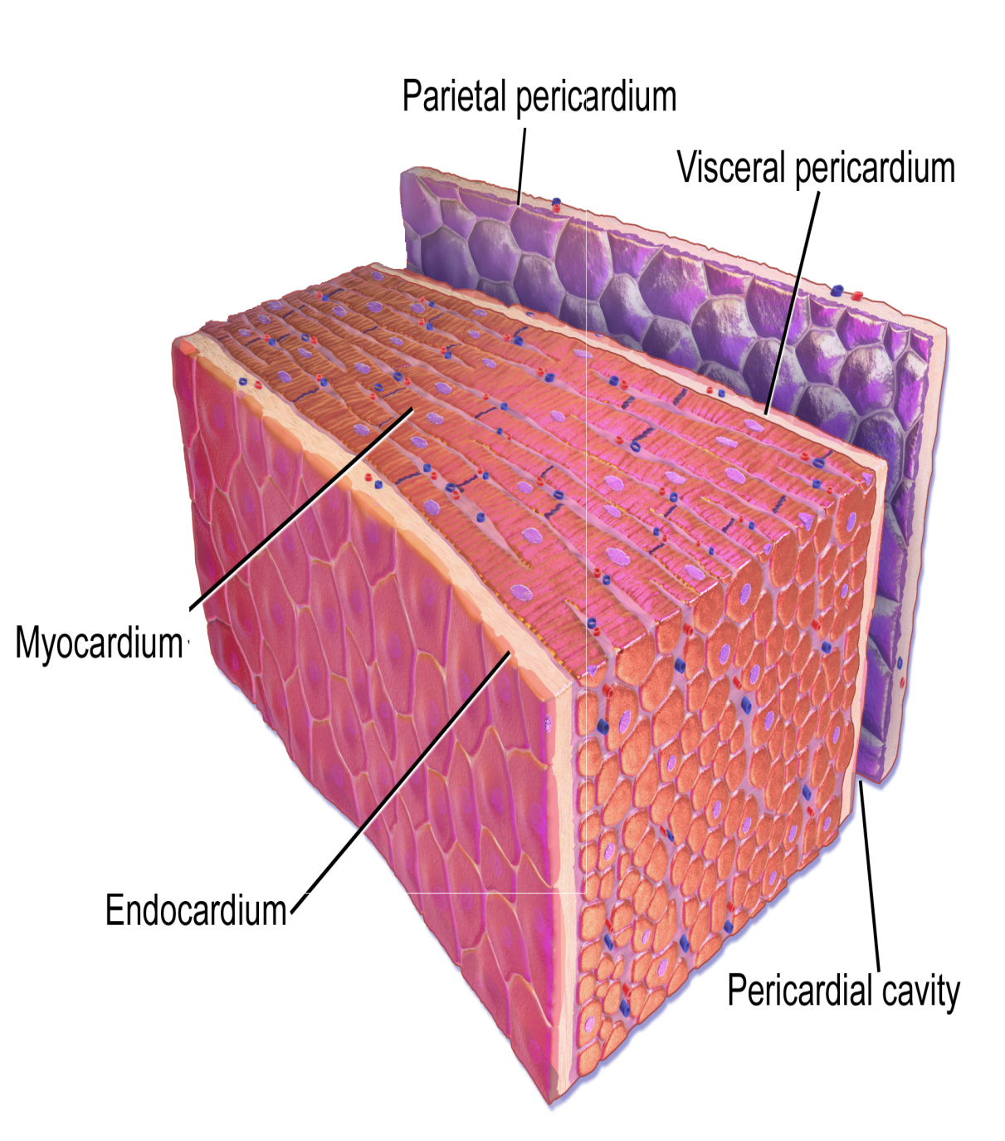

Slide 28
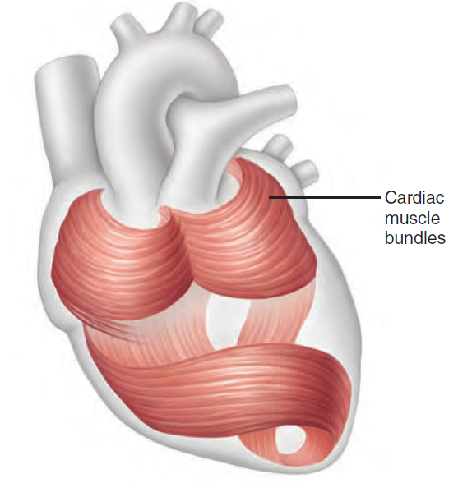
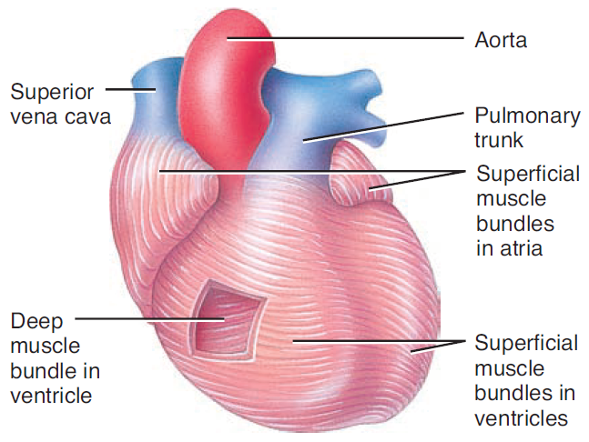
Circular and spiral arrangement of cardiac muscle

Slide 29
Endocardium
The endocardium is a glistening white sheet of endothelium (squamous epithelium) resting on a thin connective tissue layer.
It lines the heart chambers and covers the fibrous skeleton of the valves.
The endocardium is continuous with the endothelial linings of the blood vessels leaving and entering the heart.

Slide 30
Chambers of the Heart
The heart has four chambers. The two superior receiving chambers are the atria and the two inferior pumping chambers are the ventricles

Slide 31
Right Atrium
The right atrium forms the right border of the heart and receives blood from three veins: the superior vena cava, inferior vena cava, and coronary sinus. The right atrium is about 2–3 mm (0.08–0.12 in.) in thickness.
The posterior wall is smooth but the anterior wall is rough due to the presence of muscular ridges called pectinate muscles
The right atrium and left atrium is separated by interatrial septum. A prominent feature of this septum is an oval depression called the fossa ovalis.
Blood passes from the right atrium into the right ventricle through a valve that is called the tricuspid valve, it consists of three leaflets or cusps.

Slide 32
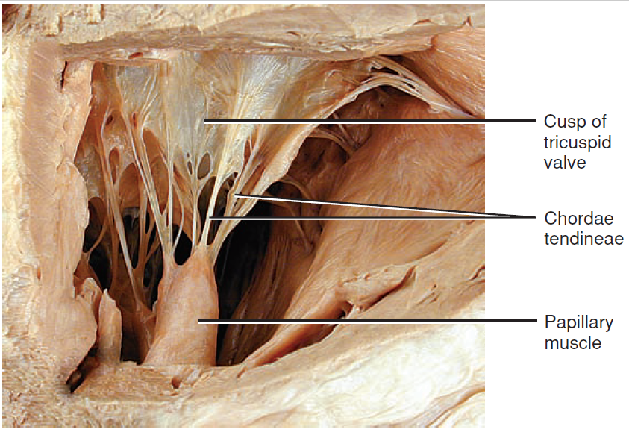
The cusps of the tricuspid valve are connected to tendon like cords, the chordae tendineae which in turn are connected to cone-shaped trabeculae carneae called papillary muscles.

Slide 33
Right Ventricle
The right ventricle is about 4–5 mm (0.16–0.2 in.) in average thickness and forms most of the anterior surface of the heart.
The right ventricle contains a series of ridges formed by bundles of cardiac muscle fibers called trabeculae carneae, it helps the heart for conduction.
The right ventricle is separated from the left ventricle by the interventricular septum.
Blood passes from the right ventricle through the pulmonary valve into a large artery called the pulmonary trunk, which divides into right and left pulmonary arteries

Slide 34
Left Atrium
The left atrium is about the same thickness as the right atrium and forms most of the base of the heart.
It receives blood from the lungs through four pulmonary veins. It has a smooth anterior and posterior wall, because pectinate muscles are confined to the auricle of the left atrium.
Blood passes from the left atrium into the left ventricle through the bicuspid (mitral) valve It is also called the left atrioventricular valve.

Slide 35
Left ventricle
The left ventricle is the thickest chamber of the heart, averaging 10–15 mm (0.4–0.6 in.) and forms the apex of the heart.
Like the right ventricle, the left ventricle contains trabeculae carneae and has chordae tendineae that anchor the cusps of the bicuspid valve to papillary muscles.
Blood passes from the left ventricle through the aortic valve (aortic semilunar valve) into the ascending aorta from here blood flows into the coronary arteries, which branch from the ascending aorta and carry blood to the heart wall.
The remainder of the blood passes into the arch of the aorta and descending aorta (thoracic aorta and abdominal aorta).
Branches of the arch of the aorta and descending aorta carry blood throughout the body.

Slide 36
Comparison of right and left atrium
Right atrium |  | left atrium
1 | Receives venous blood from body. | 1 | Receives oxygenated blood from Lung.
2 | Pushes blood to Rt ventricle through tricuspid valve. | 2 | Pushes blood to Lt ventricle through bicuspid valve.
3 | Forms Rt boarder, parts of sternocoastal and small part of base of the heart | 3 | Forms major part of the heart base
Comparison of right and left ventricle
Right Ventricle |  | left Right Ventricle
1 | Thin | 1 | Thicker
2 | Pushes blood only to the lung | 2 | Pushes blood to entire body except lung
3 | Contains three papillary muscles | 3 | Contains two papillary muscles
4 | Cavity is crescentic | 4 | Cavity is circular
5 | Contains deoxygenated blood | 5 | Contains oxygenated blood
6 | Forms sternocoastal surface | 6 | Forms diaphragmatic surface

Slide 37
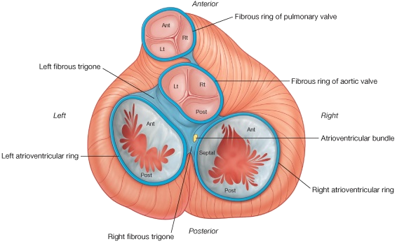
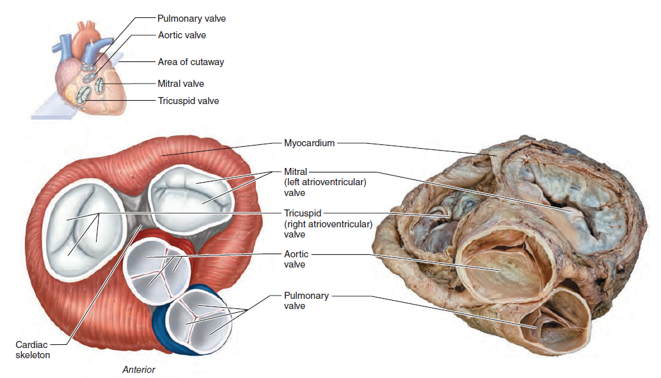
Valves of Heart

Slide 38
The Tricuspid Valve
The tricuspid valve consists of three cusps anterior, septal and inferior (posterior). These cusps are formed by a fold of the endocardium and some connective tissue. The bases of the cusps attach to the fibrous ring of the heart skeleton and their free edges attach to the chordae tendineae connecting them to the papillary muscles.

Slide 39
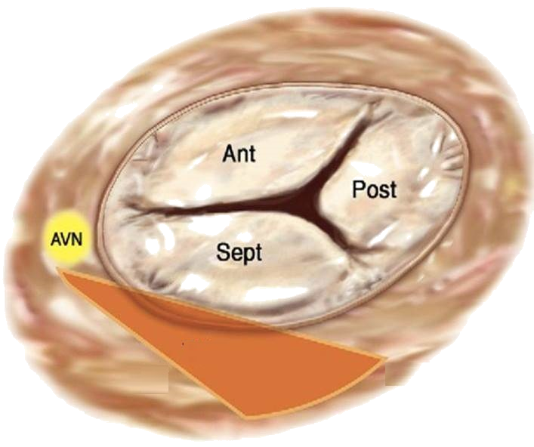
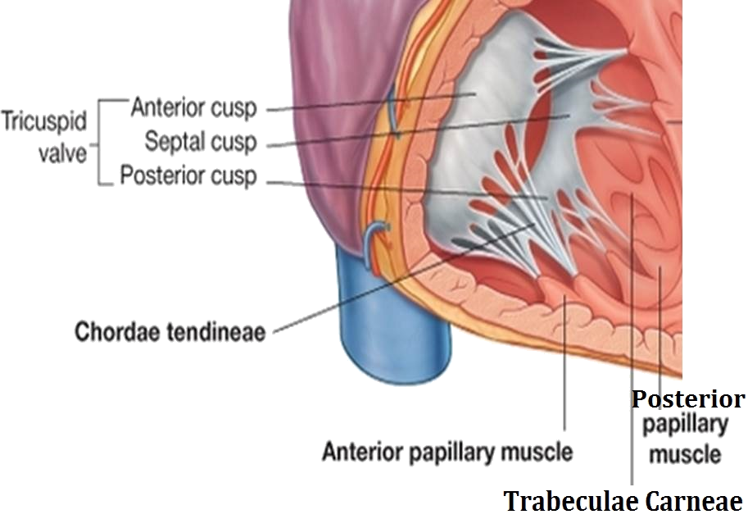

Slide 40
The Mitral Valve
The mitral valve consists of two cusps anterior and posterior: its structure is similar to the tricuspid valve. The anterior cusp is larger and intervenes between the atrioventricular and the aortic orifices. The chordae tendineae attach the cusps to papillary muscles as in the tricuspid valve.

Slide 41
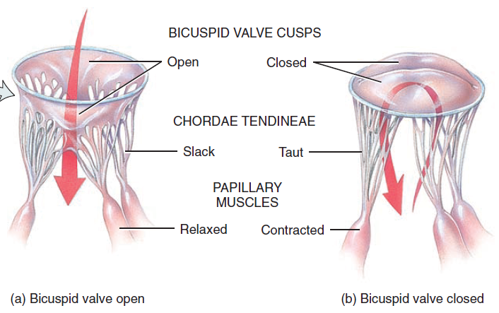
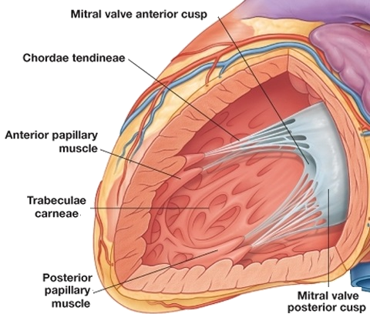

Slide 42
The Pulmonary Valve
It consists of three semilunar cusps formed by folds of the endocardium and some connective tissue. The lower margins of the cusps and their sides are attached to the arterial wall.
The pulmonary valve has three cusps: the anterior cusp (AC), the left cusp (LC), and the right cusp (RC).
There are no chordae tendineae or papillary muscles attached to these valves.

Slide 43
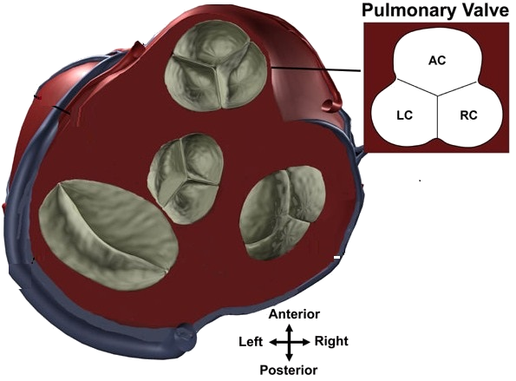
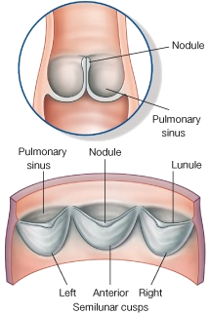

Slide 44
The Aortic Valve
The valves are arranged as one anterior (right) and two posterior (left and posterior).
The aortic valve has three cusps: the left coronary cusp (LCC), the right coronary cusp (RCC), and the non-coronary cusp (NCC).
The right coronary artery originates from the anterior aortic sinus and the left coronary artery from the left posterior sinus.

Slide 45
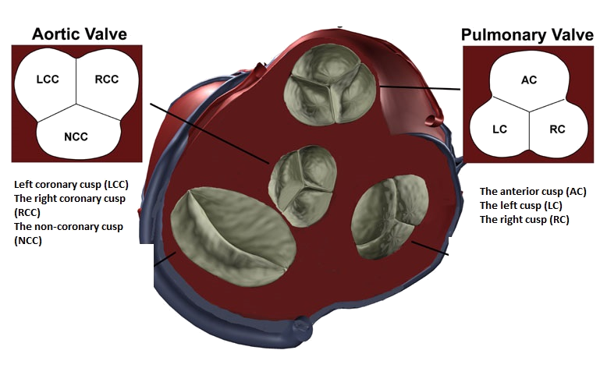
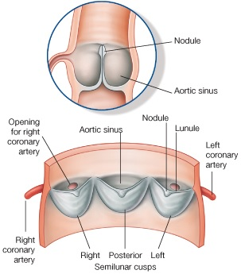

Slide 46
Blood supply to the heart
Arterial Supply
The first two branches of the aorta, called the right and left coronary arteries, supply blood to the tissues of the heart.
The left coronary artery runs toward the left side of the heart and then divides into two major branches:
The anterior interventricular artery follows the anterior interventricular sulcus and supplies blood to the interventricular septum and anterior walls of both ventricles.
The circumflex artery supplies the left atrium and the posterior walls of the left ventricle.

Slide 47
The right coronary artery courses to the right side of the heart, it has two branches:
The right marginal artery supply blood to the lateral right side of myocardium.
The posterior interventricular artery supplies blood to the posterior ventricular walls and merges (anastomoses) with the anterior interventricular artery.

Slide 48
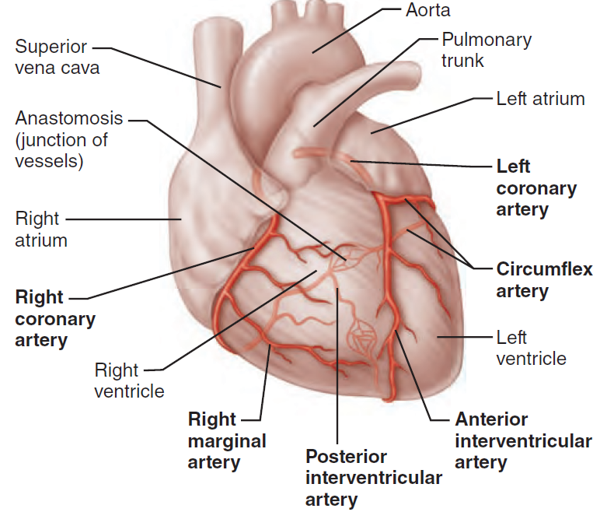

Slide 49
Coronary Veins
The venous blood is collected by the cardiac veins. These veins join to form an enlarged vessel called the coronary sinus, which empties the blood into the right atrium.
The principal tributaries carrying blood into the coronary sinus are the following:
Great cardiac vein in the anterior interventricular sulcus, which drains the areas of the heart supplied by the left coronary artery (left and right ventricles and left atrium)
Middle cardiac vein in the posterior interventricular sulcus, which drains the areas supplied by the posterior interventricular branch of the right coronary artery (left and right ventricles)
Small cardiac vein in the coronary sulcus, which drains the right atrium and right ventricle
Anterior cardiac veins, which drain the right ventricle and open directly into the right atrium

Slide 50
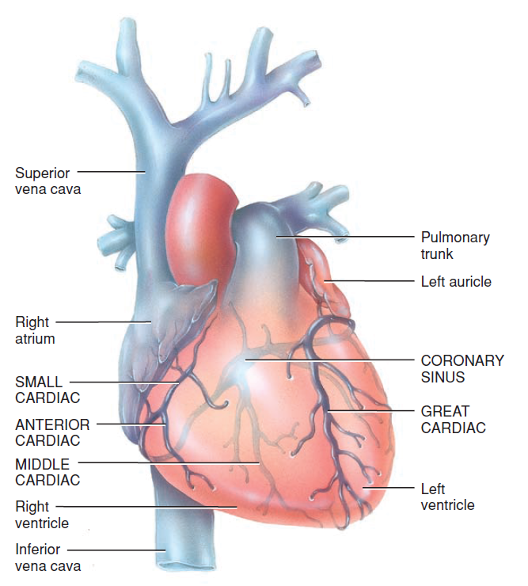

Slide 51
Nerve supply to the heart
The cardiac nerves are branched autonomic nerve fibers and are found at the level of the tracheal bifurcation.
Their function is to innervate the electrical conducting system of the heart, the atrial and ventricular myocardium and the coronary vasculature.
The medulla is the primary site in the brain for regulating sympathetic and parasympathetic outflow to the heart and blood vessels.
The hypothalamus and higher centers modify the activity of the medullary centers and are particularly important in regulating cardiovascular responses to emotion and stress (eg, exercise, thermal stress).

Slide 52
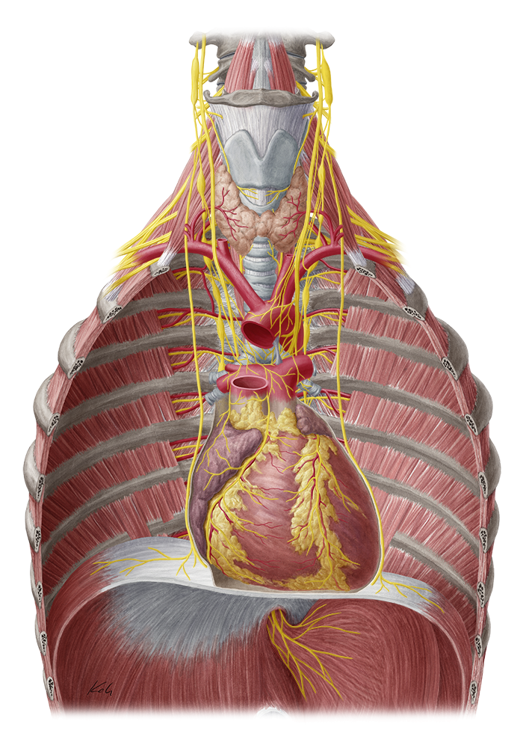

Slide 53
The Sympathetic Nerve actions
The sympathetic fibers stem from the intermediolateral cell column of the thoracic cords T1 to T4 before merging into the sympathetic trunk.
The preganglionic fibers synapse in the sympathetic ganglia of the cervical and thoracic regions, which in turn pass on postganglionic fibers to the cardiac plexus.
Sympathetic innervation directly opposes the parasympathetic system by increasing the heart rate, cardiac contractions and constricting the coronary resistance vessels.

Slide 54
Parasympathetic Nerve Actions
The parasympathetic fibers are contributed by the vagus nerve (CN X) and are classed as preganglionic fibers.
Their role during innervation is to decrease the heart rate, to decrease the force of cardiac contractions and to dilate the coronary resistance vessels.
Most of the vagal effects are limited to the area around the sinoatrial node.

Slide 55
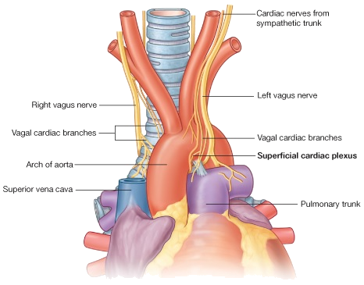

Slide 56
Cardiac muscle fibers
Cardiac muscle fibers are shorter in length and less circular in transverse section. The branching cardiac muscle fibers produce a “stair-step” appearance.
A cardiac muscle fiber is 50–100μm long and has a diameter of about 14μm and one centrally located nucleus.
The cardiac muscle together by irregular transverse thickenings of the sarcolemma called intercalated discs.
The discs contain desmosomes, which hold the fibers together, gap junctions, which allow muscle action potentials to conduct from one muscle fiber to other.
This gap junctions allow the entire myocardium of the atria or the ventricles to contract as a single, coordinated unit.

Slide 57
Cardiac muscle fibers have the same arrangement of actin and myosin, and the same bands, zones, and Z discs, as skeletal muscle fibers.

Slide 58
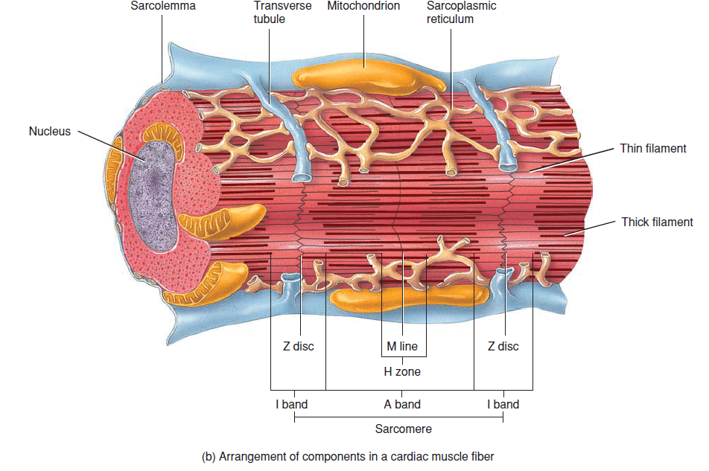

Slide 59
Applied Anatomy
X-ray (Radiography) - Chest
Chest x-ray uses a very small dose of ionizing radiation to produce pictures of the inside of the chest.
It is used to evaluate the lungs, heart and chest wall and may be used to help diagnose shortness of breath, persistent cough, fever, chest pain or injury. It also may be used to help diagnose and monitor treatment for a variety of lung conditions such as pneumonia, emphysema and cancer.

Slide 61
Coronary angiography
Coronary angiography is a procedure that uses a special dye (contrast material) and x-rays to see blood flows through the arteries in heart. The dye helps to highlight blockages in blood flow.

Slide 62
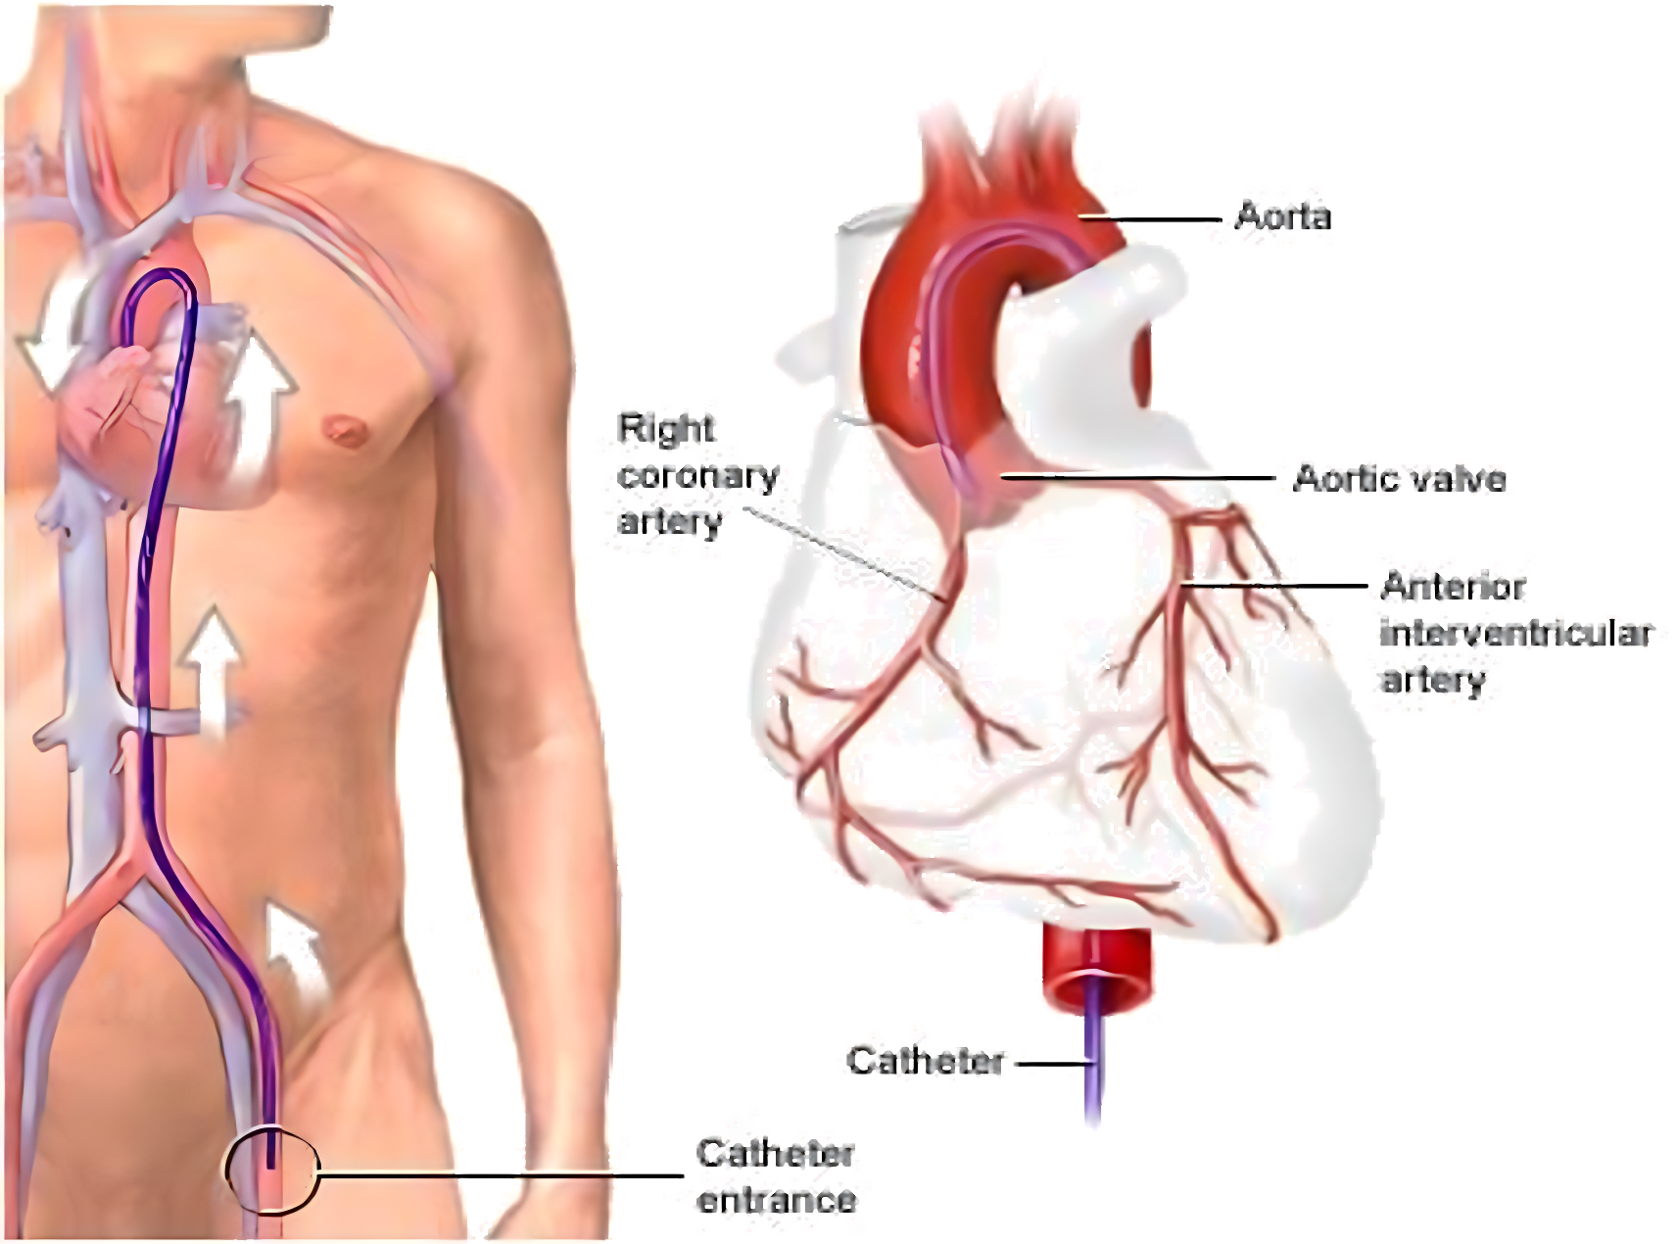

Slide 63
THANK YOU

