Slide 1

ANATOMY OF TESTIS
BY MBBSPPT.COM

Slide 2
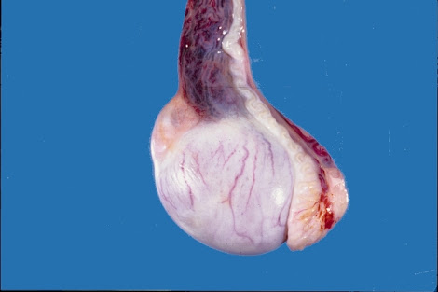
TESTIS
It is a male gonad homologous with ovary of female.
It is suspended in scrotum by the spermatic cord so that its upper pole is tilted forwards and medially.
The left testis is slightly lower than the right.
The testis is oval in shape, compressed from side to side.
It is 3.75 cm long, 1.8cm thick from side to side.
An adult testis weighs about 10-15 g.

Slide 3
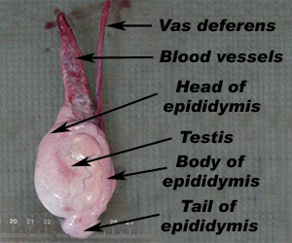
EPIDIDYMIS
Epididymis is made up of highly coiled tube which stores spermatozoa.
It has head, body and tail.
It becomes continuous with Ductus deferens.

Slide 4
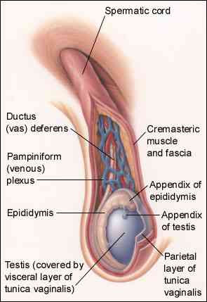
EXTERNAL FEATURES
Two poles or ends, upper and lower.
Two borders, anterior and posterior.
Two surfaces medial and lateral.

Slide 5
COVERINGS OF TESTIS
Testis is covered by 3 coats, from outside inwards they are:
Tunica vaginalis – lower persistent portion of processus vaginalis, covers whole testis except posterior border as Parietal & visceral layers.
Tunica albuginea – dense, white fibrous coat covering the testis, whose posterior border thickened to form mediastinum testis. Numerous septa extend from it into the inner surface.
Tunica vascularis – vascular coat.

Slide 6
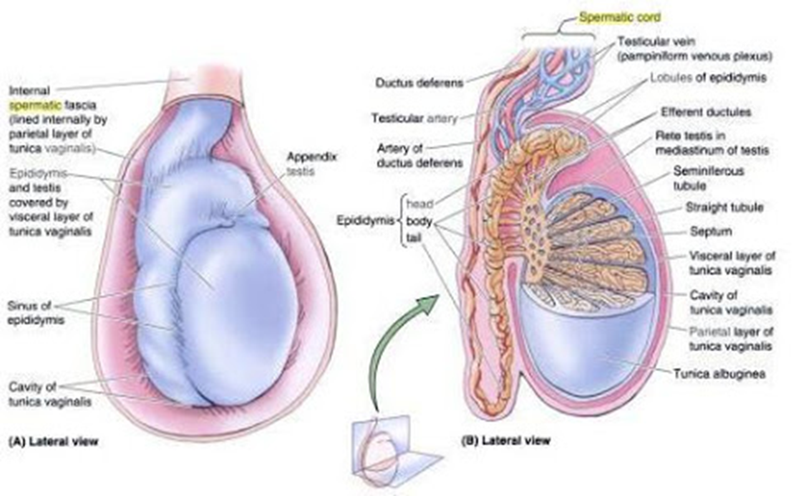
STRUCTURE OF TESTIS
Glandular part of testis contains 200-300 lobules.
Each lobule contains 2-3 seminiferous tubules.
These tubules anastomose at apices to form network called RETE TESTIS.
Each of it give rise to 12-30 efferent ductules which form head of epididymis.
It is continuous with ductus deferens.

Slide 7
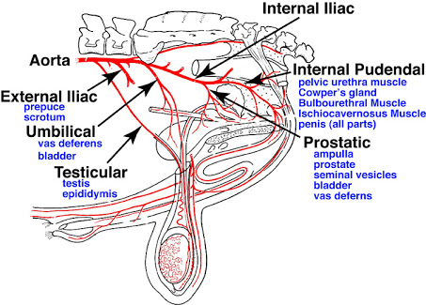
ARTERIAL SUPPLY
Testicular artery, branch of Abdominal aorta at the level of L2.
Posterior abdominal wall Deep inguinal ring Spermatic cord
Tunica albuginea & Tunica vascularis of testis.

Slide 8
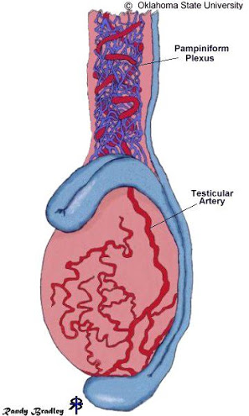
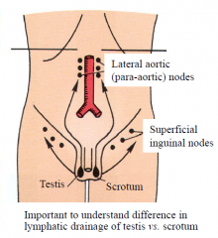
VENOUS SUPPLY: Pampiniform Plexus of Veins.
LYMPHATIC SUPPLY: Preaortic and Paraaortic lymph nodes
at the level of L2.

Slide 9
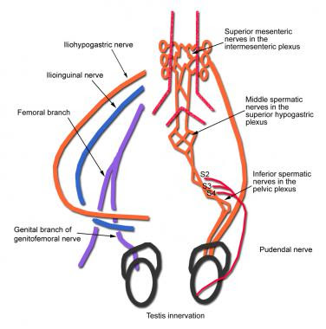
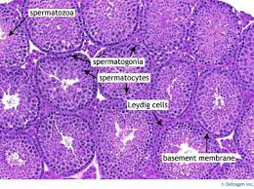
NERVE SUPPLY
Sympathetic nerves from T10, pass through Renal and Aortic plexuses.
Afferent for testicular sensation and Efferent to blood vessels (vasomotor).
HISTOLOGY OF TESTIS:

Slide 10
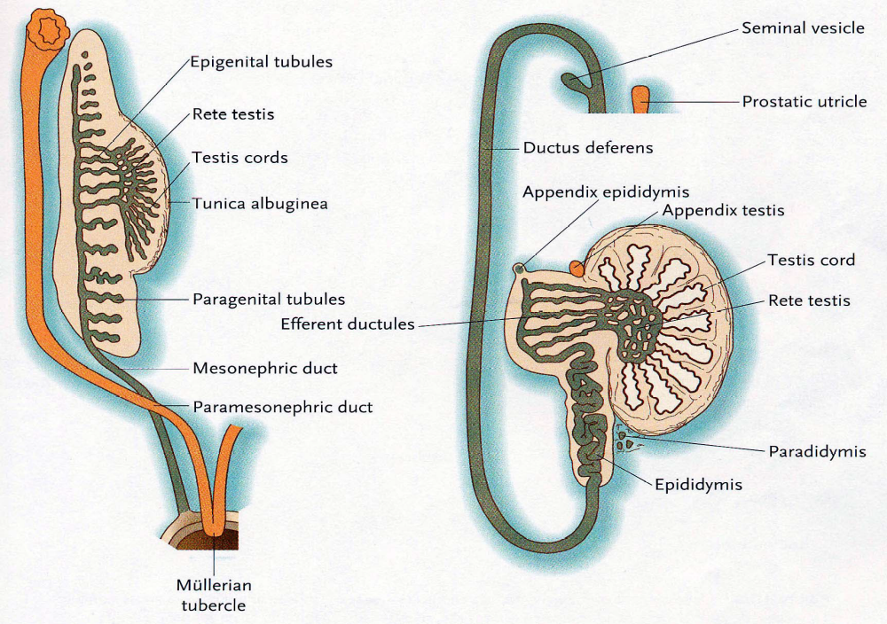
EMBRYOLOGY OF TESTIS

Slide 11
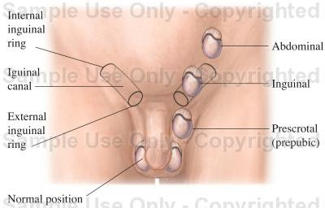
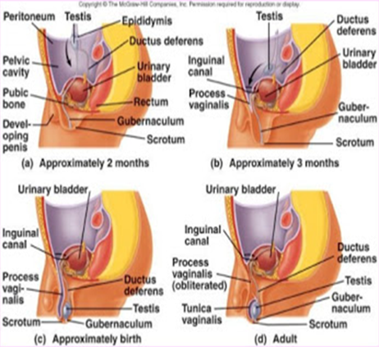
DESCENT OF TESTIS

Slide 12
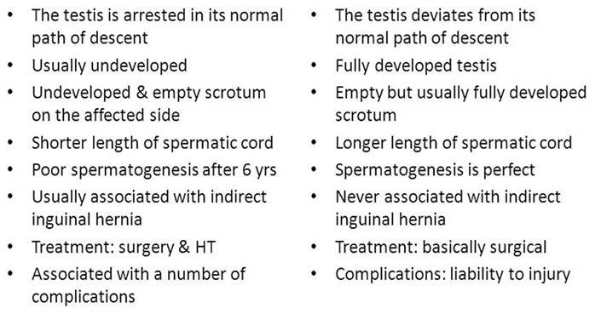
Comparison between ectopic & undescended testis
Undescended Testis
Ectopic Testis

Slide 13
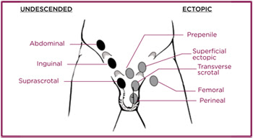
Comparison between ectopic & undescended testis

Slide 14
Thank You

