Slide 1
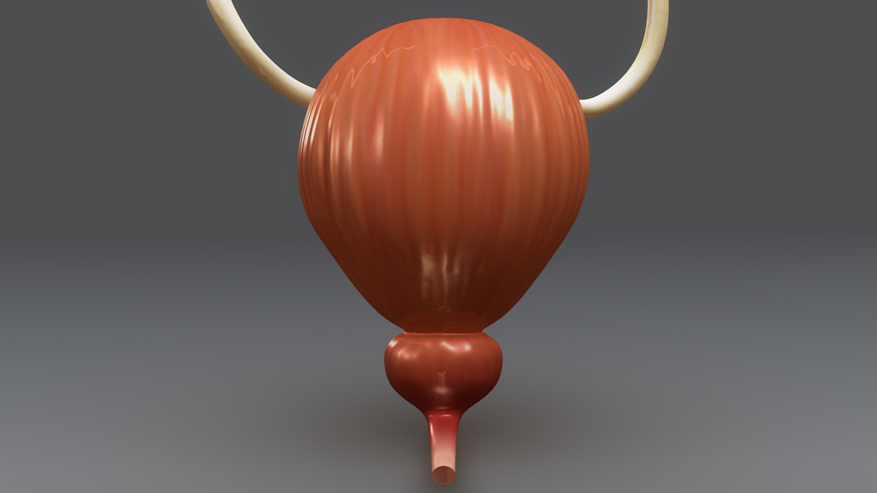
ANATOMY OF URINARY BLADDER

Slide 2
Introduction
The urinary bladder is a muscular organ which lies in the anterior part of pelvic cavity and helps in the storage of urine.
Shape, size and position of bladder varies according to the amount of urine contained in it.
An empty bladder lies entirely within the pelvis but as it fills it extends into abdominal cavity.

Slide 3
GROSS FEATURES
An empty bladder is tetrahedral in shape & has:
Apex
Base or fundus
Neck
3 surfaces: superior, right & left inferolateral.
4 borders: anterior, posterior & 2 lateral lateral borders.

Slide 4
GROSS FEATURES

Slide 5
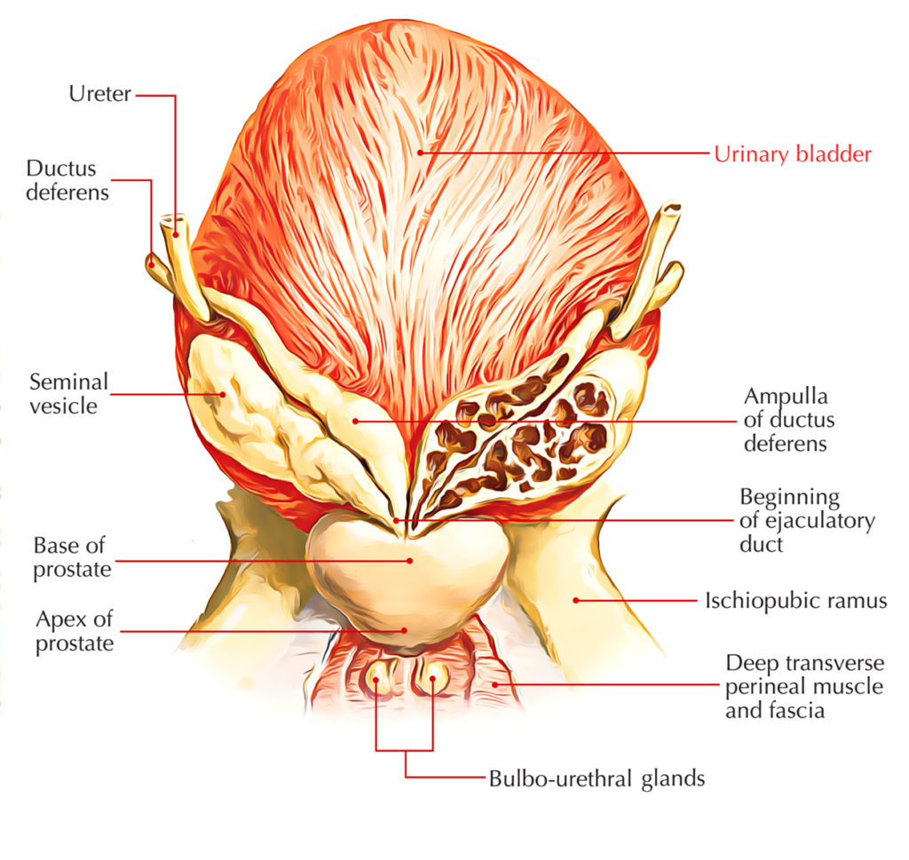
Relations
Apex:
Directed forward.
Connected to the umblicus by the median umblical ligament.
Base:
Directed backward. It is related to;
In male: Vas deferens, seminal vesicles, rectum, rectovesical pouch and peritoneum.

Slide 6
In female: Vagina and cervix of the uterus.
Neck:
Inferior and most fixed part.
In male: Related to prostate. Surrounded by smooth muscle fibres which form preprostatic sphincter.
In female: Related to pelvic fascia.

Slide 7
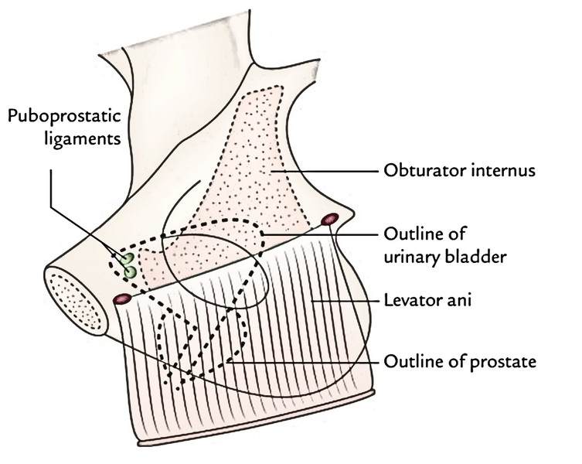
Superior surface:
In male: Peritoneum, coils of ileum & sigmoid colon.
In female: Peritoneum (covers the greater part) & Uterine cervix.
Inferolateral surfaces:
Related to the pubis, the retropubic fat, levator ani & the obturator internus in both male and female.

Slide 8
Puboprostatic ligaments in male & pubovesical ligaments in female.

Slide 9
Bladder Relations

Slide 11
Interior of the bladder
Mucosa of the bladder shows irregular folds except in a small triangular area over the base.
This area is k/a trigone of the bladder. Here, the mucosa is smooth.
Internal urethral orifice opens in the apex of this trigone.

Slide 12
The ureters open at the posterolateral angle of the trigone.
Uvula vesicae: It is a small elevation on the trigone posterior to the urethral orifice produced by median lobe of prostate.

Slide 13
Ligaments of the bladder
True ligaments
They are the condensations of pelvic fascia.
They provide support to the bladder.
Lateral true ligament
Lateral puboprostatic ligament
Medial puboprostatic ligament
Medial umblical ligament
Posterior ligament
False ligaments
They are the peritoneal folds.
They don’t provide support to the bladder.
Median umblical fold
Medial umblical fold
Lateral false ligament
Posterior false ligament

Slide 14
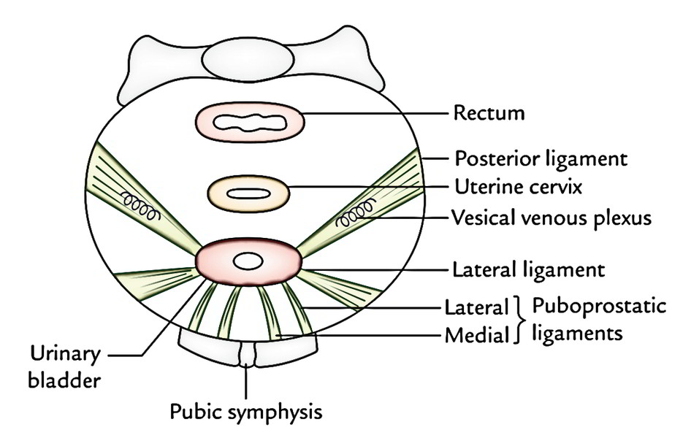
Ligaments

Slide 15
HISTOLOGY OF BLADDER
The wall of urinary bladder shows following features:
Inner mucosa
Lined by transitional epithelium.
Middle muscle layer
Consists of outer & inner longitudinal muscle layer and middle circular/ oblique fibres.
The smooth muscle is also called detrusor muscle whose contraction helps in voiding of urine.
Outer serous layer: It is the peritoneum of bladder.

Slide 16
Histology of bladder

