Slide 1
Ankle Fractures
BY MBBSPPT.COM

Slide 2
Ankle Anatomy and Biomechanics
The ankle joint consists of the talus, which articulates with the Malleoli medially and laterally and the tibial plafond superiorly
In a neutral position, approximately 90% of the load is transmitted through the tibial plafond, with the remaining load borne by the lateral talofibular articulation

Slide 3
Any ankle injury that results in a stable mechanical configuration can potentially be treated nonsurgical because biomechanically normal function is not compromised

Slide 4
Restoration of normal stability and motion in patients with unstable ankle fractures through open anatomic reduction and internal fixation yields better long-term outcomes than does closed treatment, which may not adequately reconstitute either the anatomic constraints or the motion

Slide 5
Classifications
Lauge- Hansen Classification
Danis- Weber classification
AO classification of Malleolar Fractures

Slide 6
Lauge- Hansen Classification
The initial word of the classification (eg: supination, pronation) denotes the position of the foot at the time of injury; the following phrase (eg: external rotation) denotes the direction of the deforming force.

Slide 7
Supination Adduction
Transverse avulsion type fracture of the distal fibula below the level of the joint or tear of the lateral collateral ligament
Vertical fracture of the medial malleolus.

Slide 8
Supination External rotation injury
Disruption of the anterior tibiofibular ligament
Spiral oblique fracture of the distal fibula
Disruption of the posterior tibiofibular ligament or fracture of the posterior malleolus
Fracture of the medial malleolus or rupture of the deltoid ligament

Slide 10
Pronation Abduction
Transverse fracture of the medial malleolus or rupture of the deltoid ligament
Rupture of the syndesmotic ligaments or avulsion fracture of their insertions.
Short horizontal oblique fracture of the fibula above the level of the joint

Slide 11
Pronation External Rotation
Transverse fracture of the medial mallleolus or disruption of the deltoid ligament.
Disruption of the anterior tibiofibular ligament
Short oblique fracture of the fibula above the level of the joint
Rupture of posterior tibiofibular ligament or avulsion fracture of the posterolateral tibia.

Slide 12
Pronation Dorsiflexion
Fracture of the medial malleolus
Fracture of the anterior margin of the tibia
Supramalleolar fracture of the fibula
Transverse fracture of the posterior tibial surface.

Slide 13
Danis-Weber Classification
Based on location and appearance of the fibular fracture
Type A fracture is caused by internal rotation and adduction.
Type A fracture produce transverse fracture of the lateral malleolus at or below plafond.

Slide 14
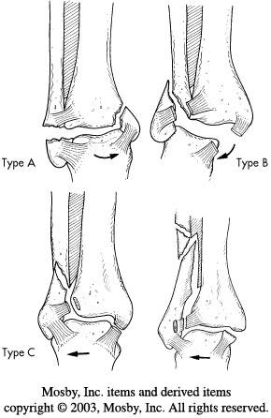

Slide 15
Type B fracture is caused by the external rotation that result in oblique fracture of the lateral malleolus.
Beginning anteromedially extending proximally to posterolateral aspect.

Slide 17
Type C fractures are divided into abduction injuries with oblique fractures of the fibula proximal to the disrupted tibiofibular ligaments

Slide 19
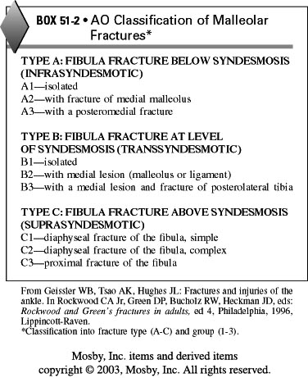
AO Classification

Slide 23
Radiology
X-ray measurements of Alignment and Stability
Measuring the talocrural angle-4-11 deg
Medial clear space-should be equal to superior clear space.(<4mm)
Evaluation of syndesmosis -
Tibiofibular clear space should be less than 6mm on both AP and mortice views.

Slide 24
Treatment
Initial evaluation-
History
Physical examination-
  Deformity,
  Color of the foot,
  Pulses
  Condition of the skin
Carefully assessing the medial ankle over the deltoid ligament for swelling and ecchymosis

Slide 25
Initial management
Reduce the talus underneath the tibia
If the joint is very unstable slab can be applied.
The other options are spanning external fixator or calcaneal pin traction.
Rest Ice and elevation
Use of continuous cryotherapy and intermittent pneumatic pedal compression pumps

Slide 26
Factors that affects the outcome
Medial plafond impaction fractures with vertical malleolus fracture
Posterior malleolar fractures
Anterolateral corner of the plafond fractures.
Level and displacement of the fracture fibula.

Slide 27
Closed Treatment
Stable ankle fractures
Usually with only fibula fractures
Immobilization in cast for 4-6 weeks is the preferred treatment.

Slide 28
Contraindications
Exact reduction and maintaince of the talus in mortice is not possible
Shoulder fractures of the medial malleolus
Large posterior maleolar fractures
Anterolateral corner fractures.

Slide 29
Open treatment
Stable fractures-Osteochondral fractures of the talar done
Unstable fractures.

Slide 30
General principles
Timing of the surgery-
  Type of the fracture,
  Skin condition,
  Other injuries and
  medical condition.
Antibiotics to reduce infections

Slide 31
Lateral Malleolar fractures
Avoid injuring the superficial peroneal nerve
Make sure that distal fibula is fully out to length
Laterally comminuted pronation abduction patterns are most difficult
For maximum stability place plate posteriorly

Slide 32
Consider the location of the syndesmosis fixation when placing a fibular plate.
Test the syndesmosis after lateral malleolar fixation.
Beware of the short distal segments in elderly patients with osteoporotic bone

Slide 33
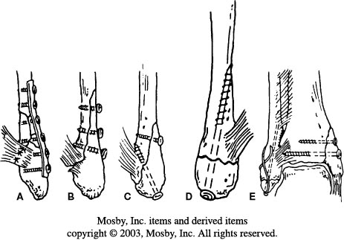

Slide 34
Medial malleolar fixation
4.0mm partially threaded screws work well
Screws should be perpendicular to the fracture line and parallel for maximal compression.
Spread two screws for good stability
Use fluoroscopy to be sure screws are clear of the joint

Slide 35
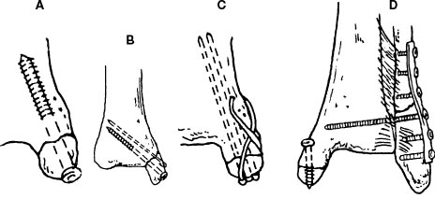

Slide 36
Deltoid Ligament Tear
The deltoid ligament, especially its deep branch is important to the stability of the ankle because it prevents lateral displacement and external rotation of the talus
X ray will show displacement and tilting of the talus with increased medial clear space

Slide 37
A 1 mm lateral shift of the talus can reduce the effective weight bearing area of the talotibial articulation by 20% and 5mm shift can reduce by 80%.
It is repaired with nonabsorbable sutures.

Slide 38
Syndesmotic injury
If the fibular fracture is above the level of the distal tibiofibular joint syndesmosis assumed to be disrupted.

Slide 39
Indications
Syndesmotic injuries associated with proximal fibular fractures for which fixation is not planned
Syndesmotic injuries extending more than 5 cm proximal to the plafond.

Slide 40
Use the syndesmosis fixation when the medial clear space widens on intraoperative stress view after the fibula is fixed
The fibula must be accurately reduced to the tibia in all views
Use 4.5 mm four cortex screw if the patient will bear weight postoperatively
Don’t remove syndesmotic screws 3-4 months post operatively

Slide 41
Achieve perfectly symmetric tibiotalar clear space
Use syndesmosis fixation only without fixing the fibula fracture when it is above the midfibula

Slide 42
Trimalleolar fracture
50deg external rotation view is required for the most accurate assessment of the size and displacement of the posterior malleolar fragment.
If the fragment of the posterior malleolus involves more than 25 to 30% of the weigh bearing surface, it should be anatomically reduced and held with internal fixation

Slide 43
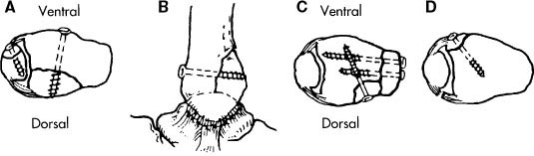

Slide 44
Irreducible fracture dislocation
Deltoid ligament after being avulsed from the medial malleolus and may be caught between malleolus and talus
Trapping of the tibialis posterior tendon between medial malleolus and talus.
Bosworth fracture with entrapment of fibula behind tibia.

Slide 45
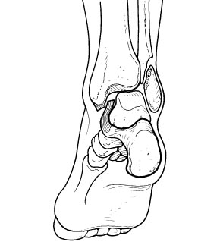

Slide 46
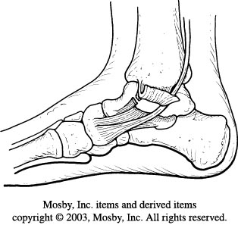
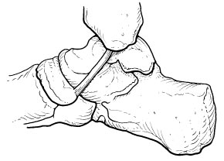

Slide 47
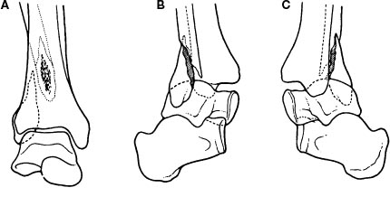

Slide 48
Complications
Loss of reduction
Malunion-Fibula heals in short or external rotated position.
Nonunion- extremely uncommon
Infection
Decreased motion- Deficits in dorsiflexion is common.
Ankle arthrosis-Quality of reduction

