Slide 1
Antenatal Care
BY MBBSPPT.COM

Slide 2
introduction
Obstetrics is largely a preventive medicine.
Aim: To ensure that throughout pregnancy and puerperium , the mother will have a good health and that every pregnancy may culminate in a healthy mother and a healthy baby.
Community Obstetrics : Combination of obstetrical concerns with concepts of primary health care.
Social Obstetrics: It is defined as the study of the interplay of social and environmental factors and human reproduction going back to the preconceptional or even premarital period . The factors are:
Age of marriage
Child bearing
Child spacing
Family size fertility patterns
Level of education
Economic status
Customs and beliefs
Role of women in society

Slide 3
Antenatal Care
Definition : It is the care of women during pregnancy.
Aim : To achieve at the end of pregnancy a healthy mother and a healthy baby. It should begin soon after conception and continue throughout pregnancy.
Objectives:
To promote , protect and maintain the health of the mother during pregnancy
To detect “high risk” cases and give them special attention.
To foresee complications and prevent them.
To remove anxiety and dread associated with delivery.
To reduce maternal and infant mortality and morbidity.
To teach the mother elements of child care , nutrition , personal hygiene and environmental sanitation.
To sensitize the mother to the need for family planning , including advice to case seeking medical termination of pregnancy
To attend the under-fives accompanying the mother

Slide 4
Antenatal visits
Ideally,
First 7 months ,once a month
Next month, twice a month
Thereafter , once a week
If it is difficult for the mother to attend the ante natal clinic so often, a minimum of 3 visits covering the entire period of pregnancy should be the target as follows:
First visit at 20 weeks or as soon as the pregnancy is known
2nd visit at 32 weeks
3rd visit at 36 weeks

Slide 5
preventive services for mother
The first visit , irrespective of when it occurs , should include:
Health history
Physical examination
Laboratory examinations:
complete urine analysis
stool examination
complete blood count , including Hb estimation
serological examination
blood grouping and Rh determination
chest X-ray , if needed
Pap test
G.C. test( Gonorrhoea test , if needed)
On subsequent visits:
Physical Examination(eg. Weight gain ,blood pressure)
Lab tests should include:
Urine examination
Hemoglobin estimation

Slide 6
Iron and folic acid supplementation and medication as needed.
Immunization against tetanus
Group or individual instruction on nutrition, family planning, self care , delivery and parenthood.
Home visiting by a female health worker/trained dai
Referral services,where necessary.
Risk Approach
Central aim of antenatal care : To identify “high risk “ cases and provide them skilled care.
What are “High risk” cases?
Elderly primi
Short statured primi
Malpresentations
Antepartum haemorrhage, threatened abortion
Pre-eclampsia, eclampsia
Anaemia
Twins, hydramnios
Previous still birth,intrauterine death, manual removal of placenta
Elderly grandmultiparas
Prolonged pregnancy

Slide 7
Maintenance of Records
“Antenatal Card” is prepared at the first examination
It contains:
Registration number
Identifying data
Previous health history
Main health events
Record is kept at MCH/FP centre
A link is maintained between the Antenatal card, Postnatal card and Under-fives’ card
Home Visits
Home visits are necessary . Why?
It will win the mother’s confidence.
Observation of the environmental and social conditions at home.
Opportunity to give prenatal advice.

Slide 8
Prenatal advice
DIET:
Pregnancy consumes about 60,000 kcal.
Lactation demands about 550 kcal a day.
Wt. gain of mother during pregnancy.
Maternal iron stores are less. Baby may lack iron stores necessary for rapid growth and increase in blood volume and muscle mass in the 1st year of life.
PERSONAL HYGIENE:
Personal Cleanliness
Rest and sleep:8 hours sleep and 2 hours rest after meals
Bowels : Constipation should be avoided
Exercise : Light household work
Smoking : Should be cut down to minimum.Perinatal mortality among babies whose mothers smoked during pregnancy is 10-40% higher than those of non-smokers.
Alcohol:Heavy drinking can cause Fetal Syndrome(FAS) which includes IUGR and developmental delay.
Dental care
Sexual intercourse: Should be restricted esp. during last trimester.

Slide 9
DRUGS:
Thalidomide-caused phocomelia
LSD-causes chromosomal damage
Streptomycin-may cause ototoxicity
Corticosteroids-may impair fetal growth
Certain drugs are excreted in breast milk
RADIATION:
Most COMMON Abdominal x-RAY
Children exposed to intra uterine X-ray Mortality rates from leukaemia and other neoplasms were higher
WARNING SIGNS:The Mother should report immediately in case of:
Swelling of the feet
Blurring of vision
Fits
Headache
Bleeding or discharge per vagina
Any other unusual complaint
CHILD CARE:The art of child care needs to be learnt

Slide 10
UNDER 5 CLINICs

Slide 11
Symbol of under 5 clinics
Care in illness
Growth monitoring
Family planning
Preventive care

Slide 12
Aims and objectives
Care in illness
Diagnosis and treatment of acute illness , chronic illness and disorders of growth and development
X-ray and laboratory services
Referral services
Preventive Care
Immunization
Nutritional surveillance
sub clinical nutrition
food supplementation
Health check-ups : every 3-6 months
Oral rehydration solution for diarrhea (a child gets 2-6 attacks in a year)
Family planning
Health education

Slide 13
Growth Monitoring - on growth chart also called “Road to health card”
Every month –up to 1 year
2 monthly-up to 2 years
3 monthly-up to 5 years
The weight of child is plotted according to age

Slide 14
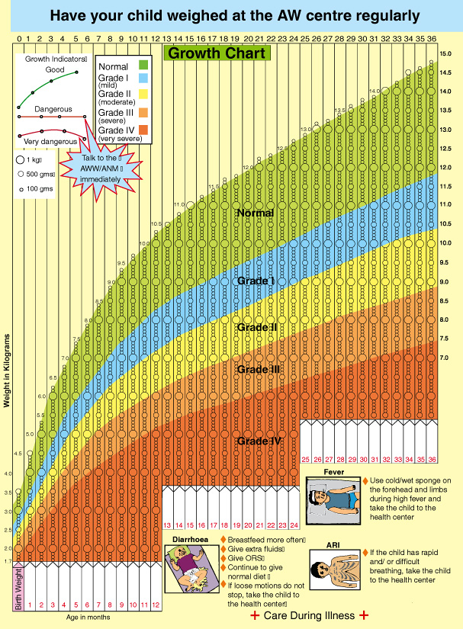

Slide 15
Thank You

