Slide 1
Approach to evaluation and management of acute vertigo
By MBBSPPT.COM

Slide 2
Approach To The Patient With Dizziness
Dizziness and other sensations of imbalance are one of the most frequent complaints among medical outpatients.
“Dizziness” refers to various abnormal sensations relating to perception of the body’s relationship to space.
Patient comes in OPD and tells “Doctor I am dizzy”.
Merely saying this could not explain the exact symptoms.

Slide 3
Approach To The Patient With Dizziness
The term “dizziness” used by the patient to a number of different sensory experiences –
A feeling of rotation or spinning as well as non-rotatory swaying, lightheadedness, faintness, weakness, or unsteadiness.
Blurring of vision, feelings of unreality, syncope, and even some seizure, phenomena.

Slide 4
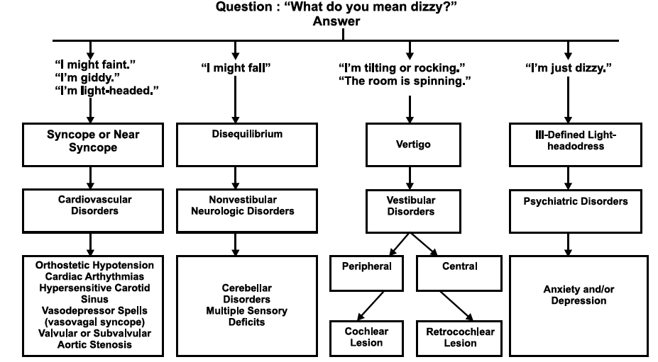

Slide 5
Approach To The Patient With Dizziness
Drachman and Hart (1972) described 4 subtypes
Dizziness
Vertigo
Pre-syncope
Dysequilibrium
Lightheadedness
Drachman DA, Hart CW. An approach to the dizzy patient. Neurology 1972;22:323-34.

Slide 6
1. Syncope or presyncope
A lightheaded, faint feeling, as though one were about to pass out.
Typically occurs in episodes lasting seconds to hours.
The following questions should be answered:
Do episodes occur only when the patient is upright, or do they occur in other positions?
Are episodes associated with palpitations, medication, meals, bathing, dyspnoea, or chest discomfort?

Slide 7
2. Disequilibrium
A sense of unsteadiness that is primarily felt in the lower extremities, most prominent when standing or walking, and relieved by sitting or lying down.
Identify whether symptom occurs in isolation or accompanies another dizziness subtype; describe exacerbating factors.

Slide 8
3. Vertigo
A feeling that one’s surroundings are moving (typically, spinning).
Identify whether symptom occurs in isolation or accompanies another dizziness subtype; describe exacerbating factors.
Episodic vertigo occurs in attacks that last seconds to days. Continuous vertigo is present all or most of the time for at least a week.
Descriptions of episodic vertigo should include the characteristics, duration, and date of the first episode; length of episodes, aggravating and relieving factors.

Slide 9
4. Ill-defined light-headedness
Vague type of feelings. May include swimming or floating sensations, vague lightheadedness, or feelings of dissociation.
May be difficult for the patient to describe.
Usually, present all or most of the time for days or weeks, sometimes years.
The following questions should be answered:
Is dizziness associated with anxiety or hyperventilation?
Is dizziness associated with changes in mood?

Slide 10
Approach to the differentiation of dizziness subtypes

Slide 11
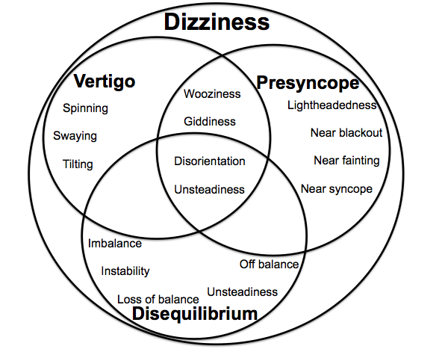

Slide 12
Challenging for the physician
Vague history
Vague complaints
Investigations?
Etiology?

Slide 13
Anatomy And Physiology Of The Vestibular System
Before considering the evaluation of vertigo, a brief review of the neuroanatomy and neurophysiology of the vestibular system may be helpful.
The end organs of this system consist of the three semicircular canals and the otolithic apparatus (utricle and saccule), situated in the bony labyrinths of inner ears on each side.
The canals transduce angular acceleration and the otoliths transduce linear acceleration and the static gravitational forces that provide a sense of head position in space.

Slide 15
Anatomy And Physiology Of The Vestibular System
The principal projections from the vestibular nuclei are to the following structures:
1. Nuclei of the cranial nerves III, IV, and VI.
2. Cerebellum
3. Spinal cord
4. Cerebral cortex

Slide 16
Anatomy And Physiology Of The Vestibular System

Slide 17
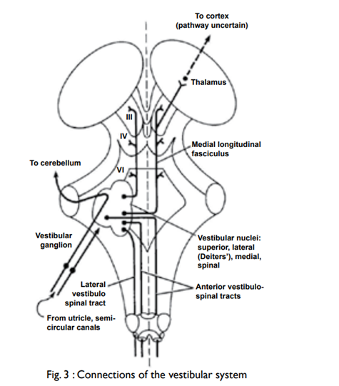
Anatomy And Physiology Of The Vestibular System
Projections from vestibular nuclei to the nuclei of the cranial nerves III, IV, and VI:
The vestibulocochlear reflex (VOR): This reflex serves to maintain the visual stability during head movement and depends on the connections of vestibular nuclei to the nuclei of the cranial nerve III, IV, and VI. these connections are responsible for the nystagmus (to- and fro- oscillations of the eyes).

Slide 18
Anatomy And Physiology Of The Vestibular System
Projections from vestibular nuclei to the cerebellum:
The vestibular nerves and nuclei project to areas of the cerebellum (primarily flocculus and nodulus) that modulate the VOR.

Slide 19
Anatomy And Physiology Of The Vestibular System
Projections from vestibular nuclei to the spinal cord:
The vestibulospinal pathways assist in the maintenance of postural stability.

Slide 20
Anatomy And Physiology Of The Vestibular System
Projections from vestibular nuclei to the cerebral cortex:
Projections to the cerebral cortex, via the thalamus, provide conscious awareness of head position and movement in space.

Slide 21
Anatomy And Physiology Of The Vestibular System
Overall, three sensory systems subserve spatial orientation and posture:
1. The vestibular system.
2. The visual system (retina to occipital cortex).
3. The somatosensory system (conveys peripheral information from skin, joint and muscle receptors).

Slide 22
Origin Of Nystagmus
Nystagmus is the objective accompaniment of vertigo and is defined best as a “rhythmical oscillation of the eyes, with a fast movement in one direction and a slow movement in the other.”
The fast component may be horizontal, vertical, rotatory, or any combination of these.

Slide 23
Origin Of Nystagmus
There are two types of Nystagmus in evaluating vertigo:
1. Spontaneous Nystagmus:
Spontaneous nystagmus is elicited by having the patient look straight ahead, up, down, to the right, and to the left.
This type of nystagmus is not influenced by head position.
It is normal to have a few beats of nystagmus with extreme lateral gaze.

Slide 24
Origin Of Nystagmus
2. Positional Nystagmus:
It is elicited by a head-hanging manoeuvre (the dix-hallpike test)
Altered input passing from the vestibular nuclei to the nuclei of the extraocular muscles through the medial longitudinal fasciculus produces nystagmus.
This input may be modified by information arising from the cerebral cortex and the cerebellum.
For example, the fast component of spontaneous nystagmus depends on interaction between the vestibular system and the cerebral cortex.

Slide 25
Evaluation Of Vertigo
TiTrATE is a novel diagnostic approach to determining the probable etiology of dizziness or vertigo.
The approach uses the
Timing of the symptom,
Triggers that provoke the symptom, And a
Targeted Examination.
Am Fam Physician. 2017 Feb 1;95(3):154-162.

Slide 26
Evaluation Of Vertigo
The first step includes a complete history and physical examination.
Following questions should be asked:
Is the symptom constant or episodic?
With episodic vertigo, what is the duration and frequency of attacks?
How did it begin (Gradual or sudden)?
Are there accompanying symptoms?
Are there aggravating or alleviating factors?
Are there identifiable triggers?

Slide 27
Evaluation Of Vertigo
Medical examination is important.
Check blood pressure changes (supine, sitting, and standing) to rule out orthostatic hypotension.
Other measures to be considered in individual patients include a visual acuity check (as adequate vision is important for balance).
Musculoskeletal inspection (significant arthritis can impair gait).
General neurologic examination with particular attention to the VIII cranial nerve (both the vestibular and cochlear components).

Slide 28
Timing of the symptom
Timing – Episodic vs Constant
Duration – Seconds vs hours vs days
Recurrence

Slide 29
Narrowing your diagnosis- based on timming
Duration | Timing
 | Episodic | Constant
Seconds | BPPV
Minutes-Hours | Meniere’s Migraine TIA
Days | Migraine | Vestibular neuritis CVA

Slide 30
Duration of vertigo symptoms
Neurol Clin 2012;30:61–74.

Slide 31
Vertigo causes:
Peripheral causes
Central causes
Benign paroxysmal positional vertigo
Vestibular neuritis
Herpes zoster oticus (Ramsay Hunt syndrome)
Meniere disease
Perilymphatic fistula
Semicircular canal dehiscence syndrome
Recurrent vestibulopathy
Acoustic neuroma
Aminoglycoside toxicity
Otitis media
Vestibular migraine
Brainstem ischemia
Cerebellar infarction and hemorrhage
Chiari malformation
Multiple sclerosis
Episodic ataxia type 2
https://www.uptodate.com/contents/evaluation-of-the-patient-with-vertigo. Updated 11 Feb 2020. Assessed on 8 Jul 2021.

Slide 32
Triggers that provoke the vertigo symptom…
At rest →
acute vestibular neuritis,
cerebrovascular disease,
attacks of vestibular migraine, or
Menière’s disease
While walking → bilateral vestibulopathy.

Slide 33
Triggers that provoke the vertigo symptom…
Provoking factor | Suggested diagnosis
lateral head rotation in an upright position (eg., rolling over in bed, extending the neck) | Hypersensitive carotid sinus syndrome Compression of the eighth nerve due to cerebellopontine angle mass Vestibular paroxysmia
Changing head position relative to gravity | BPPV
Recent upper respiratory viral illness | Acute vestibular neuronitis
Stress | Psychiatric or psychological causes; migraine
Immunosuppression | Herpes zoster, medications, advanced age
Changes in ear pressure | Perilymphatic fistula, head trauma, excessive straining, loud noises

Slide 34
Peripheral vs Central vertigo

Slide 35
Medication that causes dizziness

Slide 36
Targeted Examination
Findings from the physical examination—including a cardiac and neurologic assessment, with attention to the head, eye, ear, nose, and throat examination—are usually normal in patients presenting with dizziness.
Blood pressure: measured while the patient is standing and supine position
Orthostatic hypotension: after going from supine to standing for 1 minute
systolic blood pressure ↓20 mm Hg,
the diastolic blood pressure ↓ 10 mm Hg, or
pulse ↑30 beats/minute.
A full neurologic examination should be performed.
Am Fam Physician. 2017 Feb 1;95(3):154-162.

Slide 37
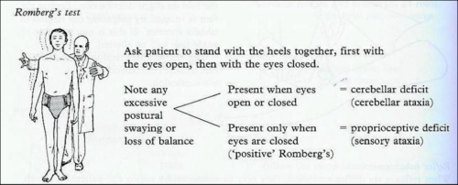
Gait: Romberg test
Am Fam Physician. 2017 Feb 1;95(3):154-162.

Slide 38
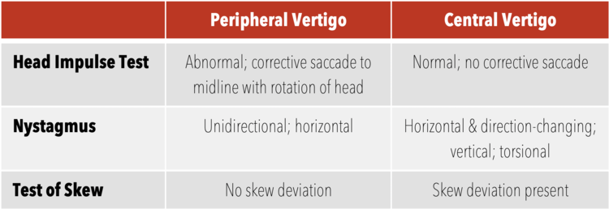
HINTS examination
HINTS
Head-Impulse,
Nystagmus,
test of Skew
This examination can help distinguish a possible stroke (central cause) from acute vestibular syndrome (peripheral cause)
Am Fam Physician. 2017 Feb 1;95(3):154-162.

Slide 39
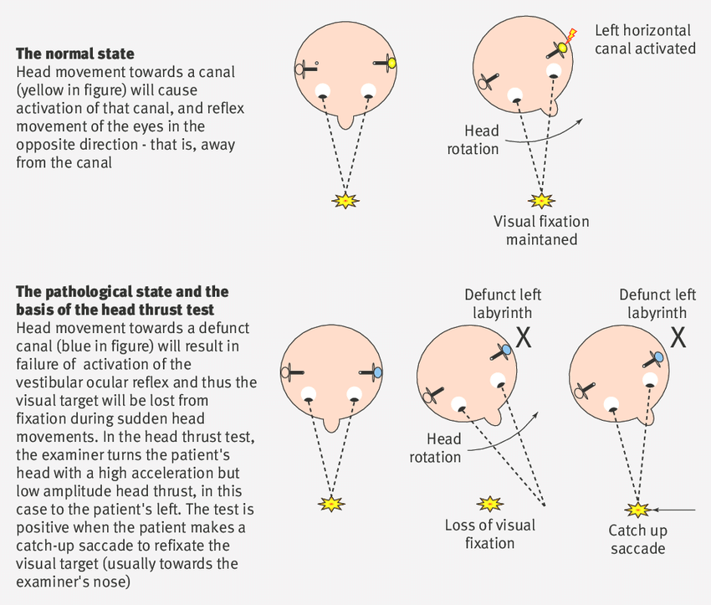
Head-Impulse test
While the patient is sitting, the head is thrust 10 degrees to the right and then to the left while the patient's eyes remain fixed on the examiner's nose. If a saccade (rapid movement of both eyes) occurs, the etiology is likely peripheral.
No eye movement strongly suggests a central etiology.
Am Fam Physician. 2017 Feb 1;95(3):154-162.

Slide 40
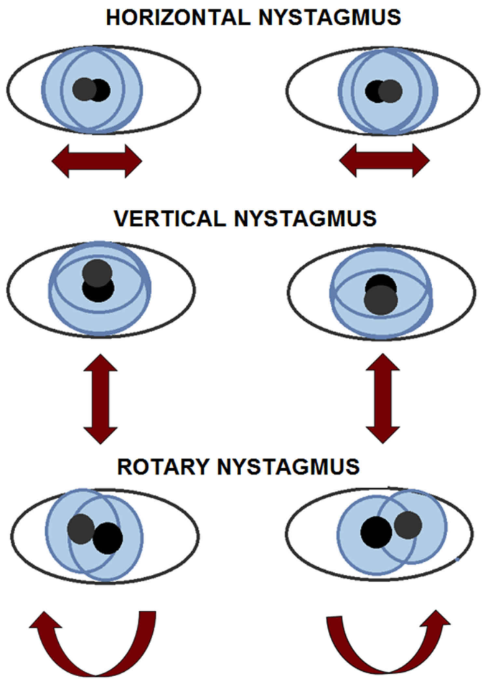
Nystagmus
The patient should follow the examiner's finger as it moves slowly left to right.
Spontaneous unidirectional horizontal nystagmus that worsens when gazing in the direction of the nystagmus → peripheral cause (vestibular neuritis).
Spontaneous nystagmus that is dominantly vertical or torsional, or that changes direction with the gaze (gaze-evoked bidirectional) → central etiology.
Central pathology nystagmus changes direction less than half the time and can be suppressed with fixation.
A video-oculography device is available to quantitatively measure eye movement.
Frenzel goggles used to detect involuntary eye movements have been helpful with nystagmus assessment.
Am Fam Physician. 2017 Feb 1;95(3):154-162.

Slide 41
Test of Skew
Test of skew is assessed by asking the patient to look straight ahead, then cover and uncover each eye.
Vertical deviation of the covered eye after uncovering is an abnormal result.
Although this is a less sensitive test for central pathology, an abnormal result is fairly specific for brainstem involvement.
Am Fam Physician. 2017 Feb 1;95(3):154-162.

Slide 42
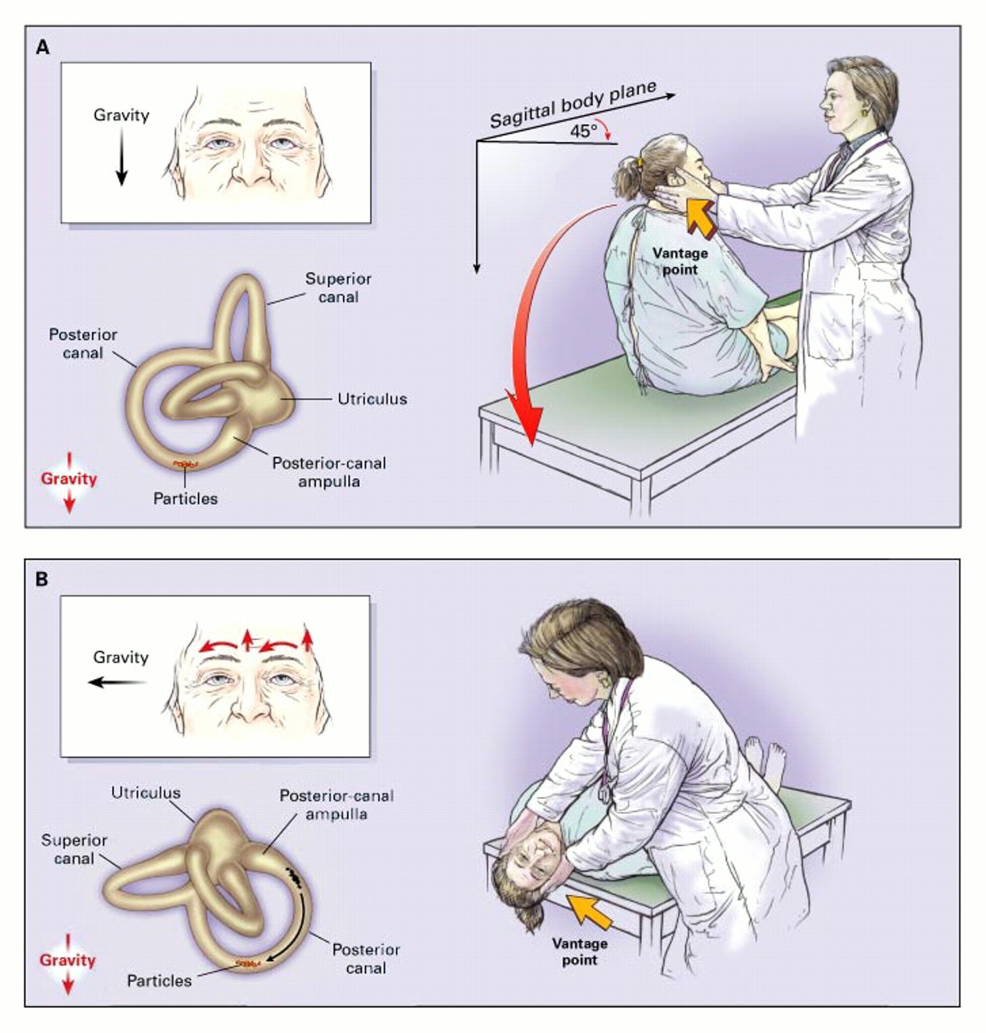
The Dix-Hallpike Test of a Patient with Benign Paroxysmal Positional Vertigo (BPPV) Affecting the Right Ear
Furman J and Cass S. N Engl J Med 1999;341:1590-1596
Notes:
The Dix-Hallpike Test of a Patient with Benign Paroxysmal Positional Vertigo Affecting the Right Ear. In Panel A, the examiner stands at the patient's right side and rotates the patient's head 45 degrees to the right to align the right posterior semicircular canal with the sagittal plane of the body. In Panel B, the examiner moves the patient, whose eyes are open, from the seated to the supine right-ear-down position and then extends the patient's neck slightly so that the chin is pointed slightly upward. The latency, duration, and direction of nystagmus, if present, and the latency and duration of vertigo, if present, should be noted. The red arrows in the inset depict the direction of nystagmus in patients with typical benign paroxysmal positional vertigo. The presumed location in the labyrinth of the free-floating debris thought to cause the disorder is also shown.

Slide 43
Vertigo: Key Points in Clinical Examination
Neurol Clin 2012;30:61–74.

Slide 44
Other neurologic signs
A careful neurologic examination should be performed since the presence of additional neurologic abnormalities strongly suggests the presence of a central lesion.
A search should be made for cranial nerve abnormalities, motor or sensory changes, dysmetria, or abnormal reflexes.
Abnormal facial sensation, ptosis, anisocoria, and diplopia of a lateral medullary infarction may be overlooked when the vertigo is profound.
Absent deep-tendon reflexes will indicate peripheral neuropathy

Slide 45
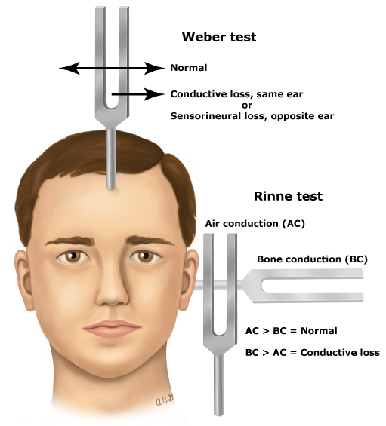
Hearing tests
Weber and Rinne tests are used to distinguish conductive and sensorineural hearing loss.
Notes:
The examiner can easily test hearing by several methods. One is to softly whisper into each ear and then ask the patient to repeat what was whispered. Another is to hold the examiner's hands next to the patient's ears but out of the patient's eyesight. The examiner then rubs the fingers together on one side, with a sham rubbing movement on the opposite side, and asks the patient to report when the finger scratching sound is heard and from which ear it is heard. Another method is to vibrate a 512 Hz tuning fork, placing it close to one ear and then the other in rapid succession so that the patient can compare the loudness.

Slide 46
Diagnostic tests
Tests that may be useful in patients with vertigo include
Brain imaging,
Electronystagmography (ENG)
Audiometry,
Brainstem auditory evoked potentials (BAEPs).
ECG ECHO 24- Hour Holter

Slide 47
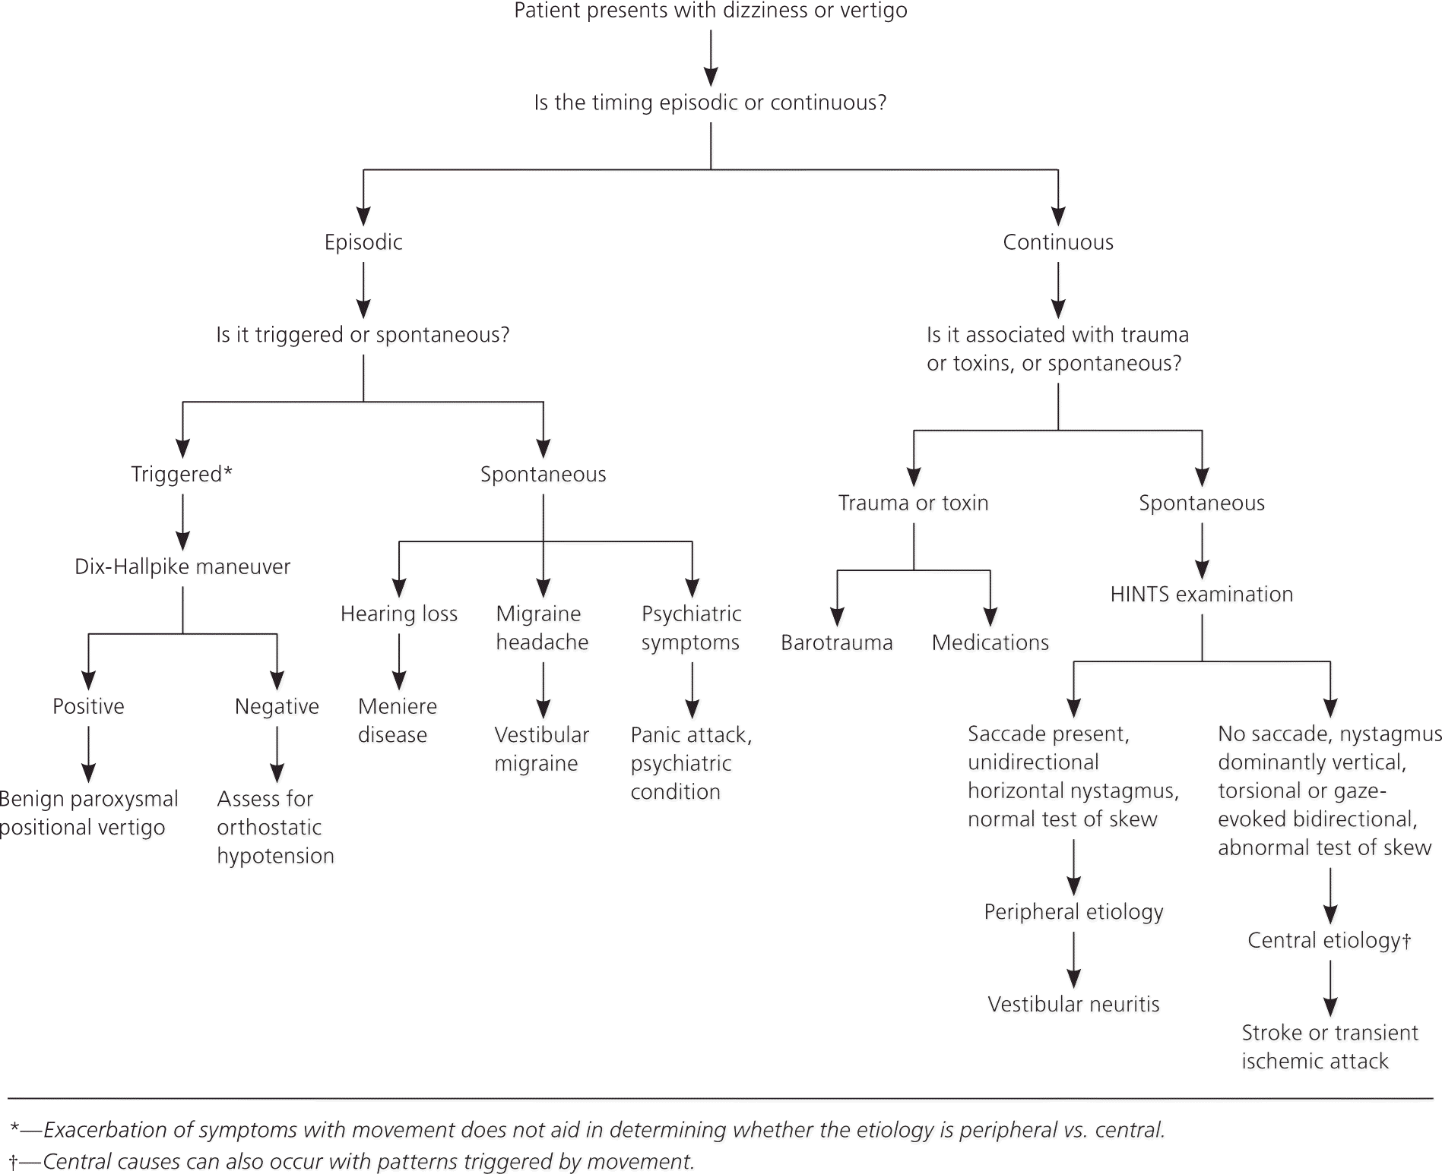
Algorithm for the diagnostic evaluation of dizziness
(HINTS = head-impulse, nystagmus, test of skew.)
Am Fam Physician. 2017 Feb 1;95(3):154-162.

Slide 48
Management of vertigo
Vertigo is caused by a number of conditions affecting either the peripheral vestibular apparatus in the inner ear or the central nervous system.
In some cases, treatment of the underlying condition improves vertigo.
Treatment of vertigo. Updated on 9 Apr 2021. Available from: https://www.uptodate.com/contents/treatment-of-vertigo. Assessed on 12 Jul 2021

Slide 49
Symptomatic treatment
Medications to suppress vestibular symptoms are best used for alleviating acute episodes of vertigo that last at least a few hours or days.
These drugs can be used to suppress the vestibular system and/or reduce associated nausea and vomiting

Slide 50
Medications for acute vertigo
Drug | Dose as-needed
Orally administered agents:
Antihistamines, first-generation
Dimenhydrinate | 50 to 100 mg every 4 to 6 hours
Diphenhydramine | 25 to 50 mg every 4 to 6 hours
Meclizine | 25 to 50 mg every 6 to 12 hours
Benzodiazepines
Alprazolam | 0.5 mg immediate release every 8 hours
Clonazepam | 0.25 to 0.5 mg every 8 to 12 hours
Diazepam | 1 mg every 12 hours
Lorazepam | 1 to 2 mg every 8 hours
Antiemetics
Domperidone (not available in United States) | 10 mg every 8 hours
Metoclopramide | 5 to 10 mg every 6 hours
Ondansetron | 4 mg every 8 to 12 hours
Prochlorperazine | 5 to 10 mg every 6 hours
Promethazine | 12.5 to 25 mg every 4 to 6 hours

Slide 51
Parenterally administered agents for acute emergency ward use
Antihistamines, first-generation
Diphenhydramine | 10 to 50 mg IV
Dimenhydrinate | 50 mg IV
Antiemetics
Metoclopramide | 10 mg IV
Ondansetron | 4 to 8 mg IV
Prochlorperazine | 2.5 to 10 mg IV
Promethazine | 12.5 to 25 mg IM or IV (vesicant, use caution with IV administration; refer to Lexicomp drug monograph included within UpToDate)

Slide 52
Anticholinergics
Central vestibular suppressants that suppress firing in vestibular nucleus neurons, reduce the velocity of vestibular nystagmus.
Increases motion tolerance.
Prominent adverse effects, e.g. dry mouth, dilated pupils, sedation.
Adverse effects such as dry mouth and blurred vision also limit use.
CNS drugs 2003 Jan;17(2):85–100.

Slide 53
Antihistaminics
Have substantial anticholinergic activity, it seems likely that most or all of their vestibular suppressant effect derives from their anticholinergic action.
Prevent motion sickness, reduce severity of symptoms even if taken after the onset of symptoms.
Antihistamines that do not cross the blood-brain barrier are not used to treat vertigo. (Fexofenadine)
CNS drugs 2003 Jan;17(2):85–100.

Slide 54
Benzodiazepines
GABA modulators.
Acting centrally to suppress vestibular responses.
In small doses, extremely useful for management of vertigo.
Also useful in prevention of motion sickness.
Habituation, impaired memory, ↑ risk of falling – main problems.
CNS drugs 2003 Jan;17(2):85–100.

Slide 55
Calcium channel antagonists (CCA)
Examples: Flunarizine, Cinnarizine
Vestibular dark cells contain calcium channels, suggesting possibility that CCA might change ion concentration in Endolymph.
CCA often have anticholinergic and/or antihistaminic activity.
CCA may be effective in 'vestibular Ménière's', as individuals with this diagnosis have a high prevalence of migraine, for which calcium channel antagonists are often effective
CNS drugs 2003 Jan;17(2):85–100.

Slide 56
Antiemetics
Control of nausea in patients with vertigo.
Choice of agent depends
consideration of route of administration
adverse effect profile
Oral agents: mild nausea
Suppositories: outpatients who unable to absorb oral agents because of gastric atony or vomiting.
Sublingual administration- motion sickness.
Injectables: emergency room or inpatient settings
CNS drugs 2003 Jan;17(2):85–100.

Slide 57
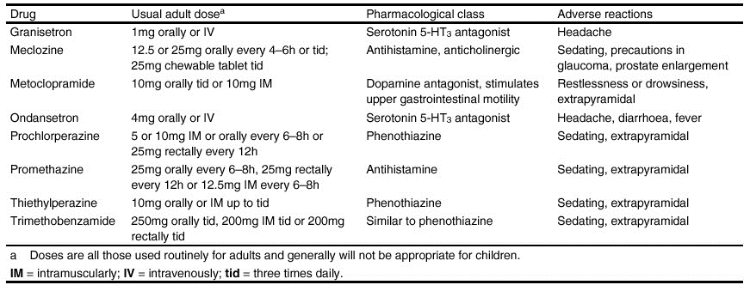
Antiemetics…
CNS drugs 2003 Jan;17(2):85–100.

Slide 58
Antiemetics …
Antihistaminics
Meclozine – peffered
Prochlorperazine, promethazine – 2nd choice
Prokinetic drugs
Metoclopramide – not effective
5HT3 antogonist e.g. ondansetron
Highly effective
Cost high
CNS drugs 2003 Jan;17(2):85–100.

Slide 59
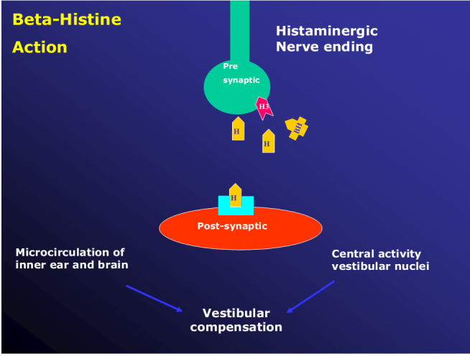
Agents of Uncertain Efficacy and Mechanism
Betahistine
H1 receptor agonist, H3 receptor antagonist.
Decouples negative feedback loop controlling histamine release, resulting in central facilitation of histaminergic neurotransmission in brain
Associated with reduction in the gain of the vestibulo-ocular reflex
↑ blood flow to inner ear
May accelerate compensation
CNS drugs 2003 Jan;17(2):85–100.

Slide 60
Other therapy
Canalith Repositioning Procedure (CRP)
Epley maneuver
Surgery
Singular neurectomy
Vestibular Nerve Section
Posterior Canal Plugging Procedure
Dietary changes (avoid caffeine)
Healthy life style (sleep)

Slide 61
Take Home Message
Dizziness is a vague symptom.
It could be syncope, disequilibrium, vertigo or ill defined light-headedness/ psychiatic illness.
Vertigo could be peripheral or central depending on associated neurologic signs/ symptoms.

Slide 62
Take Home Message
Evaluate vertigo using novel approach of TiTrATE :
Timing of the symptom,
Triggers that provoke the symptom, And a
Targeted Examination.
Various clinical tests (HINTS) used to find out various etiologies.

Slide 63
Take Home Message
Vertigo is caused by a number of conditions affecting either the peripheral vestibular apparatus in the inner ear or the central nervous system.
Treatment of the underlying condition improves vertigo.
Various categories of drugs are effective to control vertigo.

