Slide 1
ARTERIAL SUPPLY OF THE BRAIN

Slide 2
VASCULAR SUPPLY AND DRAINAGE OF THE BRAIN
The brain is a highly vascular organ, its profuse blood supply characterized by a densely branching arterial network.
It has a high metabolic rate that reflects the energy requirements of constant neural activity. It receives about 15% of the cardiac output and utilizes 25% of the total oxygen consumption of the body.
The brain is supplied by two internal carotid arteries and two vertebral arteries that form a complex anastomosis (circulus arteriosus, circle of Willis) on the base of the brain.
Venous blood from the brain drains into sinuses within the Dura mater.
Acute interruption of the blood supply to the brain for more than a few minutes causes permanent
neurological damage. Such ischaemic strokes along with intracranial haemorrhage are major contemporary sources of morbidity and mortality.

Slide 3
ARTERIAL SUPPLYOF THE BRAIN
The arterial supply of the brain is derived from the internal carotid and vertebral arteries, which lie, together with their proximal branches, within the subarachnoid space at the base of the brain.
INTERNAL CAROTID ARTERY
The internal carotid arteries and their major branches (the internal carotid system or ‘anterior’ circulation) supply blood to the majority of the forebrain. Some parts of the occipital and temporal lobes are supplied by branches of the vertebrobasilar system.
The internal carotid artery arises from the bifurcation of the common carotid artery, ascends in the neck and enters the carotid canal of the temporal bone.
Its subsequent course is said to have:-
Petrous Parts
Cavernous Parts
Intracranial Parts.

Slide 4
Fig. Internal carotid arteriograms. A, lateral projection B, Towne's projection.

Slide 5
Fig. The arteries supplying the left cerebral hemispheres. A, Lateral surface. B, Medial surface.

Slide 6
1. Petrous Part
Course
The petrous part of the internal carotid artery ascends in the carotid canal, curves anteromedially and then superomedially above the cartilage that fills the foramen lacerum, and enters the cranial cavity.
Branches
The caroticotympanic artery:- It is a small, occasionally double, vessel which enters the tympanic cavity by a foramen in the carotid canal and anastomoses with the anterior tympanic branch of the maxillary artery and the stylomastoid artery.
The pterygoid artery:- It is inconsistent: when present, it enters the pterygoid canal with the nerve of the same name, and anastomoses with a (recurrent) branch of the greater palatine artery.

Slide 7
2. Cavernous Part
Course
The cavernous part of the internal carotid artery ascends to the posterior clinoid process. It turns anteriorly to the side of the sphenoid within the cavernous sinus and then curves up medial to the anterior clinoid process, to emerge through the dural roof of the sinus.
The oculomotor, trochlear, ophthalmic and abducens nerves are lateral to it within the cavernous sinus.
Occasionally, the two clinoid processes form a bony ring round the artery.
3. Intracranial Part
Course
After piercing the Dura mater, the internal carotid artery turns back below the optic nerve to run between it and the oculomotor nerve. It reaches the anterior perforated substance at the medial end of the lateral fissure and terminates by dividing into-
the anterior and middle cerebral arteries.

Slide 8
1. Ophthalmic Artery
Arises From The Anterior Part Of The Internal Carotid as It Leaves The Cavernous Sinus, Often At The Point of Piercing The Dura, And Enters The Orbit Through The Optic Canal.
2. Posterior Communicating Artery
Runs Back From The Internal Carotid Above The Oculomotor Nerve, And Anastomoses With The Posterior Cerebral Artery (A Terminal Branch Of The Basilar Artery), Thereby Contributing To The Circulus Arteriosus Around The Interpeduncular Fossa.
The Posterior Communicating Artery Is Usually Very Small. However, Sometimes It Is So Large That The Posterior Cerebral Artery Is Supplied Via The Posterior Communicating Artery Rather Than From The Basilar Artery (‘Fetal Posterior Communicating Artery'); It Is Often Larger On One Side Only.

Slide 9
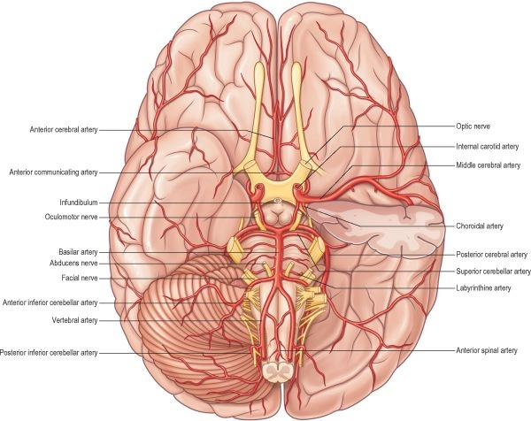
Fig. The arteries on the base of the brain. The anterior part of the left temporal lobe has been removed to display the initial course of the middle cerebral artery within the lateral fissure.

Slide 10
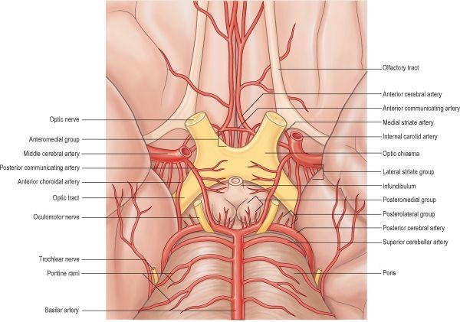
Fig. The Circulus Arteriosus on The Base of The Brain Showing The Distribution of Central (Perforating Or Ganglionic) Branches.

Slide 11
3. Anterior Cerebral Artery
The anterior cerebral artery is the smaller of the two terminal branches of the internal carotid.
The anterior cerebral artery starts at the medial end of the stem of the lateral fissure.
It passes anteromedially above the optic nerve to the great longitudinal fissure where it connects with its fellow by a short transverse anterior communicating artery.
The anterior communicating artery is about 4 mm in length and may be double. It gives off numerous anteromedial central branches that supply the optic chiasma, lamina terminalis, hypothalamus, para-olfactory areas, anterior columns of the fornix and the cingulate gyrus.
The two anterior cerebral arteries travel together in the great longitudinal fissure.
They pass around the curve of the genu of the corpus callosum and then along its upper surface to its posterior end, where they anastomose with posterior cerebral arteries .They give off cortical and central branches.
NOTE:
Surgical nomenclature divides the vessel into three parts: A1 – from the termination of the internal carotid artery to the junction with the anterior communicating artery; A2 – from the junction with the anterior communicating artery to the origin of the callosomarginal artery; and A3 – distal to the origin of the callosomarginal artery; this segment is also known as the pericallosal artery.

Slide 12
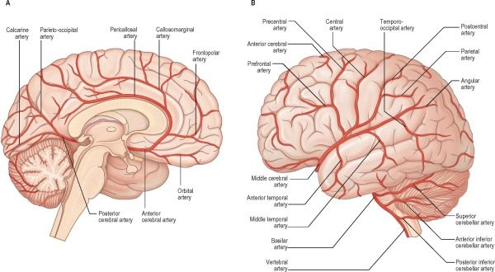
Fig. The major arteries supplying the medial, A, and lateral, B, aspects of the brain.

Slide 13
4. Middle Cerebral Artery
The middle cerebral artery is the larger terminal branch of the internal carotid.
The middle cerebral artery runs at first in the lateral fissure, then posterosuperior on the insula, and divides into branches distributed to the insula and the adjacent lateral cerebral surface. Like the anterior cerebral artery, it has cortical and central branches.
NOTE:
Surgical nomenclature divides the vessel into four parts:
M1 – from the termination of the internal carotid artery to the bi/trifurcation, this segment is also known as the sphenoidal;
M2 – the segment running in the lateral (Sylvian) fissure, also known as the insular;
M3 – coming out of the lateral fissure, also known as the opercular; and M4 – cortical portions.

Slide 14
Vertebral Artery
The vertebral arteries and their major branches (sometimes referred to as the ‘vertebrobasilar system') essentially supply blood to the upper spinal cord, the brain stem and cerebellum and a significant but variable part of the posterior cerebral hemispheres.
The vertebral arteries are derived from the subclavian arteries. They ascend through the neck in the foramina transversaria of the upper six cervical vertebrae and enter the cranial cavity through the foramen magnum, close to the anterolateral aspect of the medulla .
They converge medially as they ascend the medulla and unite to form the midline basilar artery at approximately the level of the junction between the medulla and pons.
One or two meningeal branches arise from the vertebral artery near the foramen magnum and ramify between the bone and dura mater in the posterior cranial fossa. They supply bone, diploë and the falx cerebelli.
A small anterior spinal artery arises near the end of the vertebral artery, and descends anterior to the medulla oblongata to unite with its fellow from the opposite side at mid-medullary level. The single trunk then descends on the ventral midline of the spinal cord.
The largest branch of the vertebral artery is the posterior inferior cerebellar artery.

Slide 15
1. Basilar Artery
The basilar artery is a large median vessel formed by the union of the vertebral arteries at the mid-medullary level. It lies in the pontine cistern, and follows a shallow median groove on the ventral pontine surface, extending to the upper border of the pons. It ends by dividing into two posterior cerebral arteries at a variable level behind the dorsum sellae, usually in the interpeduncular cistern.
Branches:
Anterior inferior cerebellar artery
Labyrinthine artery
Pontine branch
Superior cerebellar artery
Posterior cerebellar artery

Slide 16
Posterior Cerebralartery
The posterior cerebral artery is a terminal branch of the basilar artery.
The posterior cerebral artery is larger than the superior cerebellar artery, from which it is separated near its origin by the oculomotor nerve, and, lateral to the midbrain, by the trochlear nerve.
It passes laterally, parallel with the superior cerebellar artery, and receives the posterior communicating artery. It then winds round the cerebral peduncle and reaches the tentorial cerebral surface, where it supplies the temporal and occipital lobes. Like the anterior and middle cerebral arteries, the posterior cerebral artery has cortical and central branches.
NOTE: Surgical nomenclature divides the vessel into three parts: P1 – from the basilar bifurcation to the junction with the posterior communicating artery; P2 – from the junction with the posterior communicating artery to the portion in the perimesencephalic cistern; and P3 – the portion that runs in the calcarine fissure.

Slide 17
Circulus Arteriosus / Circle Of Willis
The circulus arteriosus (circle of Willis) is a large arterial anastomosis which unites the internal carotid and vertebrobasilar systems.
It lies in the subarachnoid space within the interpeduncular cistern, and surrounds the optic chiasma and infundibulum.
Anteriorly, the anterior cerebral arteries, derived from the internal carotid arteries, are linked by the small anterior communicating artery. Posteriorly, the two posterior cerebral arteries, formed by the division of the basilar artery, are joined to the ipsilateral internal carotid artery by a posterior communicating artery.
There is considerable individual variation in the pattern and calibre of vessels that make up the circulus arteriosus. Although a complete circular channel almost always exists, one vessel is usually sufficiently narrowed to reduce its role as a collateral route and the circle is rarely functionally complete.

Slide 18
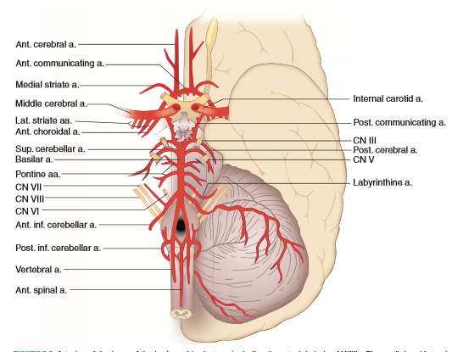

Slide 19
INTRACRANIAL HEMORRHAGE
A. Aneurysms
circumscribed dilations (ectasias) of an artery.
1. Berry (saccular) aneurysms
typically develop at arterial bifurcations. The cerebral arterial circle contains 60% of aneurysms; 30% arise from the middle cerebral artery; and the remaining 10% are found in the vertebrobasilar system.
of the anterior communicating artery may pressure the optic chiasm and cause a bitemporal lower quadrantanopia.
of the posterior communicating artery may cause a oculomotor nerve palsy.
rupture is a common cause of nontraumatic subarachnoid hemorrhage.
2. Microaneurysms (Charcot–Bouchard aneurysms)
found in small arteries, most frequently within the territory of the middle cerebral artery (i.e., the lenticulostriate arteries).
rupture occurs most frequently in the basal nuclei and is the commonest cause of nontraumatic intraparenchymal hemorrhage.

Slide 20
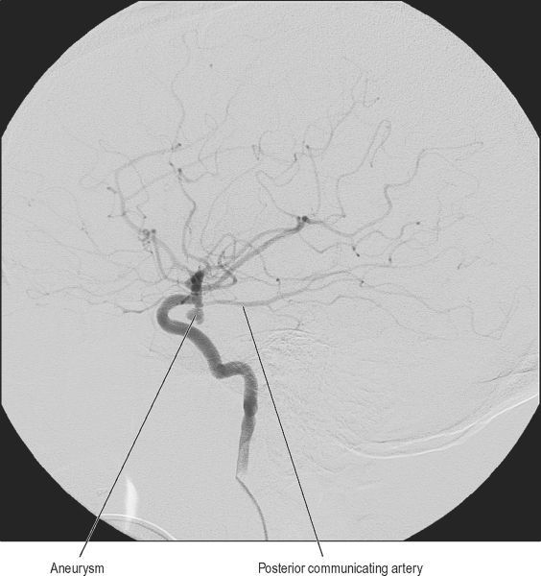
B. Subdural Hemorrhage (Hematoma)
results from rupture of the superior cerebral veins, the “bridging” veins that drain into the superior sagittal sinus.
C. Epidural Hemorrhage (Hematoma)
typically result from rupture of the middle meningeal artery that lies between the dura mater and the inner table of the skull.

Slide 21
THANK YOU!

