Slide 1
Atrial septal defect by mbbsppt.com

Slide 2
Atrial septal defect (ASD) is a deficiency of the atrial septum.
10-15% of all CHD .
Types of ASDs:
Ostium secundum defect→70% of ASDs.
Ostum primum defect→20% of ASDs.
Sinus venosus defect.→10%of ASDs.
Coronary sinus septal defect→ < 1% of ASDs .
PFO is not ASD

Slide 3
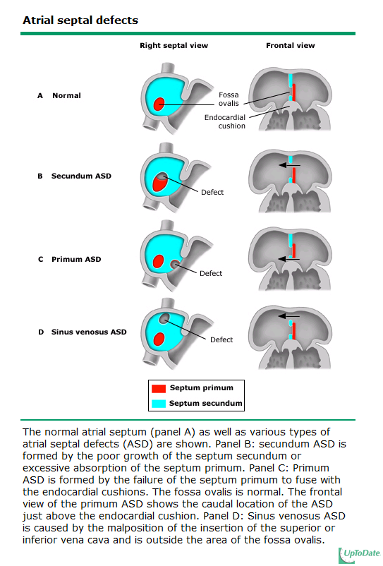

Slide 4
Age of presentation
ASD, is present at birth;
Most cases are asymptomatic until late childhood, adolescence, or adulthood. .
Ostium primum ASDs usually are diagnosed in the first few years of life because of the presence of a mitral regurgitation murmur.

Slide 5
Ostium Secundum
A defect in the region of the fossa ovalis
Associated with structurally normal AV valves.
It may be single or multiple (fenestrated atrial septum)
Female: male 3:1 incidence.
Associated lesions :partially anomalous pulmonary venous return .& Holt- Oram-syndrome.

Slide 6
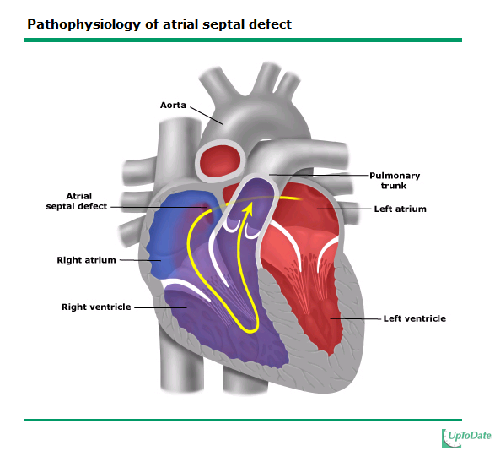

Slide 7
Clinical Manifestation
Most often is asymptomatic.
Subtle failure to thrive , exercise intolerance .
Physical Findings:
Usually discovered incidentally
1- Right ventricular impulses palpable at the left sternal border.
2- Loud S1.
3- Fixed and widely split S2 .

Slide 8
Continue…
Systolic at middle and upper left sternal border ( pulmonary flow murmur ).
Mid diastolic rumbling murmur at the lower left sternal border (functional MS).
These findings indicate Qp:Qs ratio at least 2:1 .

Slide 9
Diagnosis:
Chest X-Ray : variable degrees of RV and RA ,enlarge PA, Increase pulmonary vascularity .
ECG: signs of right ventricle volume overload.
Echocardiogram
Cardiac Catheterization: confirmation of the defect

Slide 10
Prognosis Complications
15% ostium secundum in term infants close spontaneously .
Symptoms don’t usually appear until the third decade in life or later :
Infective Endocarditis is extremely rare and there is no need for antibiotic prophylaxis.

Slide 11
Treatment:
Surgery or transcatheter device closure.
Indications : 1-all symptomatic patients.
2- asymptomatic patients with QP:QS ratio of at least 2:1.
Timing : elective closure after one year and before entry of school.

Slide 12
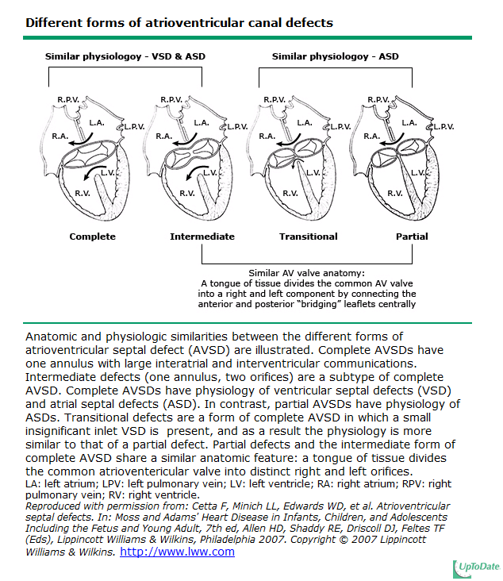

Slide 13
Pathophysiology
Location of AV valve : partial or complete AVSD.
Partial AVSD : isolated ASD + MR
Complete AVSD : ASD+VSD + common AV valve regurgitation
LT→RT shunt intially with no PVR, if increased PVR, shunts may be bidirectional
Bidirectional shunt more common in Down syndrome and unrepaired defect

Slide 14
Clinical presentation
Partial AVSD → similar to ostium secundum ASD
Complete AVSD → CHF, recurrent pneumonia
Physical Findings :
1-Loud S1
2-Fixed widely splitted S2
3-Pulmonary systolic ejection murmur and mid diastolic rumbling murmur
4-Apical harsh holosystolic mumur that radiates to the axilla ( MR )

Slide 15
Ostium secundum Vs AVSD (complete)
Asymptomatic
S2 normal until PHT develops
Normal AV valve
Chest x-ray RA RV enlargement
ECG- right axis deviation
PHT rare
Spontaneous closure
Symptomatic early
S2 loud due to PHT
Abnormal AV valve
Chest x-ray Biventricular enlargement
ECG – extreme left axis deviation
PHT common and early
No spontaneous closure

Slide 16
Treatment:
hemodynamically significant primum ASDs and partial AV canal defects is operative repair.
Timing: part. AVSD → 3-5 y
Complete AVSD → before 1 yr of age
IE remains both a preoperative and a postoperative complication.

Slide 17
PDA
5-10%ofCHDs
Spontaneous closure at 3-5 days of life in term infants
More common in premature infants
Male:femaleratiois1:3
Higher incidence of PDA in infants born at higher altitudes
PDA in premature infant is not CHD

Slide 18
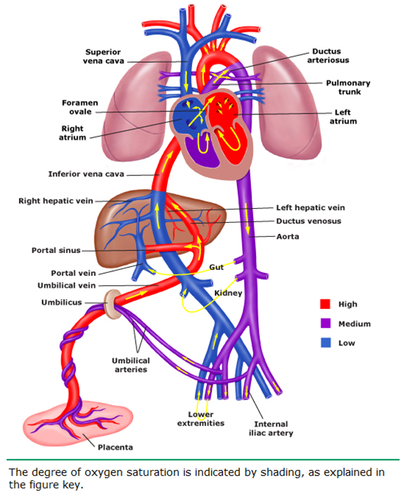
Fetal Circulation
During Fetal Life:
What is the resistance in the Pulmonary Vasculature?
What is the systemic vascular resistance?
Which direction does blood shunt through the Ductus Arteriosus?
PDA: R→L Shunting
Pulmonary Vascular
Resistance: HIGH
Systemic Vascular
Resistance: LOW

Slide 19
Hemodynamics
shunt from aorta to PA
Flow occurs both in systole &diastole → continuous murmur
Systolic as well as diastolic overloading of pulmoary artery
To lungs→ Lt atrium(enlarges)
To normal mitralvalve–accent S1, mitral DDM
LV diastolic overload→ increase systole→ delayed A2

Slide 20
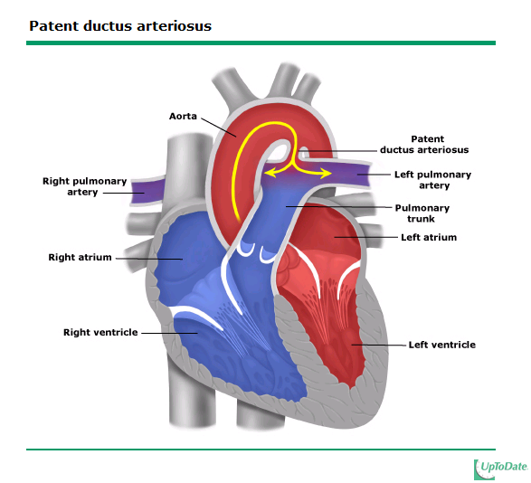

Slide 21
Clinical features
Depends upon size of shunt &degree of PHT
Small (Qp:Qs <1.5:1) : asymptomatic
Moderate (Qp:Qs 1.5-2.2) : exercise intolerance
Large ( Qp:Qs :Qs >2.2:1) : CHF, FTT, poor feeding, respiratory distress
Complications
CHF,IE,PHT,PDA aneurysm

Slide 22
What Physical Exam findings are consistent with PDA?
Respiratory Sx: Tachypnea, Apnea, CO2, increased vent settings
Cardiac: Active Precordium, Widened Pulse Pressure, Bounding Pulses
Murmur: systolic at LUSB/Left Infraclavicular, may progress to continuous
(machinery)
Notes:
Widened pulse pressure that is greater than 25 mmHg or if the difference between the systolic and diastolic blood pressure (BP) exceeds half of the value of the systolic BP

Slide 23
Investigations
Chest X ray : N to cardiomegaly, increase pulmonary vascular markings
ECG : N to LVH ,BVH in large PDA ,RVH in PHT
ECHO : presence of PDA, size of chambers
Cardiac catheterization

Slide 24
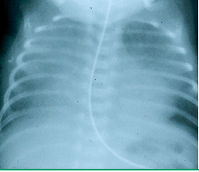
What findings on this CXR are suggestive of a PDA?
Increased Pulmonary vascular makings
Cardiomegaly
Uptodate.com

Slide 25
Treatment
Medical
Indomethacin is not effective in term infants
IE prophylaxis in repaired defect
Surgical
Hemodynamic ally significant PDA before PHT develops
IE even in small defects

Slide 26
CHF
Congestive heart failure (CHF) refers to a pathophysiologic state of systemic and pulmonary congestion resulting from inability of the heart to pump as much blood as required for the adequate metabolism of the body or does so at elevated pressure
Clinical picture of CHF results from a combination of “relatively low output” and compensatory responses to increase it

Slide 27
Pathophysiology
Reduced myocardial contractility
Increase haemodynamic burden
Heart failure

Slide 28
Systolic dysfunction
Diminished ventricular contractility > reduce SV > reduce CO
Causes
Anatomic stresses
Eg: Coarctation of Aorta > increase afterload (end systolic wall stress)
Neurohormonal factors
Increase systemic vascular resistance

Slide 29
Diastolic dysfunction
Decreased ventricular compliance > increase venous pressure (to maintain ventricular filling)
Causes
Anatomic obstruction
Eg: Pulmonary venous obstruction > prevent ventricular filling
Reduce ventricular compliance
In cardiomyopathy and transplant rejection
External constrain
Pericardial illusion
Poor haemodynamic after Fontan procedure
Increase pulmonary vascular resistance

Slide 30
Acute Heart Failure
Chronic Heart Failure
Neurohormonal mechanism (SNS + RAAS -> direct cardiotoxicity + necrosis)
Increase contactility
Peripheral vasoC
Salt + fluid retention
Cellular adaption
Energy starvation + loss of mitocondria
Cytotoxic mechanism > necrosis
Acceleration of apaptosis
Cardiac O2 demand > O2 supply
Increase HR
Increase Contratility
Increase wall stress
Myocytes dies
Fibroblast proliferation and collagen replacement
Cardiac dilatation
Increased afterload and wall tension
Further systolic dysfunction

Slide 31
Signs and Symptoms in INFANT
Left venous congestion
Right venous congestion
Tachypnoea (> 50)
Respiratory distress (retraction)
Grunting and difficulty with feeding
Diaphoresis during feeding (catecholamine surge)+ suck-rest-suck cycle
Cardiomegaly and gallop rhythm S3 gallop
Tachycardia (> 160bpm)
Hepatosplenomegaly
JVP – not reliable
Ascites / edema - less frequently
Most – FAILURE TO THRIVE
Lead to renal and hepatic failure

Slide 32
In OLDER CHILD
Left venous congestion
Right venous congestion
(>20) Tachypnoea
Respiratory distress
Wheezing (cardiac asthmma)
Hepatosplenomegaly
JVP distention
Edema / ascites / pleural effusion

Slide 33
Causes of CHF according to age gp
Day 1/fetal
Anemia . Metabolic
Arrhythmia- SVT . Myocarditis
1st -2nd week
Duct dependent heart disease . Large VSD,AVSD
1-2 month
VSD,PDA,AVSD
>2 yr
RF/RHD
CHD with operative CHD
Cardiomyopathy/tachy cardiomyopathies, mcomplications/postyocarditis
asphyxia
TGA with intact septum . Large PDA
Adrenal insufficiency . TAPVR W/O obstruction
ALCAPA
TGA with VSD without PS

Slide 34
Investigation
Hx + PE + BP (UL and LL)
FBC and Hb concentration
BNP
Anemia / infection
Distinguished CHF from primary respiratory process
>100 pg/mL (in adult and children)
Normal slightly high in neonates
Serum electrolyte, Blood sugar, S.calcium

Slide 35
ECG
Echo
Structural abnormalities
Coronary artery disease
Complete AV block
Arrhythmia
Indicated in child with unexplained CHF
Assess cardiac function – anatomic lesion

Slide 36
Chest xray of CHF
Cardiac silhouette is enlarged
Exception of CHF with normal chest xray in RESTRICTIVE CARDIOMYOPATHY, venous obstruction (TAPVR) , DIASTOLIC DYSFUNCTION)

Slide 37
Remember A B C D E

Slide 38
Management of CHF
Step1 : Acute decompensation :bed rest, propped up position, 0xygen, Na and if required volume restriction (infant not recommended)
Step2 : Start digoxin (not in myocarditis), asses and treat reversible causes, interventional procedures for CHD
Step 3 : Add ACE-I/ARB, switch to nitrate if ACE-1/ARB is not tolerated
Step4 : Add carvedilol in compensated HF

Slide 39
Continued
Step 5 : once or twice weekly dobutamine therapy, consider stem cell therapy
Step 6 : Cardiac transplantation, ventricular assisted device

Slide 40
THANK YOU..

