Slide 1
Azygos Venous System
BY MBBSPPT.COM

Slide 2
Azygos Venous System
Azygos is a term which means single that means without a companion.
This is a venous channel of anastomosis which connects the back of inferior vena cava with the back of superior vena cava.
Azygos, hemiazygos, and accessory hemiazygos veins together compose the azygos system.
These veins are located on the front of thoracic part of vertebral column.
These play a significant role in the venous drainage of the thorax.

Slide 3
Azygos Venous System
Right side Left side
Azygos vein 1. Hemiazygos (inferior hemiazygos)
2. Accessory hemiazygos (superior hemiazygos)

Slide 4
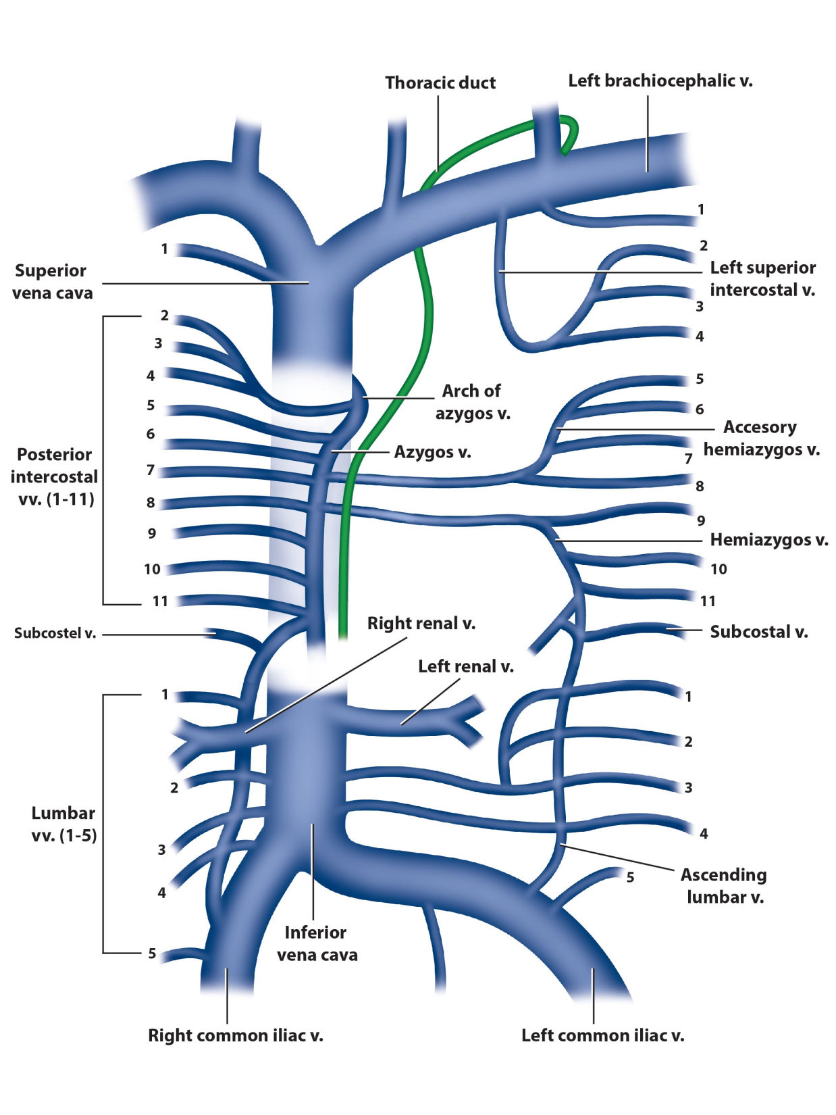

Slide 5
Azygos Venous System
Azygos vein – Formed by the union of the right lumbar vein and the right subcostal vein.
It enters the mediastinum via the aortic hiatus and drains into the superior vena cava.
Hemiazygos vein – Formed by the union of the left lumbar vein and left subcostal vein.
It enters the mediastinum through the left crus of the diaphragm, ascending on the left side. At the level of T8, it turns to the right and combines with the azygos vein.
Accessory hemiazygos vein – Formed by the union of the fourth to eighth intercostal veins. It drains into the azygos vein at T7.

Slide 7
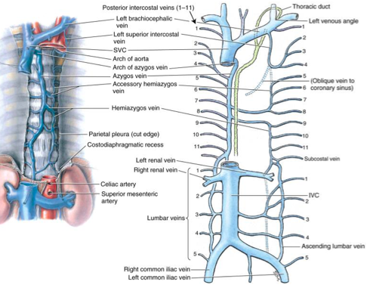

Slide 8
Azygos Vein
The azygos vein is present only on the right side in the upper part of the posterior abdominal wall and the posterior mediastinum.
It comprises of valves and might appear tortuous.
The functions of azygos vein are as follows:
It drains venous blood from the thoracic wall and upper lumbar region.
It creates an essential collateral channel attaching the superior vena cava and inferior vena cava.

Slide 9
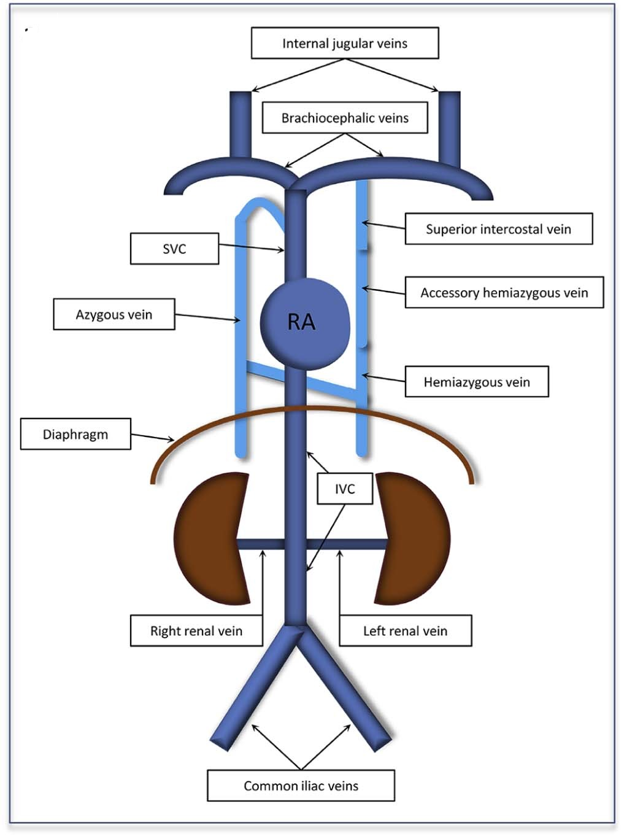
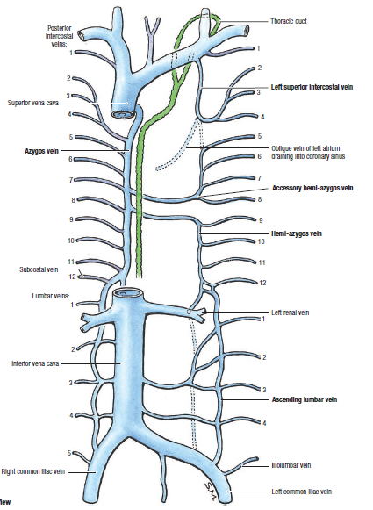

Slide 10
Azygos Vein
FORMATION:
The formation of azygos vein is variable.
It is created in one of the following ways:
Originates from the posterior aspect of the inferior vena cava (IVC) near the renal veins as a continuation of right subcostal vein.i.e. opposite L2.
This may be formed by the union of right subcostal and right ascending lumbar vein in the level of T12 vertebra (common).
Occasionally, it might originate from right renal or right ascending lumbar vein.

Slide 11
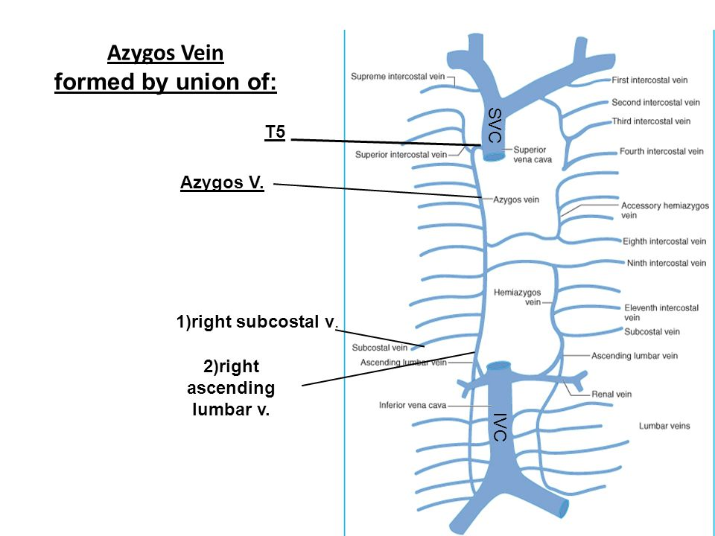

Slide 12
Course in Posterior Mediastinum
The azygos vein after formation ascends up and leaves the abdomen by going through the aortic opening of the diaphragm and enters the posterior mediastinum.
It rests upon the right side of the bodies of the lower 8 thoracic vertebrae(T12-T5) lying on the right side of descending thoracic aorta.
The azygos vein & the aorta are always separated from each other by cisterna chyle(below) and by thoracic duct(higher up).
It lies behind the right border of esophagus then behind the root of the right lung.

Slide 13
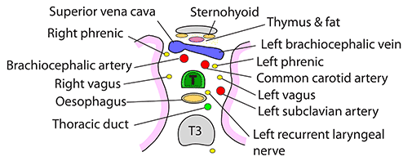

Slide 14
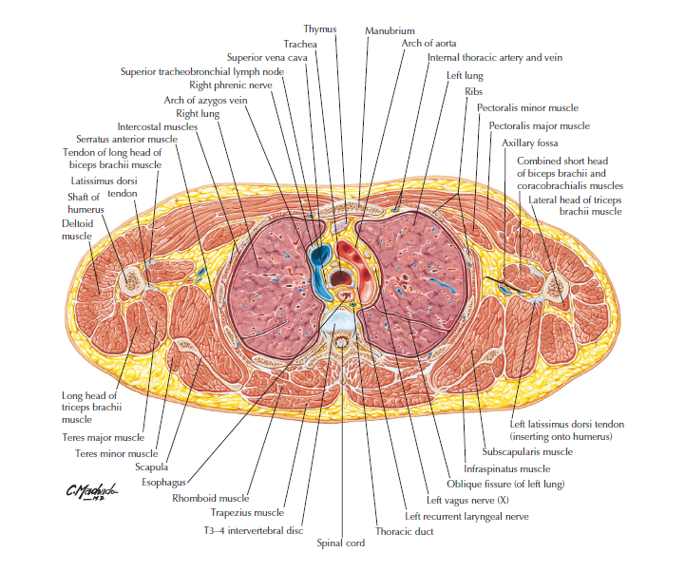

Slide 15
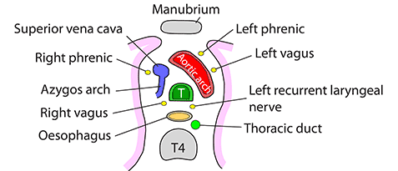

Slide 16
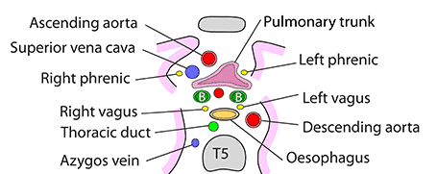

Slide 17
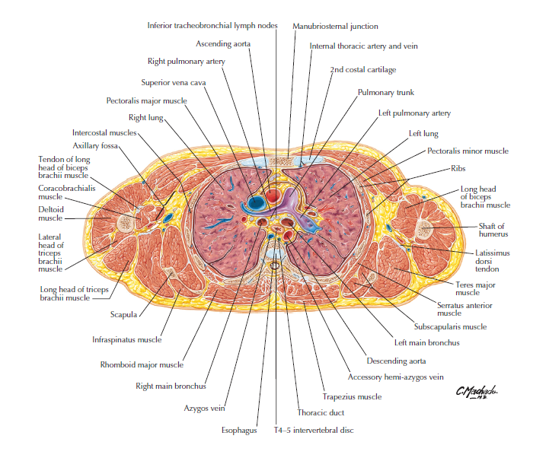

Slide 18
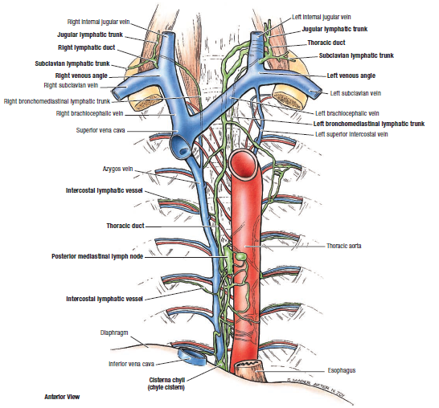

Slide 19
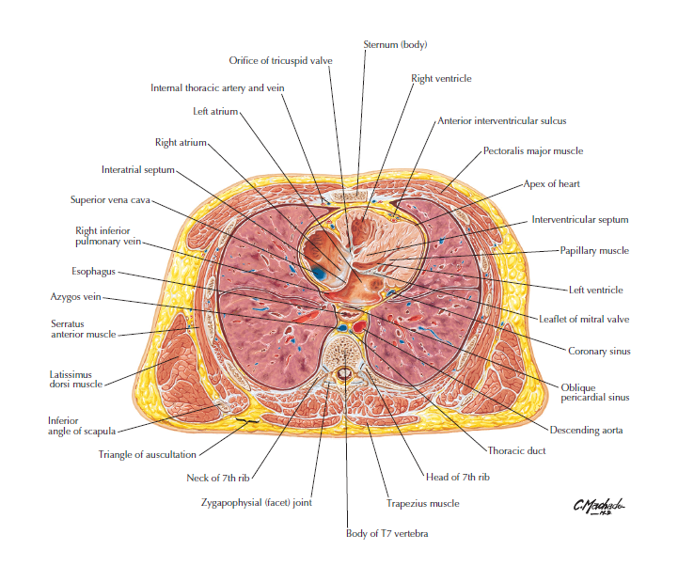

Slide 20
Course in Superior Mediastinum
There it ascends vertically being located in front of vertebral column up to the level of T4 vertebra, where it arches forwards above the hilum of the right lung to terminate in the superior vena cava in the level of the 2nd costal cartilage.
It crosses the right sides of 3 structures:
The esophagus
The trachea
The right vagus nerve

Slide 21
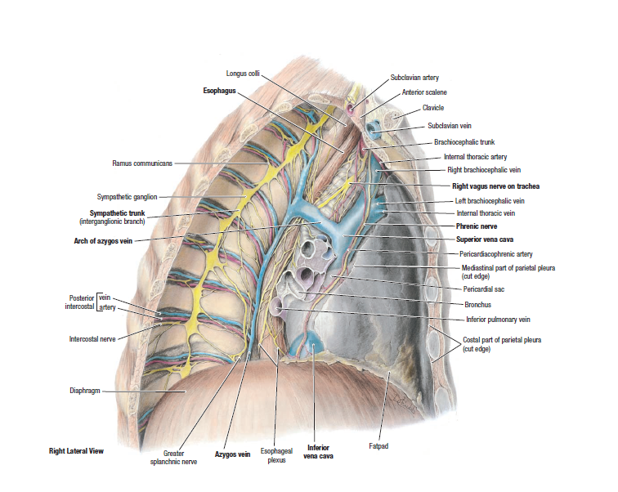

Slide 22
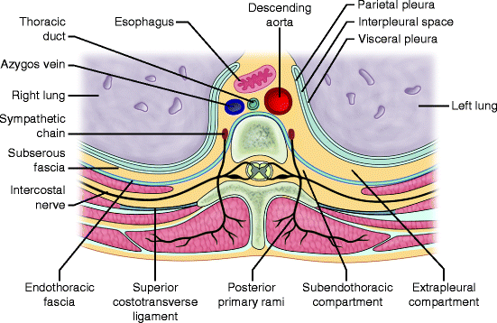

Slide 23
Azygos Vein
Anterior: | Esophagus (right edge).
Posterior: | Lower 8 thoracic vertebrae. Right posterior intercostal arteries.
To the right: | Right lung and pleura. Greater splanchnic nerves.
To the left: | Thoracic duct. Descending thoracic aorta. Esophagus (right border). The arch of azygos vein is related below to the root of right lung.

Slide 24
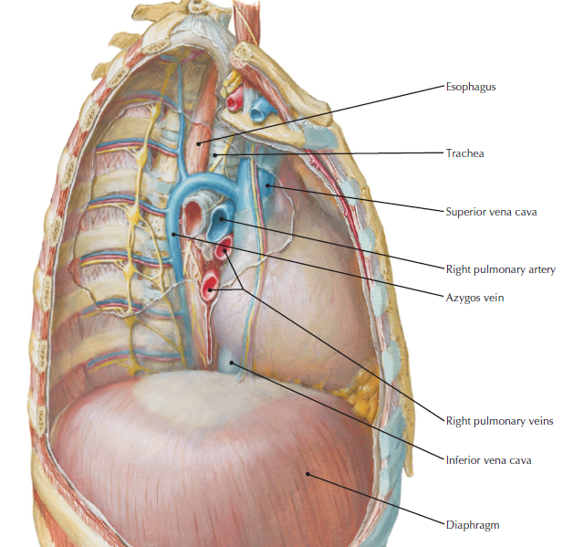

Slide 25
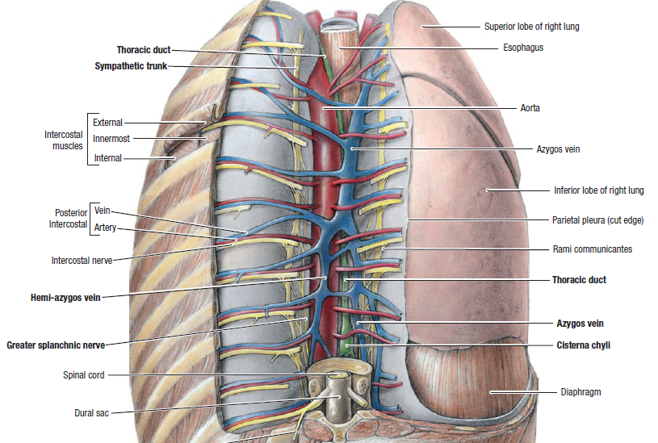

Slide 26
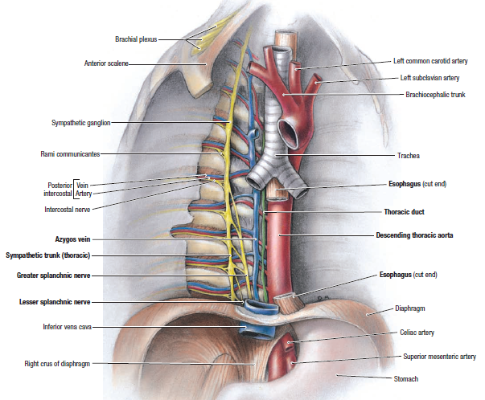

Slide 27
Tributaries
The tributaries of the azygos vein are as follows:
Right ascending lumbar vein.
Right subcostal vein.
Right posterior intercostal veins (from 5th to 11th)
Right superior intercostal vein (created by union of 2nd, 3rd, and 4th right posterior intercostal veins).
Hemiazygos vein (at the level of T7 or T8 vertebra).
Accessory hemiazygos vein (at the level of T8 or T9 vertebra).
Right bronchial vein.
Esophageal veins with the exception of those at its lower end.
Mediastinal veins.
Pericardial veins.

Slide 28
Hemiazygos Vein (or Inferior Hemiazygos Vein )
The hemiazygos vein (syn. inferior hemiazygos vein) is located on the left side only and corresponds to the lower part of the azygos vein (i.e., mirror image of the lower part of the azygos vein).
FORMATION
The hemiazygos vein created on the left, quite similar to the azygos vein, by the union of left ascending lumbar vein and left subcostal vein. It might originate from the posterior surface of the left renal vein.

Slide 29
Hemiazygos Vein
COURSE AND TERMINATION
It pierces the left crus of the diaphragm and ascends vertically in front of the left side of the vertebral column up to the level of T8 vertebra.
At T8 vertebra it turns to the right and crosses in front of the vertebral column posterior to the aorta, esophagus and thoracic duct to terminate in the azygos vein.

Slide 30
Hemiazygos Vein
TRIBUTARIES
The tributaries of the hemiazygos veins are as follows:
Lower 3 (9th-11th) left posterior intercostal veins.
Left subcostal vein.
Left ascending lumbar vein.
Small esophageal and mediastinal veins.

Slide 31
Accessory Hemiazygos Vein (or Superior Hemiazygos Vein)
The accessory hemiazygos vein (syn. superior hemiazygos vein) is located on the left side only and corresponds to the upper part of the azygos vein (i.e., mirror image of the upper part of the azygos vein).

Slide 32
Accessory Hemiazygos Vein
COURSE AND TERMINATION
The accessory hemiazygos vein begins at the medial end of left 4th or 5th intercostal space and descends to the left side of the vertebral column.
At the level of T8 vertebra, it turns to the right enters in front of the vertebral column posterior to the aorta, esophagus and thoracic duct to terminate in the azygos vein.
Sometimes the terminal parts of hemiazygos and accessory hemiazygos veins join together to create a common trunk which crosses across the vertebral column to open into the azygos vein.

Slide 33
Accessory Hemiazygos Vein
TRIBUTARIES
The following are the tributaries of accessory hemiazygos vein:
Fifth to eighth (5th-8th) left posterior intercostal veins.
Left bronchial veins (sometimes).

Slide 34
The posterior Intercostal Veins
On the right side | On the left side
The 1st vein ends in right brachiocephalic vein | The upper 4 end in the left brachiocephalic vein
All the remaining veins end in the azygos vein | The middle 4 veins unite to form the superior (accessory) hemiazygos vein.
 | The lower 4 veins end in the (Inferior) hemiazygos vein

Slide 35
Clinical Significance
In case of obstruction of SVC, it acts as the main collateral channel to shunt the blood from the upper half of the body to IVC.

Slide 36
Thank You!

