Slide 1
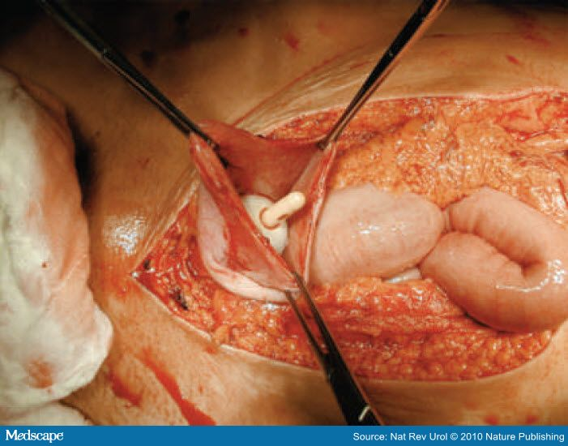
BLADDER TRAUMA

Slide 2
INTRODUCTION
The urinary bladder occupies the deep pelvic cavity and is well protected.
Because the bladder is located within the bony structures of the pelvis, it is protected from most external forces. This is the reason it is rarely traumatized.
However it can suffer traumas which can cause extraperitoneal and intraperitoneal ruptures

Slide 3
DEFINITION
It is the injury to the urinary bladder caused by either blunt or penetrating accidents.
The probability of bladder injury varies according to the degree of bladder distention; therefore, a full bladder is more likely to become injured than an empty one.

Slide 4
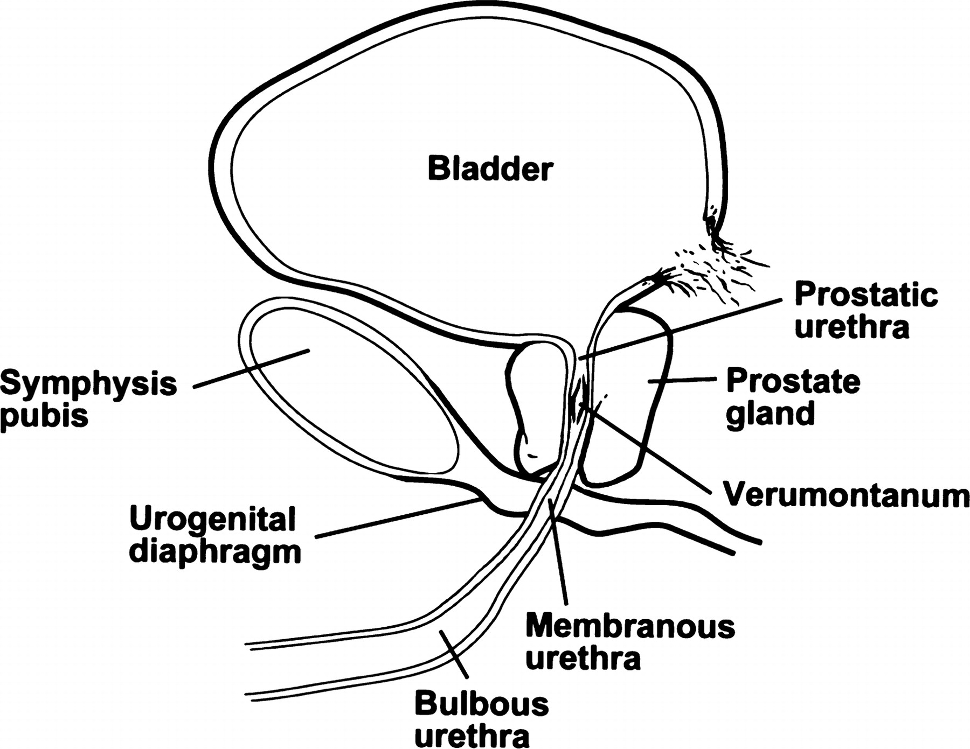
INCIDENCE
60 - 85% - Blunt injuries
15 - 40% - Penetrating injury
10 - 29% - Pelvic fractures
0.3% - Caesarean section
30% - Bladder biopsy

Slide 5
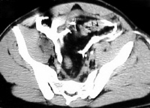
ETIOLOGY
Penetrating and blunt trauma (main causes of bladder injury) during accidents.
Iatrogenic causes include surgical misadventures from gynecologic, urologic, and orthopedic operations near the urinary bladder.
Spontaneous or idiopathic bladder injuries without an obvious underlying pathology constitute the remainder.

Slide 6
Contd…
Other causes include:
Surgeries of the pelvis or groin (including hernia repair and abdominal hysterectomy)
Tears, cuts, bruises, and other injuries to the urethra (most common in men)
Straddle injuries (direct force accidents that injure the scrotum area between a man's legs)
Deceleration injury (for example, a motor vehicle accident that occurs with a full bladder while wearing seatbelt)

Slide 7
TYPES OF BLADDER TRAUMA

Slide 8
Blunt Trauma
The most common mechanisms of blunt trauma are road traffic accidents (87%), falls (7%), and assaults (6%).
Deceleration injuries usually produce both bladder trauma (perforation) and pelvic fractures.
Approximately 10% of patients with pelvic fractures also have significant bladder injuries.

Slide 9
Contd…
The likelihood of the bladder to sustain injury is related to its degree of distention at the time of trauma.
Injury may occur if there is a blow to the pelvis that is severe enough to break the bones and cause bone fragments to penetrate the bladder wall.
Generally the bladder injury in these cases is associated with other injuries as well, the commonest being to the spleen and rectum.

Slide 10
Penetrating trauma
The most common cause of penetrating trauma is gunshot wounds (85%), followed by stabbings (15%).
It is also associated with abdominal and/or pelvic organ injuries.
Combined penetrating trauma of the rectum and urinary bladder is rare.
The combination of penetrating trauma to both rectum and the urinary system is associated with high morbidity and mortality.

Slide 11
Obstetric trauma
During prolonged labor or a difficult forceps delivery, persistent pressure from the fetal head against the mother's pubis can lead to bladder necrosis.
Direct laceration of the urinary bladder is reported in 0.3% of women undergoing a Caesarean delivery.
Previous Caesarean deliveries, and the adhesions that can remain subsequently, are a risk factor.

Slide 12
Gynecological trauma
Bladder injury may occur during a vaginal or abdominal hysterectomy.
Blind dissection in the incorrect tissue plane between the base of the bladder and the cervical fascia results in bladder injury.

Slide 13
Urologic trauma
Perforation of the bladder during a bladder biopsy, cystolitholapaxy, transurethral resection of the prostate (TURP), or transurethral resection of a bladder tumor (TURBT) is common.
Incidence of bladder perforation is reportedly as high as 36% following bladder biopsy.

Slide 14
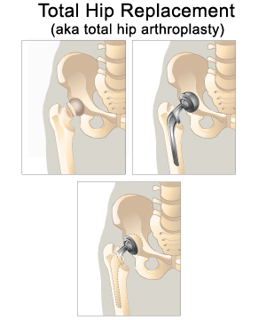
Orthopedic trauma
Orthopedic pins and screws can commonly perforate the urinary bladder, particularly during internal fixation of pelvic fractures.
Thermal injuries to the bladder wall may occur during the setting of cement substances used to seat arthroplasty prosthetics.

Slide 15
Idiopathic bladder trauma
Alcoholics and those individuals who chronically drink large quantities of fluids are susceptible to this type of injury (bladder over distension )
Person who holds urine for long time during over distension.

Slide 16
Classification
Type I injuries are partial tears of the mucosa. This is the most common injury pattern of multisystem trauma patients and is associated with blunt trauma.
Type II or intraperitoneal bladder ruptures. This is usually the result of a direct blow to the distended organ.

Slide 17
Contd…
Type III or interstitial pattern. This is an intramural or partial-thickness laceration of the intact serosa. CT cystography is used to diagnose this. Intramural contrast is shown within the bladder wall. This condition is usually the result of blunt trauma.
Type IV bladder injury is extraperitoneal. It is the most common bladder rupture. It is subdivided into simple and complex injuries.

Slide 18
PATHOPHYSIOLOGY
Extraperitoneal bladder ruptures
Traumatic extraperitoneal ruptures are usually associated with pelvic fractures (89%-100%). The bladder rupture is most often due to a direct burst injury or the shearing force of the deforming pelvic ring.
These ruptures are usually associated with fractures of the anterior pubic arch, and they may occur from a direct laceration of the bladder by the bony fragments of the osseous pelvis.

Slide 19
Contd…
The anterolateral aspect of the bladder is typically perforated by bony spicules. Forceful disruption of the bony pelvis tear the wall of the bladder.
The degree of bladder injury is directly related to the severity of the fracture.
The classic cystographic finding is contrast extravasation around the base of the bladder confined to the perivesical space

Slide 21
Contd…
With a more complex injury, the contrast material extends to the thigh, penis, perineum, or into the anterior abdominal wall.
The bladder may assume a teardrop shape from compression by a pelvic hematoma.

Slide 22
Intraperitoneal injury
Classic intraperitoneal bladder ruptures are described as large horizontal tears in the dome of the bladder. The dome is the least supported area and the only portion of the adult bladder covered by peritoneum.
The mechanism of injury is a sudden large increase in intravesical pressure in a full bladder.

Slide 23
Contd…
When full, the bladder's muscle fibers are widely separated and the entire bladder wall is relatively thin, offering relatively little resistance to perforation from sudden large changes in intra vesical pressure.
Intraperitoneal bladder rupture occurs as the result of a direct blow to a distended urinary bladder.

Slide 24
Contd…
This type of injury is common among patients diagnosed with alcoholism or those sustaining a seatbelt or steering wheel injury.
Since urine may continue to drain into the abdomen, intraperitoneal ruptures may go undiagnosed from days to weeks.

Slide 25
Contd…
Electrolyte abnormalities (e.g., hyperkalemia , hypernatremia, uremia, acidosis) may occur as urine is reabsorbed from the peritoneal cavity.
Such patients may appear anuric, and the diagnosis is established when urinary ascites are recovered during paracentesis.

Slide 26
Contd…
Intraperitoneal ruptures demonstrate contrast extravasation into the peritoneal cavity, often outlining loops of bowel and pooling under the diaphragm.
An intraperitoneal rupture is more common in children because of the relative intra-abdominal position of the bladder. The bladder usually descends into the pelvis by age 20 years.

Slide 28
CLINICAL MANIFESTATIONS
Clinical signs of bladder injury are relatively nonspecific; however, a triad of symptoms are often present:
GROSS HEMATURIA
SUPRAPUBIC PAIN OR TENDERNESS
DIFFICULTY OR INABILITY TO VOID

Slide 29
Contd…
Hematuria invariably accompanies all bladder injuries. Gross hematuria is the hallmark of a bladder rupture.
More than 98% of bladder ruptures are associated with gross hematuria, and 10% are associated with microscopic hematuria.

Slide 30
Contd…
An abdominal examination may reveal distention, guarding, or rebound tenderness.
Absent bowel sounds and signs of peritoneal irritation indicate a possible intraperitoneal bladder rupture.
A rectal examination should be performed to exclude rectal injury.

Slide 31
Contd…
Shock or hemorrhage (the symptoms include)
Increased heart rate
Pale skin
Sweating
Skin cool to touch
Drowsiness
Lethargy
Decreased alertness
Coma

Slide 32
Diagnostic tests
History of trauma
Gross hematuria
Suprapubic pain
Difficulty to void
Abdominal tenderness
Foley’s catheter
CT scanning
Cystography

Slide 33
CT Scan
It is often the first test performed in patients with blunt abdominal trauma.
The CT scan of the pelvis provides information on the status of the pelvic organs and bony pelvis .
It most sensitive test for bladder perforation

Slide 34
MANAGEMENT
The European Association of Urology (EAU) developed guidelines for the appropriate management of genito-urinary trauma.
In suspected renal injuries the hemodynamic situation of the patient is the benchmark for the diagnostic and therapeutic algorithm.

Slide 35
Contd…
Most extraperitoneal ruptures can be managed safely with simple catheter drainage (ie, urethral or Suprapubic). Leave the catheter in for 7-10 days and then obtain a cystogram.
All extraperitoneal bladder injuries heal within 3 weeks

Slide 36
Surgical Management
Intraperitoneal bladder rupture
Most require surgical exploration, as they do not heal with catheterization alone. Urine continues to leak into the abdominal cavity, resulting in urinary ascites, abdominal distention, and electrolyte disturbances.
All wounds should be explored and should be surgically repaired.

Slide 37
Contd…
Extraperitoneal extravasation
Bladders with extensive extraperitoneal extravasation are often repaired surgically.
Early surgical intervention in these cases decreases the length of hospitalization and potential complications. It also promotes early recovery.

Slide 38
Complications
Hemorrhage
Pelvic infection
Peritonitis
Urge incontinence
Urinary extravasation
Wound dehiscence
Obstructive uropathy

Slide 39
Follow-up
The patient should return in 7-10 days for staple removal and wound check.
The X-ray cystogram should be done 10-14 days after surgery.
If the cystogram finding is normal, the urethral catheter can be removed.
Advise the patient that they may return to normal activity 4-6 weeks after surgery.

Slide 40
Nursing Management
Nursing Assessment
Nursing Diagnosis

Slide 41
Nursing Diagnosis
Hypovolemia related to gross hemorrhage.
High risk for infection related to extravasation of urine and open wounds.
Acute pain related to injury of the bladder.
Fluid and electrolyte imbalance related to hemorrhage.
Anemia related to gross hematuria.

Slide 42
Thanks

