Slide 1
Blood, Blood Products & Blood Transfusion
BY MBBSPPT.COM

Slide 2
Blood
Blood is the connective tissue consisting of plasma and cellular component.

Slide 3
Blood Components

Slide 4
Functions of Blood

Slide 5
Blood Products

Slide 6
Blood Products
Whole blood

Slide 7
Blood Products
Whole Blood
Whole blood transfusion has significant advantages over packed cells as:
It is coagulation factor rich
If fresh, more metabolically active than stored blood.

Slide 8
Blood Products
Packed RBC:
Platelets and plasma are removed
I unit 330 ml contains 50 – 70 % hematocrit
Rate of transfusion 3ml/kg
Stored in SAG-M (Saline, Adenosine, Glu, Mannitol)

Slide 9
Blood Products
Packed RBC:
Indications
Trauma – acute blood loss > 20%
Symptomatic anemia without clotting factor defects
Leucoreduced RBC

Slide 10
Peri OP Blood Transfusion

Slide 11
Blood Products
Platelets:
1) Random donor units – 55 x 10 9 platelets / unit
2) Apheresis units – 250 x 10 9 platelets / unit
20- 24◦C, 5 days
Should be infused 30 Min

Slide 12
Blood Products
Indications:
BLEEDING due to thrombocytopenia
Due to platelet dysfunction
Pts on clopidogrel who are actively bleeding
Prevention of spontaneous bleeding with counts < 20,000

Slide 13
Blood Products
Fresh Frozen Plasma:
Plasma collected from single donor units or by apheresis
Frozen within 8 hours of collection
Contains labile & nonlabile clotting factors, albumin and immunoglobulin. Factor VIII ( 8 ) level at least 70 % of normal fresh plasma level
-40o C to -50 C, 2yrs
10 – 15ml/hr, must be ABO compatible

Slide 14
Blood Products
Fresh Frozen Plasma:
Indications:
Single clotting factor deficiency
Multiple coagulation factor deficiencies:
DIC
Liver Disease
Warfarin Overdose
TTP

Slide 15
Blood Products
Cryoprecipitate:
Supernatant precipitate of FFP
Rich in factor VIII and fibrinogen
Stored at −30°C , 2yrs
Indications:
1st choice for DIC
Given in hypofibrinoginemia or factor VIII def

Slide 16
Blood Products
Prothrombin complex Concentrates:
Highly purified concentrates prepared from pooled plasma.
Contain factors II, IX and X. Factor VII may be included
Indications:
Indicated for the emergency reversal of anticoagulant (warfarin)

Slide 17
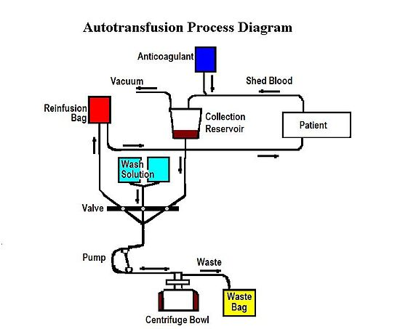
Blood Products
Autologous Transfusion:
2 Types

Slide 18
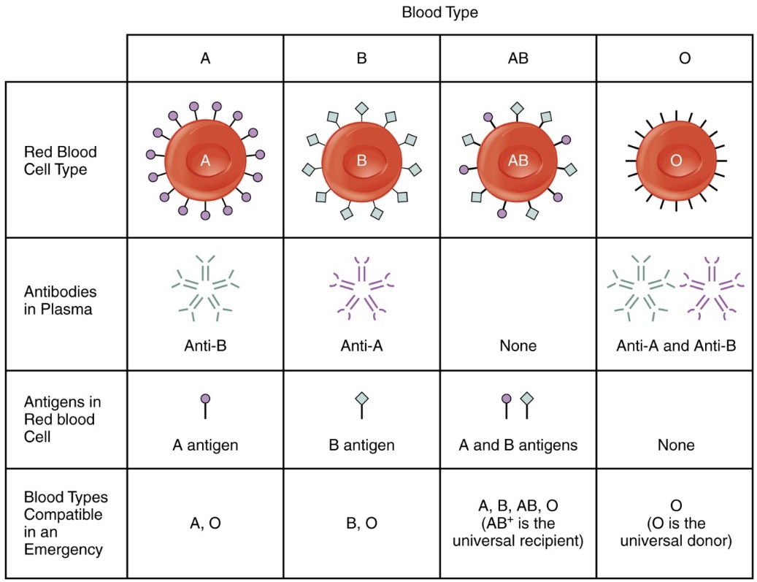
Blood Groups

Slide 19
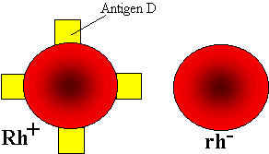
Rh System
Rh(D) antigen is strongly antigenic and is present in approximately 85 per cent of the population

Slide 20
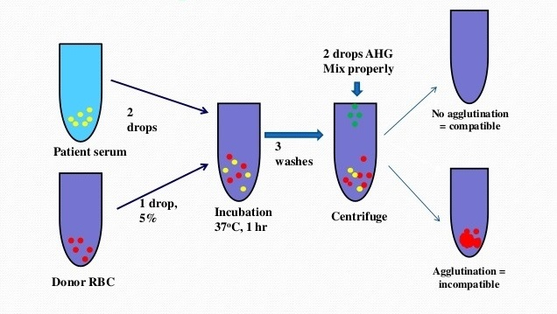
Cross Matching

Slide 21
Cross Matching
Full cross matching 45 min
Emergency cross matching takes 15min checks only ABO/rh compatibility

Slide 22
Complications
Two categories:
Infectious Complications
Non-infectious Complications

Slide 23
Infectious Complications
Bacterial Contamination:
Mostly occurs with platelet components
At time of collection either from the donor or the venipuncture site, during component preparation
Usually by staph, pseudomonas, E.Coli, yersinia
Symptoms: Rapid onset
Fever, hypotension, chills, muscle pain
Vomiting, abdominal cramps, bloody diarrhea, hemoglobinuria, shock, renal failure, & DIC.

Slide 24
Infectious Complications
Bacterial Contamination:
Transfusion must be stopped immediately
Gram stain & blood cultures should be done on the unit, patient and all infusion sets .
Broad-spectrum antibiotics should be given immediately intravenously
Viral:
HIV and HCV → 1 transmission/2 million transfusion

Slide 25
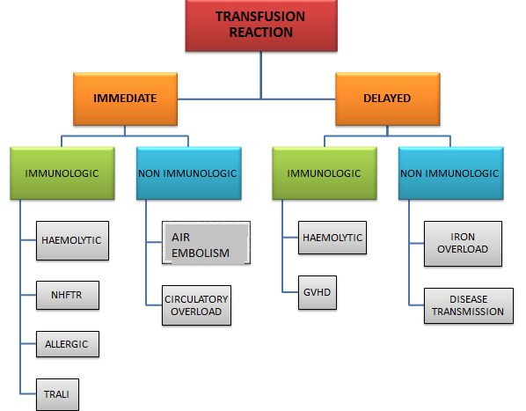
Complications
Noninfectious Complications

Slide 26
Complications
IMMEDAITE IMMUNOLOGIC
Acute Hemolytic Transfusion Reactions (AHTR):
Occurs when incompatible RBC’s are transfused into a recipient who has pre-formed antibodies (usually ABO or Rh)
Causes intravascular hemolysis
Symptoms occur within minutes

Slide 27
Immediate Immunologic
Acute Hemolytic Transfusion Reactions (AHTR):
Signs & symptoms:
High fever/chills
Hypotension
Abdominal pain
Oliguria
Dyspnea
Dark urine
Pallor

Slide 28
Immediate Immunologic
Acute Hemolytic Transfusion Reactions (AHTR):
Treatment/Prevention
Stop transfusion
Supportive care to maintain renal function
Goal of urine output 100 mL/hr. in adults for at least 18-24 hours

Slide 29
Immediate Immunologic
Nonhemolytic Febrile Transfusion Reactions (NFHTR):
Definition: Rise in patient temperature >1°C (associated with transfusion without other fever precipitating factors)
1% of PRBC transfusions , 20% of Plt transfusions
Stop transfusion
Use of Antipyretics
Leukoreduced blood component

Slide 30
Immediate Immunologic
Allergic Nonhemolytic Transfusion Reactions:
May be due to plasma proteins or blood preservative/anticoagulant
Presents with urticaria and wheezing
Treatment:
Mild reactions—Can be continued
Severe reactions—Must STOP transfusion and may require steroids or epinephrine
Prevention: Premedication (Antihistamines)

Slide 31
Immediate Immunologic
TRALI (Transfusion Related Acute Lung Injury)
Leukocyte Antibody Bioactive Lipids
↑ Pulmonary Microvascular Permeability
Pulmonary Edema

Slide 32
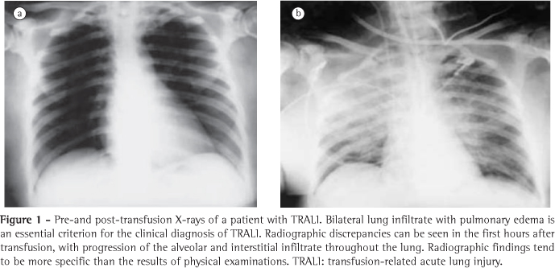
Immediate Immunologic
TRALI (Transfusion Related Acute Lung Injury)

Slide 33
Immediate Immunologic
Clinical syndrome similar to ARDS
Occurs 1-6 hours after receiving plasma-containing blood products
Treatment
Respiratory support
No role for treatment with steroids or diuretics

Slide 34
Immediate Nonimmunologic
Air Embolus:
Air infusion via line
Cough, dyspnea, chest pain, shock
If suspected:
Pt. placed on left side with head down
Displace air bubble from pulmonary valve

Slide 35
Immediate Nonimmunologic
Circulatory overload:
Acute pulmonary edema due to volume overload
Signs/Symptoms
Dyspnea, cyanosis, orthopnea, severe Headache, HTN, CHF
Prevention: Slow TX.
Treatment: Stop infusion

Slide 36
Immediate Nonimmunologic
Hypothermia
Hypocalcemia

Slide 37
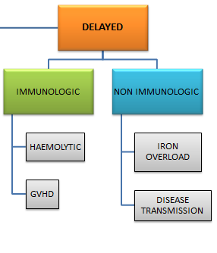
Delayed Immunologic
Delayed Hemolytic Transfusion reaction:
Antibodies that usually do NOT activate Complements : Rh, Kell, etc.
Associated with
Extravascular Hemolysis
Fever
Anemia
Mild Jaundice, Bilirubinuria

Slide 38
Delayed Immunologic
Graft vs Host Disease:
Results from engraftment of donor lymphocytes of an immuno competent donor into an immuno compromised host 2-30 days after transfusion
Symptoms: Diarrhea, skin rash, pancytopenia
Usually Fatal: No Treatment
Prevention: Irradiation of donor cells (Render T-cells incapable of replication)

Slide 39
Delayed Immunologic
Post Transfusion Purpura:
Antibodies to platelet antigens (HP1a ) causes abrupt onset of severe thrombocytopenia (platelet count <10,000/μl) 5-10 days following transfusion.
Signs: Purpura, bleeding, fall in platelet count
Treatment:
Usually self-limited, recovery within 21 days
Plasmapheresis or corticosteroids

Slide 40
Delayed Non-Immunologic
Iron Overload:
Etiology: Each unit of PRBC → 200-225 mg of Fe
Excess iron resulting from chronically transfused patients such as hemoglobinopathies, chronic renal failure
Signs: Muscle weakness, fatigue, weight loss, mild jaundice, anemia
Treatment: deferoxamine - an iron chelating agent

Slide 41
THANKS!

