Slide 1
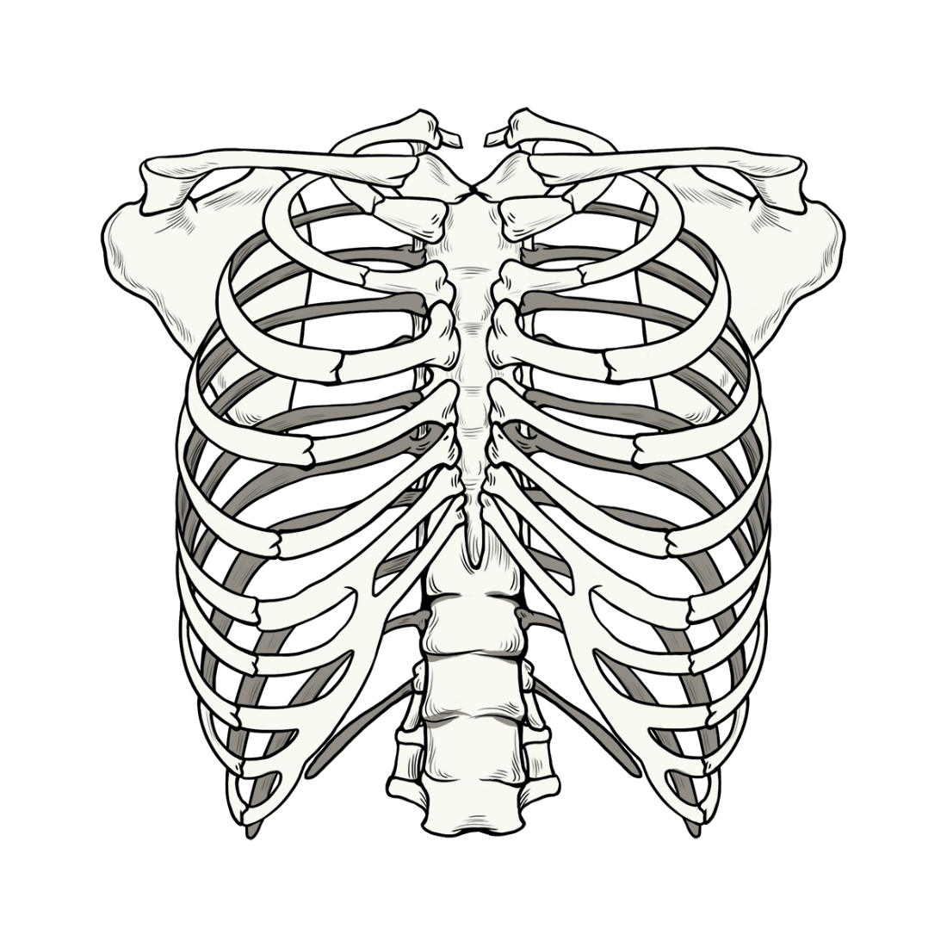
BONES OF THORAX

Slide 2
Thoracic Cage
Thoracic Cage is a skeletal framework which supports the thorax.
Muscles of thorax, upper extremities, back and diaphragm are given connection by this cage.
It’s nature is osseocartilaginous and elastic.
It has a significant role play for raising or reducing the intrathoracic pressure to ensure mechanism of respiration.
The thoracic vertebrae, ribs, costal cartilages, and sternum form the thoracic cage.
It gives protection for the internal organs of the thoracic cavity and supports the superior trunk, pectoral girdle, and upper limbs.

Slide 3
Bony Boundaries of the Thorax
Sternum
Manubrium (1)
Sternal angle (2)
Body (3)
Xiphoid process (4)
12 pairs of ribs
6 or 7 pairs of true ribs (5)
3 or 4 pairs of false ribs (6)
2 pairs of floating ribs (7)
Thoracic inlet (superiorly) (8)
Thoracic outlet (inferiorly) (9)
Thoracic vertebrae (posteriorly)

Slide 4
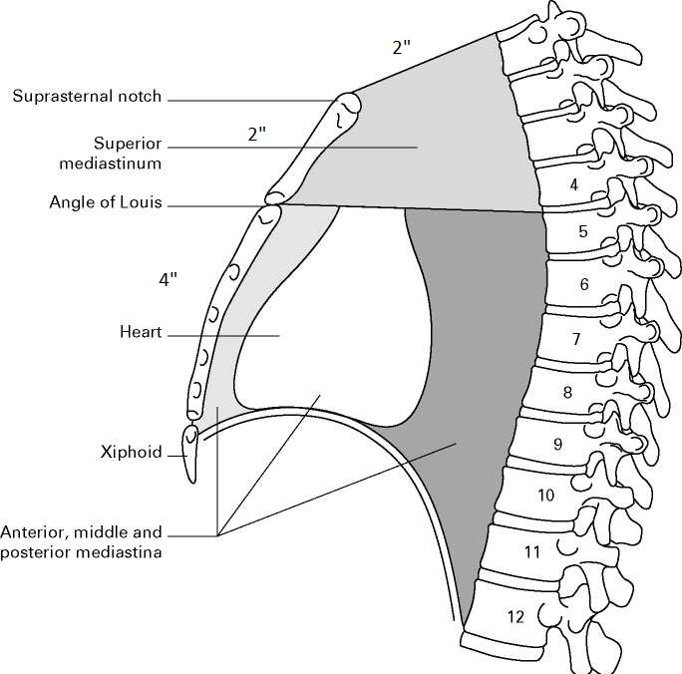
The body of sternum is 4”.
The body is formed of 4 sternebrae.
The body of sternum lies opposite 4 thoracic vertebrae(T5,6,7,8)

Slide 5
Thoracic Cavity
In cross section, it is kidney shaped.
It has the anterior, posterior and lateral boundaries.
The thoracic wall is made up of the sternum, ribs plus three layers of intercostal muscles, diaphragm and the intercostal vessels and nerves.

Slide 6
Sternum
The Sternum or Breast Bone is a long flat bone, which is enlarged about 7 cm long. It is located in the anterior median part of the chest wall.
The shape of the sternum somewhat resembles to a small sword or a dagger.
Sternum comprises of 3 parts, namely –
Manubrium
Body
Xiphoid.

Slide 7
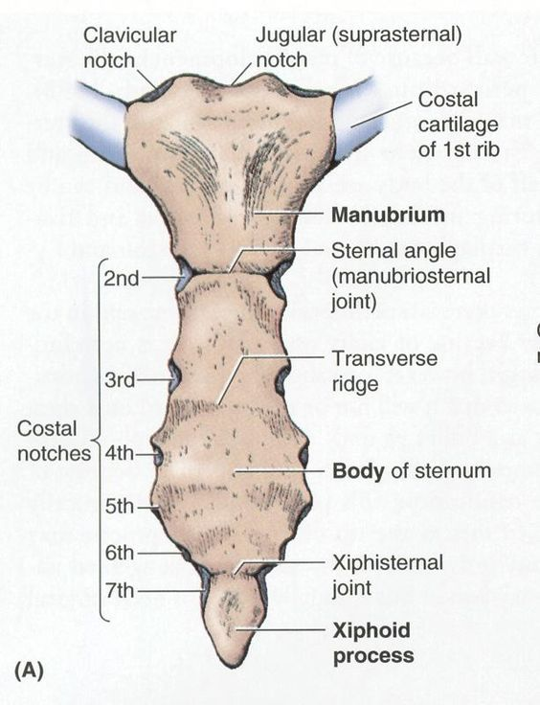

Slide 8
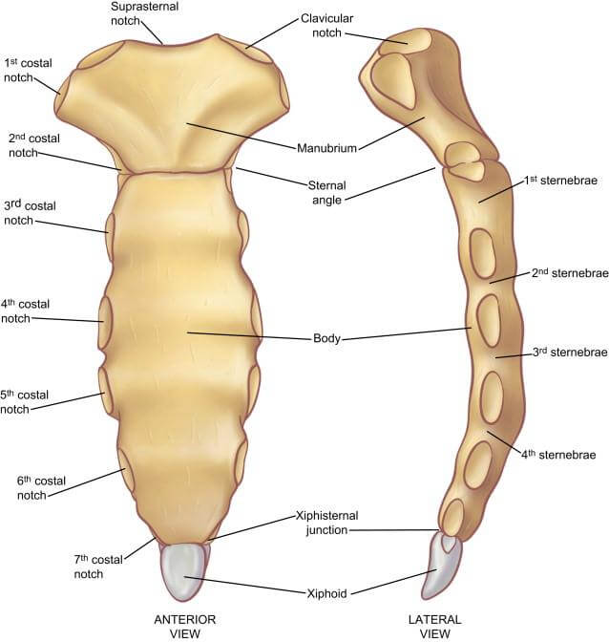

Slide 9
Parts of The Sternum
The sternum is composed of the following 3 parts:
Upper part:
Manubrium sterni / episternum
Middle part:
The body / mesosternum
Lower part:
The xiphoid process / metasternum

Slide 10
Anatomical Position of Sternum
In anatomical position, the sternum as a whole is pointed downwards and inclined somewhat forward with it’s rough convex surface facing anteriorly.
It is broad end is directed upwards and lower pointed end is directed downwards.

Slide 11
The Sternum
The upper part of sternum is broad and thick, on the other hand its lower part is thin and pointed.
Its anterior surface is somewhat rough and convex, while its posterior surface is smooth and somewhat concave.

Slide 12
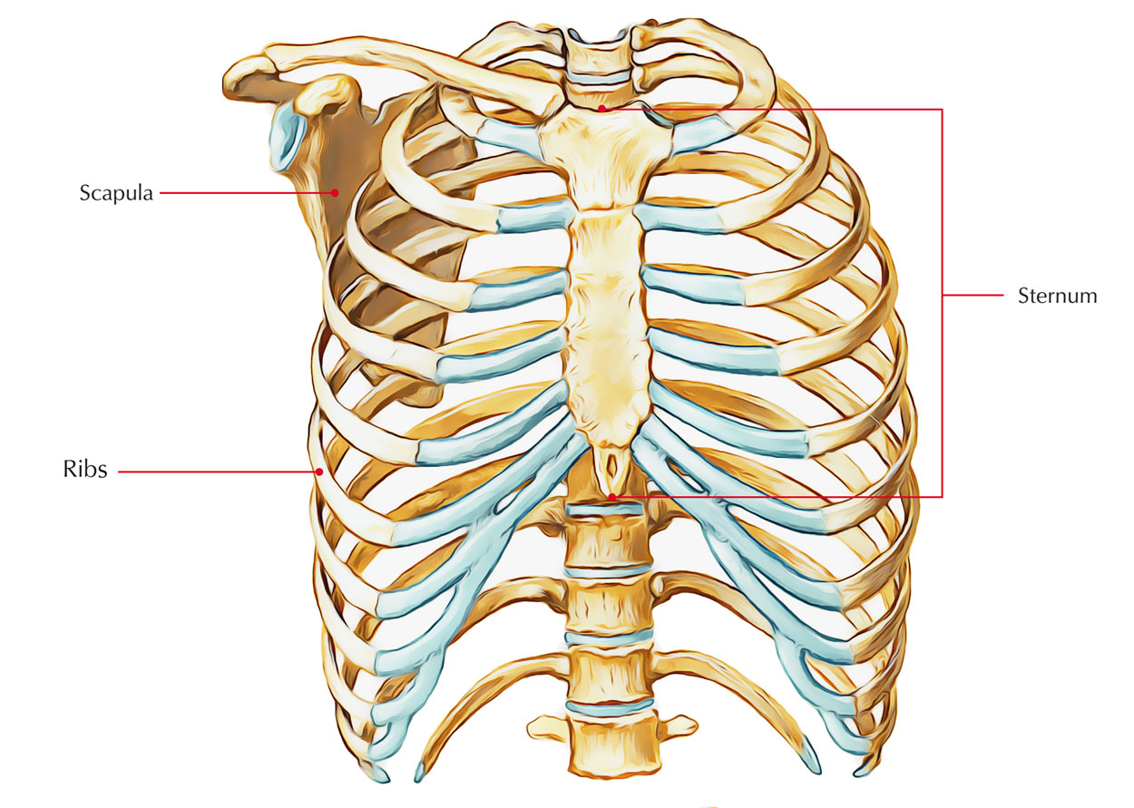

Slide 13
Manubrium Sterni
It is located opposite to the 3rd and fourth thoracic vertebrae.
It is the thickest and most powerful part of the sternum.
The Manubrium of sternum is almost quadrilateral in shape.

Slide 14
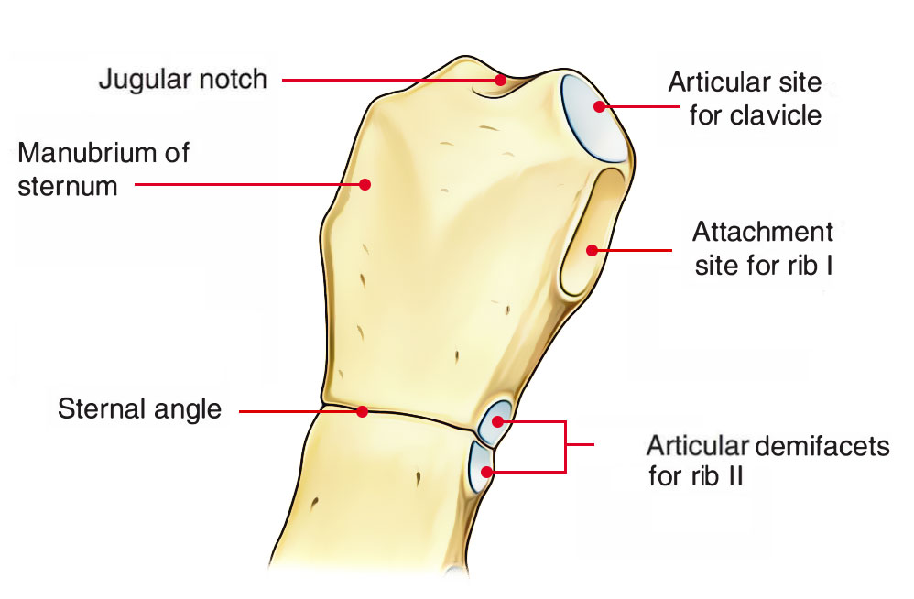

Slide 15
The Manubrium
Lower border articulates with all the upper end of the body of sternum to create secondary cartilaginous joint named manubriosternal joint.
The manubrium makes a little angle with all the body at this junction referred to as sternal angle or angle of Louis.
It is recognized by the presence of a transverse ridge on the anterior aspect of the sternum.

Slide 16
The Manubrium
It is the thickest and most powerful part of the sternum and presents
Two surfaces:
Anterior
Posterior
Four borders:
Superior (thick, forms suprasternal notch)
Inferior (forms manubriosternal angle/joint)
Lateral (left and right).

Slide 17
Manubrium
Anterior surface on every side gives connection to the sternal head of sternocleidomastoid and pectoralis major muscles.
On every side, it gives connection to 2 muscles: Sternohyoid at the level of clavicular notch, and Sternothyroid at the level of facet for 1st costal cartilage
Posterior surface is smooth and creates anterior boundary of
with arch of aorta.
Upper half is associated with three branches of the arch of aorta, viz. brachiocephalic artery, left common carotid artery, left subclavian artery, and left brachiocephalic vein

Slide 18
Manubrium
Upper border is thick, rounded, and concave. It presents a notch termed suprasternal notch or jugular notch and gives connection to the interclavicular ligament. Clavicular notch on each side of suprasternal notch articulates with the clavicle to create sternoclavicular joint.
Lateral border presents 2 articular facets:
Upper facet articulates with the 1st costal cartilage to create primary cartilaginous joint.
Lower demifacet together with other demifacet in the body of sternum articulates with the 2nd costal cartilage.
Lower border articulates with all the upper end of the body of sternum to create secondary cartilaginous joint named manubriosternal joint. The manubrium makes a little angle with the body at this junction referred to as sternal angle or angle of Louis.
It is recognized by the presence of a transverse ridge on the anterior aspect of the sternum.

Slide 19
Sternal Angle
Can be felt as a transverse ridge on the sternum about 5 cm below the suprasternal notch.
Anatomical events at sternal angle:
Second costal cartilage articulates, on each side, with the sternum at this level, therefore this level is utilized for counting the ribs.
It is located at the level of intervertebral disc between T4 and T5 vertebrae.
Horizontal plane going through this level divides superior mediastinu from inferior mediastinum.
Ascending aorta finishes at this level.
Arch of aorta starts and finishes at this level.
Descending aorta starts at this level.
Trachea bifurcates into left and right main bronchi at this level.
Pulmonary trunk splits into left and right pulmonary arteries at this level.
Upper border of heart is located at this level.
Azygos vein arches over the root of right lung to finish in the superior vena cava.

Slide 20
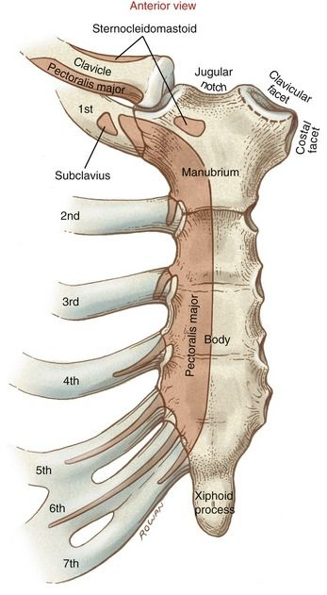
The body

Slide 21
Body of the sternum lies opposite T5,6,7,8 and part of T9
It is longer, narrower, and thinner compared to the manubrium and is widest at its lower end.
Its upper end articulates with the manubrium in the sternal angle to create manubrio sternal joint and lower end articulates with the xiphoid process to create primary cartilaginous xiphisternal joint.
Its anterior surface presents 3 dim transverse ridges signaling the lines of fusion of 4 small sternebrae.
The anterior surface on every side gives origin to the pectoralis major muscle.
Its posterior surface is smooth and somewhat concave.

Slide 22
Body of the sternum
Lower part of posterior surface gives origin to sternocostalis muscle.
On the right side of median plane, posterior surface is linked to pleura, which divides it from the lung.
On the left side of median plane, upper half of the body is linked to the pleura and lower half to the pericardium.
Its lateral border articulates with the 2nd-7th costal cartilages (to create synovial joints).
Strictly speaking, 2nd costal cartilage articulates at the side of manubriosternal junction and 7th costal cartilage articulates at the xiphisternal junction)

Slide 23
Muscles Connected on The Posterior and Anterior Surfaces Of Sternum
Muscle attached on the anterior surface of the sternum | Muscles attached on the posterior surface of the sternum
Sternal head of sternocleidomastoid | Sternohyoid
Pectoralis major | Sternocostalis
Rectus abdominis | Diaphragm (sternal fibres)

Slide 24
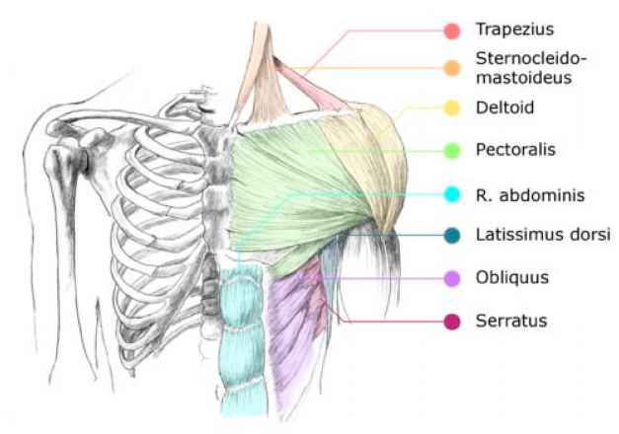

Slide 25
Muscles Connected on the Posterior and Anterior Surfaces of Sternum
Manubrium | Two from anterior surface | Pectoralis major
 |  | Sternocleidomastoid
 | Two from posterior surface | Sternohyoid
 |  | Sternothyroid
The body | One from anterior surface | Pctoralis major
 | One from posterior surface | Sternocostalis
The xiphoid process | On its anterior surface | Insertion to rectus abdominus
 | One from posterior surface | Origin to diaphragm

Slide 26
The Xiphoid Process of Sternum
It is the lowest and smallest part of the sternum.
It varies considerably in size and shape.
It might be bifid or perforated.
Its anterior surface gives insertion to the medial fibres of the rectus abdominis.
Its posterior surface gives origin to the sternal fibres of the diaphragm.
Its tip gives connection to the upper end of linea alba.

Slide 27
X I p h o I d

Slide 28
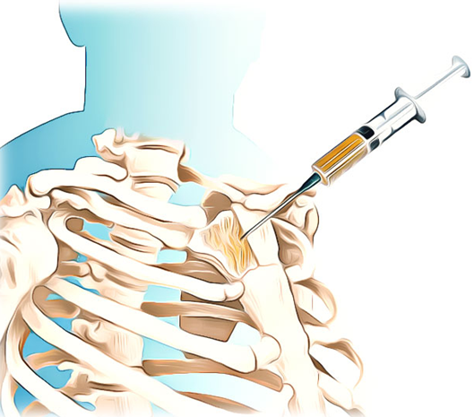
Sternal Puncture
Manubrium sterni is the favorite site for bone marrow aspiration because it’s subcutaneous and easily approachable.
The bone marrow sample is obligatory for hematological evaluation.
A thick needle is inserted into the upper part of manubrium to prevent injury to arch of aorta which is located behind the lower part.
Sternal puncture is not advisable in kids.

Slide 29
Mid-Sternotomy
To get access to the mediastinum for surgical operations on heart and great blood vessels, the sternum is frequently split in the median plane named midsternotomy.

Slide 30
Sternal Fracture
It is common in automobile accidents; for example, when the motorist’s chest is hit against the steering wheel, the sternum is frequently fractured at the sternal angle.
The backward displacement of fractured fragments may damage aorta, heart, or liver and cause serious bleeding which may prove lethal.

Slide 31
THANKYOU!

