Slide 1
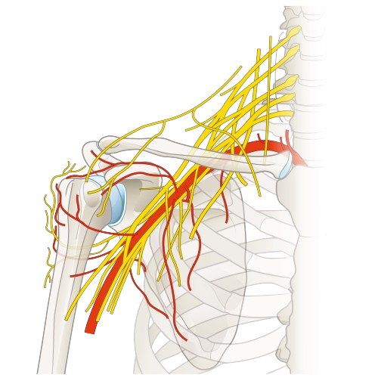
Brachial Plexus

Slide 2
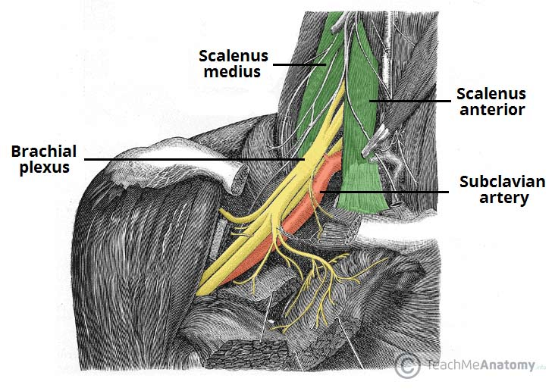
Brachial Plexus
The Brachial Plexus is a network of nerve fibers that supplies the skin and musculature of the upper limb. It begins in the root of the neck, passes through the axilla, and enters the upper arm.
The plexus is formed by the anterior rami (divisions) of the cervical spinal nerves C5, C6, C7 and C8, and the first thoracic spinal nerve, T1.
The Brachial Plexus is divided into five parts; roots, trunks, divisions, cords and branches.

Slide 4
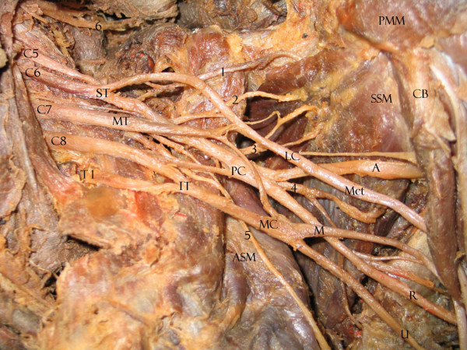

Slide 5
Roots
The ‘roots’ refer the beginning of the Brachial Plexus. They are formed by the spinal nerves C5, C6, C7, C8 and T1.
At each vertebral level, paired spinal nerves arise. They leave the spinal cord via the intervertebral foramina of the vertebral column.
Each nerve then divides into anterior and posterior nerve fibers. The roots of the Brachial Plexus are formed by the anterior divisions of spinal nerves C5-T1.
After their formation, these nerves pass between the anterior and medial scalene muscles to enter the base of the neck.

Slide 6
Trunks
At the base of the neck, the roots of the Brachial Plexus converge, forming three trunks. These structures are named by their anatomical position:
Superior trunk: A combination of C5 and C6 roots.
Middle trunk: A continuation of C7.
Inferior trunk: A combination of C8 and T1 roots.
The trunks begin to move laterally, crossing the posterior triangle of the neck.

Slide 7
Divisions
Within the posterior triangle of the neck, each trunk divides into two branches. One division travels anteriorly and the other posteriorly. Thus, they are known as the anterior and posterior divisions.
We have three anterior and three posterior nerve fibers. These divisions leave the posterior triangle and pass into the axilla region. They recombine in the next part of the Brachial Plexus.

Slide 8
Cords
Once the anterior and posterior divisions have entered the axilla, they combine together to form three nerves. These nerves are named by their position relative to the axillary artery.
The lateral cord
The posterior cord
The medial cord
The cords give rise to the major branches of the Brachial Plexus.

Slide 9
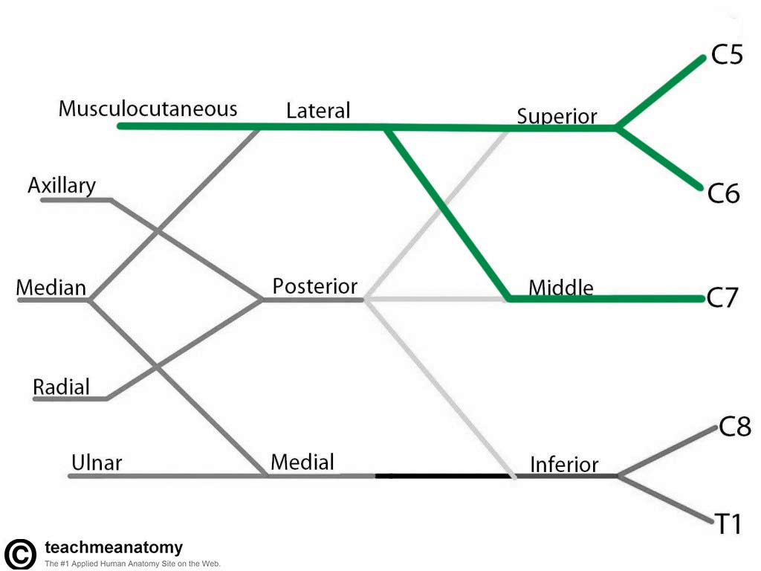
Musculocutaneous Nerve
Roots: C5, C6, C7.
Motor Functions: Innervates the brachialis, biceps brachii and coracobrachialis muscles.
Sensory Functions: Innervates the lateral half of the anterior forearm, and a small lateral portion of the posterior forearm

Slide 10
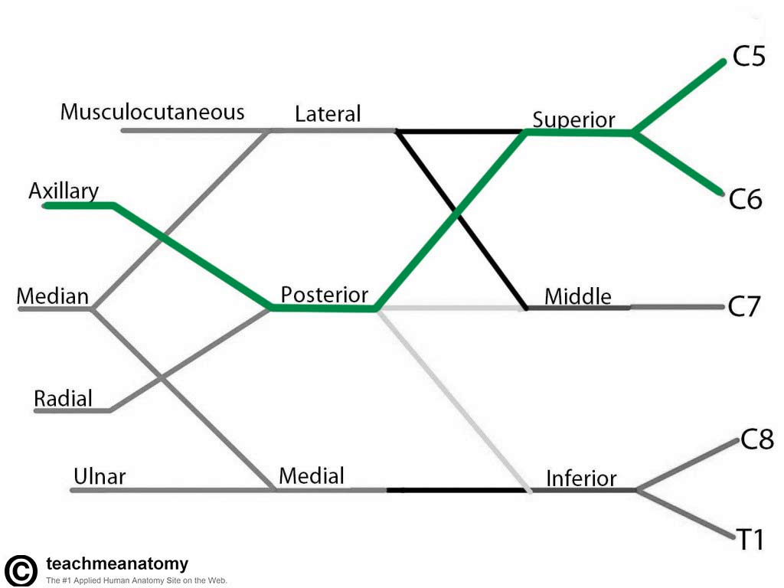
Axillary Nerve
Roots: C5 and C6.
Motor Functions: Innervates the teres minor and deltoid muscles.
Sensory Functions: Gives off the superior lateral cutaneous nerve of arm, which innervates the inferior region of the deltoid

Slide 11
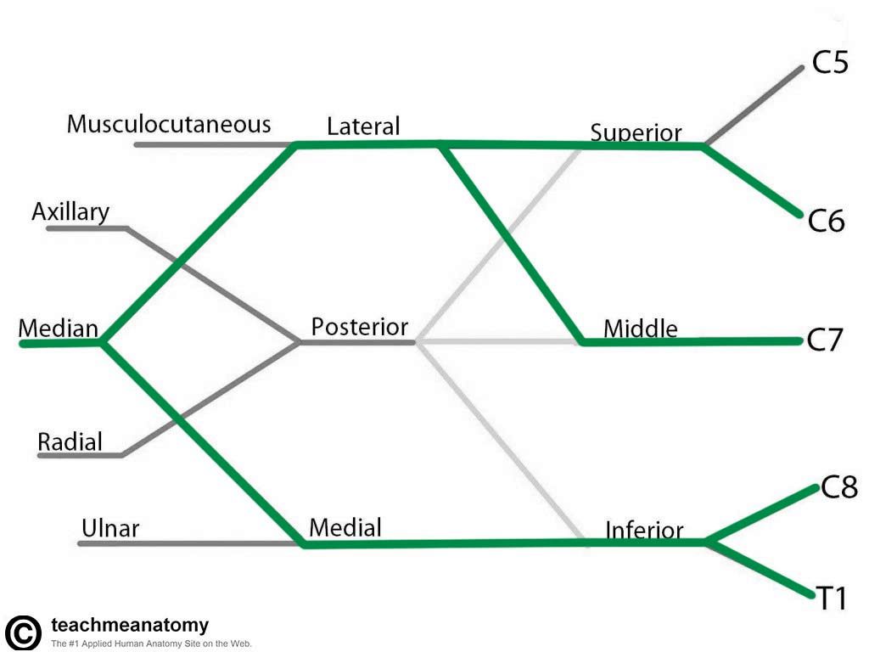
Median Nerve
Roots: C6 – T1.
Motor Functions: Innervates most of the flexor muscles in the forearm, the thenar muscles, and the two lateral lumbricals that move the index and middle fingers.
Sensory Functions: Gives off the palmar cutaneous branch, which innervates the lateral part of the palm, and the digital cutaneous branch, which innervates the lateral three and a half fingers on the anterior (palmar) surface of the hand.

Slide 12
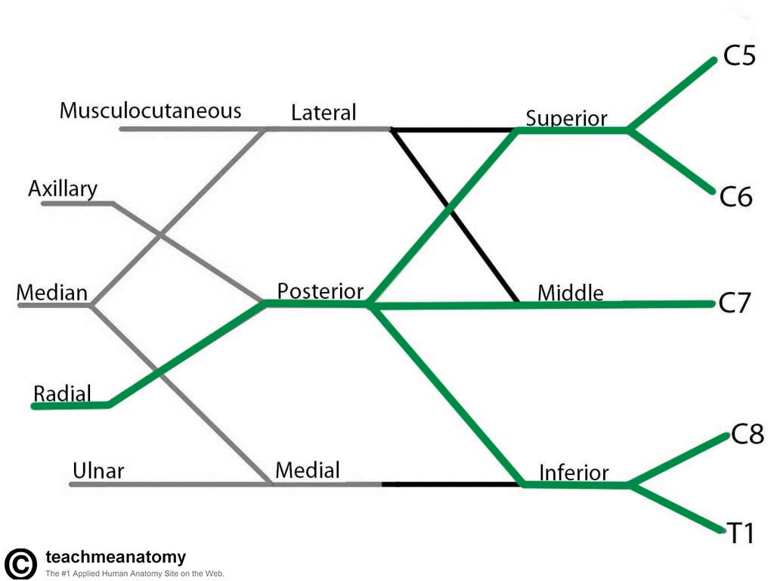
Radial Nerve
Roots: C5-C8 and T1.
Motor Functions: Innervates the triceps brachii, and the extensor muscles in the posterior compartment of the forearm.
Sensory Functions: Innervates the posterior aspect of the arm and forearm, and the posterior, lateral aspect of the hand.

Slide 13
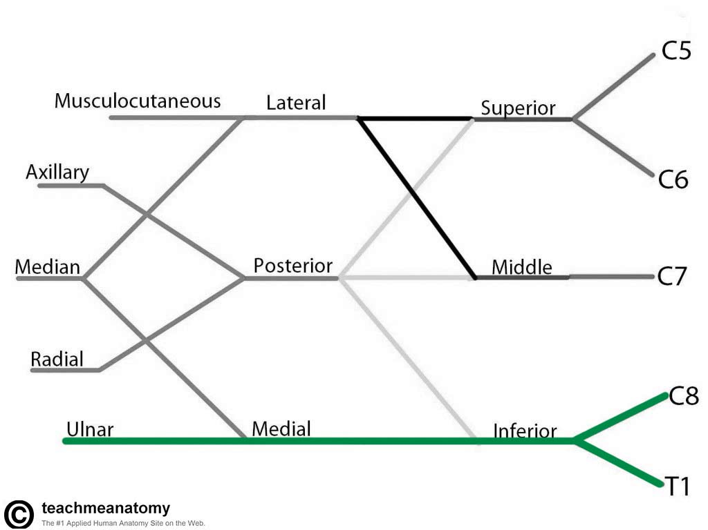
Ulnar Nerve
Roots: C8 and T1.
Motor Functions: Innervates the muscles of the hand flexor carpi ulnaris and medial half of flexor digitorum profundus.
Sensory Functions: Innervates the anterior and posterior surfaces of the medial one and half fingers, and associated palm area.

Slide 14
Minor Branches
Roots | Trunks | Lateral cord | Medial cord | Posterior cord
Dorsal scapular nerve Long thoracic nerve | Suprascapular nerve Nerve to subclavius | Lateral pectoral nerve | Medial pectoral nerve Medial cutaneous nerve of arm Medial cutaneous nerve of forearm | Superior subscapular nerve Thoracodorsal nerve Inferior subscapular nerve

Slide 15
Erb’s Palsy
Injuries to superior parts of the Brachial Plexus (C5 and C6) usually result from an excessive increase in the angle between the neck and shoulder. These injuries can occur in a person who is thrown from a motorcycle or a horse, and lands on the shoulder in a way that widely separates the neck and shoulder. This stretches or ruptures superior parts of the Brachial Plexus or avulses (tears) the roots of the plexus from the spinal cord.
Upper Brachial Plexus injuries can also occur in a neonate when excessive stretching of the neck occurs during delivery.

Slide 16
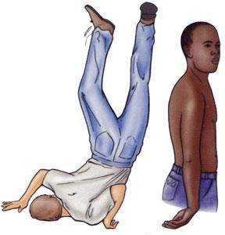
Erb’s Palsy
As a result of injuries to the superior parts of the Brachial Plexus, paralysis of the muscles of the shoulder and arm supplied by the C5 and C6 spinal nerves occurs: deltoid, biceps, and brachialis. The usual clinical appearance is an upper limb with an adducted shoulder, medially rotated arm, and extended elbow.

Slide 17
Klumpke Palsy
Injuries to inferior parts of the Brachial Plexus are much less common. Inferior Brachial Plexus injuries may occur when the upper limb is suddenly pulled superiorly—for example, when a person grasps something to break a fall, or a baby’s upper limb is pulled excessively during delivery. These events injure the inferior trunk of the Brachial Plexus (C8 and T1), and may avulse the roots of the spinal nerves from the spinal cord. The short muscles of the hand are affected, and a claw hand results.

Slide 19
Compression of cords of the Brachial Plexus
Compression of cords of the Brachial Plexus may result from prolonged hyper abduction of the arm during performance of manual tasks over the head, such as painting a ceiling. The cords are impinged or compressed between the coracoid process of the scapula and the pectoralis minor tendon. Common neurologic symptoms are pain radiating down the arm, numbness, paresthesia (tingling), erythema (redness of the skin caused by capillary dilation), and weakness of the hands.

Slide 20
THANK YOU!

