Slide 1
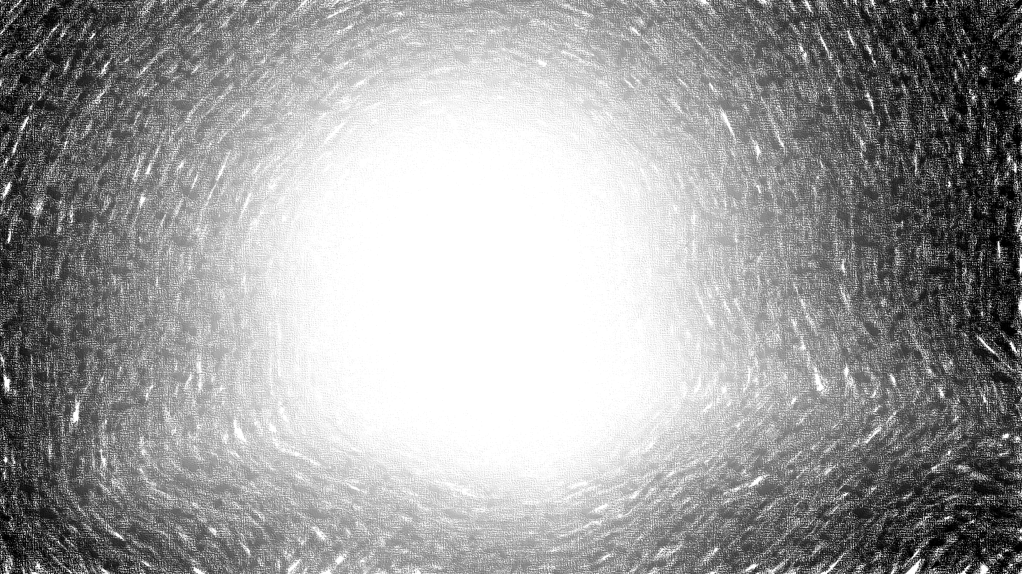
Carbohydrates

Slide 2
Carbohydrates
Carbohydrates are defined chemically as aldehyde or ketone derivatives of the higher polyhydric alcohols, or compounds which yield these derivatives on hydrolysis.
Carbohydrates are main source of energy.
It is the first respiratory substrate.
Simple carbohydrates which are soluble in water and sweet in taste are called ‘Sugars’.
Classification
Carbohydrates are divided into four major groups— monosaccharides, disaccharides, oligosaccharides and polysaccharides.

Slide 3
Some General Properties
Asymmetric Carbon : Presence of asymmetric carbon gives chiral property to the molecule.
Sterioisomerism
D-Series and L-Series: The orientation of the H and OH groups around the carbon atom just adjacent to the terminal alcohol carbon, e.g. C-atom 5 in glucose determines the series. When the – OH group on this carbon is on the right, it belongs to D-series, when the – OH group is on the left, it is a member of L-series.
Racemic: When equal amounts of dextrorotatory and laevorotatory isomers are present, the resulting mixture has no optical activity, since the activities of each isomer cancels each other. Such a mixture is said to be Racemic.
Resolution: The separation of optically active isomers from a racemic mixture is called resolution.

Slide 4
CYCLIC STRUCTURES : As the two reacting groups aldehyde and alcoholic group belong to the same molecule, a cyclic structure takes place. If the open-chain form of D-Glucose, which may be called as Aldehydo-D-Glucose is taken, and condense the aldehyde group on carbon-1, with the alcoholic-OH group on carbon-5, two different forms of glucose are formed. When the OH group extends to right, it is α-D-Glucose and it extends to left, it is β-D-Glucose.

Slide 5
Anomers and anomeric carbon: Carbon-1, after cyclization has four different groups attached to it and thus it becomes now asymmetric. The two cyclic compounds, α and β have different optical rotations, but they will not be same because the compounds as a whole are not mirror-images of each other. Compounds related in this way are called anomers and carbon-1, after cyclisation becomes asymmetric is called now anomeric carbon atom.
Epimers and epimerisation: Two sugars which differ from one another only in configuration around a single carbon atom are termed Epimers.
Examples : Glucose and galactose are examples of an epimeric pairs which differ only with respect of C4. Similarly, mannose and glucose are epimers in respect of C2.
Epimerisation: Process by which one epimer is converted to other is called epimerisation and it requires the enzyme epimerase, e.g. conversion of galactose to glucose in liver.

Slide 6
Mutarotation : When an aldohexose is first dissolved in water and the solution is put in optical path so that plane polarized light is passed, the initial optical rotation shown by the sugar gradually changes until a constant fixed rotation characteristic of the sugar is reached. This phenomenon of change of rotation is called as mutarotation.

Slide 7
Monosaccharides
Also called ‘simple’ sugars are those which cannot be hydrolysed further into simpler forms.
General Form : C_{n}H_{2n} O_{n}
They can be subdivided further:
(a) Depending upon the number of carbon atoms they possess, as trioses, tetroses, pentoses, hexoses, etc.
(b) Depending upon whether aldehyde (– CHO) or ketone (– CO) groups are present as aldoses or ketoses.
Trioses: Both D-glyceraldehyde and dihydroxyacetone occur in the form of phosphate esters, as intermediates in glycolysis. They are also the precursors of glycerol, which the organism synthesises and incorporates into various types of lipids.

Slide 8
Tetroses: Erythrose-4-P occurs as an intermediate in hexosemonophosphate shunt which is an alternative pathway for glucose oxidation.
Pentoses
• D-ribose is a constituent of nucleic acid RNA; also as a constituent of certain coenzymes, e.g. FAD, NAD, coenzyme A.
• D-2-deoxyribose is a constituent of DNA.
• L-xylulose is a metabolite of D-glucuronic acid and is excreted in urine of humans afflicted with a hereditary abnormality in metabolism called pentosuria.
Hexoses
1. D-Glucose: (Synonyms: Dextrose, Grape Sugar)
• It is the chief physiological sugar present in normal blood continually and at fairly constant level, i.e. about 0.1 per cent. All tissues utilise glucose for energy. Erythrocytes and Brain cells utilise glucose solely for energy purposes. Stored as glycogen in liver and muscles mainly.
• Occurs as a constituent of disaccharide and polysaccharides.

Slide 9
2. D-galactose: Seldom found free in nature. In combination it occurs both in plants and animals.
• Occurs as a constituent of milk sugar lactose and also in tissues as a constituent of galactolipid and glycoproteins.
3. D-fructose: It is a ketohexose and commonly called as fruit sugar, as it occurs free in fruits.
• It is very sweet sugar, much sweeter than sucrose and more reactive than glucose. It occurs as a constituent of sucrose and also of the polysaccharide inulin. It is laevorotatory and hence is also called laevulose.
Seminal fluid is rich in fructose and sperms utilize fructose for energy. Fructose is formed in the seminiferous tubular epithelial cells from glucose.

Slide 10
IMPORTANT PROPERTIES OF
MONOSACCHARIDES
Acetylation or ester formation : The ability to form sugar esters, e.g. acetylation with acetyl chloride indicates the presence of alcohol groups. Due to alcoholic OH⁻ groups, it can react with anhydrides and chlorides of many organic and inorganic acids, to form esters of corresponding acids.
Osazone formation: It is a useful means of preparing crystalline derivatives of sugars. Osazones have characteristic
• Melting points
• Crystal structures, and
• Precipitation time and thus are valuable in identification of sugars.

Slide 11
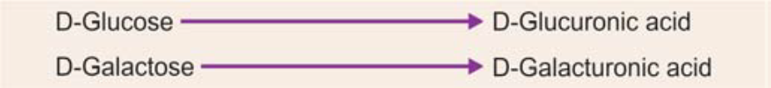
Oxidation to produce sugar acids: When oxidized under different conditions, the aldoses form sugar acids.
In the body D-Glucuronic acid is formed from Glucose in liver by uronic acid pathway. It is of importance in that it conjugates toxic substances, drugs, hormones and even bilirubin (a break down product of Hb) and converts them to a soluble nontoxic substance, a glucuronide, which is excreted in urine.
Reduction of sugars to form sugar alcohols: The monosaccharides may be reduced to their corresponding alcohols by reducing agents such as Na-Amalgam.
In microbiology sugar alcohols have been used to identify type of bacteria.

Slide 12
Disaccharides
Those sugars which yield two molecules of the same or different molecules of monosaccharide on hydrolysis.
General Formula : C_{n}(H₂O)_{n-1}
Three most common disaccharides of biological importance are: Maltose, Lactose and Sucrose. Their general molecular formula is C₁₂H₂₂O₁₁ and they are hydrolysed by hot acids or corresponding enzymes as follows:
C₁₂H₂₂O₁₁ + H₂O → C₆H₁₂O₆ + C₆H₁₂O₆

Slide 13
The disaccharides are formed by the union of two constituent monosaccharides with the elimination of one molecule of water. The points of linkage, the glycosidic linkage varies, as does the manner of linking and the properties of the disaccharides depend to a great extent on the type of the linkage.
Maltose: Maltose or malt sugar is an intermediary in acid hydrolysis of starch and can also be obtained by enzyme hydrolysis of starch. In the body, dietary starch digestion by Amylase in gut yields maltose, which requires a specific enzyme maltase to form glucose. It is a rather sweet sugar and is very soluble in water.
Lactose: Lactose is milk sugar and found in appreciable quantities in milk to the extent of about 5 per cent. It is not very soluble and is not so sweet. It is dextrorotatory. Specific enzyme which hydrolyses is lactase present in intestinal juice.

Slide 14
Sucrose: Ordinary table sugar is sucrose. It is also called as ‘Cane sugar’, as it can be obtained from sugarcane. Also obtained from sugar beet, and sugar maple Also occurs free in most fruits and vegetables, e.g. pineapples, and carrots. It is very soluble and very sweet and on hydrolysis yields one molecule of D-Glucose and one molecule of D-Fructose. The specific enzyme which hydrolyses sucrose is sucrase present in intestinal juice.
Invert Sugars and ‘Inversion’
Sucrose is dextrorotatory (+62.5°) but its hydrolytic products are laevorotatory because fructose has a greater specific laevorotation than the dextrorotation of glucose. As the hydrolytic products invert the rotation, the resulting mixtures of glucose and fructose (hydrolytic products) is called as Invert Sugar and the process is called as Inversion. Honey is largely ‘invert sugar’.

Slide 15
Oligosaccharides
Those sugars which yield 3 to 10monosaccharide units on hydrolysis, e.g. Maltotriose.
Integral membrane proteins contain covalently attached carbohydrate units, oligosaccharides, on their extracellular face. Many secreted proteins, such as antibodies and coagulation factors also contain oligosaccharide units.
Many newly synthesised glycoproteins such as, immunoglobulins (antibodies) and peptide hormones, contain oligosaccharide carbohydrate units with terminal sialic acid residues.

Slide 16
Polysaccharides
Those sugars which yield more than ten molecules of monosaccharides on hydrolysis.
Polysaccharides are further divided into two groups:
Homopolysaccharides (homoglycans): Polymer of same monosaccharide units. Examples—Starch, glycogen, inulin, cellulose, dextrins, dextrans.
Heteropolysaccharides (heteroglycans): Polymer of different monosaccharide units or their derivatives. Example—Mucopolysaccharides (glycosaminoglycans).

Slide 17
Glycogen
Glycogen is the reserve carbohydrate of the animal, hence it is called as animal starch. It has been shown to be present in plants which have no chlorophyll systems. It is also found in large amounts in oysters and other shell fish. In higher animals, it is deposited in the liver and muscle as storage material which are readily available as immediate source of energy. It is dextrorotatory. Formation of glycogen from glucose is called as Glycogenesis and breakdown of glycogen to form glucose is called as glycogenolysis.
Glycogens have a complex structure of highly branched chains. It is a polymer of D-Glucose units and resemble amylopectin.
Glucose units in main stem are joined by α1 → 4 glucosidic linkages and branching occurs at branch points by α1 → 6 glucosidic linkage.

Slide 18
Hyaluronic Acid
A sulphate free mucopolysaccharide. It was first isolated from vitreous humour of eye. Later it was found to be present in synovial fluid, skin, umbilical cord. It occurs both free and salt-like combination with proteins and forms so called ground substance of mesenchyme.
It is composed of repeating units of N-acetyl glucosamine and D-Glucuronic acid.
Proteoglycans like hyaluronic acid is present in basement membrane of glomerulus of kidney where it plays important role in charge selectiveness of glomerular filtration.
Hyaluronic acid in tissues acts as a cementing substance and contributes to tissue barrier.
Hyaluronic acid in joints acts as a lubricant and shock absorbant. Intraarticular injection of hyaluronic acid in knee joints is used to alleviate pain in chronic osteoarthritis of knee joints.

Slide 19
Heparin
It is also called α-Heparin. It is an anticoagulant present in liver and it is produced mainly by mast cells of liver (Originally isolated from liver). In addition, it is also found in lungs, thymus, spleen, walls of large arteries, skin and in small quantities in blood. Structure: It is a polymer of repeating disaccharide units of D-Glucosamine (Glc N) and either of the two uronic acids-D-Glucuronic acid (Glc UA) and L-Iduronic acid (IDUA).
Inulin
It is a polymer of D-fructose. It is levorotatory. Acids hydrolyse it to D-fructose; similarly it is also hydrolysed by the enzyme inulinase. It has no dietary importance in human beings.
• It is used in physiological investigation for determination of the rate of glomerular filtration rate (GFR).
• It has been also used for estimation of body water volume.

Slide 20
THANK YOU

