Slide 1
Carcinoma Esophagus

Slide 2
Intro
It remains the sixth most common malignancy
Incidence of 160/100,000 in parts of South Africa and China and 540/100,000 in Kazakhstan.
India 8-20 / 100,000 , 6th most common in males
Squamous cell carcinoma still accounts for most esophageal cancers diagnosed.
M:F – 3:1 (Squamous Cell Carcinoma) .. …..15:1 (adeno)
Adeno – whites …..Squamous Cell Carcinoma – African American

Slide 3
Classification
Epithelial:
  Squamous Cell Carcinoma
  Adeno Carcinoma
  Mucoepidermoid Carcinoma
  Adenoid Cystic Carcinoma
  Small Cell Carcinoma
  Undifferentiated Carcinoma
Non – Epithelial:
  Leiomyosarcoma.
  Malignant Melanoma.
  Rhabdomyosarcoma.
  Malignant Lymphoma

Slide 4
Squamous Cell Carcinoma
Squamous cell carcinomas arise from the squamous mucosa - native to the Esophagus - 70% - upper and middle thirds
Most common type of esophageal ca in India (90%)
Smoking and alcohol are common etiologic factors (5 fold increase in risk)
Combined increase risk from 25 - 100 folds

Slide 5
Squamous Cell Carcinoma
Dietary
  Nitrosamines (pickled foods , smoked food)
  long term ingestion of hot liquids
  Micronutrient deficiency (Vit. A, B12, C, E).
  Trace Element deficiency (Cobalt, Copper & Selenium).
Acquired
  Cigarette smoking. Alcohol.
  Chronic esophagitis.
  Chronic Dysphagia
  Caustic ingestion
Radiation exposure

Slide 6
Squamous Cell Carcinoma
Premalignant conditions :
Plummer – vinson syndrome
Tylosis (40%)
Achalasia (16fold)
Esophageal strictures and diverticula
p53

Slide 7
ADENOCARCINOMA
Almost 70 % - United States and Western countries.
Etiology :
  Increasing incidence of GERD
  Western diet
  Increased use of acid-suppression medications
Histologically it is from :
  Submucosal glands of the Esophagus
  Heterotopic islands of columnar epithelium
  Malignant degeneration of metaplastic columnar epithelium
  (Barrett’s Esophagus) – 40 fold increased risk

Slide 8
ADENOCARCINOMA
Barrett's Esophagus:
Traditionally - the presence of columnar mucosa extending at least 3 cm into the Esophagus.
Recently - the specialized, intestinal-type epithelium (presence of goblet cells) found in the Barrett’s mucosa is the only tissue predisposed to malignant degeneration - the diagnosis of BE is presently made given any length of endoscopically identifiable columnar mucosa that proves, on biopsy
10 % of GERD pts develop – BARRETS
Approx 1 in every 100 patient years of followup of barrets develop ADENOCARCINOMA (40 fold increased risk)

Slide 9
Symptoms
Early - asymptomatic – mimic GERD
Dysphagia.
Weight Loss (most common symptoms)
> 2/3rds of lumen has to be obstructed (lack of serosa)
Vomiting/Regurgitation
Pain.
Cough, choking, asp.pneumonia (TEF)
Hoarseness (lt.RLN, vocal cords)
Dyspnoea

Slide 10
Symptoms
In high-incidence areas where screening is practice,the most prominent early symptom is pain on swallowing rough or dry food
Systemic disease – jaundice ,excessive pain ,bone pain, respiratory symptoms

Slide 11
Diagnosis
Endoscopy
CT
PET
MRI
EUS

Slide 12
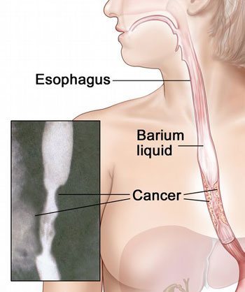
Diagnosis
Esophagoscopy :
  Good 1st test – dysphagia &
  suspecting ca Esophagus
  Can differentiate intra luminal
  From intramural & intrinsic from extrinsic
Apple core appearance

Slide 13
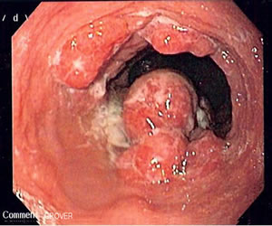
Diagnosis
Endoscopy :
  Dx of esophageal ca is best made by endoscopic biopsy
Critical points :
  Location of lesion
  Nature of lesion (polypoid etc)
  Extent & relationship to cricophayngeus, GEJ

Slide 14
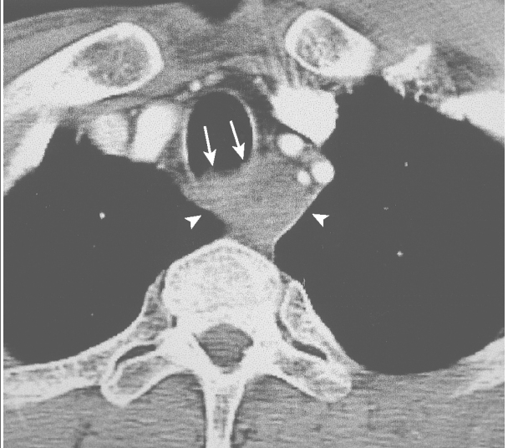
Diagnosis
CT :
Imp for staging.
Chest and abdomen –
Length , thickness, LN
Liver and lung mets , T4
Accuracy 57% T
74% N , 83% M
Many unresectable Tumors by
CT scan are deemed resectable at the
time of surgery.

Slide 15
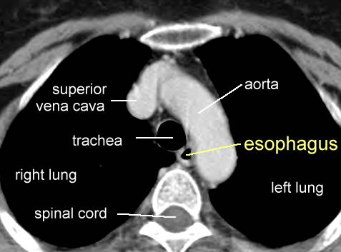
CT

Slide 16
Diagnosis
PET :
FDG –PET
Evaluates
Primary mass
LN
Mets
Sensitivity and specificity
Slightly greater than CT
Not reliable as single Dx tool]
Value in evaluating response to chemo and RT

Slide 17
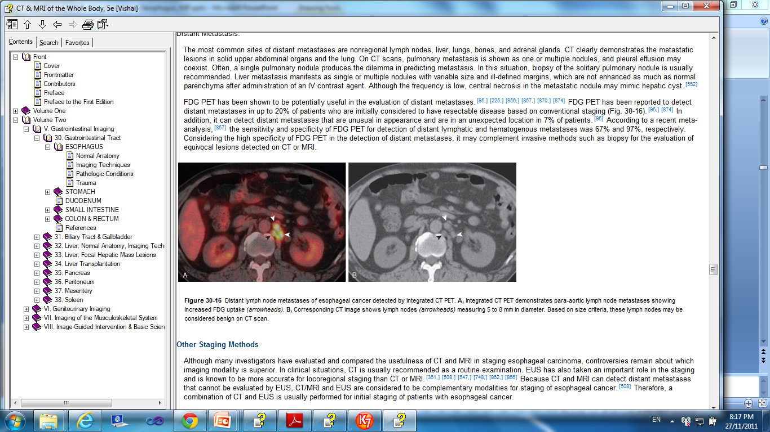
PET
Figure Distant lymph node metastases of esophageal cancer detected by integrated CT PET. A, Integrated CT PET demonstrates para-aortic lymph node metastases showing increased FDG uptake (arrowheads). B, Corresponding CT image shows lymph nodes (arrowheads) measuring 5 to 8 mm in diameter. Based on size criteria, these lymph nodes may be considered benign on CT scan

Slide 18
Diagnosis
MRI
Not done routinely
To identify involvement of vascular & neural
Accurately detects T4 and mets
Overstages T & N status

Slide 19
Diagnosis
EUS :
can identify
depth and length of the Tumor
degree of luminal compromise
status of regional LN &involvement of adjacent structures.
In addition, biopsy samples - mass and lymph nodes in the paratracheal, subcarinal, paraesophageal, celiac, lesser curvature

Slide 20
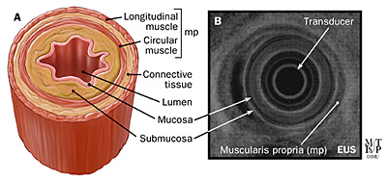
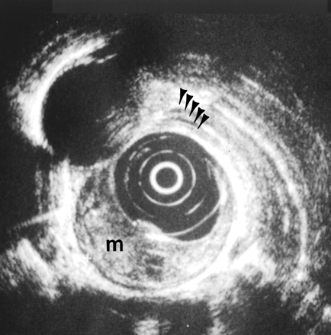
EUS

Slide 21
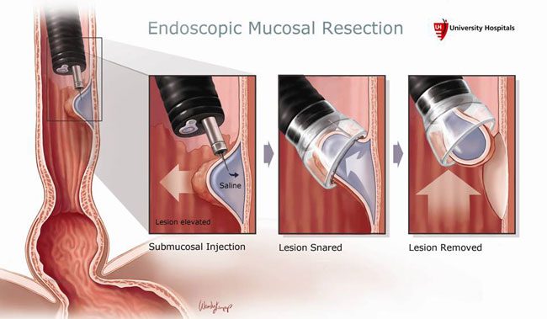
Diagnosis
EMR :
double-channel endoscope with a soft plastic cap at its tip. The cap is placed over the top of the lesion, suction is applied, and a snare is brought down over the top of the lesion
A biopsy specimen of 1 to 1.5 cm will contain mucosa and submucosa

Slide 22
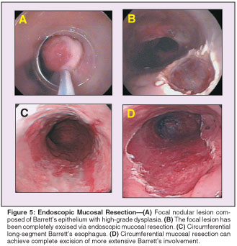
Diagnosis - EMR
May also be used as a therapeutic modality for premalignant and early malignant conditions

Slide 23
Diagnosis
Minimal invasive surgical modalities :
Includes bronchoscopy ,Thoracoscopy and Laparoscopy.
Highly accurate in evaluating N & M Status.
Right sided thoracoscopy is usually done.

Slide 24
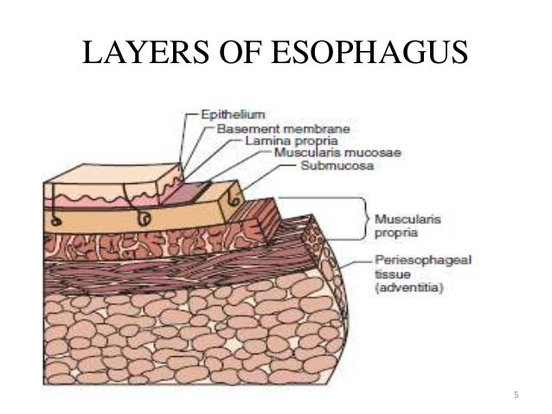
ANATOMY

Slide 25
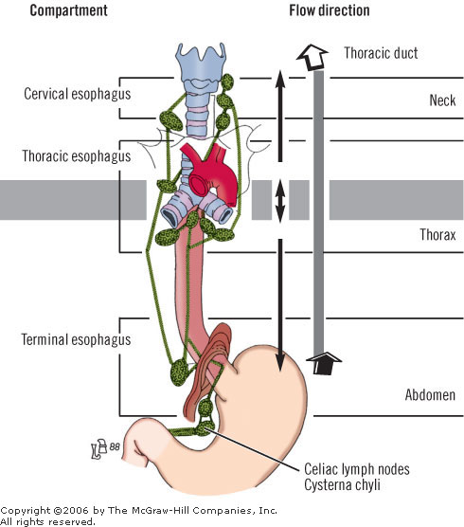
LYMPHATICS

Slide 26
STAGING
AJCC(TNM)
Tumor
Lymph node(N0,N1)
Metastasis
Most widely accepted
ELLIS (WNM)
Wall penetration
Lymph node(N0,N1,N2)
Metastasis

Slide 27
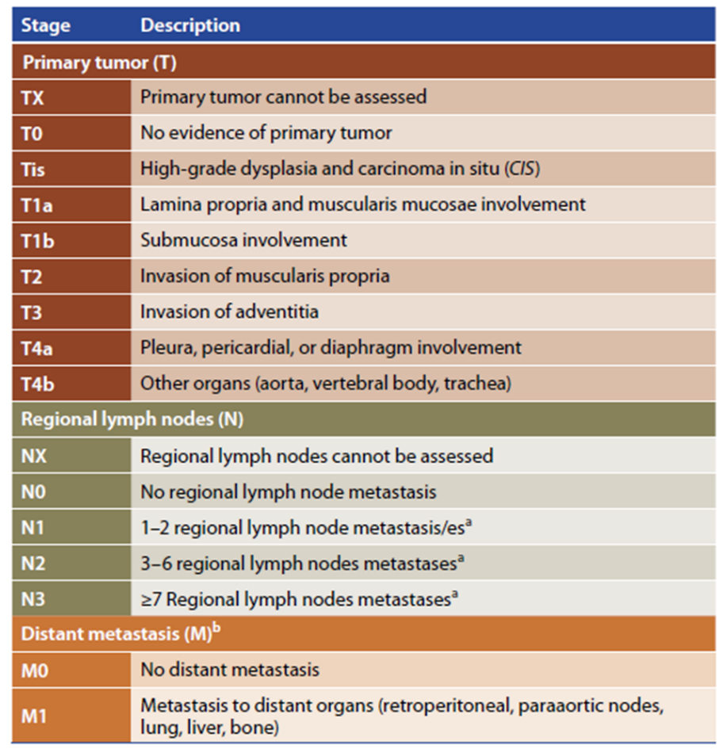
AJCC

Slide 28
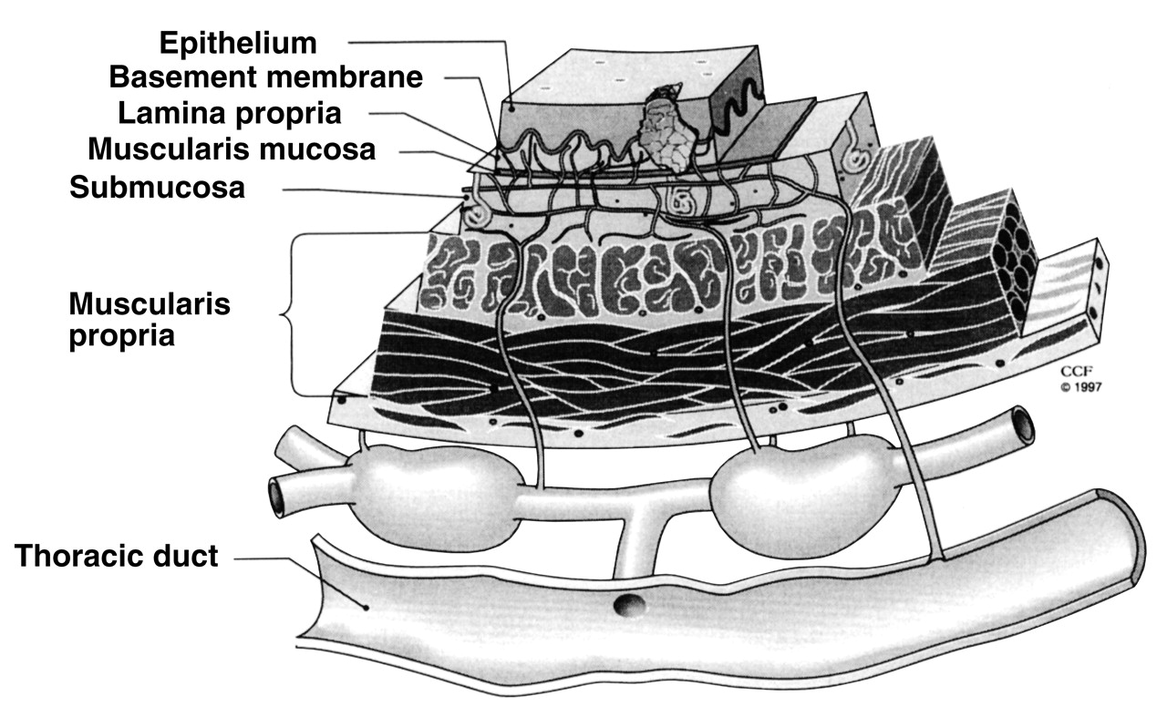
Staging
T 1A
T1B
T2
T3
N1

Slide 29
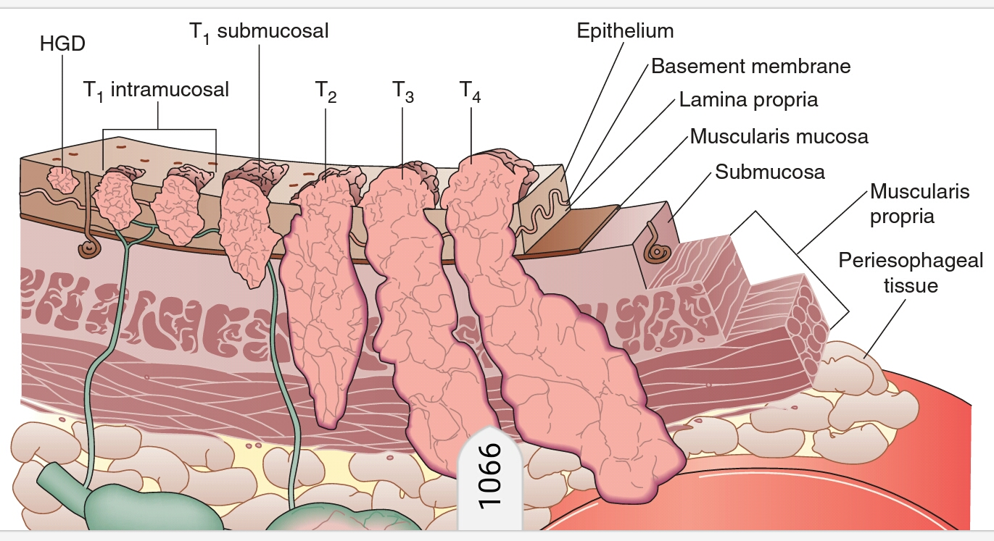

Slide 30
Staging
Tumors confined to
  Epithelial Layer Have No Associated Ln.
  Lamina Propria And Muscularis Mucosae - 5% And 18%
  Superficial And Deep Submucosal Lesions - 50% And 55% Lymph Node Involvement.

Slide 31
Staging Squamous Cell Carcinoma
There are five stages of SCC, which are numbered 0 to 4. Stage 0 is the earliest stage of SCC, and stage 4 is the most advanced stage.
Stage 0 (carcinoma in situ): At this stage, the cancer cells are abnormal but have not yet spread through the top layer of skin (epidermis).
Stage 1: The tumor is 2 cm (about ¾ of an inch) or less in diameter and has not spread to the lymph nodes.
Stage 2: The tumor is larger than 2 cm in diameter, or it has grown into deeper layers of skin, or it has spread to nearby lymph nodes.
Stage 3: The cancer has spread to lymph nodes that are farther away from the tumor, or it has grown into nerves or blood vessels.
Stage 4: The cancer has spread to distant organs, such as the lungs, liver, or bones.

Slide 32
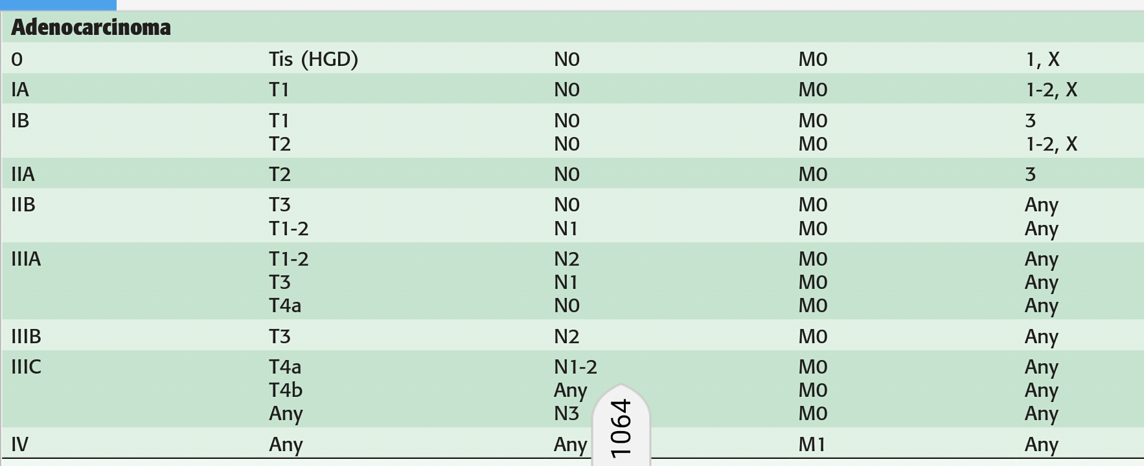
Staging - Adenocarcinoma

Slide 33
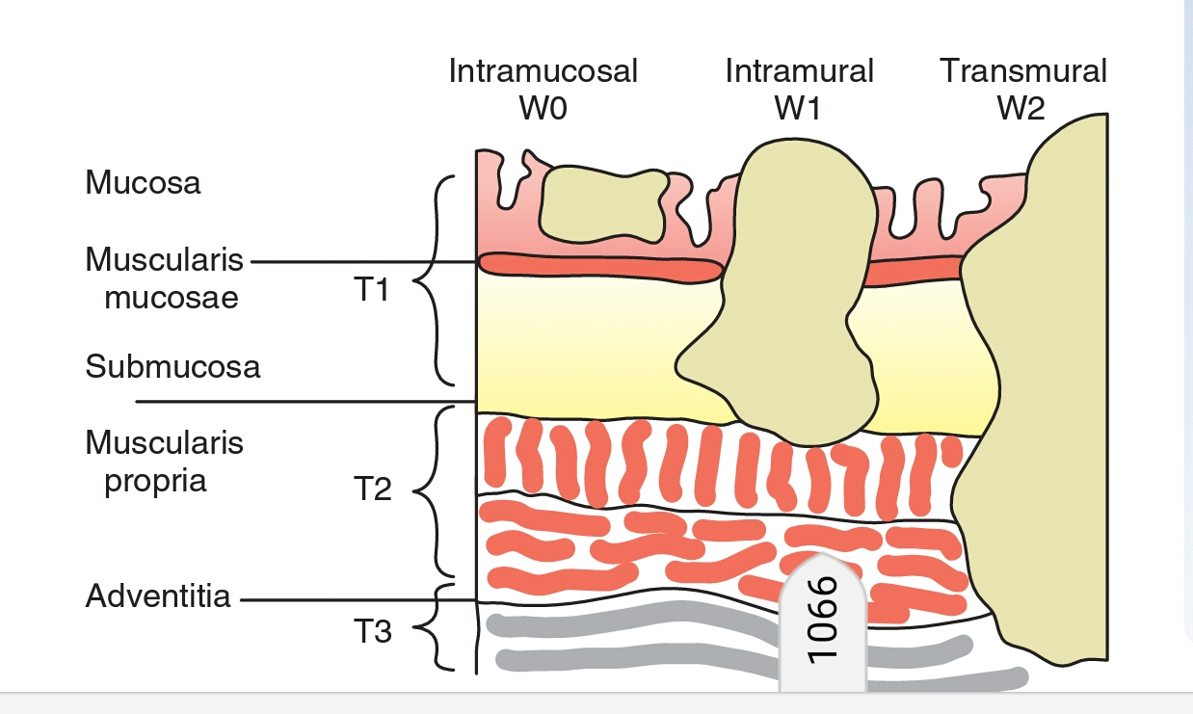
ELLIS STAGING WNM

Slide 34
LN STATUS

Slide 35
LN STATUS
Depth of Tumor Penetration (T Stage) Affects Lymph Node Involvement (LNI)
Intramucosal T1 lesions (18% LNI)
submucosal T1 lesions (55% LNI)
T2 lesions (60% LNI)
T3 lesions (80% LNI)
Chance if LN <50% - conservative eso resection and limited lymph node dissection
LN>50% - neoadjuvant therapy followed by resection

Slide 36
TREATMENT MODALITIES
Chemotherapy
Radiotherapy
Surgery

Slide 37
Chemotherapy
Unlike other malignancies chemo in esophageal and gastric ca is poorly able to control local and distant disease
The best complete response rate for adenocarcinomas is 25% when chemotherapy is given in combination with radiation.
Squamous cell cancers respond more favorably

Slide 38
Chemotherapy
Cisplatin – as single agent - 25 -30 % response rate
Combination with 5FU – 50% response rate
Administered once a week for 2 to 10 weeks, up to 8 cycles of chemotherapy are infused.
The addition of a third agent- mitomycin C, etoposide, paclitaxel - resulted in some improvement in locoregional control and short-term survival

Slide 39
Radiotherapy
A neoadjuvant regimen – induction with cisplatin and paclitaxel followed by combination chemoradiotherapy with 5-fluorouracil, cisplatin, and paclitaxel and 4500 cGy of external beam radiation.
< 4500 cGy are used in neoadjuvant therapy (reduce bleeds in radiation tissue during surgery)

Slide 40
Surgery
Factors affecting surgical decision –
  Location of the Tumor
  Surgical approach
  Location of the anastomosis
  Anastomotic technique
  Type of replacement conduit
  Position of the conduit

Slide 41
Location of Tumor
APPROACH TO CERVICAL Tumors:
Above the level of carina – Squamous Cell Carcinoma
surgery is initiated with endoscopy, bronchoscopy and cervical exploration
Non invasion to trachea, spine, larynx, or vessels are resected primarily
Tumors near to cricopharyngeus muscle/larynx- 2 to 3cycles of chemotherapy and RT before resection
Extension into the thoracic inlet – near total esophageal resection - transhiatal or transthoracic approach to ensure a safe and complete resection.

Slide 42
Location of Tumor
Approach To Thoracic And Cardia Tumor
THE
TTE
EBE
VSE
MIE

Slide 43
Location of Tumor - THORACIC
THE :
2incisions
Esophagus Blindly mobilized
No meticulous/extensive lymphadenectomy

Slide 44
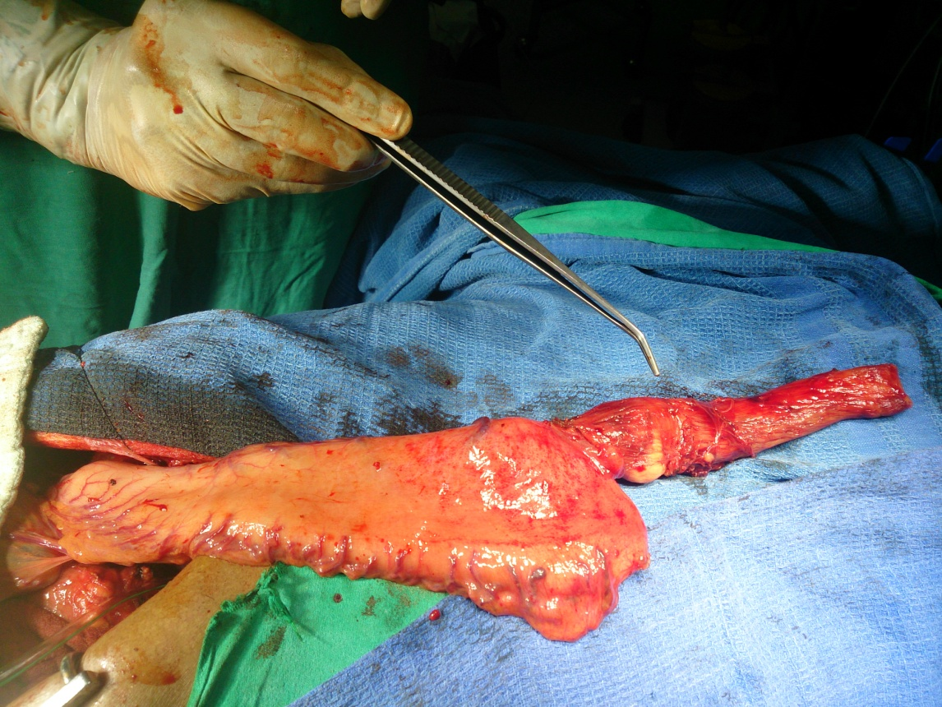
Location of Tumor – THORACIC (THE)

Slide 45
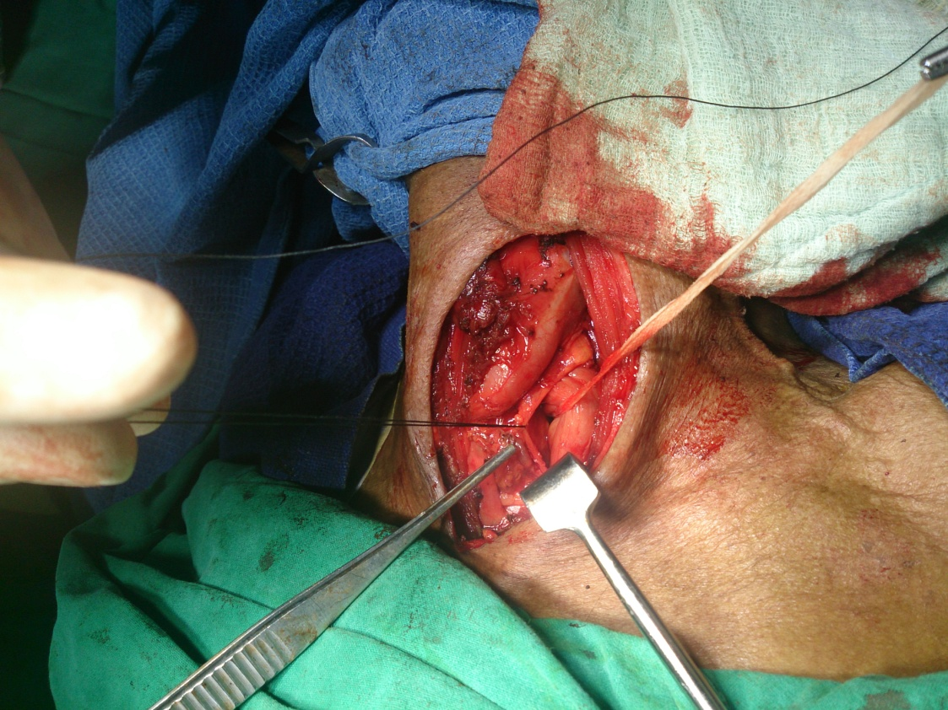
Location of Tumor – THORACIC (THE)

Slide 46
Location of Tumor – THORACIC (THE)
Advantages :
decreased anastomotic leak rate of 3%
less morbid cervical leak if a leak does occur
Less mortality when compared with TTE,EBE
Reduced operative times
less blood loss
Cardiorespiratory complications
Disadvantages
higher rate of postoperative strictures
Injury to great vessels, airway structures -blind procedure
inability to perform a complete lymph node dissection

Slide 47
Location of Tumor - THORACIC
TTE :
2 Incisions –Thoracic And Abdominal
Initiated Through An Upper Midline Laparotomy Incision
The Stomach Esophagus Are Mobilized,
A Feeding Jejunostomy Tube Is Placed
Patient Is Repositioned On The Right Side

Slide 48
Location of Tumor - THORACIC
A Thoracotomy Incision is Made Esophagus is Mobilized.
The Esophagus is Transected At The Level of The Azygos Vein
Intrathoracic Esophagogastric Anastomosis is Performed

Slide 49
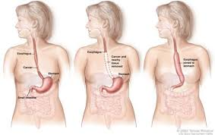
Location of Tumor – THORACIC-TTE

Slide 50
Location of Tumor - THORACIC
EN BLOC ESOPHAGECTOMY:
most extensive of all esophageal resections -
addition of a radical thoracic and abdominal lymphadenectomy
3incisions—left neck, right chest, and abdomen
Rt thoracotomy - Esophagus is mobilized - azygos, hemiazygos &intercostal veins are ligated and divided - removed en bloc with the specimen
All mediastinal lymph nodes , diaphragmatic lymph nodes,lymphatic tissues associated with the thoracic duct are removed

Slide 51
Location of Tumor – THORACIC -EBE
An upper midline abdominal incision –
stomach is mobilized.
radical abdominal lymphadenectomy- includes removal of paracardial, left gastric, portal, common hepatic, celiac, splenic, and lesser and greater curvature lymph nodes.
The gastric conduit is brought up through the posterior mediastinal space and a cervical esophagogastric anastomosis is performed – lt cervical incision

Slide 52
Location of Tumor – THORACIC -EBE
Advantages :
  Complete loco regional clearance
  increase in 5-year survival- early-stage disease who undergo EBE as compared with THE
Disadvantages :
  mortality rate of 4.5% & a morbidity rate of 51%
  Most postoperative complications are pulmonary.
  The anastomotic leak rate of 8%
Very less number of centres are practising

Slide 53
Location of Tumor – THORACIC -VSE
VAGAL-SPARING ESOPHAGECTOMY:
Technique varies from THE - without severing the vagus nerves
HSV is done and esophageal resection is done
Results have shown improved gastric function over esophageal resections that include A vagotomy
Disadvantage - incomplete resection of the Esophagus

Slide 54
Location of Tumor – THORACIC –MIE
MINIMALLY INVASIVE ESOPHAGECTOMY :
  Thoracoscopy or transcervical mediastinoscopy are substituted for a thoracotomy
  Comparable results
  Less pain and less hospital stay
  Longer learning curves and incomplete resection

Slide 55
Location of anastomosis
For Any GI Anastomosis - Good Blood Supply And A Tension-free Repair Required
Difficult In Esophageal Anastomosis – Most Of Them – Diabetes, htn, smokers – Compromised Blood Supply
The Cervical Anastomosis - Necrosis Of The Tip Of The Tubularized Stomach- Compromised Blood Flow - Compression Of The Conduit In The Mediastinum
An Intrathoracic Anastomosis Has A Slightly Better Chance Of Healing When Compared With The Cervical
Timing <48 Hrs – Inadequate Arterial Blood Supply
7-9 Days – Consequence Of Venous Compromise

Slide 56
Replacement conduits
Conduit Of Choice – Stomach (Gastric Pull-up)
Free Jejunal Flap – Microvascular Anastamosis With Internal Mammary Artery
For Longer Segments
A Supercharged Jejunal (Pedicle Flap With An Additional Microvascular Anastomosis)
Colonic Interposition
Except In Gastric Pull-up, For All - Additional Enteroenteric Anastomosis - Increases The Risk For Leaks

Slide 57
Palliation
Who Has No Chance For Cure Or Would Not Withstand Surgery
Chemotherapy, Radiation Therapy, Photodynamic Therapy, Laser Therapy, Esophageal Stenting, Feeding Gastrostomy Or Jejunostomy, And Esophagectomy

Slide 58
UNUSUAL MALIGNANT ESOPHAGEAL TumorS
The Two Cell Types Account For 98% Of All Malignancies Of The Esophagus.
2% - Unusual Tumors
Neuroendocrine Tumors,
Carcinosarcomas,
Melanomas,
Sarcomas
In General, Epithelial Tumors - Mid And Distal Esophagus,
Tumors Arising From The Deeper Layers - Evenly Distributed Throughout.

Slide 59
UNUSUAL MALIGNANT ESOPHAGEAL TumorS
These malignant Tumors have the potential to spread through one of four mechanisms:
Intraesophageal spread
Wall penetration with invasion of adjacent structures
Lymphatic spread to regional and distant
Hematogenous spread
All have poor prognosis

Slide 60
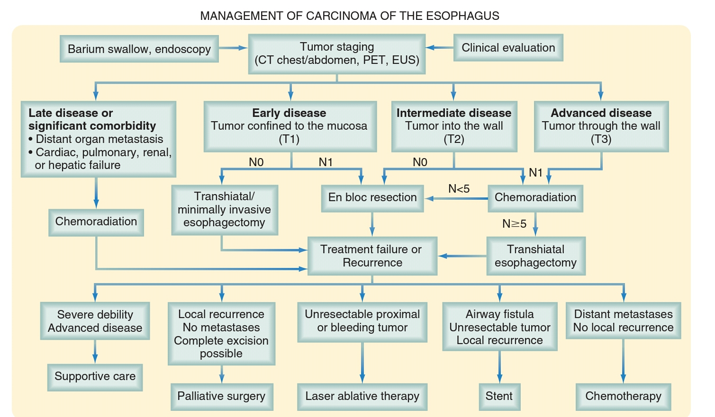
Summary

