Slide 1
Carotid Sheath
BY MBBSPPT.COM

Slide 2
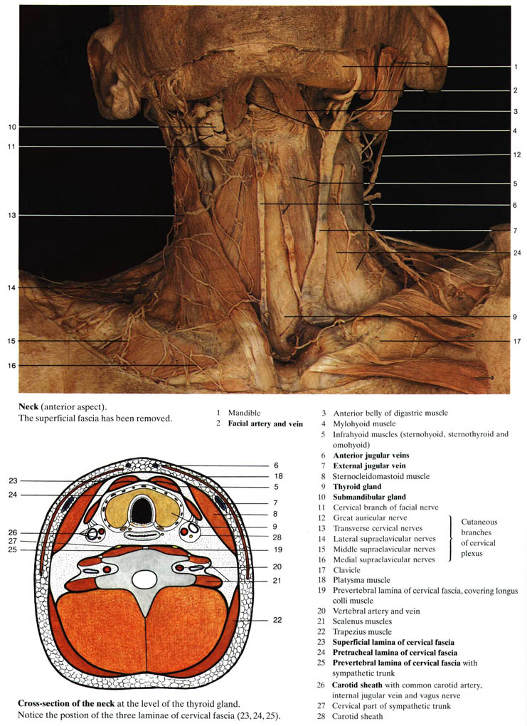

Slide 4
Extent & Position
From base of skull to root of neck
It is wedged between
Investing
Pretracheal
Prevertebral fascia.
It receives contribution from each.

Slide 5
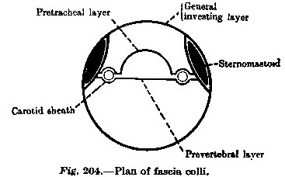

Slide 6
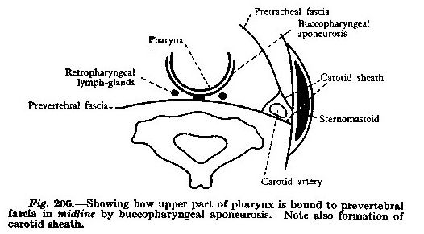

Slide 7
Contents
In upper neck
Internal carotid artery(lateral)
sympathetic nerve fibers (carotid periarterial plexuses).
Internal jugular vein
Vagus nerve
the carotid sinus nerve
Constituents of ansa cervicalis
In lower neck
Same except common carotid artery instead of internal carotid artery.
Common carotid artery bifurcates at upper part (border) of thyroid cartilage(between C3& C4).
Lymph vessels & some deep cervical lymph nodes.

Slide 8
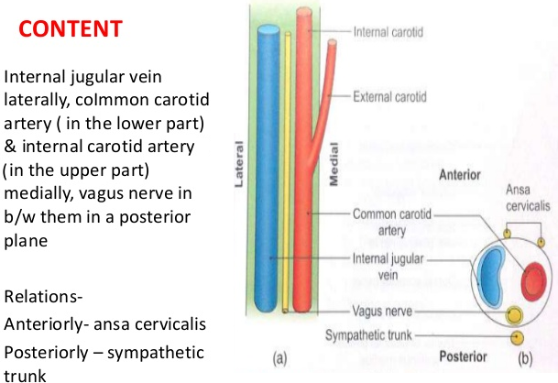

Slide 9
Infratemporal fossa
Anterior
Carotid sheath
Laterally
Medially
Deepest part of parotid
gland partly separated by styloid process & its 3 muscles
Pharynx
Posterior
Cervical sympathetic trunk on prevertebral fascia

Slide 11
The Carotid Sheath
The carotid sheath and pretracheal fascia communicate freely with the mediastinum of the thorax inferiorly and the cranial cavity superiorly.
These communications represent potential pathways for the spread of infection and extravasated blood.

Slide 12
Carotid sheath is thick on arteries but thin over veins.
Sympathetic trunk lie posterior to carotid sheath (posteriomedial wall).
Many lymph nodes lie on superficial surface.
Superior root of ansa cervicalis descend between common carotid artery & internal jugular vein & is sometimes embedded in carotid sheath( triangle of vertebral artery is closely cevered by carotid sheath & its contents, overlaps medial border of scalenes anterior).

Slide 13
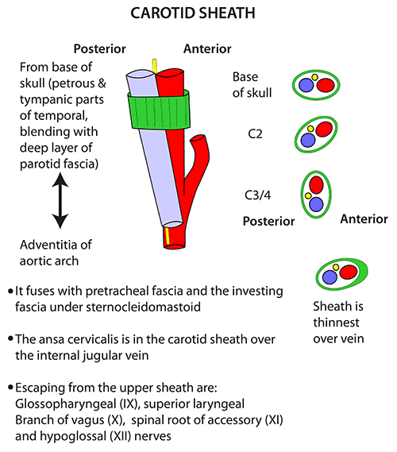

Slide 14
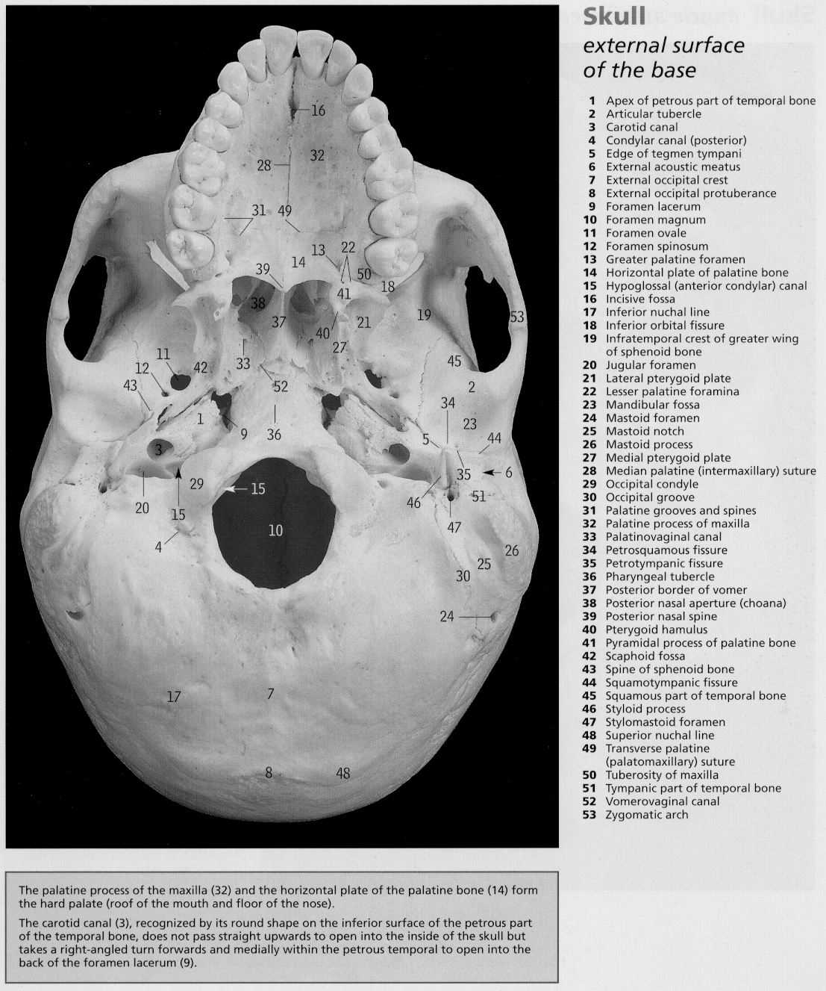

Slide 15
At the base of skull
codylar canal lies more medially & between
carotid canal(in front)
Jugular foramen(behind).
IJV lies behind ICA at a lower level, it comes on lateral side of artery(on scalenes anterior). Vagus nerve lies throughout behind & between IJV & ICA. The glossopharyngeal & accessory nerve between artery & vein and curve away from each other.
The hyoglossal nerve lies medial to sheath behind inferior cervical ganglion & turns forwards to emerge between artery & vein.
Most of its tract lies anterior to transverse process of cervical vertebrae when its pulsation can be felt.

Slide 19
Relations of the Internal Carotid Artery in the Neck
Anterolaterally: | Below the digastric lie The skin, The fascia, The anterior border of the sternocleidomastoid, and The hypoglossal nerve.
 | Above the digastric lie The stylohyoid muscle, The stylopharyngeus muscle, The glossopharyngeal nerve, The pharyngeal branch of the vagus, The parotid gland, and The external carotid artery.
Posteriorly: | The sympathetic trunk, the longus capitis muscle, and the transverse processes of the upper three cervical vertebrae
Medially: | The pharyngeal wall and the superior laryngeal nerve
Laterally: | The internal jugular vein and the vagus nerve

Slide 20
Branches of Internal Carotid Artery
Cervical Part
-No branch
Petrous Part
-Carotico tympanic
-Pterygoid
Cavernous Part
-Cavernous
-Hypophyseal
-Meningeal
Cerebral Part
-Ophthalmic
-Anterior cerebral
-Middle cerebral
-Posterior communicating
-Anterior choroid

Slide 23
Internal Jugular Vein
The internal jugular vein is a large vein that receives blood from the brain, face, and neck. It starts as a continuation of the sigmoid sinus and leaves the skull through the jugular foramen. It then descends through the neck in the carotid sheath lateral to the vagus nerve and the internal and common carotid arteries. It ends by joining the subclavian vein behind the medial end of the clavicle to form the brachiocephalic vein. Throughout its course, it is closely related to the deep cervical lymph nodes.
The vein has a dilatation at its upper end called the superior bulb and another near its termination called the inferior bulb. Directly above the inferior bulb is a bicuspid valve.

Slide 24
Relations of the Internal Jugular Vein
Anterolaterally: | The skin, the fascia, the sternocleidomastoid, and the parotid salivary gland. Its lower part is covered by the sternothyroid, sternohyoid, and omohyoid muscles, which intervene between the vein and the sternocleidomastoid. Higher up, it is crossed by the stylohyoid, the posterior belly of the digastric, and the spinal part of the accessory nerve. The chain of deep cervical lymph nodes runs alongside the vein.
Posteriorly: | The transverse processes of the cervical vertebrae, the levator scapulae, the scalenus medius, the scalenus anterior, the cervical plexus, the phrenic nerve, the thyrocervical trunk, the vertebral vein, and the first part of the subclavian artery. On the left side it passes in front of the thoracic duct.
Medially: | Above lie the internal carotid artery and the 9th, 10th, 11th, and 12th cranial nerves. Below lie the common carotid artery and the vagus nerve.

Slide 25
Tributaries of the Internal Jugular Vein
Inferior petrosal sinus
Facial vein
Pharyngeal veins
Lingual vein
Superior thyroid vein
Middle thyroid vein

Slide 33
THANK YOU!

