Slide 1
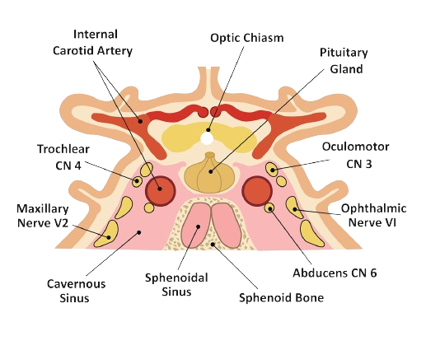
Cavernous sinus

Slide 2
Cavernous Venous Sinus
Extent
2cm long & 1cm wide
From superior orbital fissure to apex of petrous part of temporal bone
Position: Lies in the floor of middle cranial fossa on the side of body of sphenoid& sella turcica between inner & outer layers of dura

Slide 4
Ends
Anterior end lies immediately behind medial end of superior orbital fissure & receives two ophthalmic veins.
Posterior end lie opposite the dorsum sellae of sphenoid at the apex of petrous part of temporal bone where it gives origin to superior & inferior petrosal sinuses which carry blood in a backward direction.
The superior petrosal sinus carries blood to transverse sinus while inferior petrosal sinus carries blood to IJV.

Slide 5
Relations
Medially: the pituitary gland also related to upper margin of sinus
Laterally: the uncus of temporal lobe & it lies above the sinus
Below & medial: Sphenoidal air sinus
Posterolateral: trigeminal ganglion at a depression at the apex of petrous part of temporal bone

Slide 6
Structures in Lateral Wall of the Sinus
From above downwards:
Oculomotor Nerve
Trochlear Nerve
Ophthalmic Nerve
Maxillary Nerve
The maxillary division of 5th nerve lies in the floor of sinus.
ICA (along with its sympathetic plexus around) & VI nerve pass inside the cavernous sinus along the lateral wall of artery
The pituitary gland, which lies medially in the sella turcica.

Slide 7
Structures Passing Through the Sinus
ICA together with its venous & sympathetic plexuses
Abducent Nerve

Slide 9
Communications of Cavernous Sinus
1) It receives:
ophthalmic vein
sup.
Inf.
at its anterior end
Sphenoparietal sinus
2) It gives origin to
the sup. petrosal sinus
The inf. petrosal sinus
at its post.
end
3) It receives the superficial middle cerebral vein from above
4) It communicates with pterygoid venous sinus &
pharyngeal plexus through carotid canal
5) Three intercavernous sinuses connect the two avernous sinuses together medially
Ant.Intercavernous
Post.Intercavernous
Basilar Venous Plexus

Slide 10
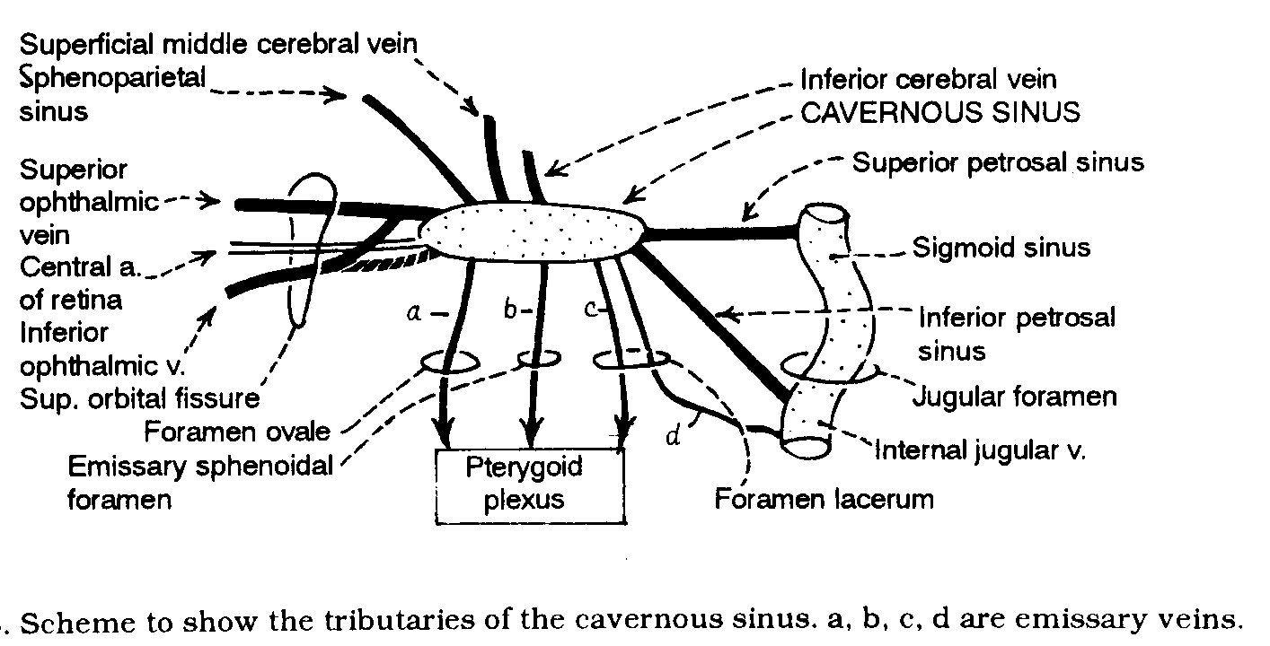

Slide 11
Clinicals
It provides venous connection with skin of face for infection & thrombosis
Angular vein via sup. Ophthalmic vein & deep facial vein via pterygoid venous plexus.
Rupture of ICA leads to AV fistula, pulsating exophthalmos.
ICA carries hot arterial blood that cools down during passage through cavernous sinus
Pulsation of ICA helps in movement of flood from cavernous sinus
ICA is the artery in body which is lined externally & internally by endothelium.

Slide 12
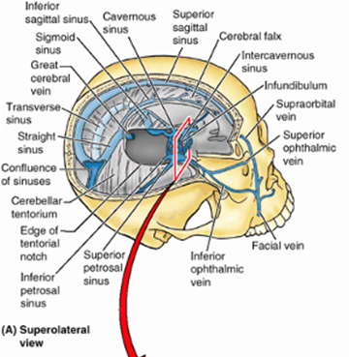

Slide 13
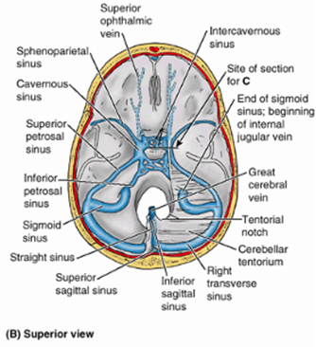

Slide 14
Intercavernous Sinuses
The two cavernous sinuses are connected by anterior and posterior intercavernous sinuses (and the basilar plexus. The intercavernous sinuses lie in the anterior and posterior attached borders of the diaphragma sellae and they thus form a complete circular venous sinus.
All connections are valveless and the direction of flow in them is reversible. Small irregular sinuses inferior to the pituitary gland drain into the intercavernous sinuses. Such inferior intercavernous sinuses are plexiform in nature and important in a surgical transnasal approach to the pituitary.

Slide 15
Summary
Lies alongside body of sphenoid in middle cranial fossa
Between periosteal (endosteal) and meningeal (fibrous) layers of dura
Roof: Anterior & posterior clinoid processes with uncus of temporal lobe & internal carotid artery on it, III & IV into it
Lateral wall: Dura, temporal lobe, III, IV, Va, Vb in wall
Floor: Greater wing of sphenoid
Medial wall: Dura over sphenoid, sella turcica, pituitary, sphenoid sinus
Posterior wall: (narrow), dura of posterior fossa, superior and inferior petrosal sinuses, peduncle of brain
Anterior wall: (narrow), medial end of superior orbital fissure, ophthalmic veins, orbit
Contains: Internal carotid artery, VI & blood
Draining into it: Superior/inferior ophthalmic veins, inter- cavernous sinuses, sphenoparietal sinuses, superficial middle cerebral vein
Draining out of it: Superior/inferior petrosal sinuses, emissary veins to pterygoid plexus

