Slide 1
CERVICAL FASCIA
BY MBBSPPT.COM

Slide 2
CERVICAL FASCIA
Superficial (investing) layer of deep cervical fascia
Prevertebral layer of deep cervical fascia
Pretracheal layer of deep cervical fascia
Carotid sheath: A non-membranous layer of fascia . (conventionally described as part of the deep cervical fascia)
E. Alar fascia
F. Buccopharyngeal fascia
G. Pharyngobasilar fascia

Slide 4
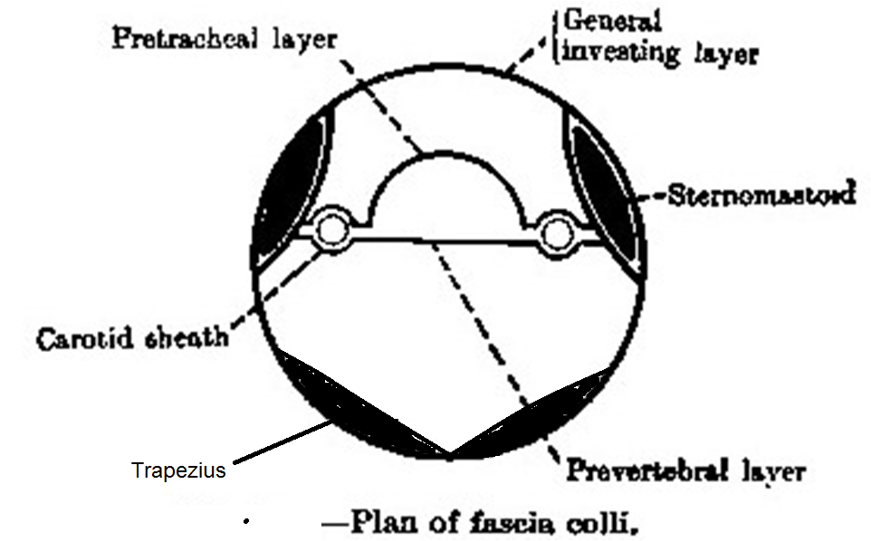

Slide 6
Superficial fascia
The superficial cervical fascia is usually a thin lamina covering platysma and is hardly demonstrable as a separate layer.

Slide 7
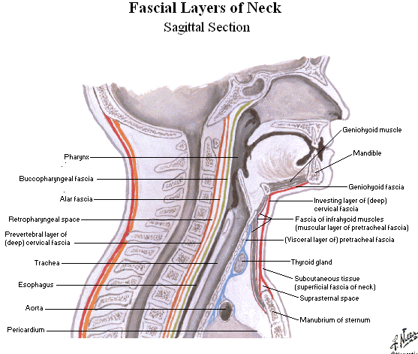

Slide 8
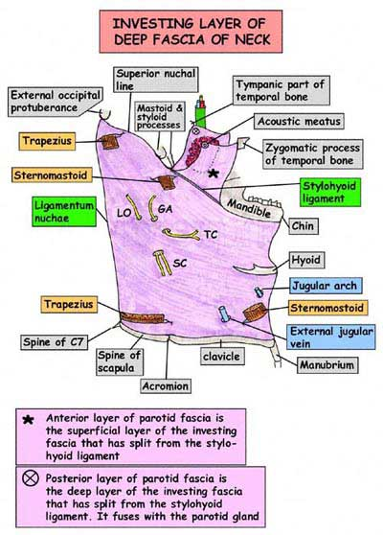

Slide 9
The investing layer of deep cervical fascia
The investing layer of deep cervical fascia, the most superficial deep fascial layer, surrounds the entire neck deep to the skin and subcutaneous tissue. At the four corners of the neck, it splits into superficial and deep layers to enclose (invest) the trapezius and sternocleidomastoid (SCM) muscles. Superiorly, the investing layer of deep cervical fascia attaches to :
Superior nuchal line of the occipital bone.
Mastoid processes of the temporal bones.
Zygomatic arches.
Inferior border of the mandible.
Hyoid bone.
Spinous processes of the cervical vertebrae.

Slide 10
Inferior to its attachment to the mandible
Just inferior to its attachment to the mandible, the investing layer of fascia also splits to enclose the submandiblar gland; posterior to the manudible, it splits to form the fibrous capsule of the parotid gland.
The stylomandibular ligament is a thickened modification of this layer.

Slide 11
Inferiorly, the investing layer of deep cervical fascia attaches to the manubrium, clavicles, and acromions and spines of the scapulae.
Inferiorly between the sternal heads of the SCMs and just superior to the manubrium, the investing layer of deep cervical fascia remains divided into two layers to enclose the SCM; one layer attaches to the anterior and the other to the posterior surface of the manubrium.
A suprasternal space lies between these layers. It encloses the inferior ends of the anterior jugular veins, the jugular venous arch, fat, and a few deep lymph nodes.
Posteriorly The investing layer of deep cervical fascia is continuous posteriorly with the periosteum covering the C7 spinous process, and with the nuchal ligament (L. ligamentum nuchae), a triangular membrane that forms a median fibrous septum between the muscles of the two sides of the neck.
The outermost layer of deep cervical fascia, the investing layer, splits to enclose the trapezius and sternocleidomastoid (SCM) at the four corners of the neck.

Slide 12
The prevertebral fascia
The prevertebral fascia covers the anterior vertebral muscles and extends laterally on scalenus anterior, scalenus medius and levator scapulae, forming a fascial floor for the posterior triangle of the neck.
As the subclavian artery and the brachial plexus emerge from behind scalenus anterior they carry the prevertebral fascia downwards and laterally behind the clavicle as the axillary sheath.
The prevertebral fascia is particularly prominent in front of the vertebral column, where there may be two distinct layers of fascia. Traced laterally, it becomes thin and areolar and is lost as a definite fibrous layer under cover of trapezius.

Slide 13
The prevertebral fascia
Superiorly:
The prevertebral fascia is attached to the base of the skull.
Inferiorly:
It descends in front of longus colli into the superior mediastinum. (where it blends with the anterior longitudinal ligament)
Anteriorly:
The prevertebral fascia is separated from the pharynx and its covering buccopharyngeal fascia by a loose areolar zone.
The retropharyngeal space.
Laterally:
This loose tissue connects the prevertebral fascia to the carotid sheath and the fascia on the deep surface of sternocleidomastoid.

Slide 14
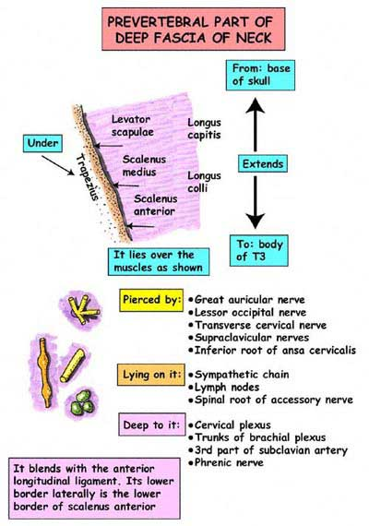

Slide 15
Pretracheal Layer of Deep Cervical Fascia
The thin pretracheal layer of deep cervical fascia is limited to the anterior part of the neck. It extends inferiorly from the hyoid into the thorax, where it blends with the fibrous pericardium covering the heart.
The pretracheal layer of fascia includes
A thin muscular part, which encloses the infrahyoid muscles, and
A visceral part, which encloses the thyroid gland, trachea, and esophagus and is continuous posteriorly and superiorly with the buccopharyngeal fascia of the pharynx.
The pretracheal fascia blends laterally with the carotid sheaths.
In the region of the hyoid, a thickening of the pretracheal fascia forms a pulley or trochlea through which the intermediate tendon of the digastric muscle passes, suspending the hyoid.
By wrapping around lateral border of hyoid, the pretracheal layer also tethers the two-bellied omohyoid muscle, redirecting the course of the muscle between the bellies.

Slide 16
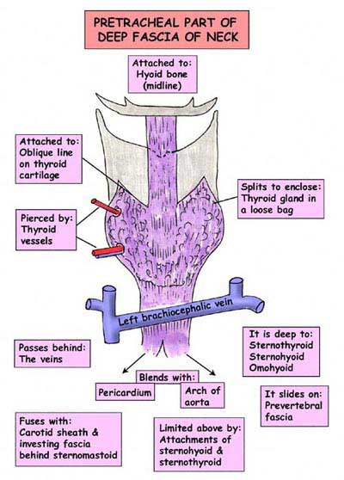

Slide 17
The Carotid Sheath
The carotid sheath is a tubular fascial investment that extends from the cranial base to the root of the neck.
This sheath blends anteriorly with the investing and pretracheal layers of fascia and posteriorly with the prevertebral layer of fascia.
The carotid sheath contains
(1) the common and internal carotid arteries,
(2) the internal jugular vein,
(3) the vagus nerve (CN X),
(4) some deep cervical lymph nodes,
(5) the carotid sinus nerve, and
(6) sympathetic nerve fibers (carotid periarterial plexuses).
The carotid sheath and pretracheal fascia communicate freely with the mediastinum of the thorax inferiorly and the cranial cavity superiorly. These communications represent potential pathways for the spread of infection and extravasated blood.

Slide 19
Axillary Sheath
As the subclavian artery and the brachial plexus emerge in the interval between the scalenus anterior and the scalenus medius muscles, they carry with them a sheath of the fascia, which extends into the axilla and is called the axillary sheath.

Slide 20
Alar Fascia
Is an ancillary layer of the deep cervical fascia between the pretracheal (or buccopharyngeal) and prevertebral fasciae, and forms a subdivision of the retropharyngeal space.
Blends with the carotid sheath laterally and extends from the base of the skull to the level of the seventh cervical vertebra, where it merges with the pretracheal fascia.

Slide 21
Buccopharyngeal fascia
The fascia that covers the muscular layer of the pharynx and is continued forward onto the buccinator muscle
Is attached to the pharyngeal tubercle and the pterygomandibular raphe.
Covers the buccinator muscles and the pharynx and blends with the pretracheal fascia.

Slide 22
Pharyngobasilar Fascia
Is the fibrous coat in the wall of the pharynx and is situated between the mucous membrane and the pharyngeal constrictor muscles.
The fibrous coat of the pharyngeal wall situated between the mucous and muscular coats; it is attached above to the basilar part of the occipital bone, and the petrous part of the temporal bone. This layer and the mucosa which lines it forms the wall of the non-muscular pharynx (pharyngeal vault) above the superior pharyngesl constrictor muscle.

Slide 23
Cervical(mandibular)Ligaments
Stylohyoid ligament: Connects the styloid process to the lesser cornu of the hyoid bone
Stylomandibular ligament: Connects the styloid process to the angle of the mandible
Sphenomandibular ligament: Connects the spine of the sphenoid bone to the lingula of the mandible
Pterygomandibular ligament: Connects the hamular process of the medial pterygoid plate to the posterior end of the mylohyoid line of the mandible. It gives attachment to the superior constrictor and the buccinator muscles.

Slide 24
The Retropharyngeal Space
The retropharyngeal space is the largest and most important interfascial space in the neck.
It is a potential space that consists of loose connective tissue between the visceral part of the prevertebral layer of deep cervical fascia and the buccopharyngeal fascia surrounding the pharynx superficially.

Slide 25
Spread of Infections in the Neck
The investing layer of deep cervical fascia helps prevent the spread of abscesses caused by tissue destruction.
If an infection occurs between the investing layer of deep cervical fascia and the muscular part of the pretracheal fascia surrounding the infrahyoid muscles, the infection will usually not spread beyond the superior edge of the manubrium.
If, however, the infection occurs between the investing fascia and the visceral part of pretracheal fascia, it can spread into the thoracic cavity anterior to the pericardium.
The pus may perforate the prevertebral layer of deep cervical fascia and enter the retropharyngeal space, producing a bulge in the pharynx (retropharyngeal abscess). This abscess may cause difficulty in swallowing (dysphagia) and speaking (dysarthria).
Similarly, air from a ruptured trachea, bronchus, or esophagus (pneumomediastinum) can pass superiorly in the neck.

Slide 26
Acute Infections of the Fascial Spaces of the Neck
Dental infections most commonly involve the lower molar teeth. The infection spreads medially from the mandible into the submandibular and masticatory spaces and pushes the tongue forward and upward. Further spread downward may involve the visceral space and lead to edema of the vocal cords and airway obstruction.
Ludwig's angina is an acute infection of the submandibular fascial space and is commonly secondary to dental infection.

Slide 27
Chronic Infection of the Fascial Spaces of the Neck
Tuberculous infection of the deep cervical lymph nodes can result in liquefaction and destruction of one or more of the nodes. The pus is at first limited by the investing layer of the deep fascia.
Later, this becomes eroded at one point, and the pus passes into the less restricted superficial fascia.

Slide 28
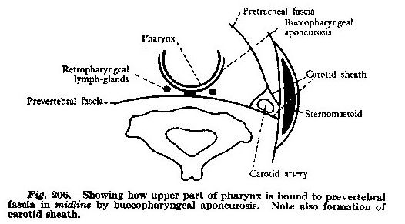

Slide 29
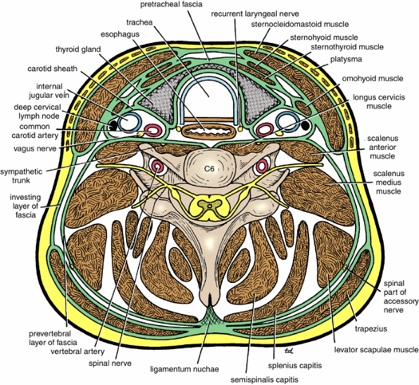

Slide 30
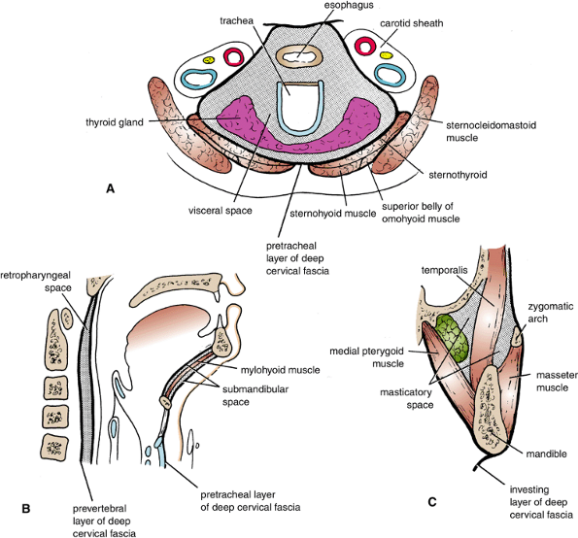

Slide 31
THANK
YOU!

