Slide 1
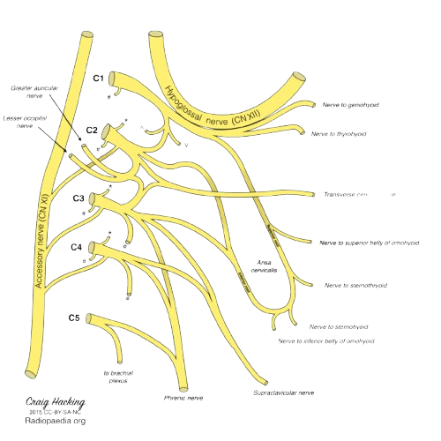
Cervical Plexus
BY MBBSPPT.COM

Slide 2
Plexus in neck
There Are 4 Plexus In Neck:
(Three Nervous + One Venous)
Cervical Nervous Plexus
Brachial Nervous Plexus
Pharyngeal Nervous Plexus
Pharyngeal Venous Plexus

Slide 3
The pharyngeal plexus of veins
  Lies deep to the fascia, draining the pharynx, soft palate and the pharyngeal tonsil.
  Communicates with the pterygoid plexus of veins and drains into the internal jugular vein.
  These veins have no valves and infection from the pharynx, palate and tonsils may spread (septicemia) systemically or into the meningeal venous plexus.

Slide 4
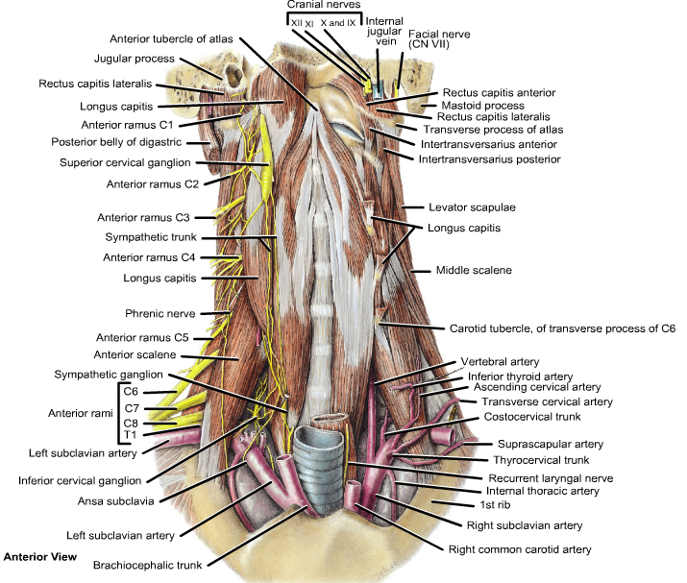

Slide 5
The pharyngeal nervous plexus
The pharyngeal nervous plexus is formed by:
  The skeletal and parasympathetic motor branches of X.
  Sensory branches of IX.
  Vasomotor branches of the sympathetic system.

Slide 6
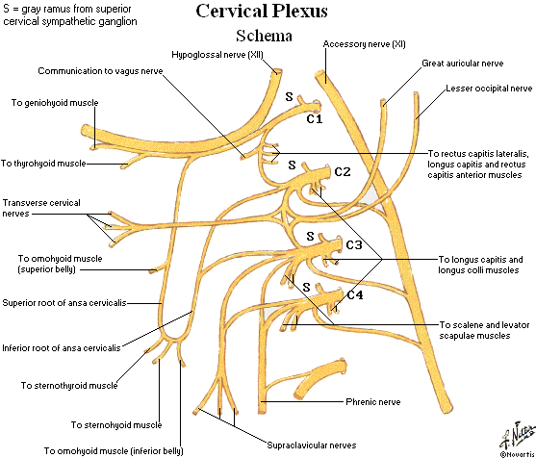

Slide 9
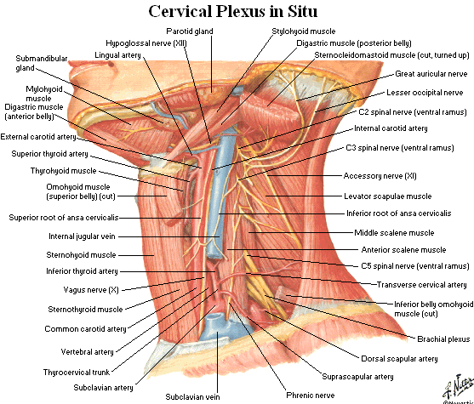

Slide 10
Eight cervical spinal nerves, first one is called suboccipital because it leaves vertebral canal below occipital bone. Each cervical spinal nerve receives grey ramus from sympathetic chain. Each nerve divides into post. & ant. rami. The post. ramus passes backwards to reach muscles of back of neck (No formation of Plexus).
The ant. pri. rami pass laterally to form Plexus.
  Upper 4 pri. rami form cervical plexus
  Lower 4 pri. rami form brachial plexus
The cervical plexus supplies skin, muscles of neck & diaphragm. It lies on scalenes medius & levator scapulae and lies deep to SCM & IJV.

Slide 11
Mechanism
Each nerve except 1st divides into upper & lower branches. These branches join together to form 3 loops. The 1st nerve joins upper branch of C2. The adjoining upper & lower branches fuse. The lower branch of C4 takes part in the formation of brachial plexus.
There are 3 loops, 1st loop is directed forward in front of transvers process of atlas. 2nd & 3rd are directed backwards.

Slide 12
The cervical plexus of loops
  Is formed by the ventral rami of the upper four cervical nerves.
  It supplies some neck muscles and the diaphragm, and areas of skin on the head, neck and chest.
  The cervical plexus consists of an irregular serious of nerve loops and the branches that arise from the loops(plexus of loops). Each participating ramus, except the first, divides into ascending and descending branches that unite with the branches of the adjacent spinal nerve to form the loops.

Slide 14
The branches
  The branches are superficial or deep.
  The superficial branches perforate the cervical fascia to supply the skin while the deep branches in general supply muscles.
  The superficial branches of the plexus that initially pass posteriorly are cutaneous branches.
  The deep branches passing anteromedially are motor branches, including the roots of the phrenic nerve (to the diaphragm) and the ansa cervicalis.

Slide 15
Cervical plexus
Superficial
Ascending
Braches
Descending
branches
Deep
Medial series
Lateral series

Slide 16
The superficial branches
Ascending:
  The lesser occipital, C2 which supplies the back of the scalp and the auricle.
  The great auricular C2, C3 which supplies the skin over the angle of the mandible.
  The transverse cutaneous nerves, C2, C3 which supplies the skin over the front of the neck.
Descending:
  Supraclavicular nerves, C3, C4: The medial, and intermediate, and lateral branches supply the skin over the shoulder region. These nerves are important clinically, because pain may be referred along them from the phrenic nerve (gallbladder disease).

Slide 17
The deep branches - Medial series
Communicating branches pass from the loop between the first and second cervical rami to the vagus and hypoglossal nerves and to the sympathetic trunk.
The hypoglossal branch later leaves the hypoglossal nerve as a series of branches, viz. the meningeal, superior root of ansa cervicalis, nerves to thyrohyoid and to geniohyoid.
A branch also connects the fourth and fifth cervical rami.
The first four cervical ventral rami each receive a grey ramus communicans from the superior cervical sympathetic ganglion.
Muscular branches:
Rectus capitis lateralis (C1),
Rectus capitis anterior (C1, 2),
Longus capitis (C1-3) and
Longus colli (C2-4).
The inferior root of the ansa cervicalis and the phrenic nerve are additional muscular branches.
In the neck, each nerve receives variable filaments from the cervical sympathetic ganglia or their branches and may also connect with internal thoracic sympathetic Plexus.

Slide 18
DEEP BRANCHES - LATERAL SERIES
Communicating branches
Lateral deep branches of the cervical plexus (C2, 3, 4) may connect with the spinal accessory nerve within sternocleidomastoid, the posterior triangle or beneath trapezius.
Muscular Branches:
Muscular branches are distributed to
Sternocleidomastoid (C2, 3, 4),
Trapezius (C2 and possibly C3),
Levator scapulae (C3, 4) and
Scalenus medius (C3, 4).
Branches to trapezius cross the posterior triangle obliquely below the spinal accessory nerve.
It is situated in the neck opposite a line drawn down the side of the neck from the root of the auricle to the level of the upper border of the thyroid cartilage.
It is deep to the internal jugular vein, the deep fascia and sternocleidomastoid, and anterior to scalenus medius and levator scapulae.

Slide 19
Ansa cervicalis
The superior root of the ansa cervicalis (descendens hypoglossi) leaves the hypoglossal nerve where it curves round the occipital artery and then descends anterior to or in the carotid sheath. It contains only fibres from the first cervical spinal nerve.
After giving a branch to the superior belly of omohyoid, it is joined by the inferior root of the ansa from the second and third cervical spinal nerves.
The two roots form the ansa cervicalis (ansa hypoglossi), from which branches supply sternohyoid, sternothyroid and the inferior belly of omohyoid.
Another branch is said to descend anterior to the vessels into the thorax to join the cardiac and phrenic nerves.

Slide 20
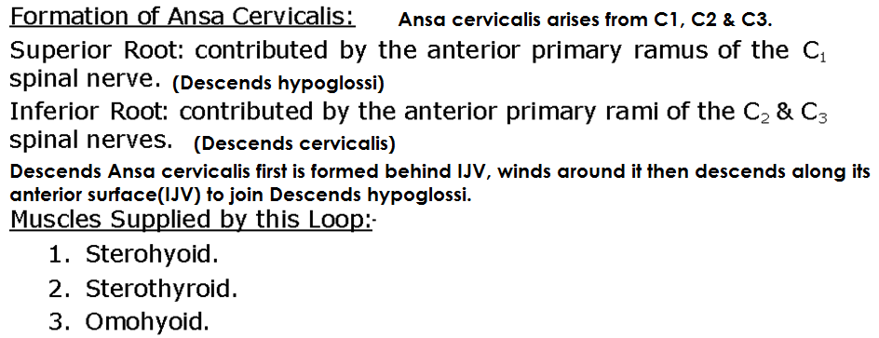

Slide 21
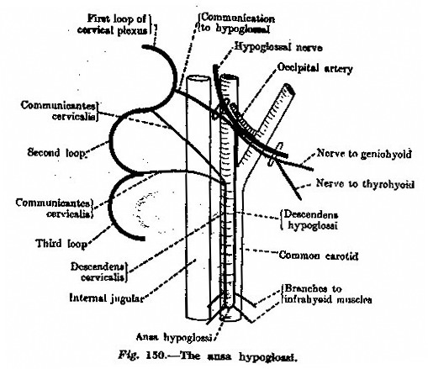

Slide 22
The superior root of the ansa cervicalis
(descendens hypoglossi)
Leaves the hypoglossal nerve where it curves round the occipital artery and then descends anterior to or in the carotid sheath.
It contains only fibres from the first cervical spinal nerve. After giving a branch to the superior belly of omohyoid, it is joined by the inferior root of the ansa from the second and third cervical spinal nerves.
The two roots form the ansa cervicalis (ansa hypoglossi), from which branches supply sternohyoid, sternothyroid and the inferior belly of omohyoid. Another branch is said to descend anterior to the vessels into the thorax to join the cardiac and phrenic nerves.

Slide 23
The inferior root of the ansa cervicalis
Formed by the union of a branch from the second with another from the third cervical ramus.
It descends on the lateral side of the internal jugular vein, crosses it a little below the middle of the neck, and continues forwards to join the superior root anterior to the common carotid artery, forming the ansa cervicalis (ansa hypoglossi), from which all infrahyoid muscles except thyrohyoid are supplied.
The inferior root comes from the second and third cervical ventral rami in 75% cases.

Slide 24
The phrenic nerve
The phrenic nerve arises chiefly from the fourth cervical ventral ramus, but also has contributions from the third and fifth.
It is formed at the upper part of the lateral border of scalenus anterior and descends almost vertically across its anterior surface behind the prevertebral fascia.
It descends posterior to sternocleidomastoid, the inferior belly of omohyoid (near its intermediate tendon), the internal jugular vein, transverse cervical and suprascapular arteries and, on the left, the thoracic duct.
At the root of the neck, it runs anterior to the second part of the subclavian artery, from which it is separated by the scalenus anterior (some accounts state that on the left side the nerve passes anterior to the first part of the subclavian artery), and posterior to the subclavian vein.
The phrenic nerve enters the thorax by crossing medially in front of the internal thoracic artery.

Slide 25
The accessory phrenic nerve
The accessory phrenic nerve is composed of fibres from the fifth cervical ventral ramus which run in a branch of the nerve to subclavius.
This lies lateral to the phrenic nerve and descends posterior (occasionally anterior) to the subclavian vein.
The accessory phrenic nerve usually joins the phrenic nerve near the first rib, but may not do so until near the pulmonary hilum or beyond.
The accessory phrenic nerve may be derived from the fourth or sixth cervical ventral rami or from the ansa cervicalis.

Slide 26
Thank You

