Slide 1
CHRONIC SUPPURATIVE OTITIS MEDIA BY MBBSPPT.COM

Slide 2
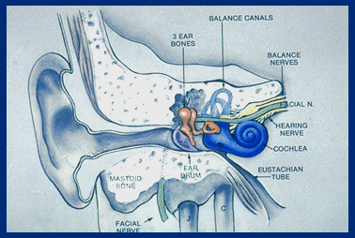

Slide 3
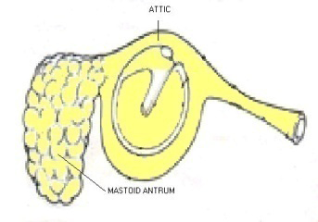
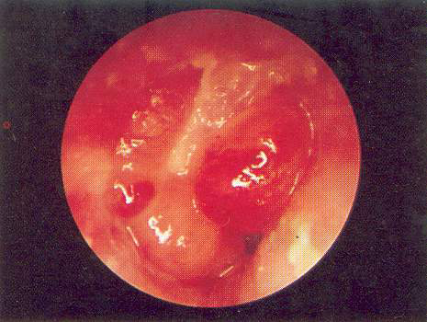
ATTICOANTRAL TYPE OR UNSAFE TYPE
It involves the posterosuperior part of the middle ear cleft (attic, antrum , posterior tympanum and mastoid) and is associated with cholesteatoma. This is termed as unsafe because dangerous intra cranial and extra cranial complications can occur, proving fatal to the patient.

Slide 4
CHOLESTEATOMA
Cholesteatoma ( or keratoma ) is defined as a cystic bag like structure lined by stratified squamous epithelium on a fibrous matrix. This sac contains desquamated squamous epithelium. Cholesteatoma is also defined as 'skin in wrong place'.

Slide 5
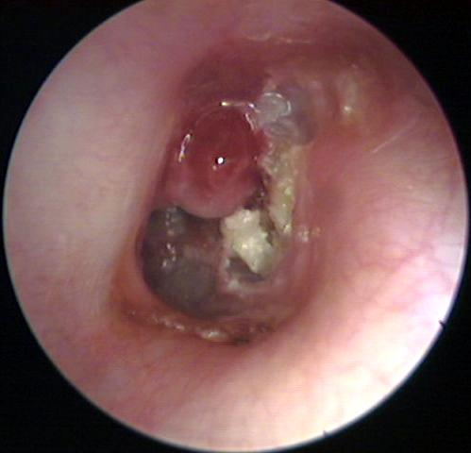

Slide 6
THEORIES TO EXPALIN PATHOGENESIS OF CHOLESTEATOMA
Cawthrone theory
Basal cell hyperplasia or Ruedi’s theory
Epithelial invasion or Habermann’s theory
Metaplasia or sade’s theory
Theory of invagination or Wittmaack's theory

Slide 7
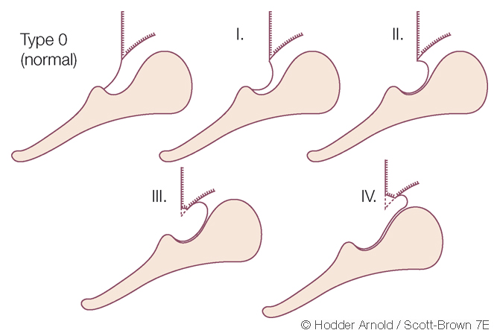
ATTIC RETRACTION POCKETS

Slide 8
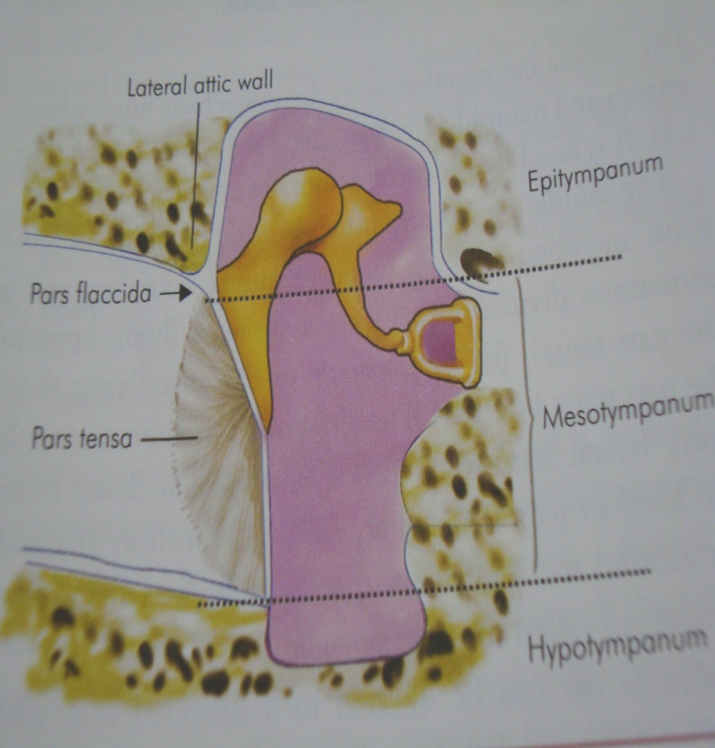
COMMON SITES OF ORIGIN OF CHOLESTEATOMA
Posterior epitympanum
Posterior mesotympanum
Anterior epitympanum

Slide 9
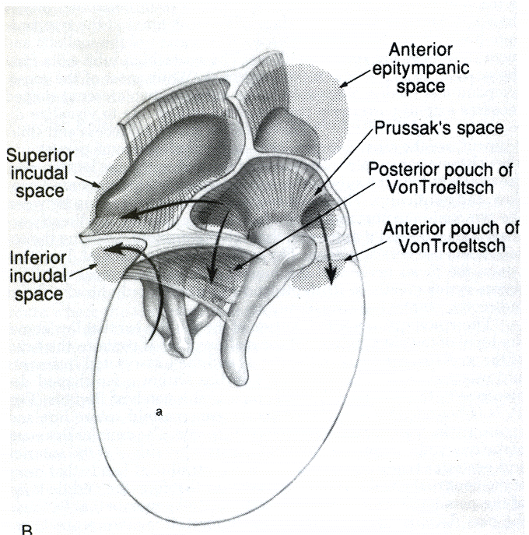
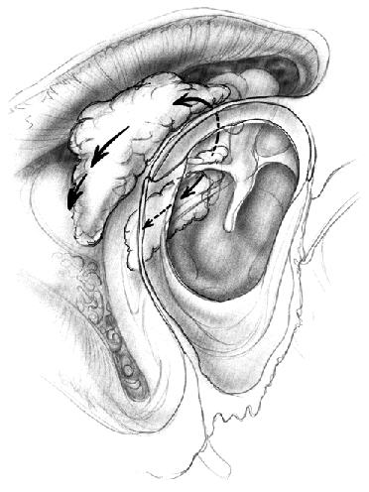
CHOLESTEATOMA SPREAD
Posterior epitympanic cholesteatoma spreads by passing through superior incudal space and antrum

Slide 10
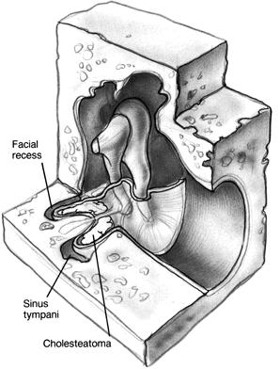
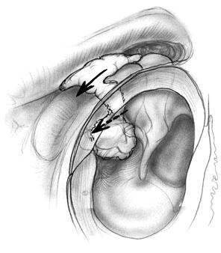
Posterior mesotympanic cholesteatoma spreads by invading the sinus tympani and facial recess

Slide 11
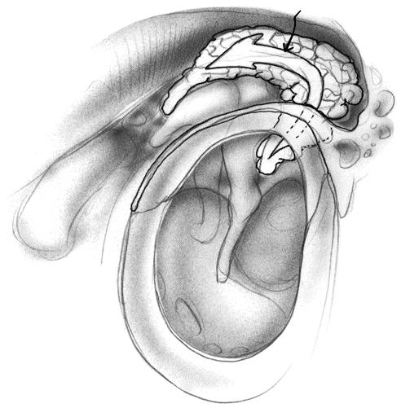
Anterior epitympanic cholesteatoma spreads with extension to geniculate ganglion

Slide 12
CLASSIFICATION OF CHOLESTEATOMA
1. Congenital cholesteatoma
2. Acquired
a. Primary acquired cholesteatoma
b. Secondary acquired cholesteatoma

Slide 13
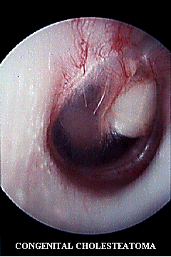
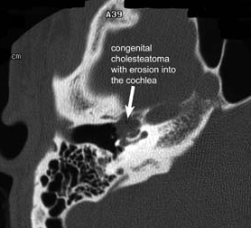
CONGENITAL CHOLESTEATOMA
Arises from embryonic cell rests present in the middle ear cavity and temporal bone. Occurs commonly at 3 important sites : middle ear , petrous apex and cerebello pontine angle.

Slide 14
ACQUIRED CHOLESTEATOMA
Primary : In this condition there is no history of preexisting or previous episodes of otitis media or perforation. Lesions just arise from the attic region of the middle ear.
Secondary : always follows active middle ear infection , there is already a pre-existing perforation in pars tensa . Often associated with posterosuperior marginal perforation or large central canal perforation.

Slide 15
PRIMARY ACQUIRED CHOLESTEATOMA
Eustachian tube obstruction
Persistent negative pressure in middle ear
Attic or posterosuperior retraction pocket
Metaplasia of Proliferation of
Middle ear mucosa basal layer
Subclinical infections of middle ear
Primary acquired cholesteatoma

Slide 16
SECONDARY ACQUIRED
CHOLESTEATOMA
Repeated infection Acute necrotising
through perforation otitis media
Metaplasia of Large central or
middle ear mucosa marginal perforation
Epithelial migration
through perforation
Secondary acquired
cholesteatoma

Slide 17
THEORIES OF BONE INVASION BY
CHOLESTEATOMA
1. Pressure theory - increase in the pressure caused by enlarging cholesteatoma leads to bone erosion. (This theory is not accepted anymore )
2. Enzymatic theory: Cholesteatoma has osteoclasts and mononuclear inflammatory cells. These cells release acid phosphatase, collagenase and other proteolytic enzymes which cause bone erosion.
3. Pyogenic osteitis: Pyogneic bacteria releases enzymes which cause bone destruction.

Slide 18
SEQUELAE
Infection
Otorrhea
Bone destruction
Hearing loss
Facial nerve paralysis
Labyrinthine fistula
Intracranial complications

Slide 19
CSOM (UNSAFE)

Slide 20
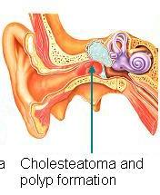
PATHOGENESIS
Atticoantral diseases is associated with the following
pathological processes:
1. Cholesteatoma
2. Osteitis and granulation tissue
3. Ossicular necrosis
4. Cholesterol granuloma

Slide 21
BACTERIOLOGY
Gram -ve: Proteus, Pseudomonas and E. Coli
Gram +ve: Staphylococci
Anaerobes: Bacteroides melaninogenicus, Bacteroides fragilis

Slide 22
SYMPTOMS
EAR DISCHARGE
HEARING LOSS
BLEEDING

Slide 23
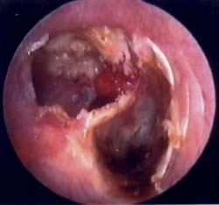
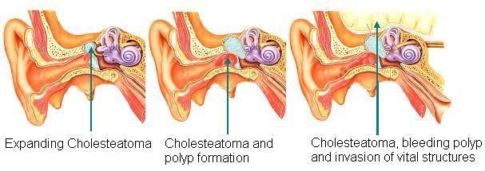
Notes:
Cholesteatoma. ear

Slide 24
SIGNS
PERFORATION
RETRACTION POCKET
CHOLESTEATOMA

Slide 25
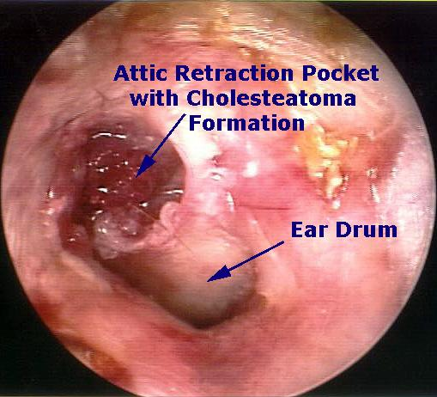

Slide 26
INVESTIGATIONS
Examination under microscope
Audiogram and Tuning fork tests
(Usually of conductive type.
Loss in low frequencies of 64, 28, 256)
3. X-Ray Both Mastoid or CT scan temporal bone
• Benign CSOM - Sclerosis of Mastoid
• Danger CSOM – Sclerosis with Erosion
4. Pus – Culture & Sensitivity

Slide 27
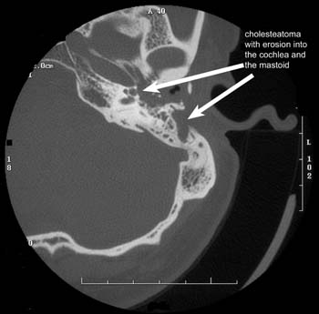

Slide 28
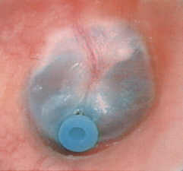
PREVENTIVE MANAGEMENT
Tympanostomy tube for early retraction pockets
Surgery if the retraction persists

Slide 29
TREATMENT
To achieve the goal of total eradication of cholesteatoma to obtain a safe and dry ear.
Methods:
Surgical
- Canal wall up procedure
- Canal wall down procedure
2. Reconstructive surgery

Slide 30
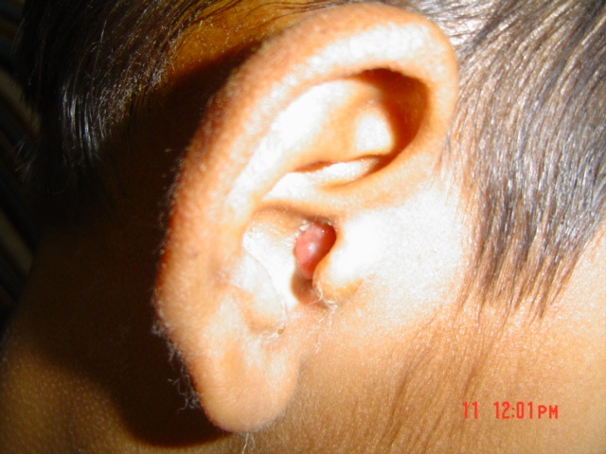

Slide 31
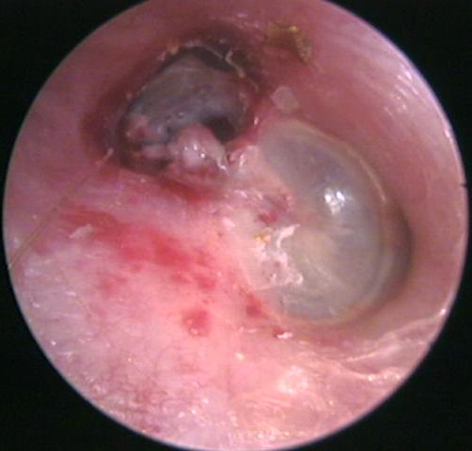

Slide 32
FACTORS INDICATING
COMPLICATIONS IN CSOM
PAIN
VERTIGO
PERSISTENT HEADACHE
FACIAL WEAKNESS
IRRITABILITY AND NECK RIGIDITY
DIPLOPIA
ATAXIA
ABSCESS ROUND THE EAR

Slide 33
 | Tubotympanic/safe | Atticoantral/unsafe
Discharge | Profuse, mucoid, odourless | Scanty, purulent, foulsmelling
Perforation | Central | Attic/marginal
Granulations | Uncommon | Common
Polyp | Pale | Red and fleshy
Cholesteatoma | Absent | Present
complications | Rare | Common
Audiogram | Mild to moderate conductive deafness | Conductive or mixed deafness

Slide 34
Thank You

