Slide 1
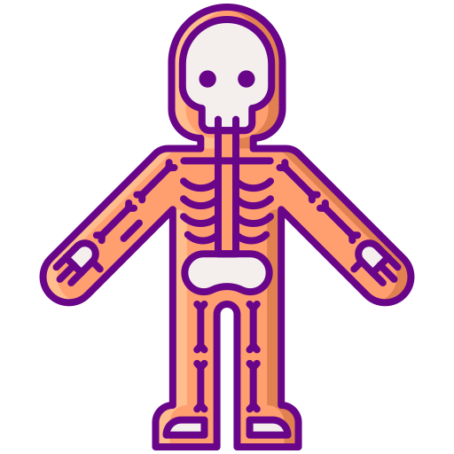
Constitution of Bone
BY MBBSPPT.COM

Slide 2
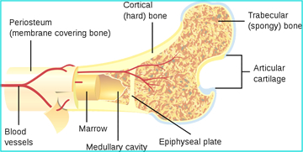
Introduction
Bone is mineralized dense connective tissue.
Made up of Few cells in mineralized matrix.
Consists of 30-40 % of our body weight.
Dynamic in nature.

Slide 3
Functions
Framework of the body.
Attachment of muscle and tendon.
Permit the movements in body parts.
Protection of organs.
Hematopoiesis.
Reservoir of minerals and fat.

Slide 4
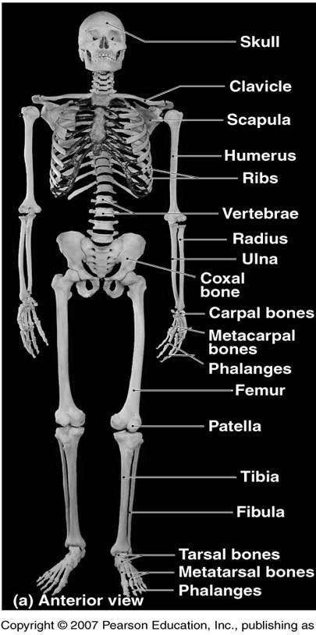
Classification
Regional Classification
Axial Skeleton- 80 Bones
Appendicular Skeleton-126 Bones
Microscopic Classification
Compact Bone
Cancellous/Trabecular Bone

Slide 5
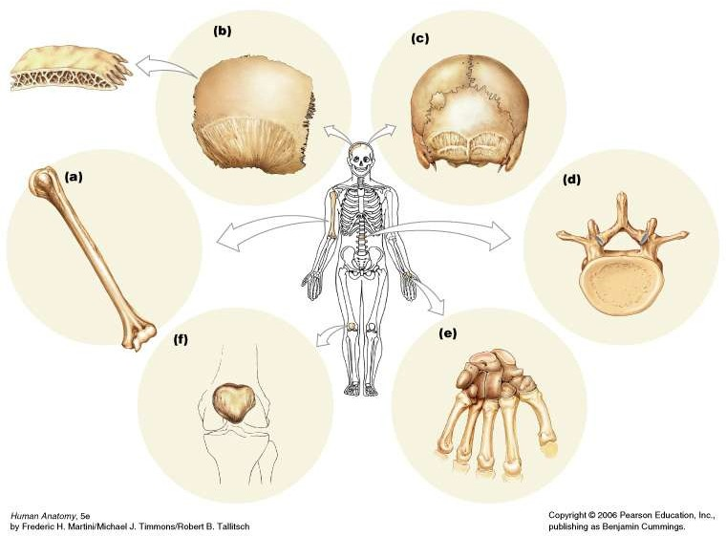
Bone shapes

Slide 6
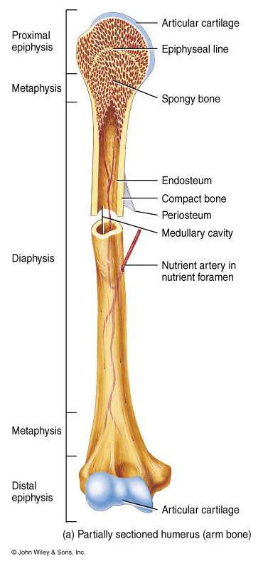
Parts of a Long Bone
Epiphysis – Secondary Centers.
Pressure Epiphysis
Traction Epiphysis
Atavistic Epiphysis
Diaphysis – Primary Centre.
Strongest Part Of Bone
Metaphysis – Epiphysial Ends of a Diaphysis.
Maximum Blood Supply
Epiphysial Plate of Cartilage – Separate Epiphysis from Metaphysis.
Maximum Growth

Slide 7
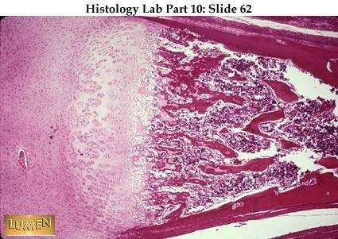
Epiphysial/Growth plate
Hyaline cartilage that separates the epiphysis from diaphysis.
Zone where bones elongate by a growth process.
Zone of resting cells
Zone of proliferating cells
Zone of hypertrophic cells
Zone of calcified cells
Increase in length

Slide 8
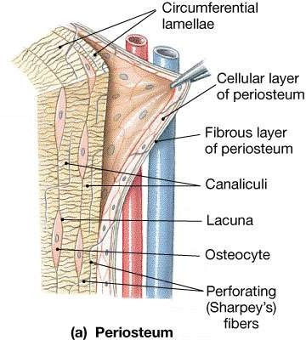
GENERAL STRUCTURE OF BONES
Periosteum
It is an outer fibrous sheath of dense regular connective tissue covering of the bone except articular surface.
Two layers
Outer fibrous layer
Inner cellular (osteoprogenic) layer
It is well defined If active bone formation is in progress.
Sharpey’s fibers
Collagen fibers from ligaments and tendons extend directly into the bone tissue, where they are continuous with the collagen fibers of the extracellular matrix of the bone tissue.

Slide 9
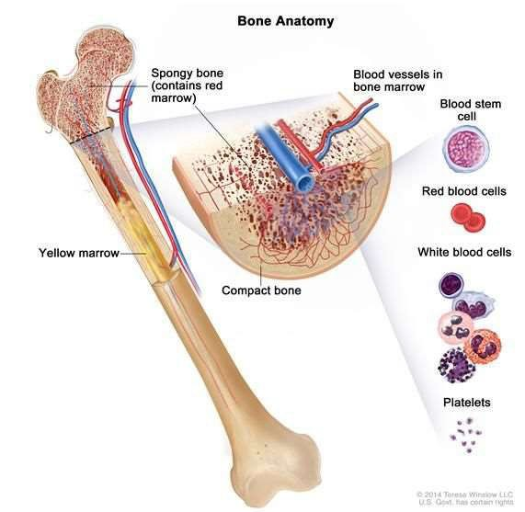
Bone Cavities
The marrow cavity and the spaces in spongy bone contain bone marrow.
Red bone marrow.
normally restricted to the spaces of spongy bone in the adult.
Yellow marrow – consists mostly of fat cells.
can revert to red marrow e.g. extreme blood loss.

Slide 10
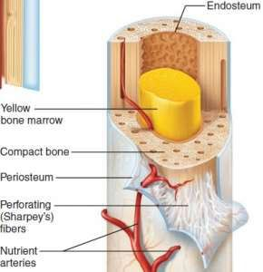
Endosteum
Is often only one cell thick a layer of connective tissue cells lining Bone cavities.
Made up of osteoprogenitor cells that can differentiate into osteoblasts, and bone-lining cells endosteal cells layer.

Slide 11
BLOOD & NERVE SUPPLY
Bone is supplied with blood by,
Periosteal arteries: Enter the Volkmann’s canals. Supply outer 1/3rd of cortex.
Nutrient artery: Supplies medullary cavity, inner 2/3rd of cortex.
Metaphyseal arteries.
Nerves accompany the blood vessels that supply bones.
The periosteum is rich in sensory nerves sensitive to tearing or tension.
Bone tissue lacks lymphatic vessels; lymphatic drainage occurs only from the periosteum.

Slide 12
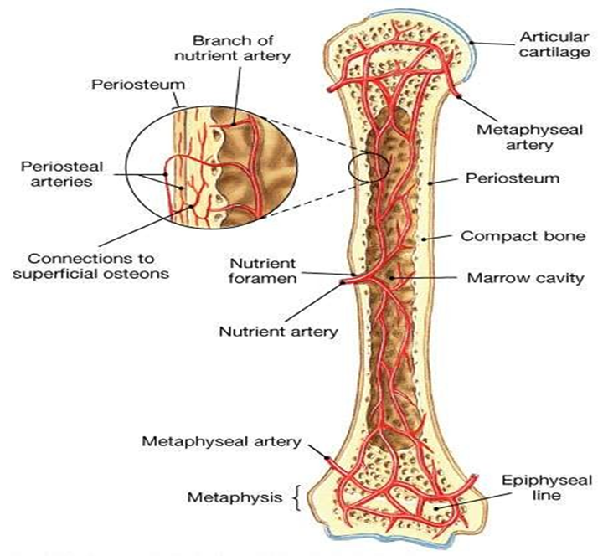

Slide 13
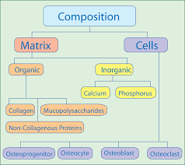
Composition of Bone
Cellular structures in ground substance.
Ground substance made up of:
(A) Organic matrix(35%)
Collagen type 1
Glycosaminoglycans
Proteoglycans, BMP, Osteonectin and Osteocalcin.
To be Contd..

Slide 14
Composition of Bone
(B) Inorganic content (65%)
Largely made up of Ca++ , PO4--- and OH-.
These ions arranged parallel to the direction of collagen fibers by forming a crystalline structure called as Hydroxyapatite.
Ca10(Po4)6(OH)2
Living bone contain 20% of water.
Inorganic content give rigidity to the bone
Organic content give the elasticity to the bone.
Lack of inorganic content - Soft bone.
Lack of organic content - Brittle bone.

Slide 15
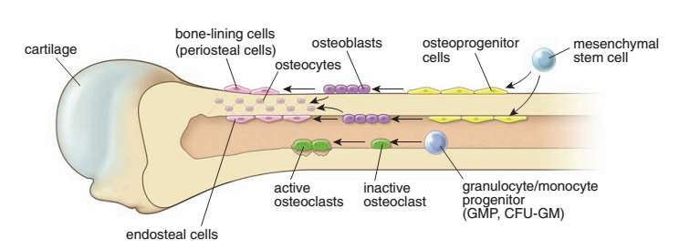
Bone Cells

Slide 16
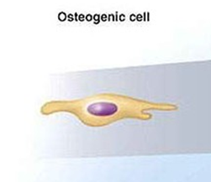
Osteoprogenitor Cells
Derived from mesenchymal stem cells.
Stem cells that give rise to most other bone cells.
Found in the endosteum layer, inner layer of the periosteum and central canal.
Multiply continually!
Stress or fractures stimulates osteogenic cells to multiply rapidly and differentiate into osteoblasts in order to lay down more bone, to rebuild and reinforce.

Slide 17
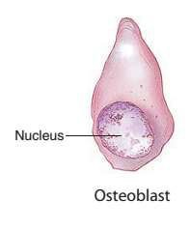
Osteoblast
It is the differentiated bone-forming cell that secretes bone matrix/type I collagen and bone matrix proteins (BMPs).
Active osteoblasts are cuboidal or polygonal in shape and aggregate into a single layer of cells lying in apposition to the forming bone.
Inactive osteoblasts are flat or attenuated cells that cover the bone surface.
Osteoblast processes communicate with other osteoblasts and with osteocytes by gap junctions.

Slide 18
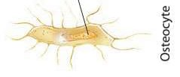
Osteocytes
When completely surrounded by osteoid or bone matrix, the osteoblast is referred to as an osteocyte and the space occupied is lacuna.
Connected to each other by slender channels called canaliculi.
Each Osteocyte is connected to the next by gap junctions in order to pass nutrients, chemical signals to one another, and waste to the nearest blood vessel for removal.
They are responsible for maintaining the bone matrix.
Synthesize new matrix, as well as participate in matrix degradation → maintain calcium homeostasis

Slide 19
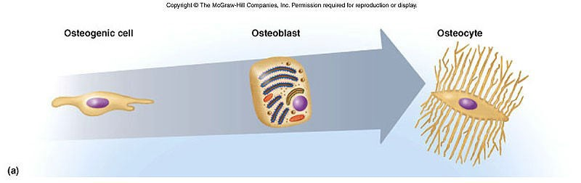

Slide 20
Bone-Lining Cells
Bone-lining cells are derived from osteoblasts and cover bone that is not remodeling.
Layer of flat cells with attenuated cytoplasm
on external bone surfaces = Periosteal cells.
on internal bone surfaces = Endosteal cells.
Function
Maintenance and Nutritional support of the osteocytes.
Regulate the movement of calcium and phosphate into and out of the bone.

Slide 21
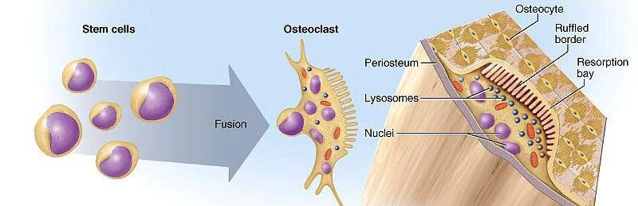
Osteoclasts
These are phagocytotic cells derived from fusion of hemopoietic progenitor cells (stem cells) of neutrophilic granulocyte and monocyte lineages→ multinucleated cells.
These are bone-resorbing cells present on bone surfaces where bone is being removed or remodeled.
Shallow groove formed by osteoclasts called as Howship’s lacunae (Resorption bay).

Slide 22
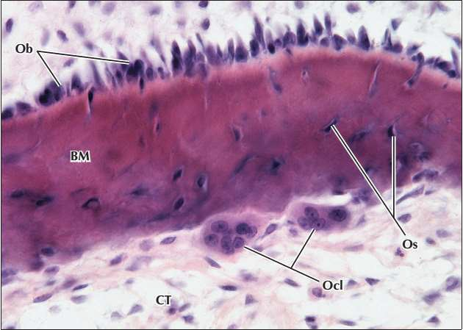

Slide 23
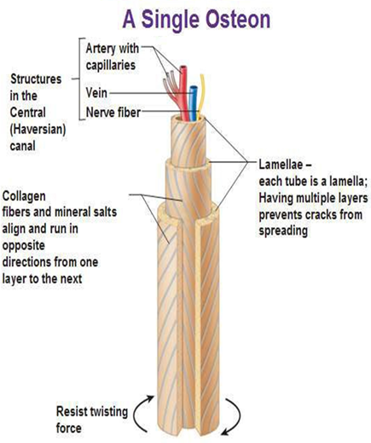
Mature Bone/lamellar bone
Composed of cylindrical units called osteons or Haversian systems.
Osteons consist of concentric lamellae of bone matrix surrounding a central canal, the osteonal (Haversian) canal, which contains the vascular and nerve supply of the osteon.

Slide 24
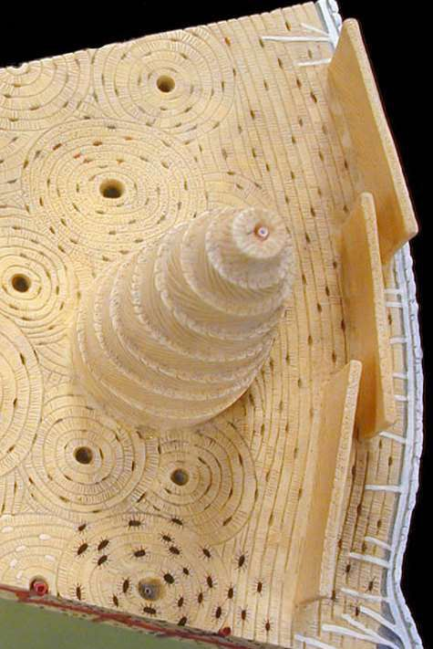
Within the bone matrix are spaces called lacunae, each containing osteocyte.
The osteocyte extends numerous processes into small tunnels called canaliculi.
communicate by Gap junctions with other osteocytes.
Canaliculis generally arranged in a radial pattern with respect to the Haversian canal.
serves for the passage of substances between the osteocytes and blood vessels.

Slide 25
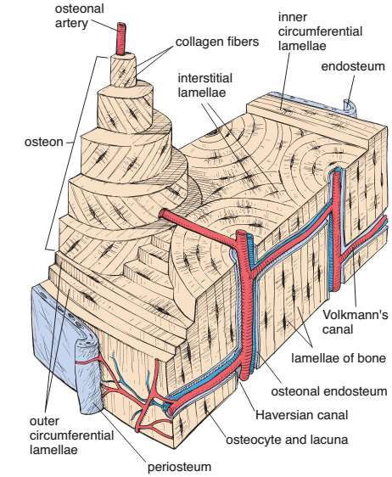
Between the osteons are remnants of previous concentric lamellae called interstitial lamellae.
Circumferential lamellae follow the entire inner and outer circumferences of the shaft of a long bone.
Perforating canals (Volkmann’s canals).
Blood vessels and nerves travel from the periosteal and endosteal surfaces to reach the osteonal canal; they also connect osteonal canals to one another.
Not surrounded by concentric lamellae.

Slide 26
Immature Bone
The skeleton of a developing fetus.
Aka bundle bone or woven bone because of the interlacing arrangement of the collagen fibers.
Comparison with mature bone.
Does not display an organized lamellated appearance.
Contains randomly arranged, relatively more cells per unit area.
More ground substance, not heavily mineralized.
Stains more intensely with hematoxylin whereas mature bone stains more intensely with eosin.
Areas of immature bone are present in adults, especially where bone is being remodeled. E.g. in the alveolar sockets and where tendons insert into bones.

Slide 27
Bone Formation
Intramembranous ossification.
Flat bones of the skull and mandible are formed in this way.
Endochondral ossification.
Gradual replacement of cartilage by bone.
Most bones of the body are formed in this way including long bones.

Slide 28
Intramembranous ossification
Bone formation directly from the mesenchymal sheath (formed by collagen fibers in between the mesenchymal cells).
Not the common process.
Also called as dermal ossification because of its presence in deeper layers of dermis.
Roofing bones of skull, clavicle and mandible.
Mesenchymal cells condensation.
Secretion of organic matrix by the mesenchymal cells which consists of collagen fibers. Thus, forming the mesenchymal sheath.
Localized differentiation of osteoblasts with in sheath.

Slide 29
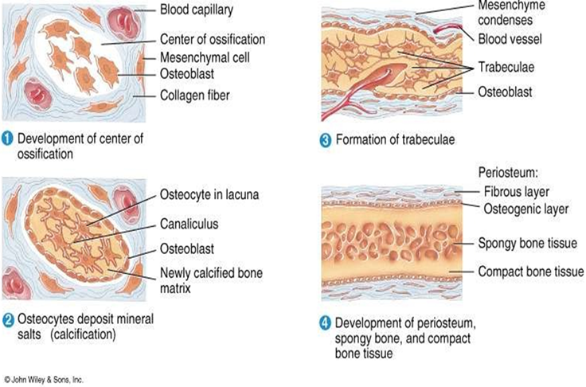
Intramembranous osteogenesis

Slide 30
Endochondral ossification
Most bone formed by this way.
Cartilaginous model is gradually replaced (!!) by the bone.
Chondrocyte hypertrophy.
Degeneration and calcification.
Vascular invasion.
Ossification.

Slide 31
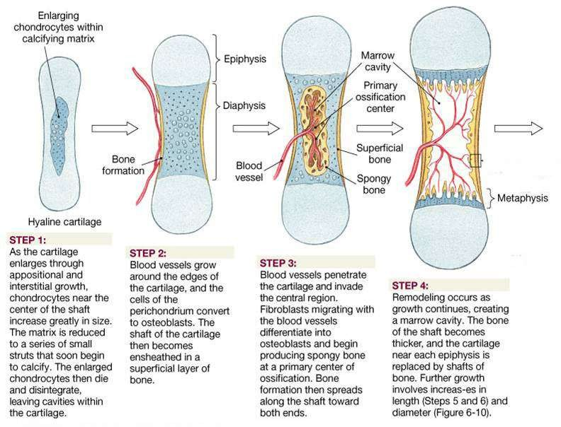

Slide 32
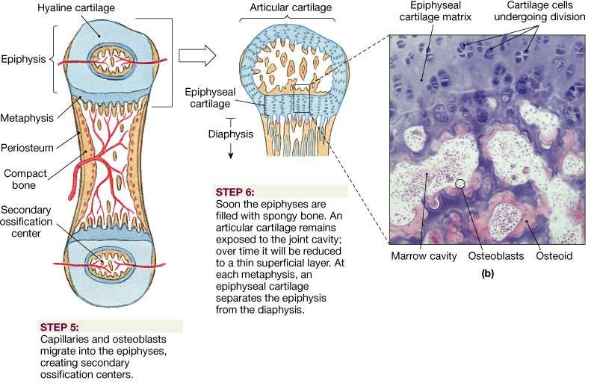

Slide 33
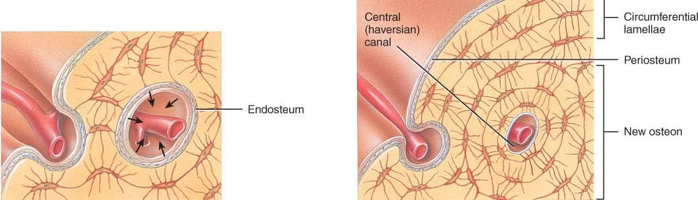
Appositional growth
Increased in thickness of bone.
Occurs in bony surface.

Slide 34
Thank You

