Slide 1
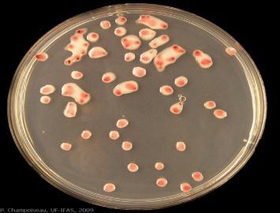
Bacterial Media Culture Basics
MBBSPPT.COM

Slide 2
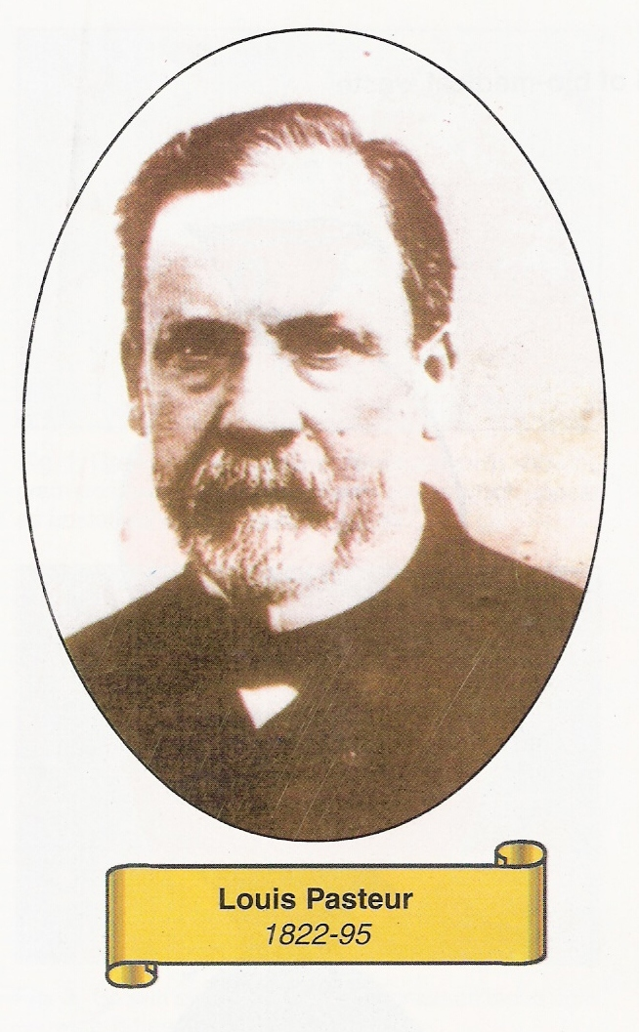
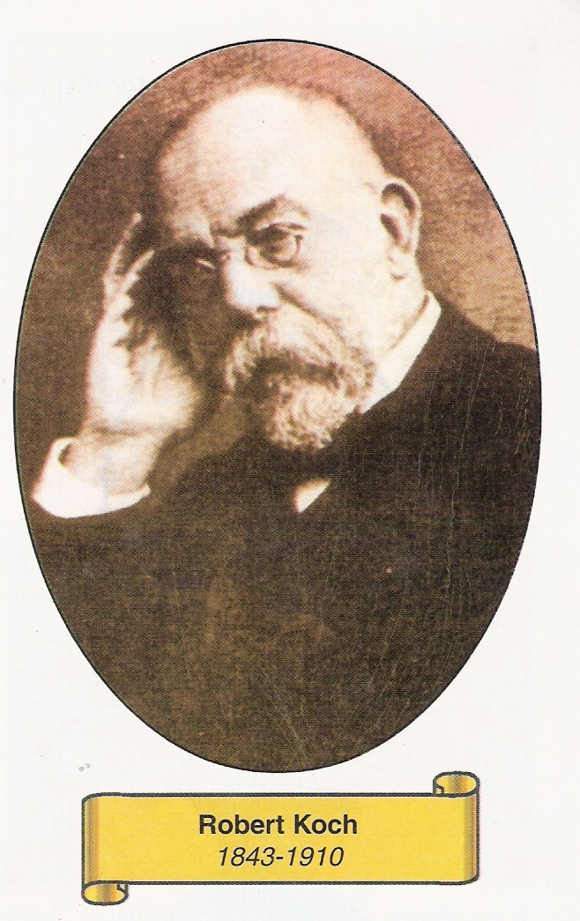
Major Contribution to Culture Media

Slide 3

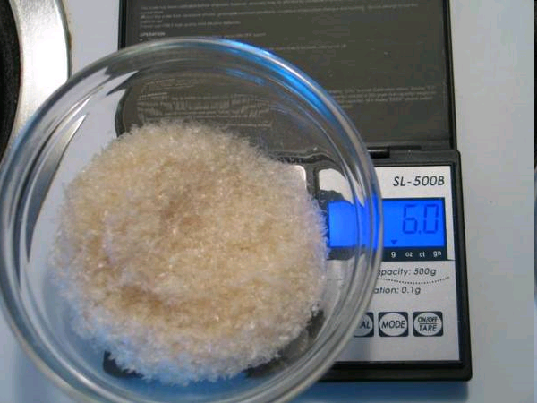
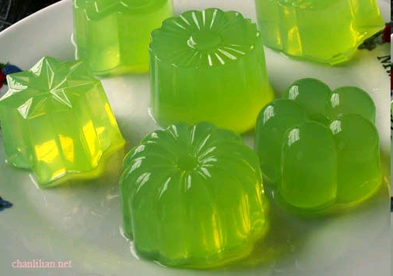
Agar - Agar Frau Hesse’s Contribution

Slide 4
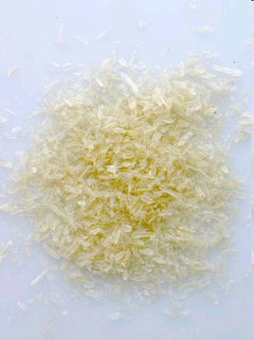
Agar – Agar
Solid medium is made by adding Agar
Agar is obtained from Sea weeds New Zealand agar, Japanese agar
Agar contain long chain poly saccharides.Inoranic salts and protein like substance
Melts at 98⁰c and sets at 42⁰c

Slide 5
Agar isolated from seaweed
Is not degraded by bacteria
Agar is melted by boiling
Liquid medium can be converted into solid medium by addition of agar (1-2%)
or semisolid medium (0,6%)

Slide 6
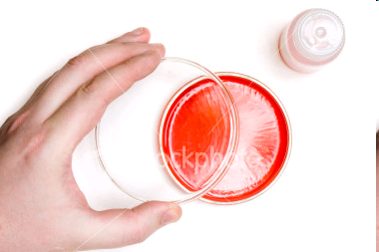
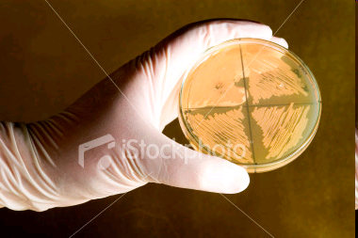
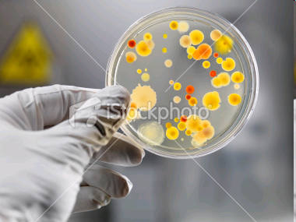
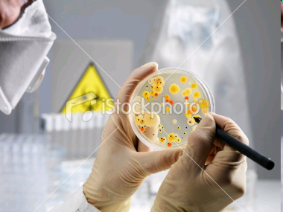

Slide 7
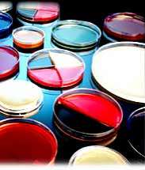
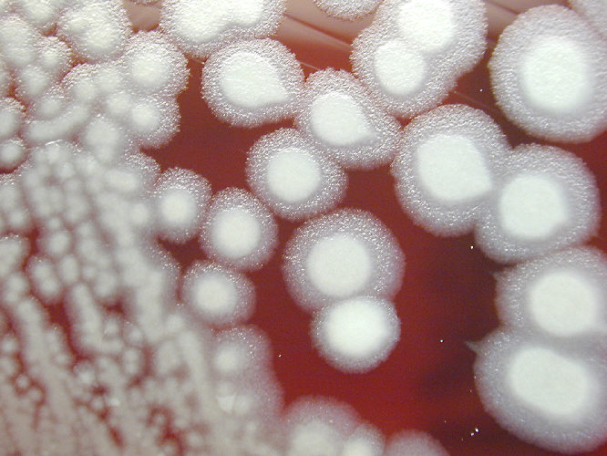
Media and Culture
Media: Nutrients (agar, pH indicators, proteins and carbohydrates) used to grow organisms outside of their natural habitats
Notes:
Here is photograph of colonies growing on SBA. This is the vaccine strain of Bacillus anthracis, but non-vaccine strains look substantially similar. You can see the flat, wavy-edged, ground-glass appearing colonies.

Slide 8

Culture media
Used to grow bacteria
Can be used to:
Enrich the numbers of bacteria
  Select for certain bacteria and suppress others
  Differentiate among different kinds of bacteria

Slide 9
Culture and Medium
Culture is the term given to microorganisms that are cultivated in the lab for the purpose of identifying and studying them.
Medium is the term given to the combination of ingredients that will support the growth and cultivation of microorganisms by providing all the essential nutrients required for the growth (that is, multiplication) in order to cultivate these microorganisms in large numbers to study them.

Slide 10
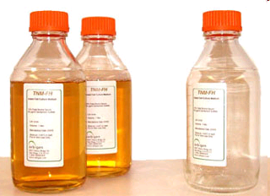
Specific Media
Defined media are media composed of pure ingredients in carefully measured concentrations dissolved in double distilled water i.e., the exact chemical composition of the medium is known. Typically, they contain a simple sugar as the carbon and energy source, an inorganic nitrogen source, various mineral salts and if necessary growth factors (purified amino acids, vitamins, purines and pyrimidines

Slide 11
Need for Culture Media
It is usually essential to obtain a culture by grwoing the organism in an artificial medium.
If more than one species or type of organism are present each requires to be carefully separated or isolated in pure culture.
Several organism need the determination of Antibiotic sensitivity pattern for optimal antibiotic selection.

Slide 12
Basic requirements of culture media
Nutrients
- Energy source
- Carbon source
- Nitrogen source
Mineral salts – Sulphate, phosphates, chlorides & carbonates of K, Mg & Ca.
A suitable pH – 7.2 – 7.4
Accessory growth factors
- Tryptophan for Salmonella typhi
- X & V factors for H. influenzae

Slide 13
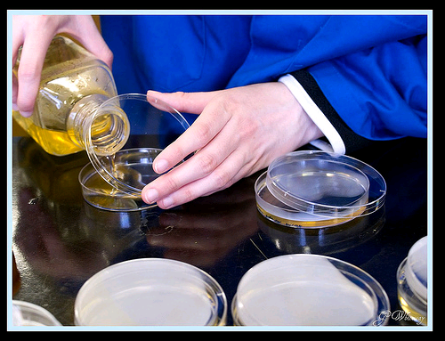
Pouring the Culture Plates

Slide 14
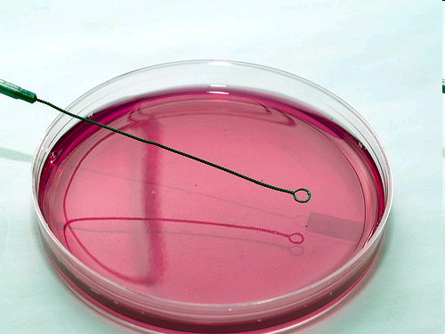
Petri dish with media
Plate: provide large surface for isolation and observation of colonies
Using a sterile loop or a sterile swab streak your sample on the petri plate
Important let your sterilized loop cool before you pick up your sample

Slide 15
Classification of Culture media
Based on the consistency:
Liquid -- Peptone water, Nutrient broth
Semisolid -- Nutrient agar stabs
Solid -- Blood agar, Serum agar
Based on Oxygen requirement:
-- Aerobic medium
-- Anaerobic media

Slide 16
Aerobic Media
Simple media
Complex media
May be Synthetic or Defined Medium
- Enriched media
- Differential media
- Enrichment media
- Selective media
Semisyntetic Medium
- Sugar media
- Transport media

Slide 17
Aerobic media
Simple media- consists of only basic necessities
Liquid media
- Peptone water(1% peptone +0.5%Nacl + 100 ml water)
- Nutrient broth ( peptone water + 1% meat extract
Solid media
- Nutrient agar (nutrient broth + 2% Agar)
Use: To grow non-fastidious microorganisms

Slide 18
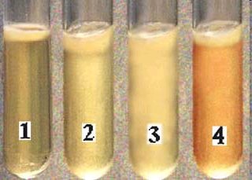
Liquid Medium
Difficulat to identify all types of organisms
Suitable for isolation of bacteria from Blood culturing and water analysis

Slide 19
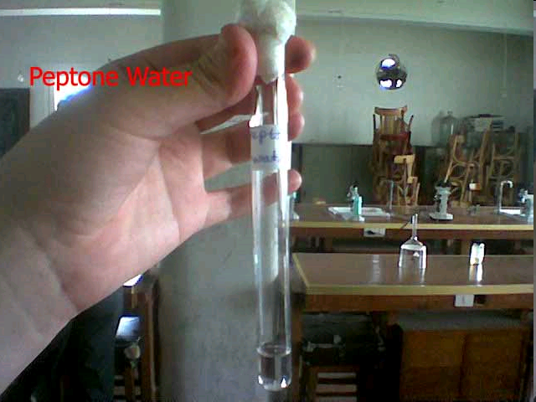
Peptone
Peptone contain partially digested proteins
Proteases
Polypeptides
Aminoacids
Inorganic salts
Phosphates
Potassium and Magnesium
Riboflavin
Meat exract called as Lab lemco

Slide 20
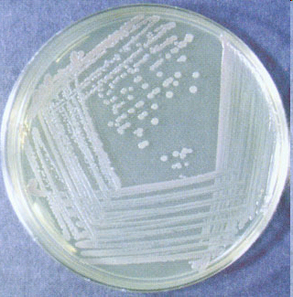

Nutrient Agar
Contain 2% agar added to Nutrient agar commonly used
Concentration can be increased to 6% to prevent swarming
Can be reduced to 0’5%

Slide 21
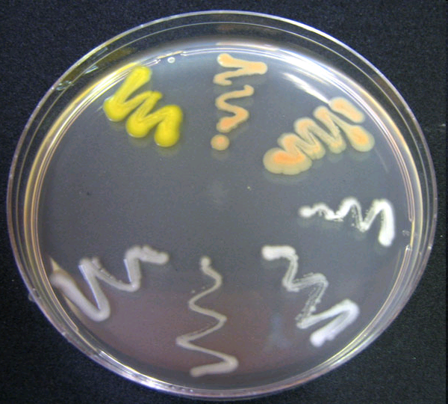
Pigment producing Staphylococci

Slide 22
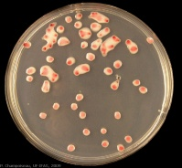
Complex media Enriched media: Blood agar
Nutrient agar + 5 to 10% sheep blood
Melt the sterile nutrient agar by steaming, cool, to 45⁰ c
Add the blood aseptically with constant shaking
Mix the blood with molten nutrient agar thoroughly but gently avoiding froth formation
Immediately pour in to the Petri dishes or tubes and allow to set
Use: To cultivate all the fastidious organisms
Notes:
Enriched media-prepared by adding blood serum egg milk glucose etc. to basal media ex. Blood agar,loeffler’s serum slope,dorset’s egg medium,L-J media(lowenstein-jansen medium)

Slide 23
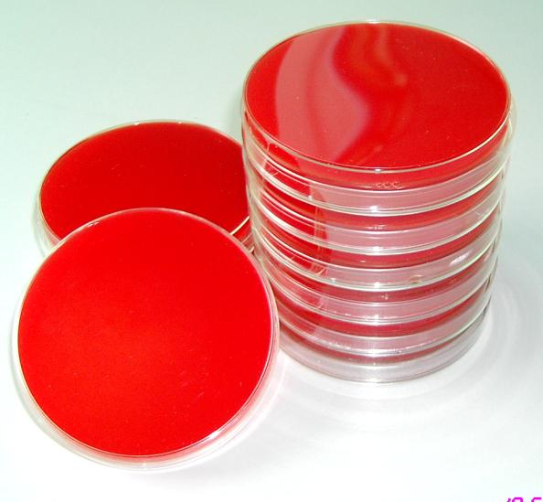
Enriched Medium
To culture medium Blood serum or egg are added to medium
eg Blood agar
Chocolate agar
Egg

Slide 24
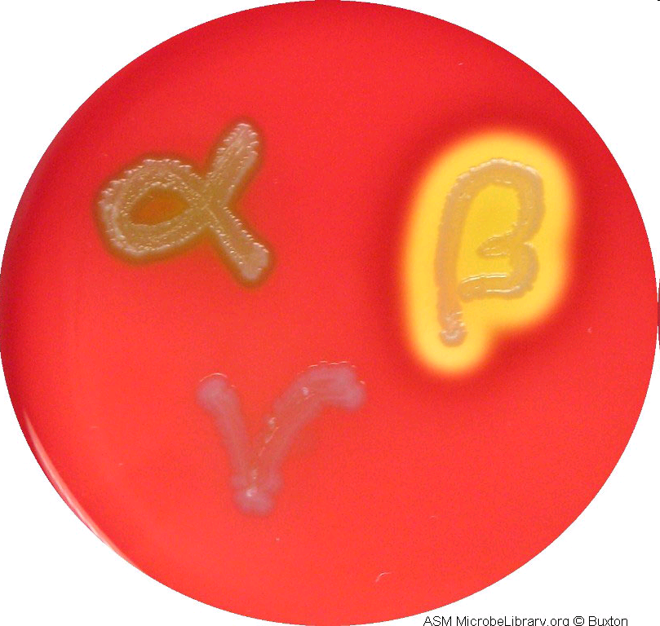
Different types of hemolysis on Blood Agar

Slide 25
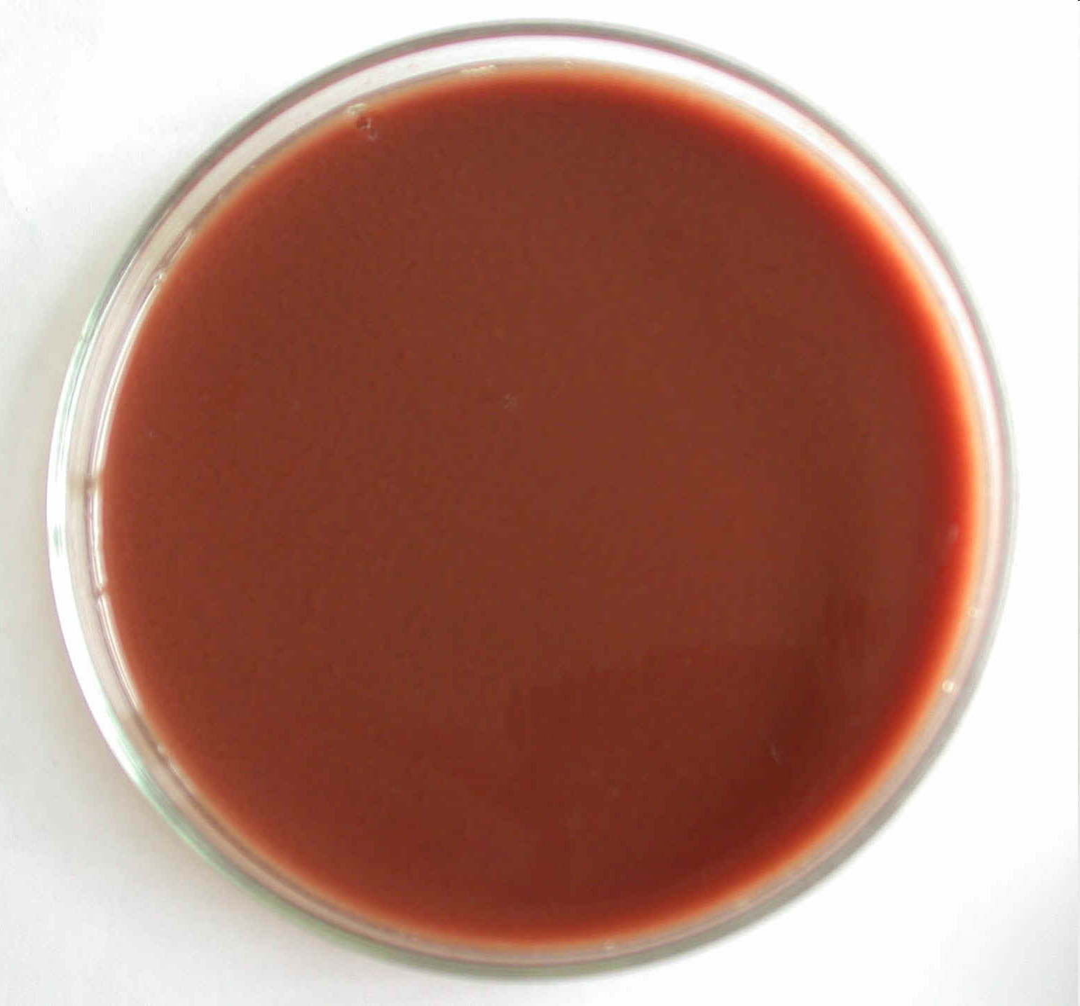
Other Enrichments – Chocolate Agar
Several organic materials are added to the basic constituents of the Medium such as Blood, yeast, yeast extract etc

Slide 26
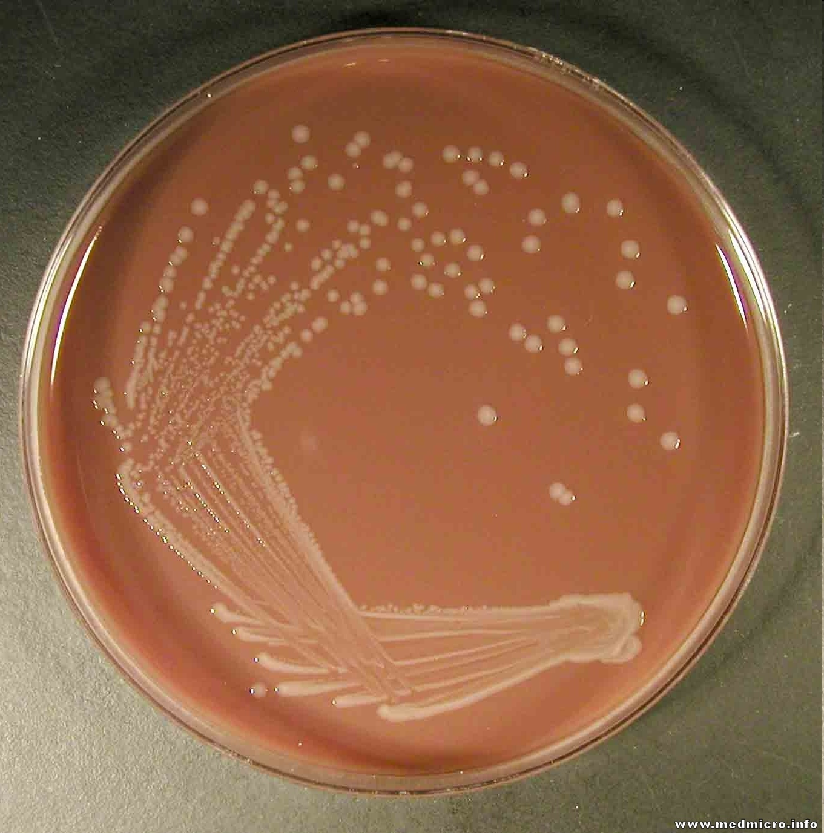
Chocolate agar

Slide 27
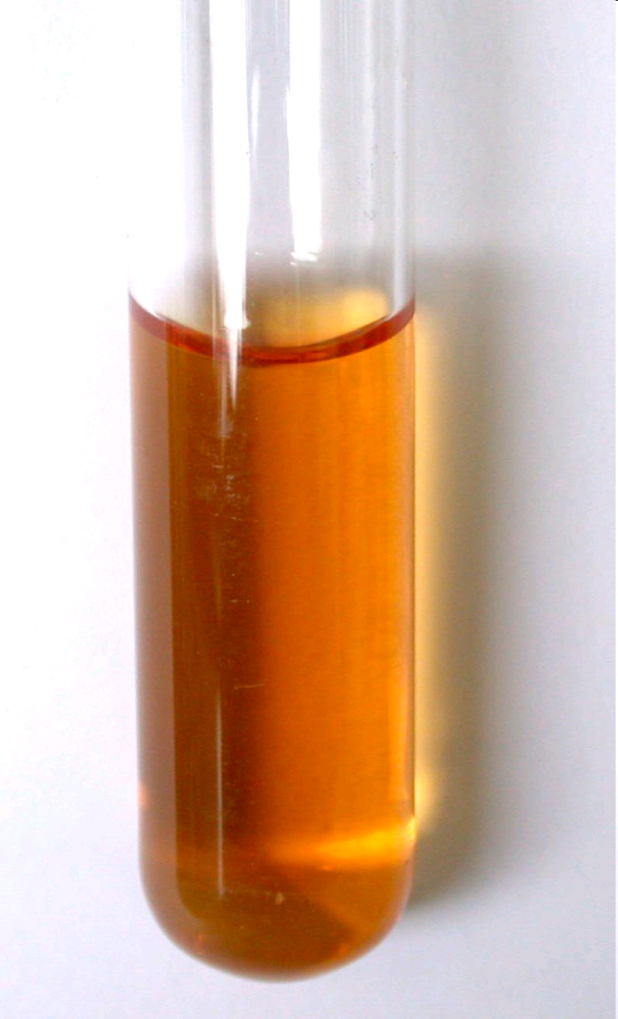
Enrichment Medium
If the sample contain more than one type of bacteria, undesired bacteria grwoth can be reduced or eliminated.
The desired organism is facilitated to grow
Eg Tetrathionate broth
Selenite F broth
Notes:
Enrichment media-liquid medium containing specific nutrients which causes enrichment of the required pathogenic bacteria & inhibits the growth of unwanted bacteria.ex:selenite F broth ,alkaline peptone water

Slide 28
Selective media
Serve the same purpose as Enrichment media but are solid in consistency
- Wilson & Blair’s medium -
- Lowenstein Jensen’s medium -
Use: To cultivate Salmonella, Shigella &
Mycobacteria

Slide 29
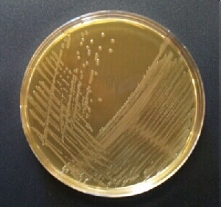
Deoxycholate citrate Agar
Suitable for isolation of dysentery bacilli, food poisoning Salmonella and S.paratyphi B, and less so, but superior to MacConkey agar for S. typhi.
It is a heat sensitive medium It should not be autoclaved or remelted
When prepared from commercial medium it should be dissolved and sterilized at 100⁰c for a short period

Slide 30
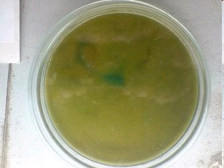
Indicator Medium Wilson-Blair Medium
Indicate by change of color Sulphite to sulphide in Wilson-Blair medium
S.typhi reduces sulphite to sulphide in the presence of Glucose

Slide 31
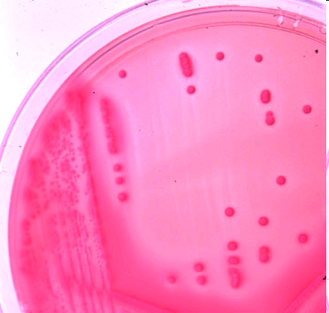
Differential Medium Mac Conkey’s Agar
Bringing out different characters of bacteria their atypical characters
Mac Conkey’s medium
Contain peptone, Lactose Agar, Neutral red and taurocholate and show grwoth of Lactose fermenters as pink colored colonies

Slide 32
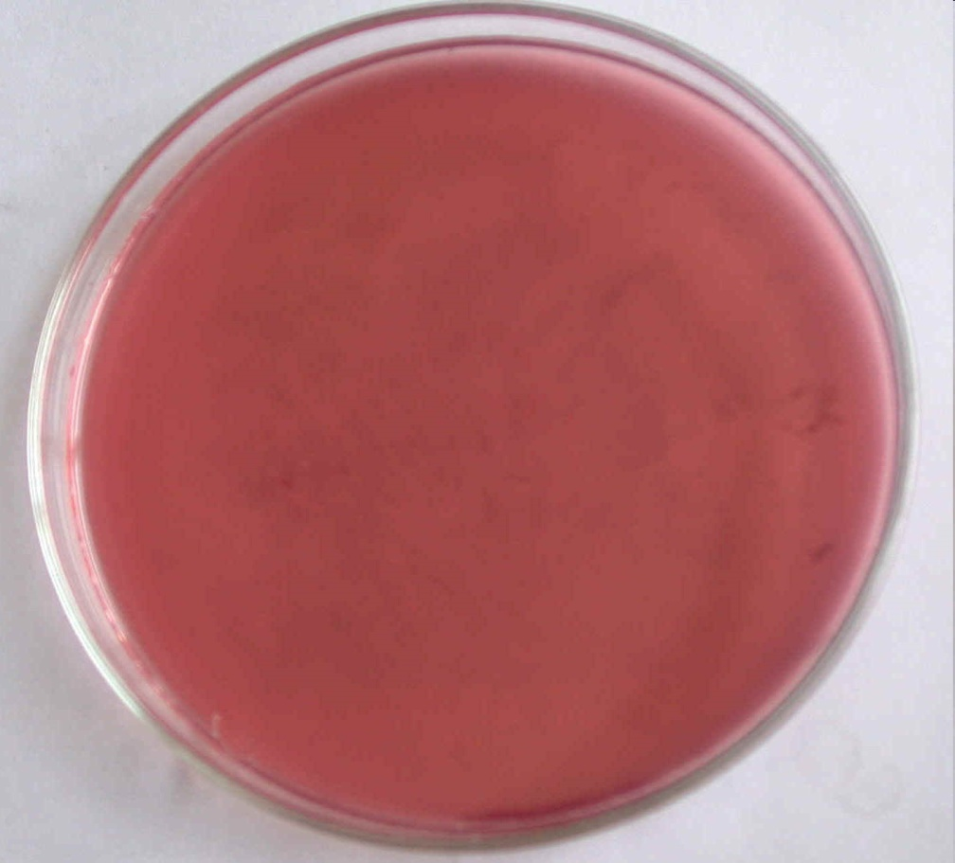
MacConkey agar
MacConkey agar is useful medium for cultivation of enterobacteria
It contains a bile salt to inhibit non intestinal bacteria
Lactose in combination with Neutral red distinguish the lactose fermenting from the non lactose fermenting Salmonella and Dysentery group

Slide 33
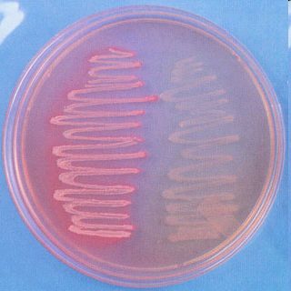
Lactose fermenting and Non lactose fermenting

Slide 34
Carbohydrate media
Peptone water – 100 ml, Desired sugar 1 gm% and Andrade's indicator – 0.005% soln(1ml)
Dissolve the desired carbohydrate in peptone water and steam for 30 min or sterilize by filtration.
Distribute into sterile test tube containing inverted Durham’s tubes to detect gas production and steam for 30 min
Use: To test the fermenting ability of an
organism

Slide 35
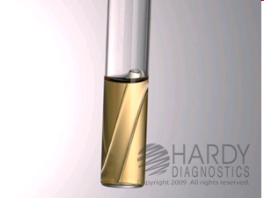
Carbohydrate media
Peptone water – 100 ml, Desired sugar 1 gm% and Andrade's indicator – 0.005% soln(1ml)
Dissolve the desired carbohydrate in peptone water and steam for 30 min or sterilize by filtration.
Use: To test the fermenting ability of an organism

Slide 36
Sugar Medium
Sugars are fermenting substances
Monosaccharide – peptone, arabinose,xylose and hexose's, dextrose and mannose
Disaccharides Sucrose and Lactose
Polysaccharides – Starch and Inulin
Alcohols – Glycerol. Sorbital
Sugar medium contain 1% sugar
Durham’s tube indicates production of gas
Hiss Serum sugars apart from sugar , serum is added.

Slide 37
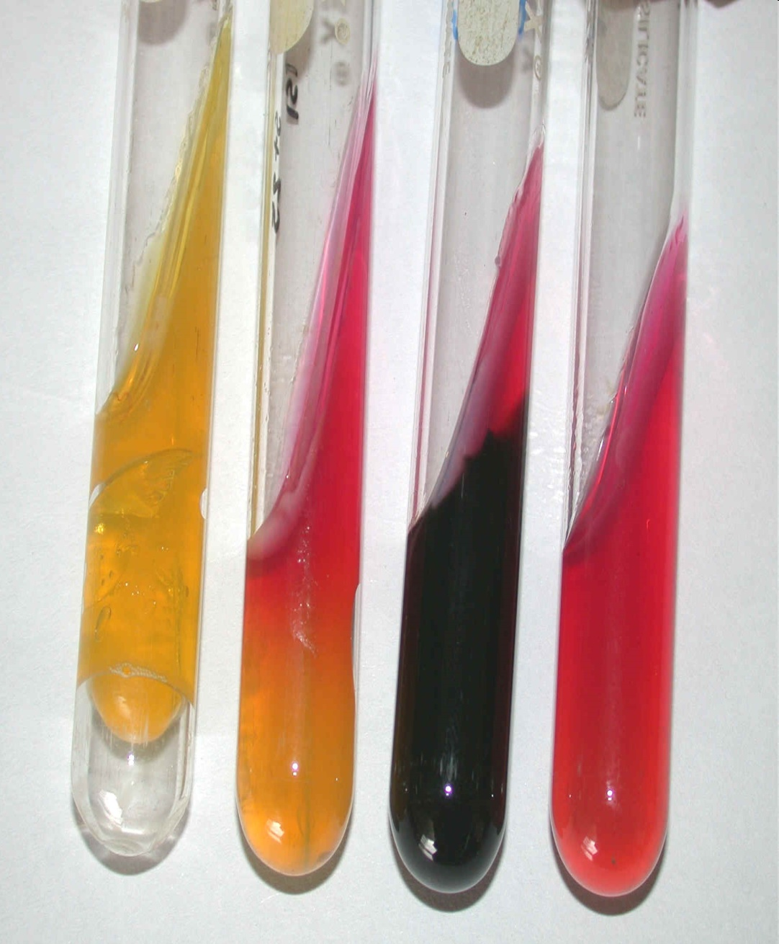
Sugar Medium
Sugar medium contain 1% sugar
Durham’s tube indicates production of gas
Hiss Serum sugars apart from sugar , serum is added.

Slide 38
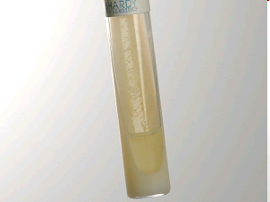
Loeffler’s serum slope

Slide 39
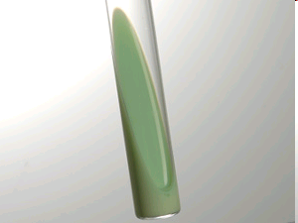
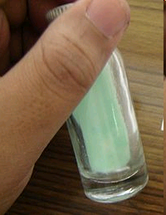
Lowenstein Jensen Medium

Slide 40
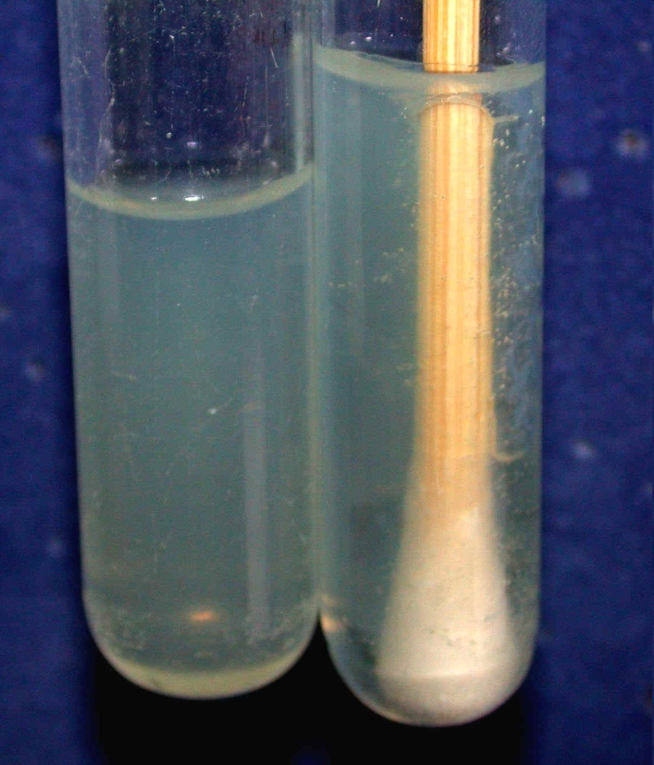
Transport Medium
Stuart’s medium contain reducing agents to prevent oxidation.
Charcoal to neutralize certain bacterial inhibitors to Gonococci,

Slide 41
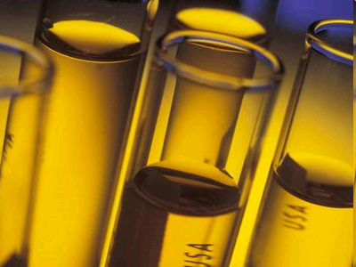
Hiss Serum Sugars
Sugar Medium with Serum enrichment

Slide 42
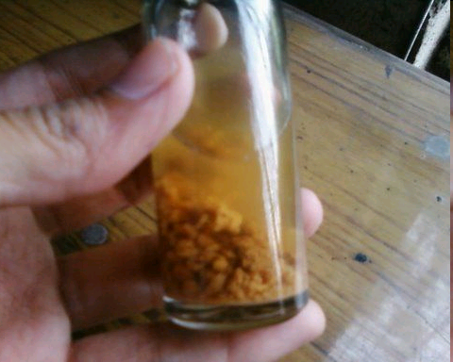
Anaerobic Medium
Robertson’s cooked meat medium
Thiglyclolate liquid medium

Slide 43
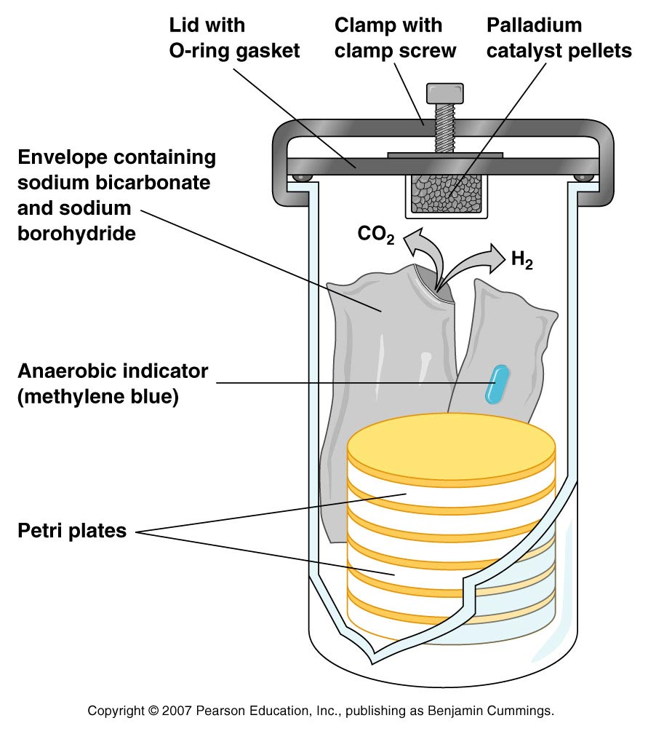
Anaerobic Culture Methods Anaerobic Jar
Anaerobic jar
Figure 6.5

Slide 44
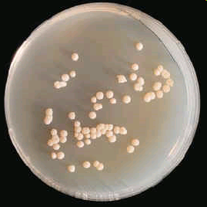
Sabouraud's Dextrose agar commonly used Fungal Isolation Medium

Slide 45
Sabouraud's Dextrose Agar
Dextrose - 4 gm%
Neopeptone - 1 gm%
Agar - 1.5 gm%
Distilled water - 100 ml
Dissolve the ingredients by heating in a water bath, cool and adjust pH to 5.4
Autoclave and dispense 20 ml amount in test tubes
Use: For the cultivation of Fungi

Slide 46
Robertsons’cooked Meat Medium
Place meat in 1 ounce bottles to the depth of 2.5 cms and cover it with 15 ml of broth
Autoclave at 121⁰ c for 20 min
After sterilization, adjust the pH to 7.5
Use: To cultivate the anaerobic bacteria

Slide 47
Lowenstein Jensen Medium - cultivation of Mycobacterium tuberculosis

Slide 48
Lowenstein-Jensen’s medium
Mineral salt soln - 600ml
Malachite green soln - 20ml
(2gm% in D.water)
Beaten egg - 1000ml
(20-22 eggs)
Mix the above
Distribute in Mc Cartney bottles
Sterilize by Inspissation
Use: To cultivate Mycobacteria

Slide 49
Sterilization of culture media
Media are sterilized in the autoclave at 121⁰ c for 15’ under 15lbs of Pressure
Heat-labile substances like serum & sugar solutions must be sterilized by free-steam or filtration
Egg containing media –-- Lowenstein-Jensen’s medium, Loeffler's serum slope by inspissation
Discarded culture plates are to be sterilized by autoclaving prior to washing

Slide 50




Colonies of Bacteria on Culture plates

Slide 51
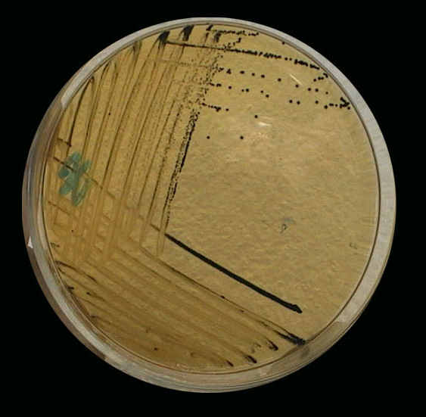
Salmonella Shigella agar

Slide 52
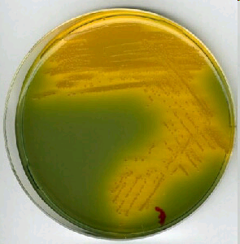
TCBS Medium

Slide 53
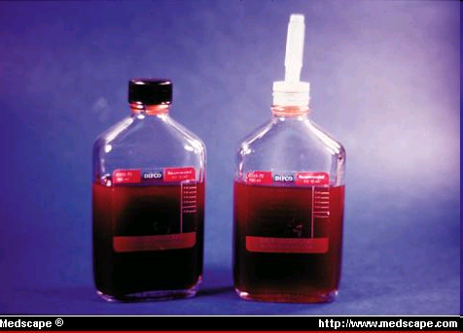
Blood culture – ‘Liquid Medium’

Slide 54
Carbohydrate media
Peptone water – 100 ml, Desired sugar 1 gm% and Andrade's indicator – 0.005% soln(1ml)
Dissolve the desired carbohydrate in peptone water and steam for 30 min or sterilize by filtration.
Use: To test the fermenting ability of an organism

Slide 55
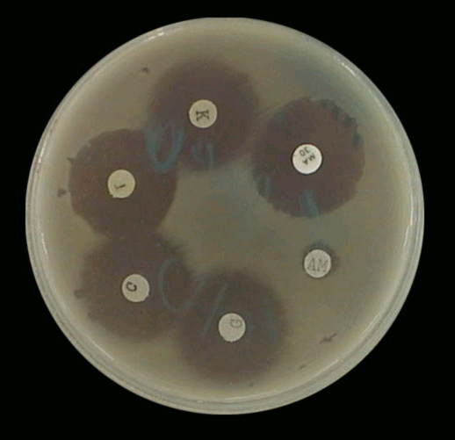
Mueller Hinton Agar for Antibiotic Testing

Slide 56
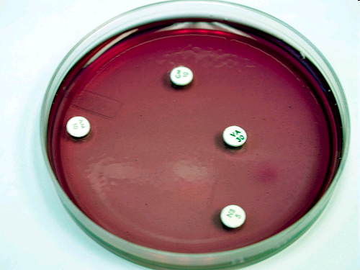
Antibiotic Testing on Blood Agar Medium

Slide 57
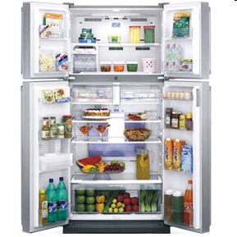
Storage of culture media
Prepared media in individual screw capped bottles can be stored for weeks at room temp
Poured plates deteriorate quickly and often contaminated, hence cold storage is necessary
For smaller labs domestic refrigerators & for larger labs insulated cold room(4-5ºc)
Deep freeze refrigerators for preservation of sera, antibiotics & amino acids (-10 to - 40⁰c)

