Slide 1
Cyanotic congenital heart disease BY MBBSPPT.COM

Slide 2
CAUSES OF CENTRAL CYANAOSIS
Congenital Heart Disease
1) Cyanosis with PBF 2) Cyanosis with PBF
a) TOF a) D-TGA
b) Pulm. Atresia b) DORV without PS
c) Tricuspid Atresia c) TAPVC
d) Critical PS d) Truncus
e) DORV with PS
f) Ebstein anomaly
arteriosus

Slide 3
CAUSES OF CENTRAL CYANAOSIS
B. LUNG DISEASE D. CNS DEPRESSION
a) RDS a) IVH
b) Pneumonia b) Perinatal asphyxia
c) Pneumothorax c) Heavy maternal sedation
d) Diaphragmatic hernia
e) T.E.Fistula
C. PERSISTENT PULMONARY E. MISCELLANOUS
HYPERTENSION
a) shock & sepsis
b) Hypoglycemia
c) Methemoglobinemia
d) Neuromuscular conditions
( Werdnig – Hoffman)

Slide 4
RADIOLOGICAL FEATURES
CXR may exclude non cardiac causes of cyanosis e.g. RDS. . Meconium aspiration, Diaphgramatic hernia, Pneumothorax
Pulmonary Vascular Markings
Decreased Increased
Heart Size Heart Size
Normal Increased Increased
( “Boot shaped”) (“ Wall-to-Wall”)
TOF Ebstein (“ egg-on-end”)
D-TGA
Aortic Arch \ Mediastinum Abdominal Situs

Slide 5
ECG
RV dominance on ECG is normal in the newborn.
Left axis deviation with LVH strongly suggests:
Tricuspid Atresia.
Left axis deviation in a newborn may also indicate:
AV canal ( However , AV canal is usually an acyanotic form of heart disease).

Slide 6
Blood gases & response to 100% O2
Always try to obtain ABG from RIGHT radial artery.
Low PH: may indicate sepsis, circulatory shock or
severe hypoxia
High pCO 2: may indicate CNS or pulmonary disease.
Hyperoxia Test: 100% O2 by hood for 10 minutes.
pO2 > 150 torr= pulmonary disease.
pO2 < 100 torr=cyanotic heart disease

Slide 7
5 “T’s”
Most common cyanotic lesions of the newborn
Tetralogy of Fallot
Transposition of the Great Arteries
Truncus Arteriosus
Total Anomalous Venous Return
Tricuspid Atresia
Notes:
Make this a question and animate it

Slide 8
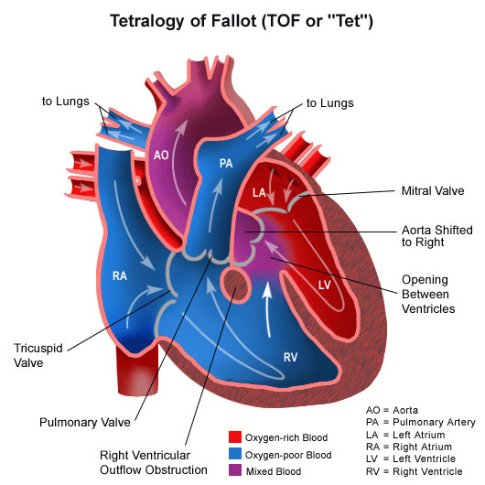
Tetralogy of Fallot
Commonest CCHD
>2 yr of age
High Nonrestrictive
VSD
RVOT Obstruction
RVH
Overriding aorta
Notes:
Ask what are the 4 compents and animate

Slide 9
Embryology
Anterocephalad malalignement of infundibular(outlet) septum with trabecular septum(muscular)→ RVOT obstruction
Arrested development of bulbar cordis→ PS/infundibular stenosis
Incomplete rotation of aortic- pulmonary septum→ dextraposition of aorta
Failure of aortic-pulmonary septum to fuse with interventricular septum→ High VSD

Slide 10
Associated defects
Rt sided aortic arch 25% cases
Anomalous origin of coronary art. 2-10% cases
ASD 15% cases
Two variants : pentalogy and triology of Fallot
Pulmonary atresia or bicuspid valve
Systemic collaterals or PDA in severe obstruction
Hypo plastic pulmonary art. or branches

Slide 11
TOF- hemodynamics
Pulmonary stenosis-concentric RV hypertrophy without cardiac enlargement & increase in RV pressure
Increase in RV pressure- leads R-L shunt
Once RV &LV pressure equals ,increasing severity of pulmonic stenosis reduce pulm. blood flow
VSD-silent
Flow across the pulmonary stenosis – ejection systolic murmur
Acyanotic Vs cyanotic Fallot

Slide 12
TOF- hemodynamics
The more severe PS –The shorter the ejection systolic murmur and more the cyanosis
The VSD of TOF is always large-effectively decompress RV and so CCF never occurs in TOF
Exceptions-anemia,infective endocarditis, systemic HT ,Myocarditis ,associated AR,PR ,post shunt surgery, collaterals formations, pink Fallot
Compensatory mechanism to relieve hypoxia
Polycythemia
Pulmonary to systemic collaterals
Persistent PDA

Slide 13
Tetralogy of Fallot
Physical examination:
Single accent. S2
ESM at left 2nd 3rd I.C.S.
Postoperative patients: continues shunt murmur, early diastolic murmur of PR (graham steel)
CXR: CTR normal initially
Later boot shaped heart
Decrease PVM
ECG: RVH

Slide 14
TOF- Clinical features
Anoxic spells-paroxysmal attack of dyspnea any time after birth
Cyanosis-since birth or may present some yrs after
Commonest presentation-dyspnoea on exertion and exercise intolerance/syncope--- relieved by squatting position
Anoxic spells occur predominantly after waking up or following exertion-starts crying, dyspneic, may loose consciousness, convulsion may occur.

Slide 15
TOF- Clinical features
Cyanosis, clubbing, slightly prominent ‘a’ waves
ECG-right axis deviation with RV hypertrophy. ‘T’ waves usually inverted in right precordial leads.
CxR-N sized heart with upturned apex .
Oligemic lung fields. Absence of main pulmonary artery segment-boot shaped or “cor-en –sabot”

Slide 16
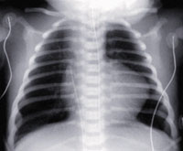
X-ray picture of TOF

Slide 17
TOF- complication
ANOXIC infarction (<2 yr),embolism and venous thrombosis-hemiplegia
Brain abscess (>2yr),
Anemia, polycythemia ,cyanotic spells
DIC, bleeding disorder, metabolic acidosis
Hemoptysis , pressure on trachea by right sided aortic arch (stridor & wheeze)
Poor physical growth
Neurodevelopemental delay

Slide 18
Cyanotic /anoxic/tet spells
Infants (2-4 months of age )
Sudden increase in RVOT and/or fall in SVR
Paroxysm of hyperpnoea, sudden increase in cyanosis, decrease intensity of murmur, irritability and excessive crying, may be limpness or convulsion
Usually occurs after awakening, during feeding, crying or following defecation

Slide 19
Cyanotic Spells
Spasm of decrease SVR crying, feeding,
defecation
RVOT
Increase R→L shunting
Increase systemic venous return DecreaseO2 Increase CO2 Decrease pH
Tachypneea

Slide 20
Management of Cyanotic Spells
Increase systemic vascular resistance
Squat/Knee chest position
Ketamine 1-2mg/kg IV
Phenylephrine 0.02mg/kg IV
Tachycardia Propranolol 0.1mg/ Kg IV
Release of infundibular spasm
Irritability Morphine 0.2mg/ Kg S.C or IM
Hypoxia Oxygen
Dehydration Volume
Acidosis NaHco3 1mEq/ Kg IV

Slide 21
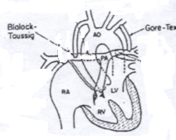
TOF management
Medical :
Correct iron deficiency anemia
Correct polycythemia
B-Blocker prophylaxis
Surgical:
Palliative = Blalock-Taussig shunt
for small PA’s
Definitive= Total correction

Slide 22
Indications of palliative shunt procedures
Recurrent spells
PCV>65
Children who can not tolerate total repair
Hypo plastic Pulmonary artery
Types
1.Blalock-taussig and modified blalock-taussig shunt
2. Potts and waterston shunt→obsolute
3. Glenns shunt

Slide 23
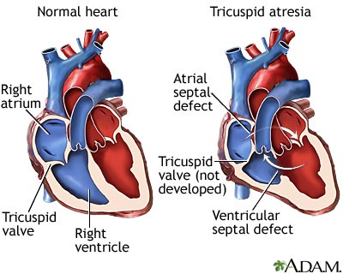
Tricuspid atresia
Congenital absence of the TV
RV and PA are hypoplastic
Associated defects- ASD,VSD,PDA
Dilation of LA and LV,
essentially single
ventricle physiology
C/F,course&management-same as TOF

Slide 24
Features suggestive of TA
1.LV type of apical impulse
2.Prominent a wave in the JVP
3.Enlarged liver with presystolic pulsation
4.ECG-left axis deviation with LV HT
Palliative T/t—GLENN shunt(SVC-RPA)
-FONTAN OPERATION (( Total Cavo Pulmonary Connection)

Slide 25
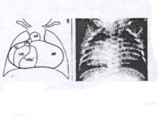
Ebstein’s anomaly
Posterior as well as the septal leaflet of the tricuspid valve is displaced downwards---arterialized RV
ECG-`p’ pulmonale as well as `p’ mitrale
PE:
Mild to severe cyanosis
S2 wide split
TR murmur
Hepatomegaly
CXR:
Balloon shape
Increase CTR
Decrease PVM
ECG:
RAE
± RBBB
WPW? SVT?

Slide 26
Cyanotic CHD -Increased PBF
Abnormal mixing of pulmonary venous blood and absence of pulmonary blood flow obstruction
Clinical presentation-
-Cyanosis
- CHF
- Recurrent chest infection
-Failure to thrive
Prognosis-Poor-80% of Pts expire within 3 months

Slide 27
Complete Transposition of the Great Arteries
5% of all CHD
Boys 3:1
Most common cyanotic condition that requires hospitalization in the first two weeks of life

Slide 28
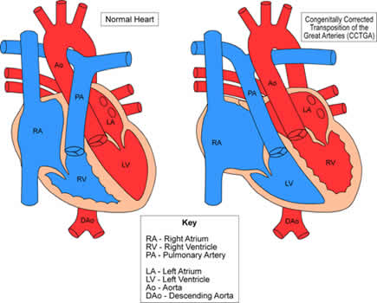
Complete Transposition of the Great Arteries
Aorta arises from the right ventricle
Pulmonary artery arises from the left ventricle

Slide 29
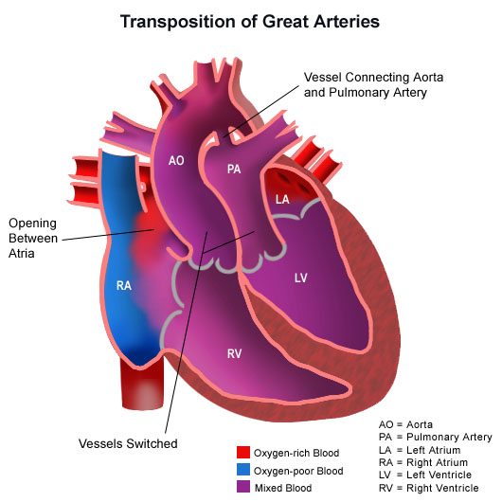
Complete Transposition of the Great Arteries
Complete separation of the 2 circuits
Hypoxemic blood circulating in the body
Hyperoxemic blood circulating in the pulmonary circuit

Slide 30
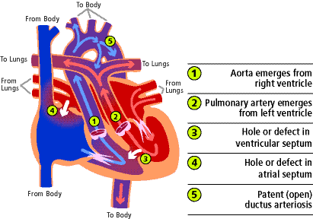
Complete Transposition of the Great Arteries
Defect to permit mixing of 2 circulations- ASD, VSD, PDA.
VSD is present in 40% of cases
Necessary for survival

Slide 31
Transposition of great vessels
C/F- Cyanosis-at birth or 1st week of life
Congestive Heart Failure
ECG-Rt axis deviation& Rt ventricular hyertrophy
CxR- Cardiomegaly with a narrow base and plethoric lung fields.(EGG ON side apearance)
Treatment-Rx-CHF &acidosis
If hypoxemia –prostaglandin infusion
Operative- septostomy→ switch

Slide 32
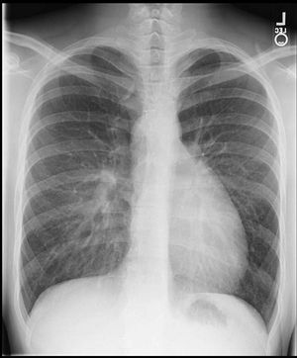
CXR
Egg shaped cardiac silhouette
Narrow superior mediastinum
Notes:
Describe the findings on this CXR, and animate

Slide 33
Total Anomalous Pulmonary Venous Return
The pulmonary veins drain into the RA or its venous tributaries rather than the LA
A interatrial communication (ASD or PFO) is necessary for survival
Pulmonary venous return reaches the RA
Systemic and pulmonary venous blood are completely mixed

Slide 34
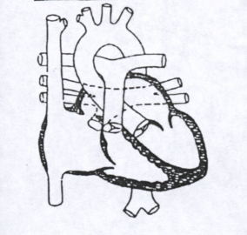
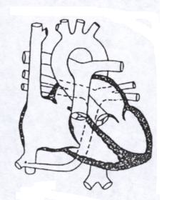
Total Anomalous Pulmonary Venous Connection ( TAPVC)

Slide 35
TOF Vs TGA
TOF
TGA
At birth asymptomatic
Cyanosis > 2 months
ESM present at left 3rd ,4th LSB
ECG: RVH
Chest x ray: pulmonary oligemia+ RVH
Generally sick at birth
Cyanosis at birth
VSD murmur or silent heart
ECG: RVH
Chest x ray : pulmonary plethora + RVH

Slide 36
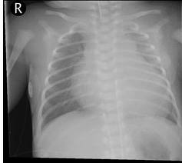
Clinical signs for unobstructed veins
Mild cyanosis, signs of CHF in infancy, history of pneumonia
Widely split S2, Grade 2-3/6 systolic murmur heard at the ULSB
CXR- marked cardiomegaly

Slide 37
Clinical signs for obstructed veins
Profound desaturation
Acidosis
PGE₁ administration does not improve oxygenation because elevated pulmonary pressures in the right side of the heart (due to obstructed pulmonary outflow) will result in right to left shunting across an open ductus further decreasing arterial saturation.

Slide 38
Treatment
Digitalis and diuretics to treat heart failure
Intubation and inc PEEP for those with severe pulm over load
Corrective surgery

Slide 39
Flow Chart for DD
Cyanosis
↓ PBF
↑ PBF
RVH
LVH
BVH
RVH
LVH
BVH
1.TOF
2.Complex lesions with PS
1.TA
1.Complex transpositions
2.Double outlet ven.
1.TGA
2.TAPVC
3.Hypoplastic left heart Synd.
1.TA with VSD
2.Truncus arteriosus
1.TGA with VSD
2.Truncus arteriosus

Slide 40
USEFUL HINTS
Large male baby with rapid, shallow abdominal breathing:
D-TGA
Upper body blue, lower body pink; seen in : D-GA+PDA.COA
Only cyanotic newborn who has a thrill: Tricuspid atresia.
Ejection click is often heard in : Severe PS, HLHS
Systolic ejection murmurs in first hours of life: TOF, PS, AS
Silent heart characteristic of : D-TGA, Pulmonary atresia.
Pulse oximetry& ABG should be obtained from the RIGHT arm.
ECG showing LEFT axis deviation: Tricuspid atresia

Slide 41
Thank You

