Slide 1
DEEP CERVICAL FASCIA
BY MBBSPPT.COM

Slide 2
DEEP CERVICAL FASCIA (FASCIA COLLI)
Lies under cover of the Platysma, and invests the neck and fills up the interval between muscles, vessels and cervical viscera.

Slide 3
DEEP CERVICAL FASCIA
It is condensed to form
Investing Layer
Pretracheal Layer
Prevertebral Layer
Carotid Sheath
Buccopharyngeal Fascia
Pharyngobasilar Fascia

Slide 4
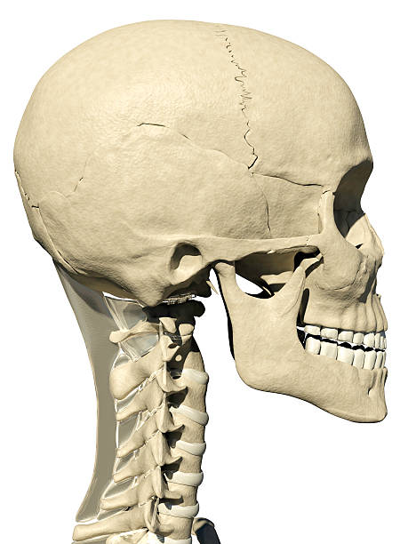

Slide 8
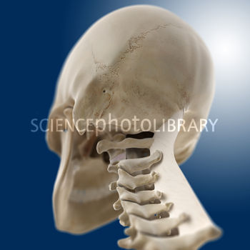
Investing Layer
Attachments

Slide 9
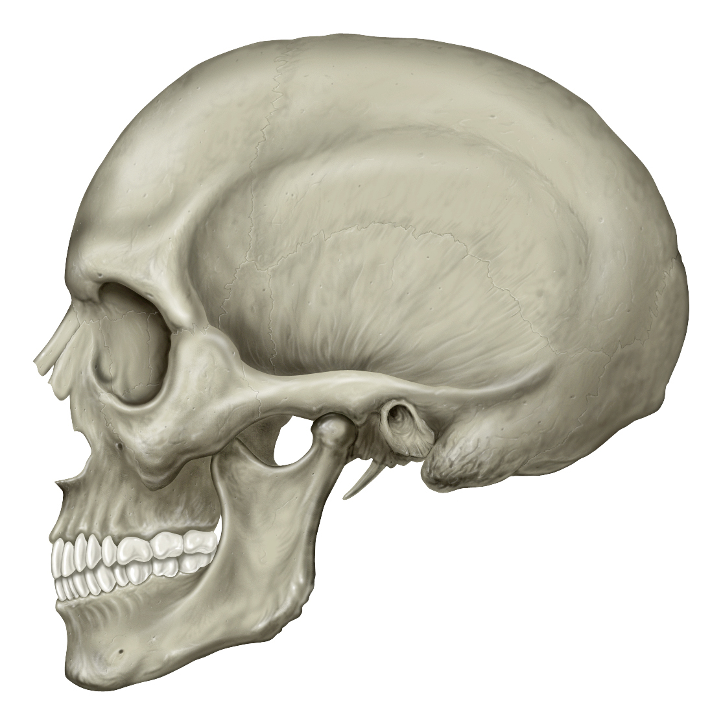

Slide 10
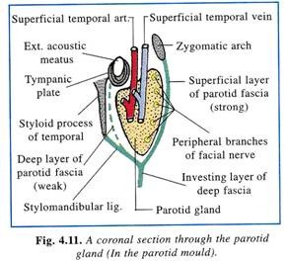

Slide 12
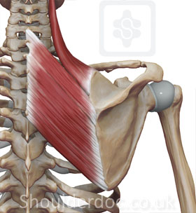
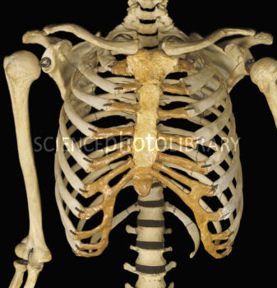

Slide 13
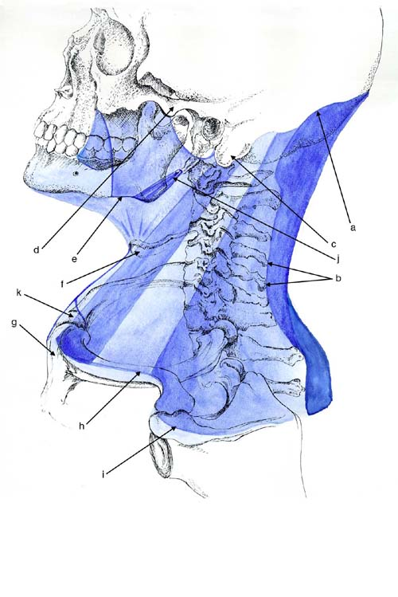

Slide 14
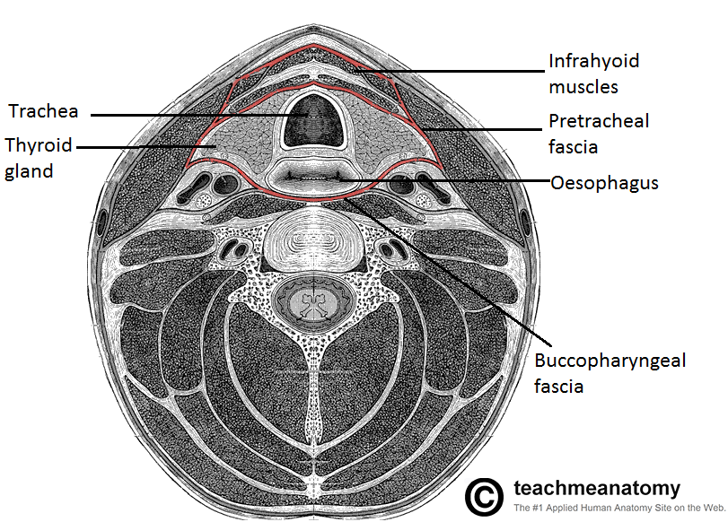
Tracings
Horizontal Extent

Slide 15
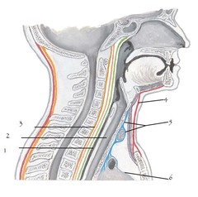
Vertical extent

Slide 17
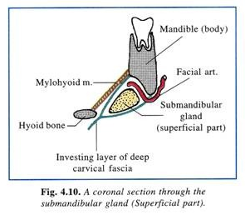

Slide 18
Suprasternal space (Space of Burn’s)

Slide 19
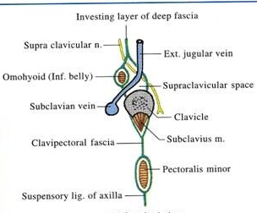
Supraclavicular space

Slide 20
To sum up
Encloses 2 Muscles – Trapezius, Sternomastoid;
Encloses 2 Glands – Submandibular & Parotid;
Encloses 2 Spaces – Suprasternal & Supraclavicular;

Slide 21
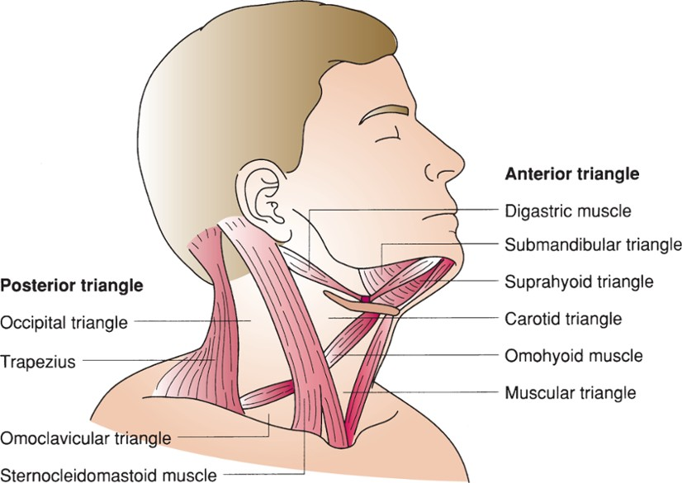
Forms roof of 2 triangles – anterior & posterior

Slide 22
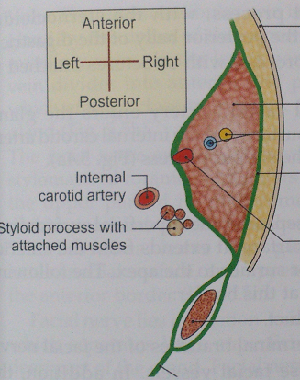
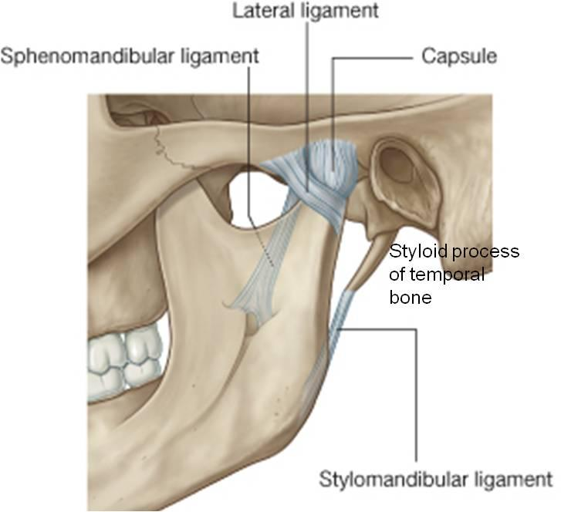
Thicken twice to form parotido-masseteric fascia and stylomandibular ligament.

Slide 23
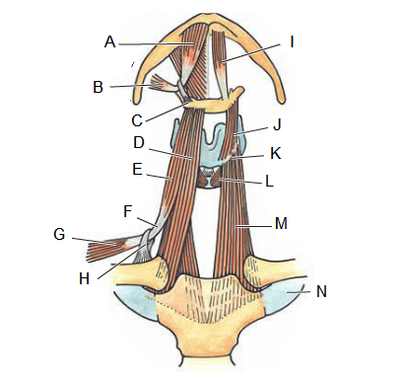
Forms 2 fascial slings for omohyoid and digastric

Slide 24
Gives origin to 2 fascial processes – pretracheal & prevertebral fasciae.

Slide 25
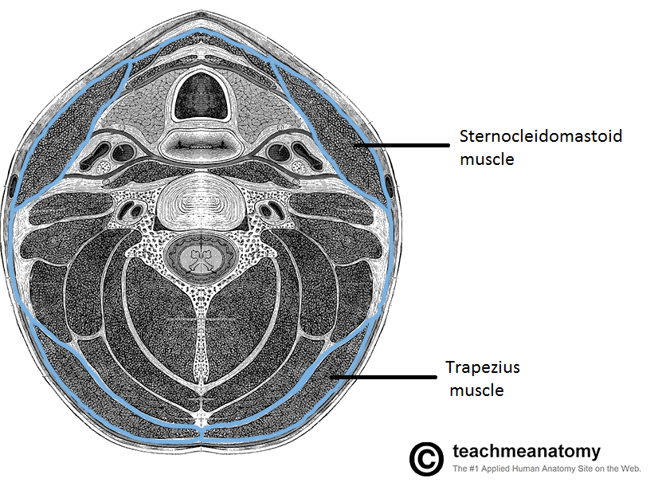
Pretracheal fascia
Tracings
Horizontal extent

Slide 26
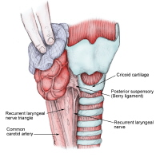
Ligament of Berry

Slide 27
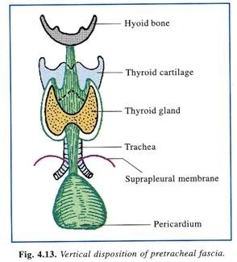
Vertical Extent

Slide 28
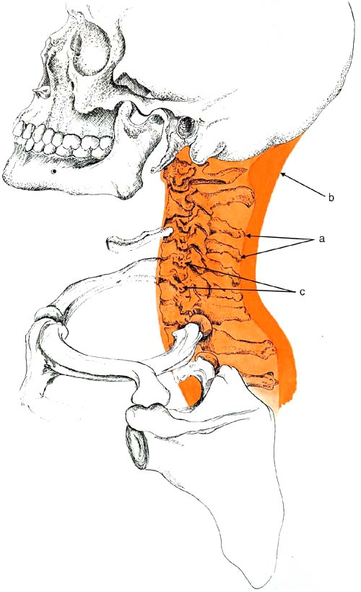
Prevertebral Fascia

Slide 29
Tracings
Horizontal Extent

Slide 30
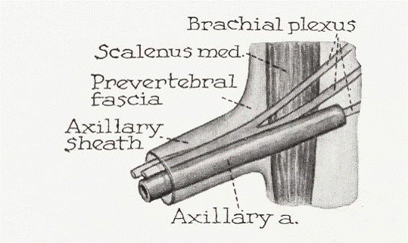

Slide 31
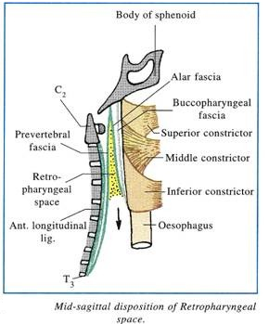
Vertical extent

Slide 32
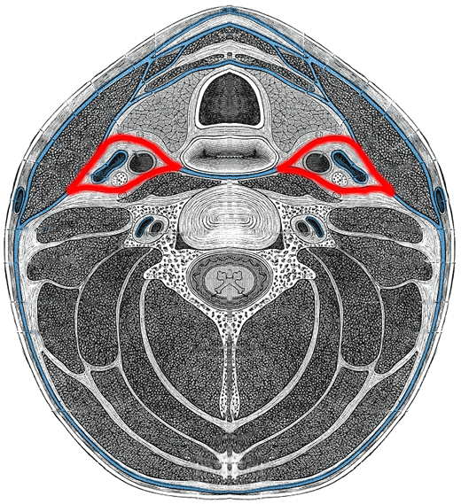
Carotid Sheath

Slide 33
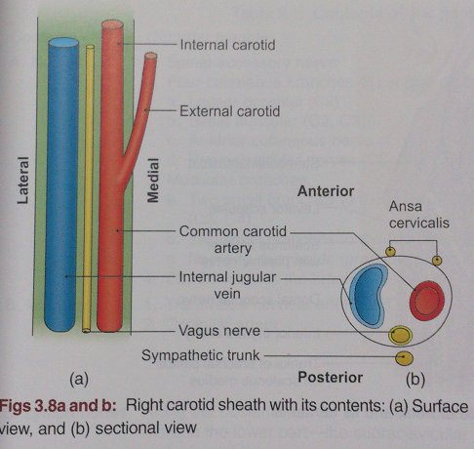

Slide 34
Buccopharyngeal Fascia

Slide 35
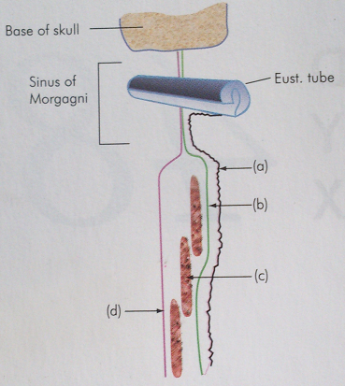
Pharyngobasilar Fascia
Mucous Membrane
Pharyngobasilar Fascia
Buccopharyngeal Fascia

Slide 36
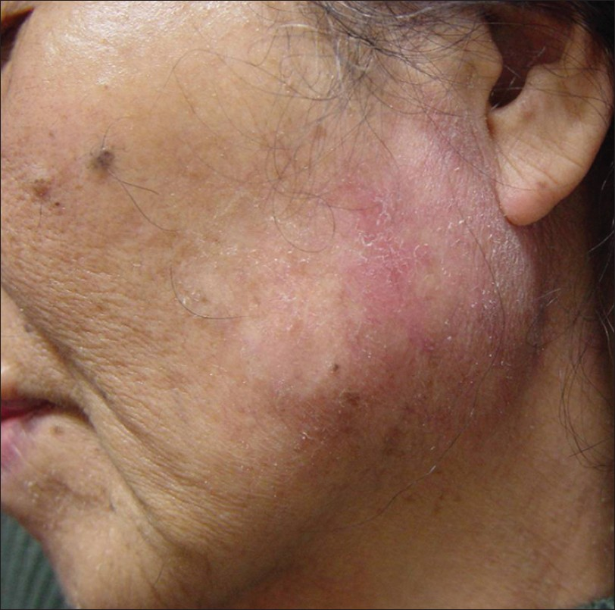
Applied Anatomy
1. Collection of pus beneath Parotido-Masseteric Fascia => Severe Pain

Slide 37
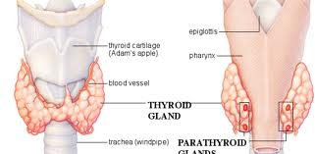
2. Pretracheal fascia which covers the posterior surface of thyroid gland, is ill defined or thin
Enlargement in Post. Direction
Compression of Esophagus

Slide 38
3. Thyroid moves with deglutition.
4. In block dissection of neck during removal of deep cervical
lymph nodes, frequently exposes carotid sheath.
5. While excising the submandibular salivary gland, the external
carotid artery should be secured before dividing it, otherwise
it may retract through the stylomandibular ligament and cause
severe bleeding.

Slide 39
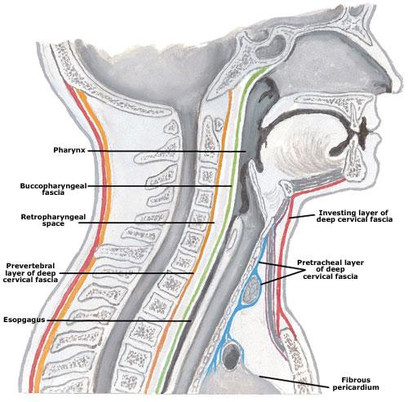
6. Collection of pus in Retropharyngeal Space

Slide 40
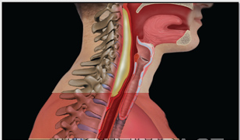

Slide 41
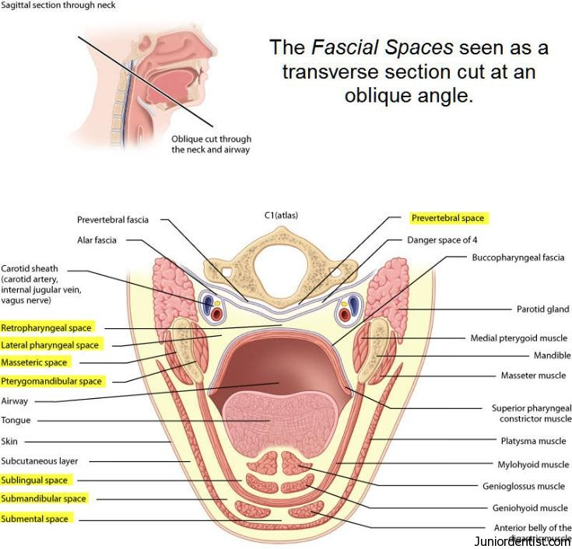
7. Collection of pus in lateral Pharyngeal Space

Slide 42
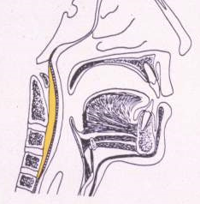
8. Collection of pus in behind Prevertebral Fascia.

Slide 43
Thank You

