Slide 1
Diabetes Ketoacidosis BY MBBSPPT.COM

Slide 8
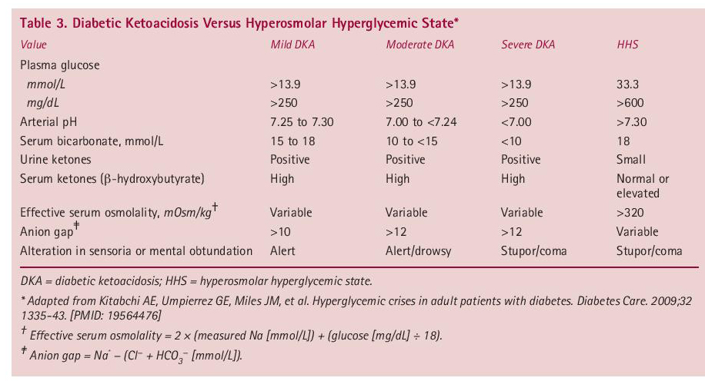

Slide 11
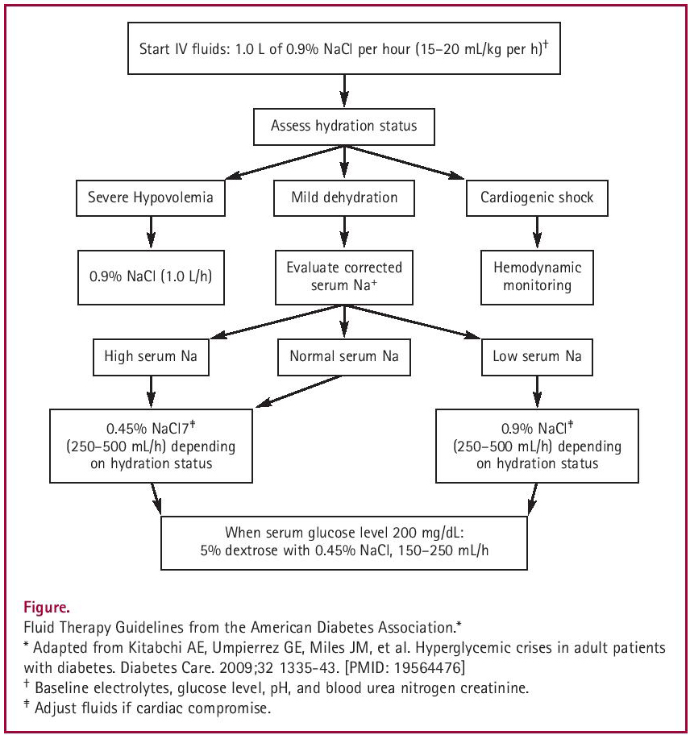

Slide 14
Thank You

