Slide 1
DIFFERENT STAGES OF BCG VACCINE BY MBBSPPT.COM

Slide 2
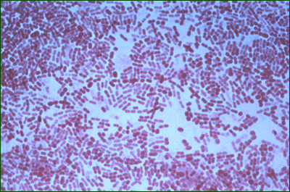
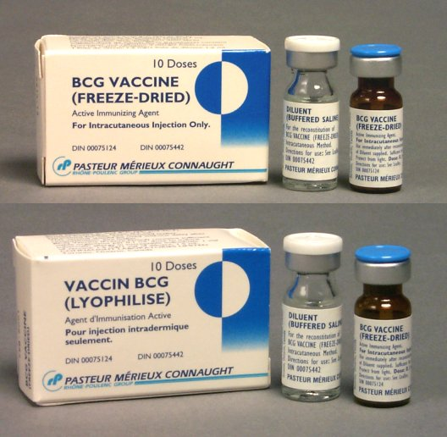
DIFFERENT STAGES OF BCG VACCINE
Bacille Calmette-Guérin (BCG)
is a vaccine against tuberculosis that is prepared from a strain (WHO recommended “Danish 1331” strain) of the attenuated live bovine tuberculosis bacillus, Mycobacterium bovis The aim of BCG vaccine is to induce a benign infection which will stimulate an acquired resistance to subsequent infection of virulent tubercle bacilli .
There are 2 main types of BCG vaccine :-
Liquid vaccine 2. Freeze-dried vaccine

Slide 3
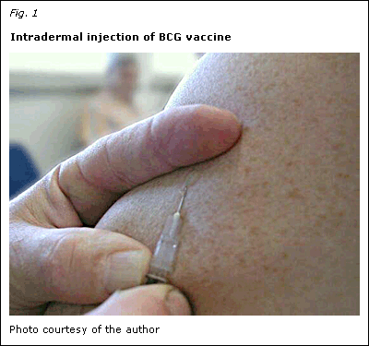
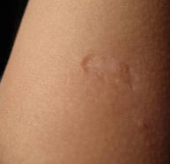
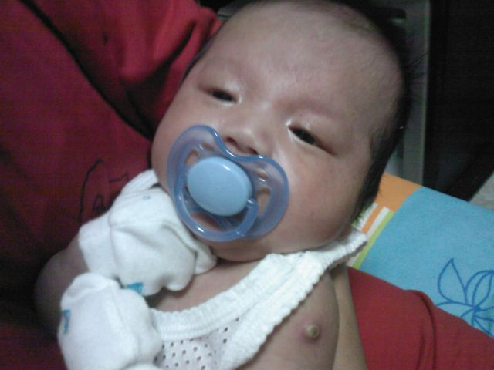
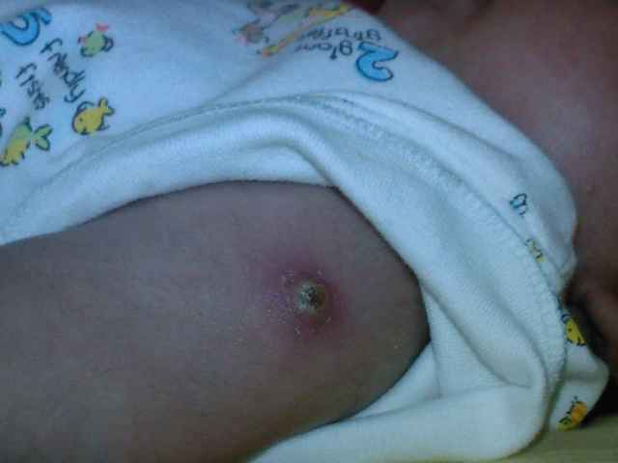
Intradermal injection
Scar formation
At birth
Development of papule
Healing occurs and in 6-8
Weeks a permanent round scar 4-8mm in diameter is formed.
Ulcer formation
2 to 3 weeks after vaccination
Papule increases to a diameter of 4-8mm in 5 weeks
then breaks into a shallow ulcer covered with crust

Slide 4
DOSAGE OF BCG VACCINE: normally the dose is 0.1mg in 0.1ml volume but in newborn
babies below the age of 4 weeks it is 0.05ml.
The duration of protection offered by the BCG vaccine is 15-20 years.
PRECAUTIONS/CONTRAINDICATIONS:
BCG should not be given to patients suffering from generalized eczema, infective dermatosis, hypogammaglobulinaemia, or to patients with history of deficient immunity as the effects are exaggerated in these patients.
DOs AND DON’Ts (for BCG vaccination):
Dos - advice the mother about the different stages of BCG vaccine, their duration and
type of appearance.
- give an appropriate dose of paracetamol to the child.
- incase of any irregularity or problem consult the concerned health facility without
further delay.
DON’Ts
- don’t apply any lotion or antiseptic on the injection site.
- don’t apply any direct heat on the injection site.
- no treatment should be given to the wound or ulcer formation.

Slide 5
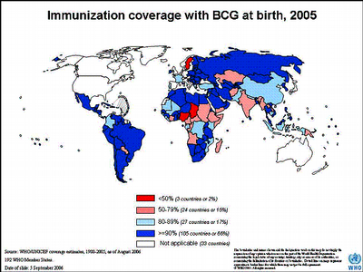
IMPORTANCE OF BCG VACCINE:
India accounts for nearly one-fifth of the global burden of tuberculosis. Every year approximately 1.8 million people develop tuberculosis. Annual risk of developing tuberculosis is 1.5%. Two of every five Indians are infected with tuberculosis bacillus and almost 0.37 million Indians die of tuberculosis every year.

Slide 6
Thank You

