Slide 1
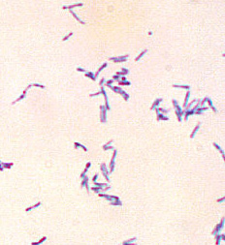
DIPHTHERIA BY MBBSPPT.COM

Slide 2
EPIDEMIOLOGICAL DETERMINANTS
AGENT FACTORS
AGENT : C. diptheriae (gram positive, non-motile)
4 strains : gravis, mitis, belfanti, intermedius
non-toxigenic strain may become toxigenic when exposed
to beta-phage.
SOURCE OF INFECTION : may be a case or carrier
Case : clinical or subclinical
Carrier : temporary or chronic .
Do not suffer from the disease
or show symptoms.
Immunization does not prevent carrier state.

Slide 3
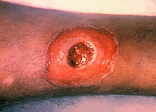
INFECTIVE MATERIAL :
Nasopharyngeal secretions, discharges from skin lesions, Contaminated fomites and infected dust.
PERIOD OF INFECTIVITY :
14 – 28 days from onset of disease.
Carrier can remain infective for longer.

Slide 4
HOST FACTORS
AGE : 1-5 years
SEX : Both sexes are affected
IMMUNITY :Infants borne to immune mothers are immune during first few weeks or months of life. 70% children above 3 years and most children above 5 years are immune .
Herd immunity of 70% is required to prevent epidemic spread.
ENVIRONMENTAL FACTORS : Occur in all seasons but winter
is preferred

Slide 5
MODE OF TRANSMISSION : Disease spreads by droplet infection. Direct transmission from infected cutaneous lesions or from objects contaminated by nasopharyngeal secretions.

Slide 6
Thank You

