Slide 1
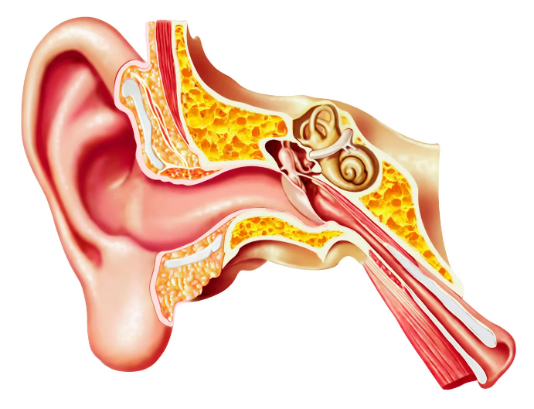
Ear
By MBBSPPT.COM

Slide 2
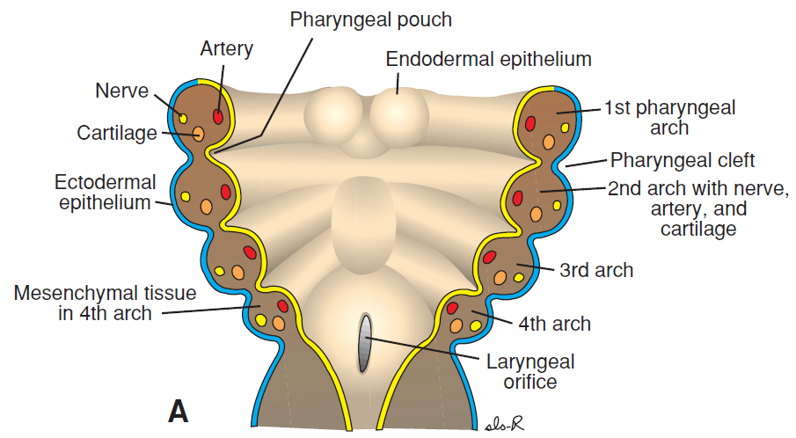

Slide 3
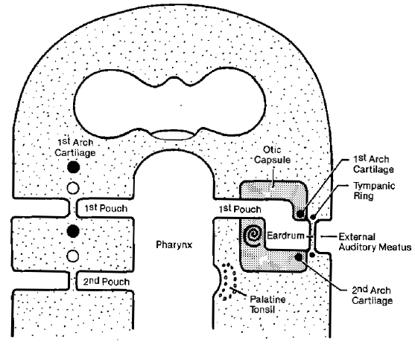

Slide 4
The Ear
Houses two senses
    Hearing
    Equilibrium (balance)
Receptors are mechanoreceptors

Slide 5
Ear
The external and middle parts are mainly concerned with the transference of sound to the internal ear, which contains the organ for equilibrium as well as for hearing.
The tympanic membrane separates the external ear from the middle ear.
The pharyngotympanic tube joins the middle ear to the nasopharynx.

Slide 6
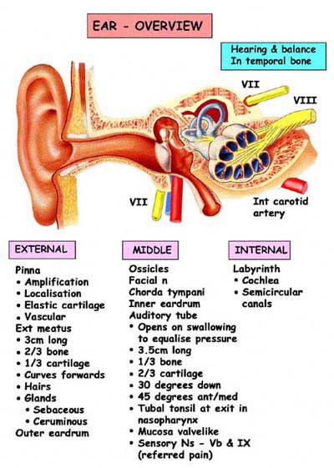

Slide 7
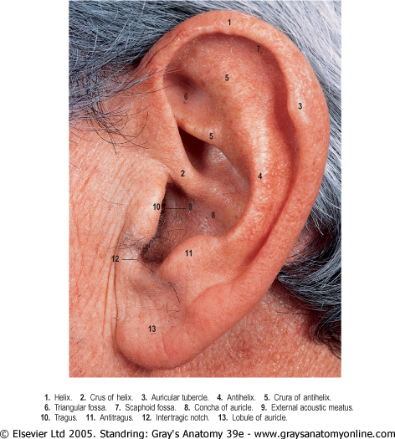

Slide 8
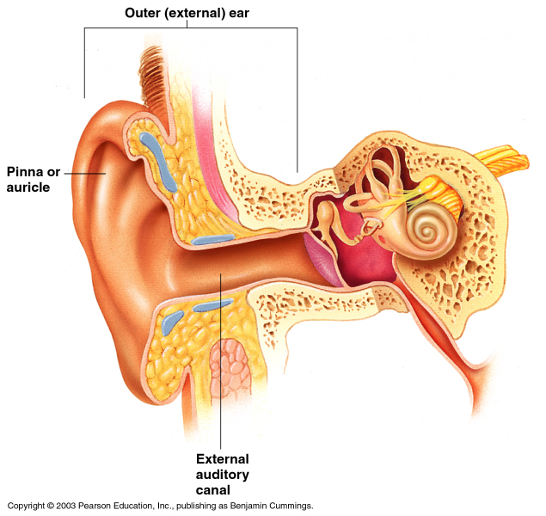
The External Ear
Involved in hearing only
Structures of the external ear
  Pinna (auricle)
  External auditory canal

Slide 9
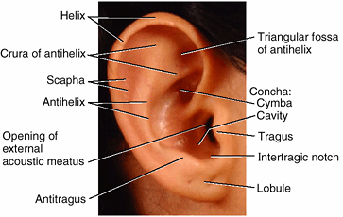

Slide 10
The auricle (L. auris, an ear)
Composed of an irregularly shaped plate of elastic cartilage.
The auricle has several depressions and elevations. The concha is the deepest depression.
  The large hollow, or floor of the auricle, between the anterior portion of the helix and the antihelix; it is divided by the crus of the helix into the cymba above and the cavum below.
The elevated margin of the auricle is the helix.
The antihelix is a Y shaped curved structure in front of helix.
The non-cartilaginous lobule (earlobe) consists of fibrous tissue, fat, and blood vessels. It is easily pierced for taking small blood samples and inserting earrings.
The tragus is a tongue-like projection overlapping the opening of the external acoustic meatus & antitragus overhang the concha.
The scaphoid fossa is a depressed region deep to helix.
The intertragic notch bounds tragus inferiorly & separates it from antitragus

Slide 11
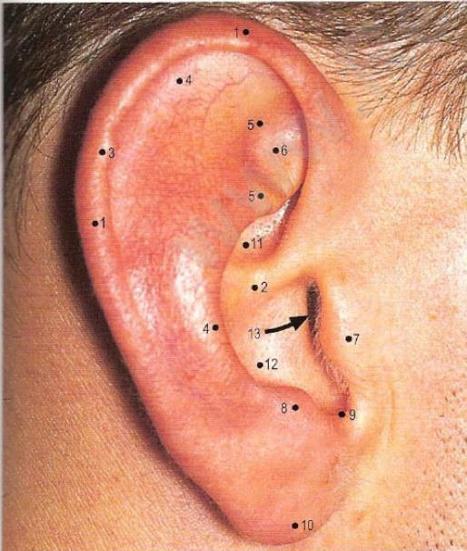
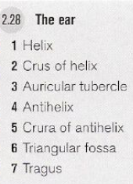
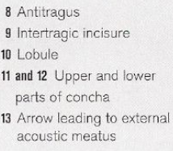

Slide 12
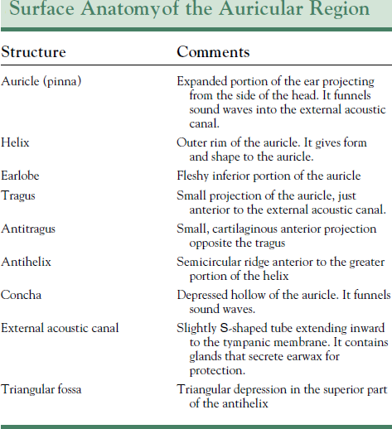

Slide 13
Blood supply of Auricle
The arterial supply to the auricle is derived mainly from the posterior auricular and superficial temporal arteries.
The veins drain into external jugular & maxillary vein

Slide 14
Nerves of auricle
The main nerves to the skin of the auricle are the great auricular and auriculotemporal nerves.
  The great auricular nerve supplies
    The cranial (medial) surface (commonly called the back(lower 2/3rd ) of the ear and
    Lower 1/3rd of the lateral surface.
  The auriculotemporal nerve, a branch of CN V3, supplies the skin of the auricle anterior to the external acoustic meatus(upper 2/3rd of lateral surface.
  The upper 1/3rd of medial surface is supplied by lesser occipital nerve.
Minor contributions of embryological significance are made to the skin of the concha and its eminence by the vagus and facial nerves.

Slide 15
Sensory Nerves Supplying the Auricle
Lateral Surface:
  Upper 2/3-Auriculotemporal nerve
  Lower 1/3-Great auricular nerve
Medial Surface:
  Upper 1/3-Lesser occipital nerve
  Lower 2/3-Great auricular nerve
Junctional Zone of Auricle and Scalp
  Supplied by auricular branch of Vagus nerve

Slide 16
The lymphatic drainage of the Auricle
The lateral surface of the superior half of the auricle drains to the superficial parotid lymph nodes.
The cranial surface of the superior half of the auricle drains to the mastoid nodes and deep cervical lymph nodes; and
The remainder of the auricle, including the lobule, drains into the superficial cervical lymph nodes.

Slide 17
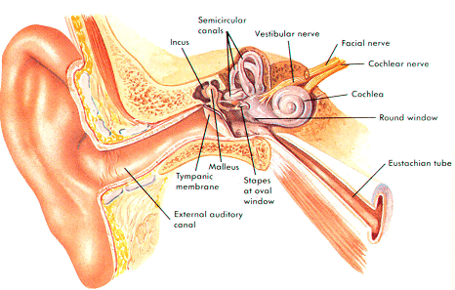

Slide 18
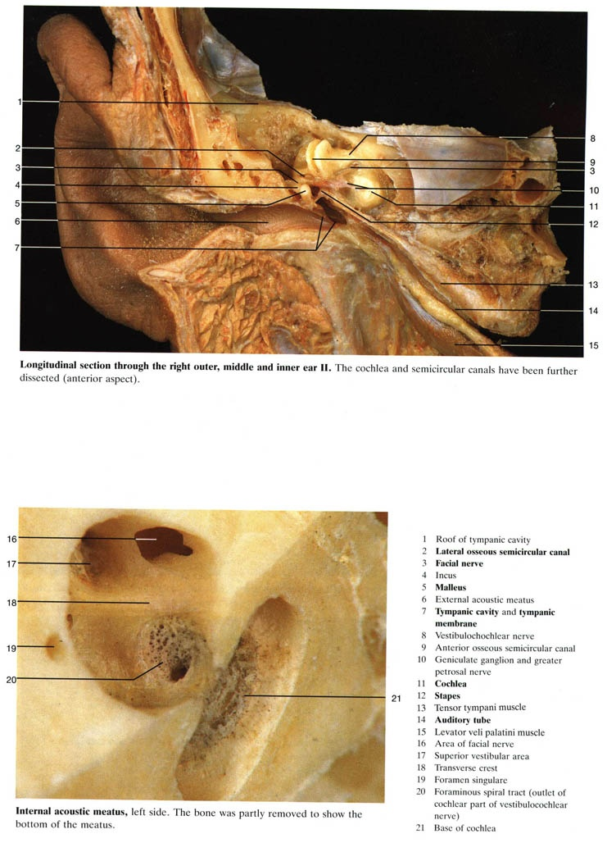

Slide 19
The External Acoustic Meatus
This passage extends from the concha (L. shell) of the auricle to the tympanic membrane (L. tympanum, tambourine). It is about 2.5 cm long in adults.
The lateral 1/3 of the S-shaped canal is cartilaginous, whereas its medial 2/3 is bony.
The lateral third of the meatus is lined with the skin of the auricle and contains hair follicles, sebaceous glands, and ceruminous glands(. glands produce cerumen) (L. cera, wax).
The medial two-thirds of the meatus is lined with very thin skin that is continuous with the external layer of the tympanic membrane. It is devoid of hair.
The lateral end of the meatus is the widest part. It has the diameter about that of a pencil.
The meatus becomes narrow at its medial end, about 4 mm from the tympanic membrane. The constricted bony part is called the isthmus.

Slide 20
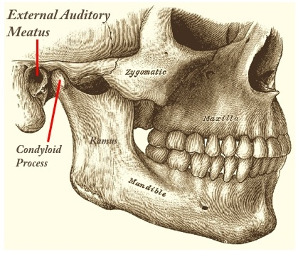

Slide 21
Innervation of the external acoustic meatus
Innervation of the external acoustic meatus is derived from three cranial nerves:
The auricular branch of the auriculotemporal nerve (derived from the mandibular, CN V3).
The facial nerve (CN VII) by the branches from the tympanic plexus.
The auricular branch of the vagus nerve (CN X).

Slide 22
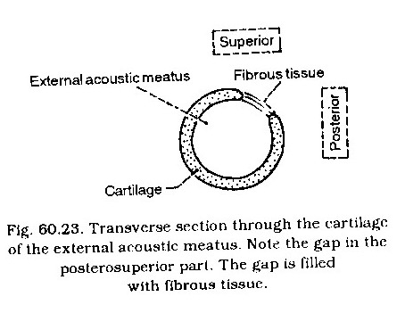

Slide 23
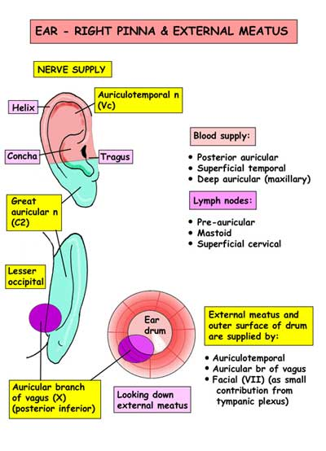

Slide 24
The Tympanic Membrane or ear drum
This is a thin, semi-transparent, pearly grey, oval membrane at the medial end of the external acoustic meatus. It is an elliptical disc.
It forms a partition between the external and middle ears.
It is circumferentially is slotted into a groove “tympanic sulcus”
The groove, or tympanic sulcus, is deficient superiorly, which forms a notch. From the sides of the notch, two bands, termed the anterior and posterior malleolar folds, pass to the lateral process of the malleus.
The small triangular area on the tympanic membrane that is bounded by the folds is slack and is called the pars flaccida. The remainder of the membrane is tense and is called the pars tensa. The handle of the malleus is bound down to the inner surface of the tympanic membrane by the mucous membrane.

Slide 25
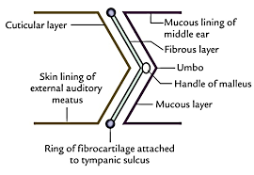

Slide 26
The Tympanic Membrane
The tympanic membrane is a thin fibrous membrane, that is covered with very thin skin externally and mucous membrane internally, sandwiched between is middle layer of fibrous tissue.
The middle fibrous layer forms pars tensa while it is absent in uppermost part where it forms pars flaccida. The two pars are separated by two bands called anterior & posterior malleolar folds.
The tympanic membrane shows a concavity toward the meatus with a central depression, the umbo, which is formed by the end of the handle of the malleus.
From the umbo, a bright area referred to as the cone of light, radiates anteroinferiorly.

Slide 27
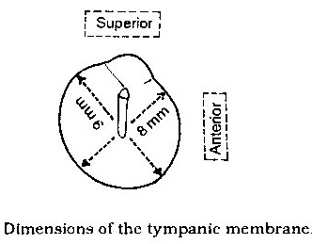

Slide 28
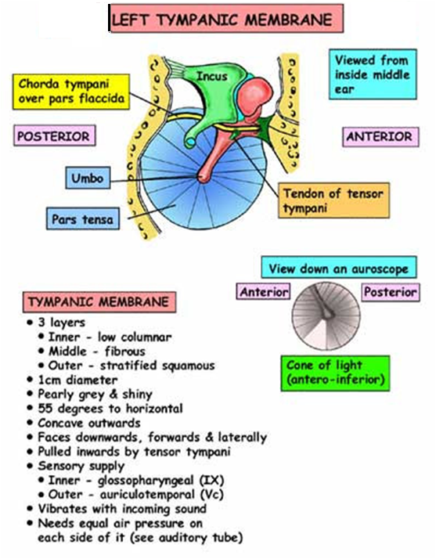

Slide 29
Nerve supply of Tympanic Membrane
The external surface of the tympanic membrane is supplied by the auriculotemporal nerve.
The internal surface is supplied by a small auricular branch of the vagus nerve (CN X); this nerve may also contain some glossopharyngeal and facial nerve fibres (tympanic plexus).

Slide 30
Blood supply of Tympanic Membrane
Deep auricular branch of maxillary artery supplies external surface, posterior auricular artery & tympanic branch of maxillary artery supplies internal surface.
Veins from external surface drain to external jugular vein & from internal surface drain to transverse sinus & partly to venous plexus of auditory tube.

Slide 31
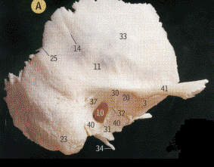
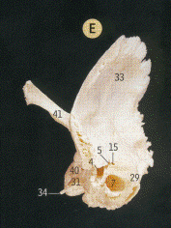
10 External acoustic meatus
11 Groove for middle temporal artery
12 Groove for sigmoid sinus
13 Groove for superior petrosal sinus
14 Grooves for branches of middle meningeal vessels
15 Hiatus and groove for greater petrosal nerve
16 Hiatus and groove for lesser petrosal nerve
17 Internal acoustic meatus
18 Jugular fossa
19 Jugular surface
20 Mandibular fos5a
21 Mastoid canaliculus for auricular branch of vagus nerve
22 Mastoid notch
23 Mastoid process
24 Occipital groove
25 Parietal notch
26 Petrosquamous fissure (from above)
27 Petrosquamous fissure (from below)
28 Petrotympanic fissure
29 Petrous part
30 Postglenoid tubercle
31 Sheath of styloid process
32 Squamotympanic fissure
33 Squamous part
34 Styloid process
35 Stylomastoid foramen
36 Subarcuate fossa
37 Suprameatal triangle
38 Tegmen tympani
39 Trigeminal impression on apex of petrous part
40 Tympanic part
41 Zygomatic process

Slide 32
Suprameatal Triangle
A triangle formed by the root of the zygomatic arch, the posterior wall of the bony external acoustic meatus, and an imaginary line connecting the extremities of the first two lines; used as a guide in mastoid operations.
Syn: Macewen's triangle

Slide 33
Otoscopic Examination
Examination of the external acoustic meatus and tympanic membrane begins by straightening the meatus.
In adults, the helix is grasped and pulled posterosuperiorly (up, out, and back). These movements reduce the curvature of the external acoustic meatus, facilitating insertion of the otoscope .
The meatus is relatively short in infants; therefore, extra care must be exercised to prevent injury to the tympanic membrane.
The tympanic membrane is normally translucent and pearly gray . The handle of the malleus is usually visible near the center of the membrane (the umbo). From the inferior end of the handle, a bright cone of light is reflected from the otoscope's illuminator. This light reflex is visible radiating anteroinferiorly in the healthy ear.

Slide 34
External Ear Injury
Bleeding within the auricle resulting from trauma may produce an auricular hematoma.
A localized collection of blood forms between the perichondrium and the auricular cartilage, causing distortion of the contours of the auricle. As the hematoma enlarges, it compromises the blood supply to the cartilage.
If untreated (e.g., by aspiration of blood), fibrosis (formation of fibrous tissue) develops in the overlying skin, forming a deformed auricle (e.g., the cauliflower or boxer's ear of some professional fighters).

Slide 35
Acute Otitis Externa
Otitis externa is an inflammation of the external acoustic meatus.
The infection often develops in swimmers who do not dry their meatus after swimming and/or use ear drops, but it may also be the result of a bacterial infection of the skin lining the meatus.
The affected individual complains of itching and pain in the external ear.
Pulling the auricle or applying pressure on the tragus increases the pain.

Slide 36
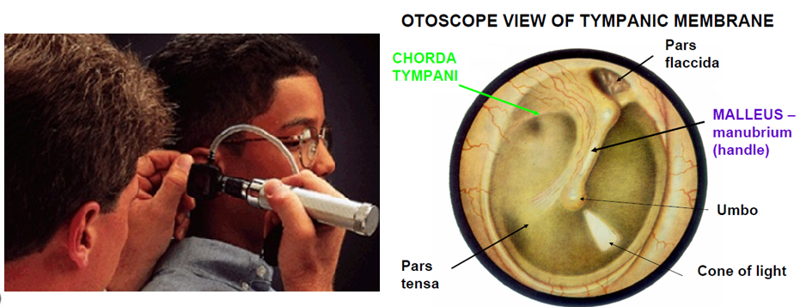

Slide 37


