Slide 1
EPIDEMIOLOGY OF MALARIA BY MBBSPPT.COM

Slide 2
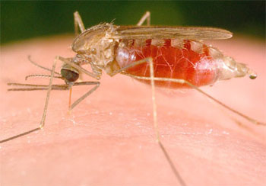
VECTOR OF MALARIA
Out of the 45 species of anophelies in India only An. culicifacies, An. fluviatilis, An. stephensi, An. minimus, An. philippinesis, An. sundaicus, An. maculatus are vectors of primary importance.
An. culicifacies in rural and An. stephensi in urban areas

Slide 3
THE MAIN FACTORS WHICH DETERMINE THE VECTORIAL IMPORTANCE OF MOSQUITOES ARE :
1.DENSITY
-sudden increase may be the cause of an epidemic outbreak
-critical density
2.LIFE SPAN
- Must live for 10 to 12 days after infective blood meal
3.CHOICE OF HOST
- Preference for human or animal
4.RESTING HABITS
Endophily or exophily

Slide 4
5.BREEDING HABITS
Flowing water or stagnant water or brackish water
6.TIME OF BITING
-nocturnal between dusk and dawn
7.VECTORIAL CAPACITY
- (density of vector population + susceptibility to infection + Life span + probability of feeding on men)
8.RESISTANCE TO INSECTICIDES

Slide 5
MODE OF TRANSMISSION
1.VECTOR TRANSMISSION - female anopheles mosquito
2.DIRECT TRANSMISSION – IM / IV (blood transfusion)
3.CONGENITAL MALARIA – from infected mother (rare)

Slide 6
INCUBATION PERIOD
FALCIPARUM MALARIA – 12(9-14) DAYS
VIVAX MALARIA – 14(8-17) DAYS
QUARTAN MALARIA – 28(18-40) DAYS
OVALE MALARIA - 17(16-18) DAYS

Slide 7
CLINICAL FEATURES
1.COLD STAGE 2.HOT STAGE
Lasts upto 1 hour
2-6 hours

Slide 8
3.SWEATING STAGE
Periodicity and interval of febrile
paroxysms are different for different
species of anopheles
2-4 hours

Slide 9
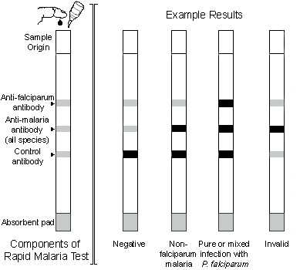
DIAGNOSIS
1.MICROSCOPIC EXAMINATION
- Thin and thick smear
2.SEROLOGICAL TEST
(+ve after 2 weeks or more after primary infection)
3.RAPID DIAGNOSTIC TEST

Slide 10
MEASUREMENT OF MALARIA
PRE-ERADICATION ERA
a. spleen rate
- % of children between 2-10 yrs showing enlargement of spleen
b. average enlarged spleen
- denoting the average size of enlarged spleen
c. parasite rate
- % of children between 2-10 yrs showing malarial parasite in their blood film

Slide 11
d. parasite density index
- average degree of parasitaemia in a blood sample.
e. infant parasite rate
- % of infants below 1 yr showing malarial parasite in their blood films.
f. proportional case rate
- number of cases diagnosed as clinical malaria for every 100 patients attending hospitals and dispensaries.

Slide 12
ERADICATION ERA
Following parameters are in use at present
1. annual parasite incidence (API)
API = confirmed cases during one year X 1000
population under surveillance
2. annual blood examination rate(ABER)
ABER = number of slides examined X 100
population

Slide 13
3.annual falciparum incidence(AFI)
4.slide positivity rate(SPR)
- % of slides positive for malarial parasite
5.slide falciparum rate(SFR)
- % of slides positive for P. falciparum parasite

Slide 14
VECTOR INDICES
-human blood index
-sporozoid rate
-mosquito density
-man biting rate
-inoculation rate

Slide 15
Thank You

