Slide 1
ETIOPATHOGENESIS OF DIABETES BY MBBSPPT.COM

Slide 2
TYPE 1 DIABETES
PATHOLOGY
Type 1 diabetes is a T cell-mediated autoimmune disease involving destruction of the insulin-secreting β cells in the pancreatic islets which takes place over many years.

Slide 3
The pathology in the pre-diabetic pancreas in type 1 diabetes is characterised by:
-insulitis: infiltration of the islets with mononuclear cells containing activated macrophages, helper cytotoxic and suppressor T lymphocytes, natural killer cells and B lymphocytes
-initial patchiness of this lesion with, until a very late stage, lobules containing heavily infiltrated islets seen adjacent to unaffected lobules
-β-cell specificity of the destructive process, with the glucagon and other hormone-secreting cells in the islet remaining intact.

Slide 4
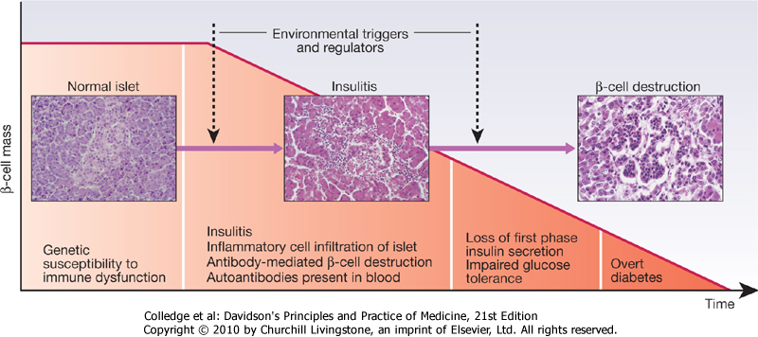

Slide 5
GENETIC PREDISPOSITION
Genetic factors account for about one-third of the susceptibility to type 1 diabetes, the inheritance of which is polygenic . Over 20 different regions of the human genome show some linkage with type 1 diabetes but most interest has focused on the human leucocyte antigen (HLA) region within the major histocompatibility complex on the short arm of chromosome 6; this locus is designated IDDM 1. The HLA haplotypes DR3 and/or DR4 are associated with increased susceptibility to type 1 diabetes. Candidate gene and genome-wide association studies have also implicated other genes in type 1 diabetes, e.g. CD25, PTPN22, IL2RA, which are involved in immune recognition of pancreatic islet antigens, T cell development and immune regulation.

Slide 6
RISK OF DEVELOPING TYPE 1 DIABETES IN INDIVIDUALS WITH TYPE 1 DIABETIC RELATIVE
Relative with type 1 diabetes | % overall risk
Identical twin | 35
Non-identical twin | 20
HLA-identical sibling | 16
Non-HLA-identical sibling | 3
Father | 9
Mother | 3
Both parents | Up to 30

Slide 7
ENVIRONMENTAL FACTORS
Environmental factors have an important role in promoting clinical expression of the disease. The nature of these environmental factors is uncertain.
-One proposal is that reduced exposure to microorganisms in early childhood limits maturation of the immune system and increases susceptibility to autoimmune disease (the 'hygiene hypothesis').
Another is that viral infection in the pancreas alters β cells' immunogenicity; several viruses have been implicated, including mumps, Coxsackie B4, retroviruses, rubella (in utero), cytomegalovirus and Epstein-Barr virus.

Slide 8
Stress may precipitate type 1 diabetes by stimulating the secretion of counter-regulatory hormones and possibly by modulating immune activity.
-Dietary factors may also be important. Various nitrosamines (found in smoked and cured meats) and coffee have been proposed as potentially diabetogenic toxins. Bovine serum albumin (BSA), a major constituent of cow's milk, has been implicated, since children who are given cow's milk early in infancy are more likely to develop type 1 diabetes than those who are breastfed.

Slide 9
METABOLIC DISTURBANCES IN TYPE 1 DIABETES PATIENTS
Patients with type 1 diabetes present when progressive β-cell destruction has crossed a threshold at which adequate insulin secretion and normal blood glucose levels can no longer be sustained. Above a certain level, high glucose levels may be toxic to the remaining β cells so that profound insulin deficiency rapidly ensues. Severe insulin deficiency is associated with the metabolic sequelae . Hyperglycaemia leads to glycosuria and dehydration, which in turn induces secondary hyperaldosteronism . Unrestrained lipolysis and proteolysis result in weight loss, increased gluconeogenesis and ketogenesis.

Slide 10
TYPE 2 DIABETES
PATHOLOGY
Type 2 diabetes is a more complex condition than type 1 diabetes because there is a combination of resistance to the actions of insulin in liver and muscle together with impaired pancreatic β-cell function leading to 'relative' insulin deficiency. Insulin resistance appears to come first, and leads to elevated insulin secretion in order to maintain normal blood glucose levels. However, in susceptible individuals the pancreatic β cells are unable to sustain the increased demand for insulin and a slowly progressive insulin deficiency develops.

Slide 11
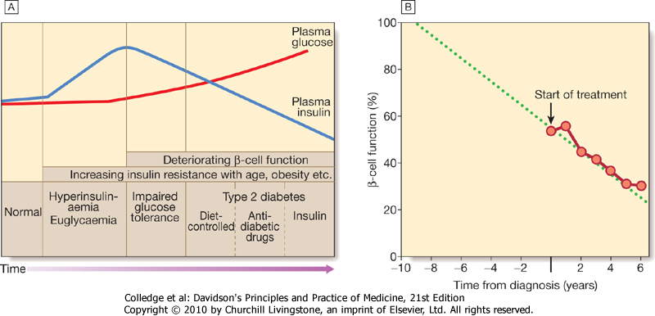

Slide 12
INSULIN RESISTANCE
Type 2 diabetes, or its antecedent impaired glucose tolerance, is often associated with other disorders, particularly central (visceral) obesity, hypertension and dyslipidaemia .
It has been suggested that coexistence of this cluster of conditions, all of which predispose to cardiovascular disease, is a specific entity (the 'insulin resistance syndrome' or 'metabolic syndrome'), with insulin resistance being the primary defect and the presence of obesity being a powerful amplifier of the insulin resistance.
The primary cause of insulin resistance remains unclear.

Slide 13
1.Intra-abdominal 'central' adipose tissue is metabolically active, and releases large quantities of FFAs which may induce insulin resistance because they compete with glucose as a fuel supply for oxidation in peripheral tissues such as muscle.
2.adipose tissue releases a number of hormones called 'adipokines' which act on specific receptors to influence sensitivity to insulin in other tissues. Because visceral adipose tissue drains into the portal vein, central obesity may have a particularly potent influence on insulin sensitivity in the liver, and thereby adversely affect gluconeogenesis and hepatic lipid metabolism.

Slide 14
3.Physical activity is another important determinant of insulin sensitivity. Inactivity is associated with down-regulation of insulin-sensitive kinases and may promote accumulation of FFAs within skeletal muscle. Sedentary people are therefore more insulin-resistant than active people with the same degree of obesity. Moreover, physical activity allows non-insulin-dependent glucose uptake into muscle, reducing the 'demand' on the pancreatic β cells to produce insulin
4.Additional disorders have been associated more recently with insulin resistance. Deposition of fat in the liver is a common association with central obesity and is exacerbated by insulin resistance and/or deficiency. Many patients with type 2 diabetes have evidence of non-alcoholic fatty liver disease (NAFLD)

Slide 15
PANCREATIC BETA CELL FAILURE
In the early stages of type 2 diabetes, reduction in the total mass of pancreatic islet tissue is modest. At the time of diagnosis, around 50% of β-cell function has been lost and this declines progressively with time . Some pathological changes are typical of type 2 diabetes, the most consistent of which is deposition of amyloid. Elevated plasma glucose and FFAs exert toxic effects on pancreatic β cells to impair insulin secretion. However, while β-cell numbers are reduced, α-cell mass is unchanged and glucagon secretion is increased, which may contribute to the hyperglycaemia.

Slide 16
GENETIC PREDISPOSITION
Genetic factors are important in type 2 diabetes, in monozygotic twins concordance rates for type 2 diabetes is approaching 100%. Genome-wide association studies have identified over 20 genes or gene regions that are associated with type 2 diabetes, each exerting a small effect. The largest effect is seen with variation in TCF7L2. Most of the genes known to contribute to risk of type 2 diabetes are involved in β-cell function or in regulation of cell cycling and turnover, suggesting that altered regulation of β-cell mass is a primary predisposing factor.

Slide 17
RISK OF DEVELOPING TYPE 2 DIABETES FOR SIBLINGS OF PROBANDS WITH TYPE 2 DIABETES
Age at onset of type 2 diabetes in proband | Age-corrected risk of type 2 diabetes for siblings (%)
25-44 | 53
45-54 | 37
55-64 | 38
65-80 | 31

Slide 18
ENVIRONMENT AND OTHER RISK FACTORS
DIET AND OBESITY
The risk of developing type 2 diabetes increases tenfold in people with a body mass index (BMI) > 30 kg/m² . Obesity probably acts as a diabetogenic factor (through increasing resistance to the action of insulin) only in those who are genetically predisposed both to insulin resistance and to β-cell failure.
Sweet foods rich in refined carbohydrate consumed frequently may increase the demand for insulin secretion, while high-fat foods may increase FFAs and exacerbate insulin resistance.

Slide 19
AGE
Type 2 diabetes is more common in the middle-aged and elderly .
PREGNANCY
During normal pregnancy, insulin sensitivity is reduced through the action of placental hormones and this affects glucose tolerance. The insulin-secreting cells of the pancreatic islets may be unable to meet this increased demand in women genetically predisposed to develop diabetes. The term 'gestational diabetes' refers to hyperglycaemia occurring for the first time during pregnancy . Repeated pregnancy increases the likelihood of developing irreversible diabetes,80% of women with gestational diabetes ultimately develop permanent diabetes.

Slide 20
METABOLIC DISTURBANCES IN TYPE 2
Patients with type 2 diabetes have a slow onset of 'relative' insulin deficiency. Relatively small amounts of insulin are required to suppress lipolysis, and some glucose uptake is maintained in muscle, so that, in contrast with type 1 diabetes, lipolysis and proteolysis are not unrestrained and weight loss and ketoacidosis seldom occur.

Slide 21
OTHER FORMS OF DIABETES
In most cases there is an obvious cause of destruction of pancreatic β cells. Some acquired disorders, notably other endocrine diseases such as acromegaly or Cushing's syndrome, can precipitate type 2 diabetes in susceptible individuals.
A number of unusual genetic diseases are associated with diabetes. In rare families, diabetes is caused by single gene defects with autosomal dominant inheritance. These subtypes present as 'maturity-onset diabetes of the young' (MODY), i.e. non-insulin-requiring diabetes presenting before the age of 25 years .

Slide 22
Type 1 diabetes
-Immune-mediated
-Idiopathic
Type 2 diabetes
Other specific types
-Genetic defects of β-cell function
-Genetic defects of insulin action (e.g. leprechaunism,
lipodystrophies)
-Pancreatic disease (e.g. pancreatitis, pancreatectomy,
neoplastic disease, cystic fibrosis,
haemochromatosis, fibrocalculous pancreatopathy)
-Excess endogenous production of hormonal antagonists
to insulin (e.g. growth hormone-acromegaly;
glucocorticoids-Cushing's syndrome; glucagon-glucagonoma;
catecholamines-phaeochromocytoma;
thyroid hormones-thyrotoxicosis)

Slide 23
Gestational diabetes
-Drug-induced (e.g. corticosteroids, thiazide diuretics, phenytoin)
-Viral infections (e.g. congenital rubella, mumps, Coxsackie virus B)
-Uncommon forms of immune-mediated diabetes
-Associated with genetic syndromes (e.g. Down's syndrome; Klinefelter's syndrome;
-Turner's syndrome; DIDMOAD (Wolfram's syndrome)-diabetes insipidus, diabetes mellitus, optic atrophy, nerve deafness; Friedreich's ataxia; myotonic dystrophy)

Slide 24
Thank You

