Slide 1
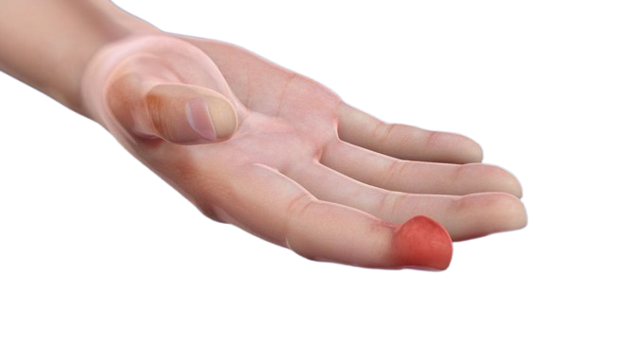
Felon
BY MBBSPPT.COM

Slide 2
Hand infections
Hand infections can occur due to a number of reasons, including injuries, bites, or delayed treatment.
Causes
Hand infections can be caused by a variety of bacterial and fungal pathogens, including Staphylococcus aureus and Streptococcus species. They can be caused by injuries, such as bites, puncture wounds, or manicures. Infections can also spread through the blood, which is more common in children, people who are immunocompromised, or people who use intravenous drugs.
Symptoms
Symptoms of a hand infection include pain, redness, and swelling. Viral infections can cause blisters, itching, or mild burning.

Slide 3
Hand infections
Types
Hand infections can be superficial or deep. Superficial infections affect the skin and subcutaneous tissues, while deep infections can affect the bones, joint spaces, and tendon sheaths.
Treatment
Early treatment is essential to prevent severe problems, such as loss of strength, stiffness, or tissue loss. Treatment depends on the type of infection and how far it has progressed:
Superficial infections: Can be treated with antibiotics, rest, elevation, warm soaks, and splinting.
Deep infections: Require surgical intervention, such as incision and drainage, or debridement.
Necrotizing fasciitis and gas gangrene: Require immediate surgical intervention.

Slide 4
types of hand infections
Some common types of hand infections include:
Paronychia: An infection or inflammation of the nail fold that can be acute or chronic.
Felon: An infection of the distal pulp of the finger that often requires surgical drainage.
Herpetic whitlow: Caused by the herpes simplex virus and usually resolves on its own.

Slide 5
Felon
Infections of intermediate depth spaces.
Pulp space infection (FELON).
Web spaces infection.

Slide 6
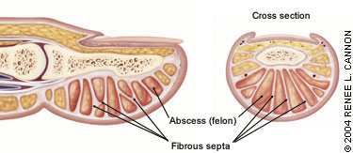
Anatomy

Slide 7
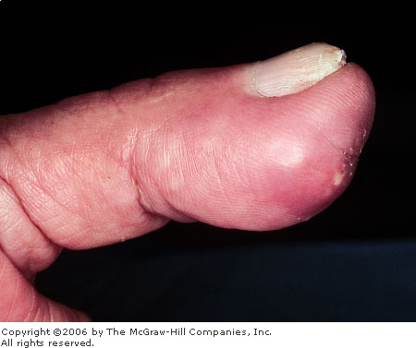
Felon
Felon is an abscess of pulp of the finger.
It may involve the terminal, middle or proximal volar pulp space.
Most commonly involves distal pulp space.
Second most common hand infection.
Most commonly involves - index and thumb.
Results from a minor trauma, ex: finger prick.

Slide 8
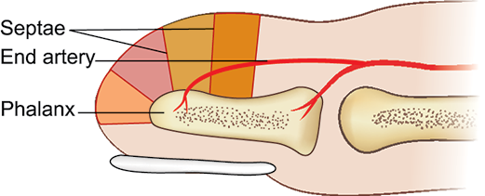
Surgical anatomy
Pulp space contains fat - partitioned by septae.
Septae are attached from periosteum of phalynx to skin.
Terminal pulp space is a closed compartment.

Slide 9
Pathophysiology
Minor Trauma
Infection to the Pulp Space
Collection of Pus in Space
Increase in Pressure in that Closed Compartment
Compression of Terminal Artery
Gangrene of the Pulp Space Osteomyelitis of Phalynx

Slide 10
Felon
Causative Organisms –
Staph. Aureus (Most Common).
Streptococcus.
Gram –Ve Organisms.

Slide 11
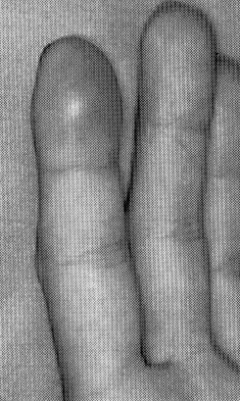
Clinical features of Felon
Severe pain
Redness
Swelling
Fever
Tender axillary lymph nodes.

Slide 12
Complications
Extend Toward the Phalanx – Osteomyelitis.
Obliterate Vessels --- Skin Slough or Necrosis.
Suppurative Flexor Tenosynovitis or Septic Arthritis of the DIPJ.
Extend to form deep Palmar Space Infection.
Septicemia.

Slide 13
Felon
Investigations:
Xray of the part to check for the presence of osteomyelitis.
Culture and sensitivity of pus.

Slide 14
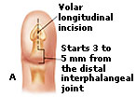
Felon
Treatment:
Antibiotics and analgesics.
Definitive treatment: Drainage of terminal pulp space by a longitudinal deep incision.
If there is osteomyelitis of the terminal phalanx, it has to be amputated.

Slide 15
Thank You

