Slide 1
FOURNIER’S GANGRENE
BY MBBSPPT.COM

Slide 2
DEFINITION
Fournier’s gangrene is a synergistic polymicrobial necrotizing fasciitis of the perineum and genitalia.

Slide 3
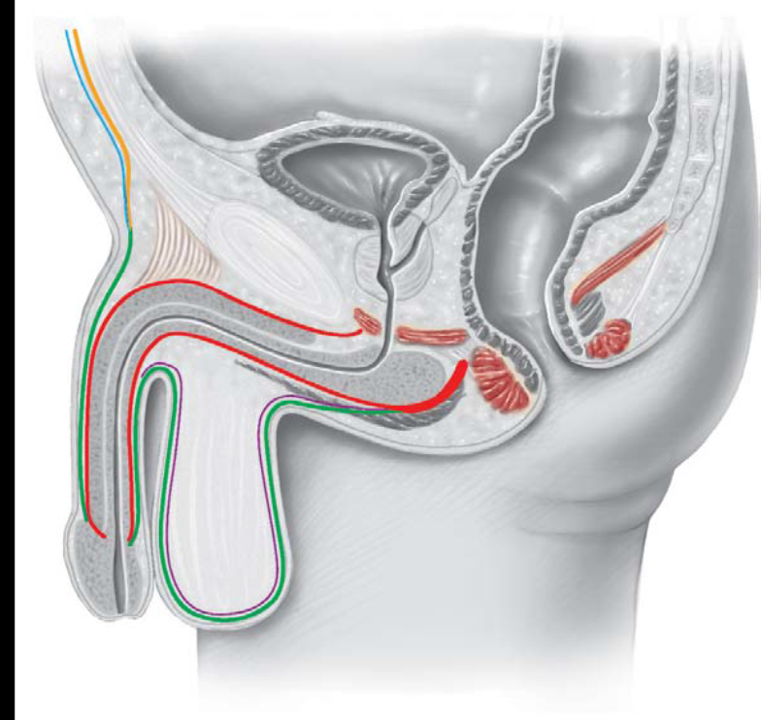
ANATOMY
The five fascial planes that can be affected are:
Colles’fascia,
dartos fascia,
Buck’s fascia,
Scarpa’s fascia,
and Camper’s fascia.

Slide 4
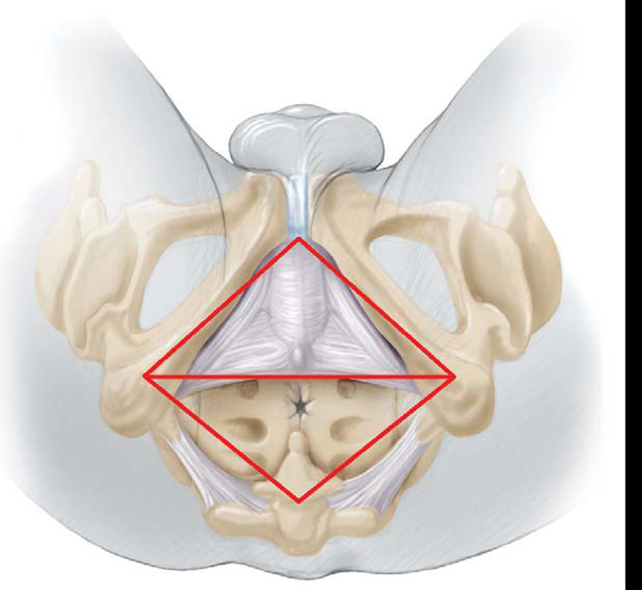
ANATOMY
Colles’ fascia is the fascia of the anterior triangle of the perineum.
It prevents the spread of infection in a posterior or lateral direction, but provides no resistance to spread in an anterosuperior direction towards the abdominal wall. Posterior spread to the anal region will be limited by the termination of Colles’ fascia in the posterior edge of the perineal membrane
Dartos fascia is the continuation of Colles’ fascia over the scrotum and penis.
Buck’s fascia lies deep to the dartos fascia, covering the penile corpora.
Camper’s fascia is the loose areolar fascial layer deep to the skin of the abdominal wall, but superficial to
Scarpa’s fascia. Together with Scarpa’s fascia it is continuous with Colles’ fascia inferomedially.

Slide 5
ANATOMY
Urogenital causes of Fournier’s gangrene lead to initial involvement of the anterior triangle, whereas anorectal causes primarily involve the posterior triangle.
Blood supply to the testis, bladder, and rectum originates directly from the aorta and not from the perineal vasculature, and for this reason they are rarely affected in Fournier’s gangrene.

Slide 8
CAUSES
UROGENITAL
Urethral stricture
Indwelling transurethral catheter
Prolonged or neglected use of condom catheter
Urethral calculi
Urethritis
Transurethral surgery
Infection of periurethral glands and paraurethral abscess
Urogenital tuberculosis
Urethral cancer
Prostate biopsy
Prostatic massage
Prostate abscess
Insertion of penile prosthesis
Constriction ring device for management of ED

Slide 9
CAUSES
ANORECTAL
Ischiorectal or perianal or intersphincteric abscess
Rectal mucosal biopsy
Banding of hemorrhoids
Anal dilatation
Cancer of sigmoid or rectum
Diverticulitis
Rectal perforation by foreign body
Ischemic colitis
Anal stenosis

Slide 10
CAUSES
Latrogenic Trauma
Cauterization of genital warts
Circumcision
Manipulation of longstanding paraphimosis
Noniatrogenic trauma
Animal, insect, or human bite
Scrotal abscess
Infected hydrocele
Hydrocelectomy
Vasectomy
Balanitis
Phimosis

Slide 11
CUTANEOUS
Hidradenitis suppurativa
Folliculitis
Scrotal pressure sore
Post-scrotal surgery wound infection
Cellulitis of scrotum
Pyoderma gangrenosum
Femoral access for intravenous drug users

Slide 12
RETROPERITONEAL CAUSES
Psoas abscess
Perinephric abscess
Appendicitis and appendix abscess
Pancreatitis with retroperitoneal fat necrosis
Others
Inguinal hernia repair
Filariasis in endemic areas
Strangulated Richter hernia

Slide 13
PREDISPOSING FACTORS
Diabetes mellitus
Chronic alcoholism
Malnutrition
Obesity
Liver cirrhosis
Poor personal hygiene
Immunosuppression:
Chronic steroid use
Organ transplantation
Chemotherapy for malignancy
HIV/AIDS
Tuberculosis
Syphilis

Slide 14
RISK FACTORS
Circumcision
Episiotomy
Extravasations of urine (periurethrally or through cutaneous fistula)
Hernioplasty
Hysterectomy
Local trauma or instrumentation to the perineum
Paraphimosis
Septic abortion
Urethral stricture caused by sexually transmitted diseases

Slide 15
MOST COMMON CAUSATIVE ORGANISMS
Gram-negative
E. coli
Klebsiella pneumoniae
Pseudomonas aeruginosa
Proteus mirabilis
Enterobacteria
Gram-positive
Staphylococcus aureus
Beta-hemolytic streptococci
Streptococcus faecalis
Staphylococcus epidermidis
Anaerobes
Bacteroides fragilis
Peptococcus
Fusobacterium
Clostridium perfringens
Mycobacteria
Mycobacterium tuberculosis
Yeasts
Candida albicans

Slide 16
PATHOGENESIS
The pathogenesis of Fournier’s gangrene is characterized by polymicrobial infection with subsequent vascular thrombosis and tissue necrosis, aggravated by poor host defense due to one or more underlying systemic disorders.

Slide 17
PATHOGENESIS
Aerobic organisms cause intravascular coagulation by inducing platelet aggregation and complement fixation, while anaerobes produce heparinase.

Slide 18
PATHOGENESIS
Hypoxic tissue leads to the formation of oxygen free radicals (superoxide anions, hydrogen peroxide, hydroxyl radicals)
This lead to cell membrane disruption, decreased ATP production, and DNA damage, which leads to decreased protein production

Slide 19
PATHOGENESIS
Anaerobic organisms secrete various enzymes and toxins. Lecithinase, collagenase, and hyaluronidase cause digestion of the fascial planes.
They produce insoluble hydrogen and nitrogen, leading to the formation of gas in the subcutaneous tissues, clinically palpable as crepitus.

Slide 20
PATHOGENESIS
Endotoxins are released from the cell walls of Gram negative bacteria.
Macrophage activation and subsequent complement activation ensues with release of pro-inflammatory cytokines and eventual development of septic shock

Slide 21
CLINICAL PRESENTATION
1-Prodromal symptoms of fever and lethargy, which may be present for 2-7 days
2-Intense genital pain and tenderness that is usually associated with edema of the overlying skin
3-Increasing genital pain and tenderness with progressive erythema of the overlying skin.
4-Dusky appearance of the overlying skin; subcutaneous crepitation
5-Obvious gangrene of a portion of the genitalia; purulent drainage from wounds

Slide 22
CLINICAL PRESENTATION
Fournier’s gangrene shows vast heterogeneity in clinical presentation,
  from insidious onset and slow progression to
  rapid onset and fulminant course,
the latter being the more common presentation.
The disease tends to present more in elderly men(6-7th decade) and also has been reported in women and children

Slide 23
INVESTIGATION
Laboratory Studies
Full blood count, clotting profile, urea, creatinine and electrolytes, liver function tests, blood glucose, blood gases, group and screen, HIV and VDRL.
Abnormal findings include anemia, thrombocytopenia, coagulopathy, hyponatremia, and raised urea and creatinine.
Hypocalcemia may occur in some cases, subsequent to the chelation of ionized calcium by triglycerides liberated by bacterial lipases.

Slide 24
Imaging Studies
  Radiography
  Ultrasonography
  CT scanning
  MRI

Slide 25
TREATMENT
Medical
  Aggressive resuscitation
  Antibiotics with broad-spectrum coverage
Surgical
  Emergent surgical excision of all necrotic tissue
  The skin should be wide opened
  Re-debridement
  Fecal diversion
  Urinary diversion
  Orchiectomy?

Slide 26
TREATMENT
Reconstruction
  Primary closure of the skin, if possible.
  Local skin flap coverage.
  Split-thickness skin grafts.
  Muscular flaps, which are used to fill a cavity.

Slide 27
COMPLICATION
Unresolved sepsis
Unrecognized cause of the infection
  (perforated peptic ulcer disease, appendicitis, diverticulitis) or extension of the necrotizing process outside the obvious wound.
Complication of severe acute illness.
  (bacterial endocarditis, pneumonia)
The plethora of comorbid conditions.
  (acute myocardial infarction, respiratory failure, pressure ulcerations, delirium) or the bed-rest conditions imposed on patients who are acutely ill (pulmonary embolus, deep venous thrombosis, atelectasis, pneumonia)

Slide 28
DIFFERENTIAL DIAGNOSIS
Cellulitis
Strangulated hernia
Scrotal abscess
Streptococcal necrotising fascitis
Vascular occlusion syndromes
Herpes simplex
Gonococcal balanitis and oedema
Pyoderma gangrenousm
Allergic vasculitis
Polyarteritis nodosa
Necrolytic migratory erythema
Warfarin necrosis
Ecthyma gangrenosum

Slide 29
PROGNOSIS
In the pre-antibiotic era, Fournier’s gangrene was commonly fatal; even today, it poses a significant risk of morbidity and mortality.
Despite aggressive therapy, the mortality rate for patients with Fournier’s gangrene is nearly 50% because of the aggressive nature of the infection and the presence of underlying comorbidities.

Slide 30
PROGNOSIS
Delays in diagnosis or treatment increase the mortality rate.
  A 24-hour delay in radical debridement increases the mortality rate by 11.5%;
  A 6-day delay is associated with a mortality rate of 76%.
Additional factors associated with high mortality include:
  Anorectal origin
  Advanced age.
  Extensive disease
  Shock
  Sepsis at presentation,
  Renal failure
  Hepatic dysfunction.
Multiorgan system failure secondary to gram-negative sepsis is the most common cause of death

Slide 31
THANK YOU!

