Slide 1
furuncle OF NOSE
BY MBBSPPT.COM

Slide 2
WHAT IS IT?
This is one of the inflammatory conditions of nasal vestibule. Here are some of the inflammatory conditions of nasal vestibule:
Furuncle or boil
Vestibulitis
Erysipelas
We will see in detail about furuncle/boil.

Slide 3
FURUNCLE OR BOIL
Definition:
It is ab acute infection of the hair follicle of nasal vestibule caused by staphylococcus aureus.

Slide 4
FURUNCLE OR BOIL
Causative Agent:
Staphylococcus Aureus
Predisposing Factors:
Trauma From Pricking of Nose
Diabetes
Immunodeficiency State
Long Term Steroids
Clinical Features:
Complain of Pain Over Affected Area.
Swelling Which Involve the Tip of the Nose Depending on the Site of the Affected Area.

Slide 5
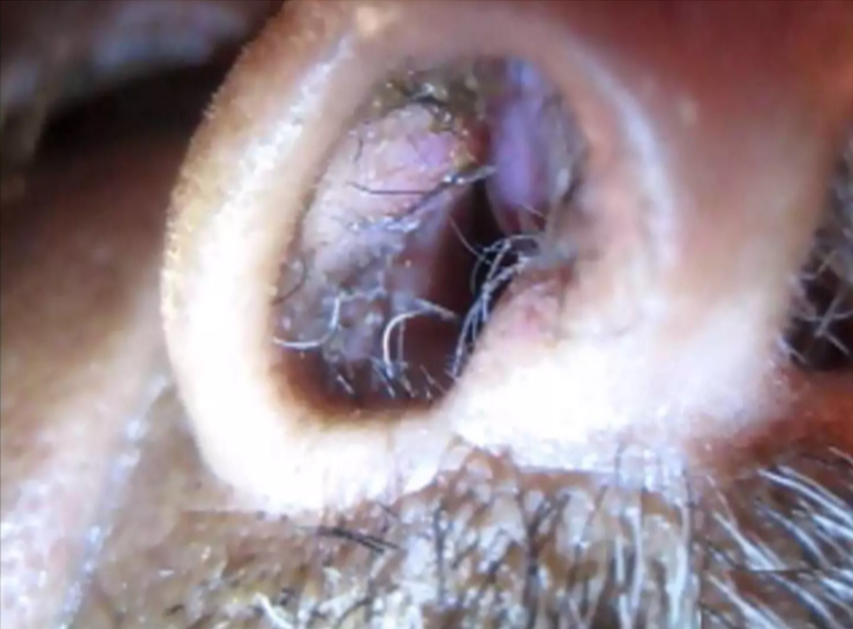

Slide 6
Sign:
Swelling and redness of the affected area.
The affected area is usually tender.
Treatment:
Warm compression.
Analgesics to relieve pain.
Tropical and systemic antibiotics directed against staphylococcus.
If a fluctuant area appears, incision and drainage can be done.
In NO case should the furuncle be squeezed or prematurely incised because of the danger of spread of infection to cavernous sinus through venous thrombophlebitis.

Slide 7
Complications:
Cellulitis of the upper lip.
Septal abscess.
Cavernous Sinus Thrombosis. As veins of the nose is connected with the cavernous sinus through two routes:
Through facia; veins communicating with ophthalmic vein 9both having no valves).
Through the pterygoid plexus of vein which communicate with facial veins on one hand the cavernous sinus through emissary veins on the other hand.
If the patient of nasal furunculosis complains of malaise, headache and pyrexia, cavernous sinus thrombosis should be suspected.

Slide 8
Thank You

