Slide 1
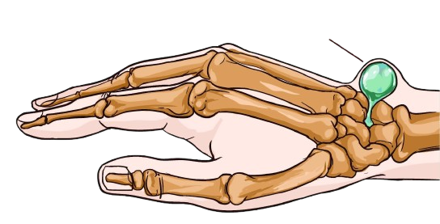
GANGLION & BURSITIS
BY MBBSPPT.COM

Slide 2
INTRODUCTION
Most common swelling in the wrists.
Arises from leakage of synovial fluid from a joint or tendon sheath.
Contains a glairy, viscous fluid.
Can appear anywhere around the carpus.
Usually develops on the dorsal surface of the scapho-lunate ligament.

Slide 3
Common Sites Are:
Dorsally:
Dorsal Carpus.
Second And Third Cmc Joint.
Intratendon Area.
Dip (Muscous Cyst).
Volarlly:
Flexor Sheath.
Guyon’s Canal.
Volar Carpus Ganglion.

Slide 5
ETIOLOGY
Unknown.
Traumatic.
Mucous cysts associated with OA of DIP joint.

Slide 6
PATHOLOGY
Multi-loculated.
Outer wall: several layers of collagen layers, few fibroblasts and
mesenchymal cells.
No synovial lining: not a cyst in true sense.
Content: clear, viscous, mucin- glucosamine, albumin, globulin, hyaluronic acid

Slide 7
PATHOGENESIS
Unclear Communication of fluid from wrist joint: herniation.
Rent in capsule and tendon sheath→ escape of synovial fluid→ irritation of surrounding tissues→ pseudo capsule formation.
Enlarge when fluid is pumped in and reduced when water content is absorbed.
Mucoid degeneration of connective tissue and breakdown products coalesce.

Slide 8
CLINICAL FEATURES
Often Young Adults.
More Common In Woman.
Older Patients: Mucous Cyst.
Painless Lump.
Occasionally Slight Ache And Weakness.
Well Defined Swelling.
Cystic And Not Tender.
Trans - Illuminated.

Slide 9
DORSAL CARPAL GANGLION
Most common location.
Originates from the scapho- lunate interval.
May decompress into EPL or common extensor tendon sheath.
Asymptomatic, decreasing and increasing in size.
May be associated with aching pain, tenderness and interference with activity at the time of presentation.
Occult ganglion: pressure on branches of posterior inter – osseous nerve.
Large ganglion: pressure on radial nerve branches.

Slide 11
VOLAR CARPAL GANGLION
Second most common location.
Originates from the FCR tendon sheath or from the articulation between the radius and the scaphoid (2/3), the scaphoid and the trapezium (1/3).
Located between radial artery and FCR.
May present with sensory or motor nerve palsy involving palmar cutaneous branch of median nerve, ulnar nerve, deep ulnar motor branches.
Aspiration is not recommended.

Slide 13
VOLAR RETINACULAR GANGLION
7-12 %.
Arise from A1 or A2 pulley.
Firm, minimally mobile mass near proximal digital crease or MCP joint.
Excision if pressure symptoms.

Slide 14
MUCOUS CYSTS
Middle age or later.
Females.
Dorsal DIP joint.
Observation, aspiration or excision.
Pain is the indication for excision.

Slide 15
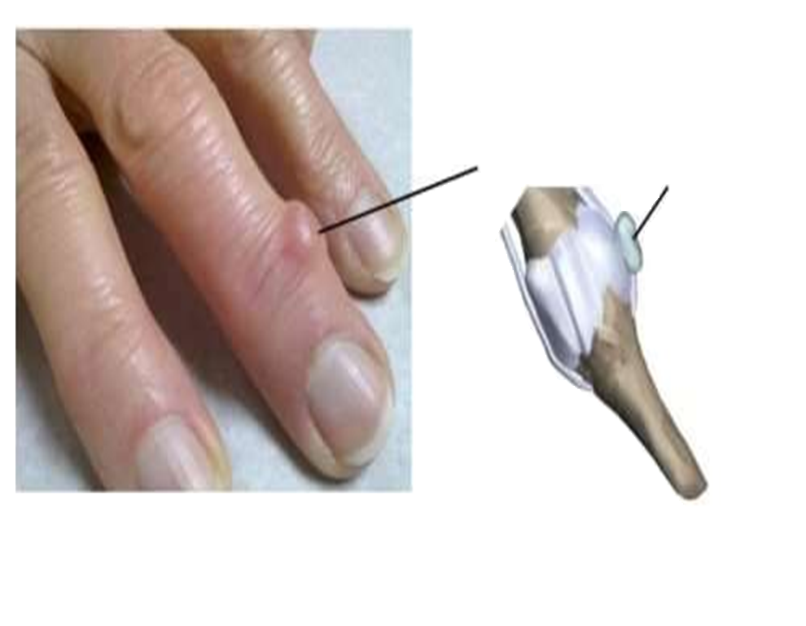
MUCOUS CYSTS
Fig: MUCOUS CYSTS of the finger

Slide 16
DIFFERENTIAL DIAGNOSIS
Non - Neoplastic Masses:
Soft - Tissue:
Aneurysm
Displaced Tendon
Nerve Entrapment
Nerve Ganglion
Neuroma
Tendon Entrapment
Chondroma
Fibroma
GCT Of Tendon Sheath
Infection
Ra
Gout

Slide 17
TREATMENT
Observation
Closed Rupture
Cyst Puncture
Aspiration
Excision
Spontaneous Resolution In 50% Cases.

Slide 18
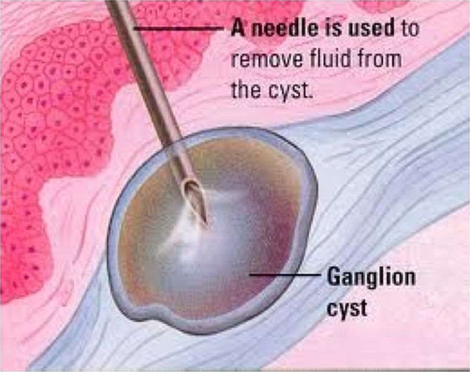

Slide 19
Fig: EXCISION

Slide 20
REHABILITATION
2 Weeks:
Remove the short Arm Splint and Sutures.
Arom and Aarom of Wrist Flexion And Extension.
Continue Interval Splint Wear during the day between Exercises and at Night.
2-4 Weeks:
RROM And Gradual Strengthening Exercises.
Discontinue the Splint at 4 Weeks.
4-6 Weeks: Normal Activities to Tolerance.
6 Weeks: Allow Full Activity.

Slide 22
COMPLICATIONS
Due to Ganglion is Rare.
Due to Surgery: Infection, Decreased Motion, Instability and Neurovascular Injury.

Slide 23
Bursa & Bursitis
The Bursa is a small sac filled with lubricating fluid, located between tissues such as bone, muscle, tendons, and skin.
Bursa help to decrease friction, rubbing and irritation and help joints to move with ease.
The more superficial Bursa act as cushions between the skin and bone.
Bursitis is the inflammation or irritation of the bursa which results in pain and discomfort.
The hallmark symptom of Bursitis is localized swelling at the joint.
A fever, localized skin warmth and redness, tenderness and joint pain, may be signs of septic Bursitis.

Slide 24
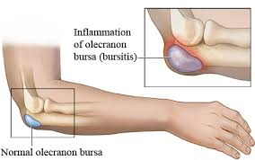

Slide 25
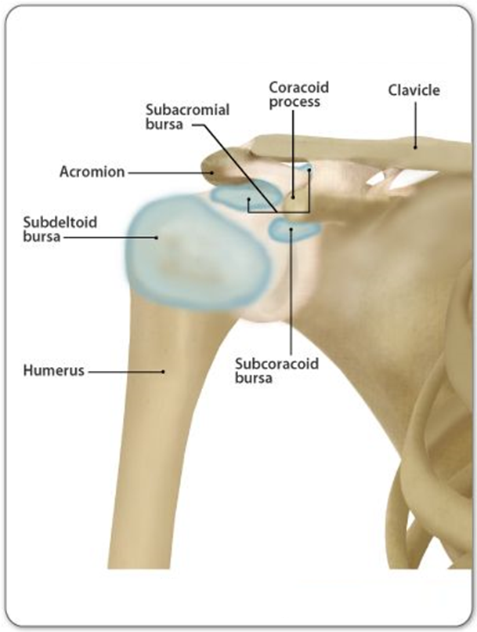
Fig: Bursae in the Shoulder

Slide 26
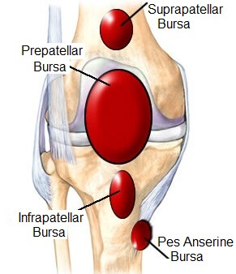

Slide 27
Bursitis can be treated in a number of ways, including:
Avoiding activities that aggravate the problem
Resting the injured area
Ice pack application,
NSAIDs.
Surgical excision of bursa.

Slide 28
Thank You

