Slide 1
GENERAL ANATOMY

Slide 2
HISTORY OF ANATOMY
HIPPOCRATES (460-377 BC)
Greek physician
Father of Medicine
His name is memorialized in the Hippocratic oath
Humoral theory :
Four body humors –
-Blood
-Phlegum
-Yellow Bile
-Black Bile
Attributed diseases to natural causes.

Slide 3
GRECIAN PERIOD
HEROPHILUS (about 325BC)
Father of Anatomy
Performed:
-vivi-sections (dissections of living humans) and dissections of human cadavers
regarded brain as seat of intelligence
described cerebrum, cerebellum, fourth ventricle
first to identify nerves as sensory or motor.

Slide 4
SIXTEENTH CENTURY
VESALIUS (1514- 1654)
His work De humani corporis fabrica written in 7 volumes
His work revolutionised the teaching of anatomy and ruled for two centuries
Chose not to have his name attached to the parts of body he described unlike anatomists Sylvius, Fallopius, Eustachius.
Father of Modern Anatomy
‘Reformer of Anatomy’

Slide 5
Anatomy
GENERAL ANATOMY
Anatomy = Ana (Gr) Tome (Gr)
Apart To Cut
Dissection = Dissecare (Latin)
To Cut Apart

Slide 6
SUBDIVISIONS OF ANATOMY
Gross/ Cadaveric Anatomy
Microscopic Anatomy (Histology)
Developmental Anatomy (Embryology)
Living Anatomy
Clinical Anatomy (Applied)
Neuroanatomy
Surface (Topographic) Anatomy
Radiographic Anatomy
Comparative Anatomy
Sectional Anatomy

Slide 7
GROSS ANATOMY
REGIONAL ANATOMY
Head and neck
Brain
Thorax
Abdomen
Upper Limb
Lower limb
SYSTEMIC ANATOMY
Integumentary system
Skeletal system
Muscular system
Nervous system
Cardiovascular system
Lymphatic system
Endocrine system
Digestive system, Respiratory system, Urogenital system

Slide 8
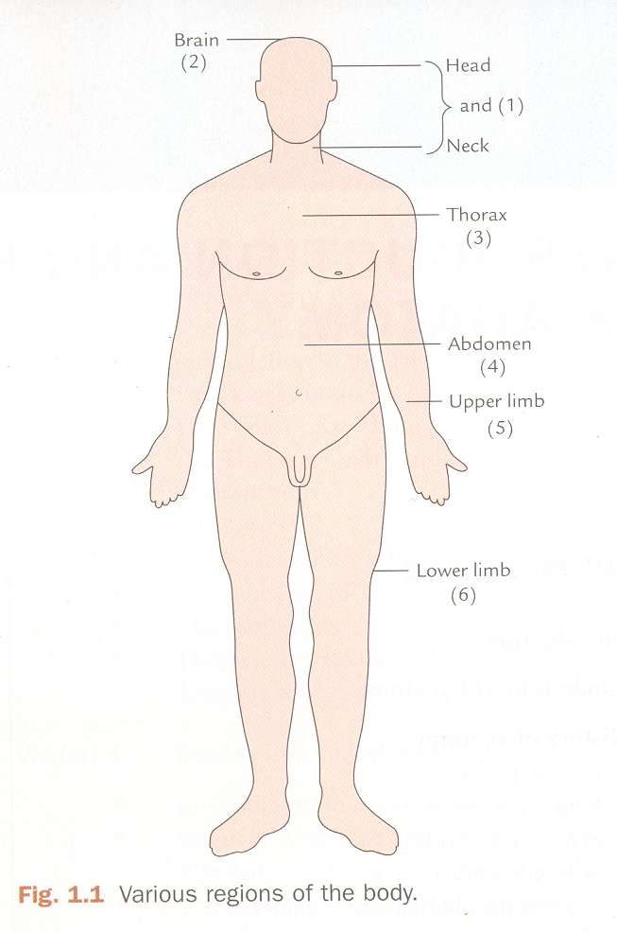
Anatomy
SUB – DIVISIONS OF BODY
Head and Neck
Brain
Superior Extremity
Thorax
Abdomen and Pelvis
Inferior Extremity

Slide 9
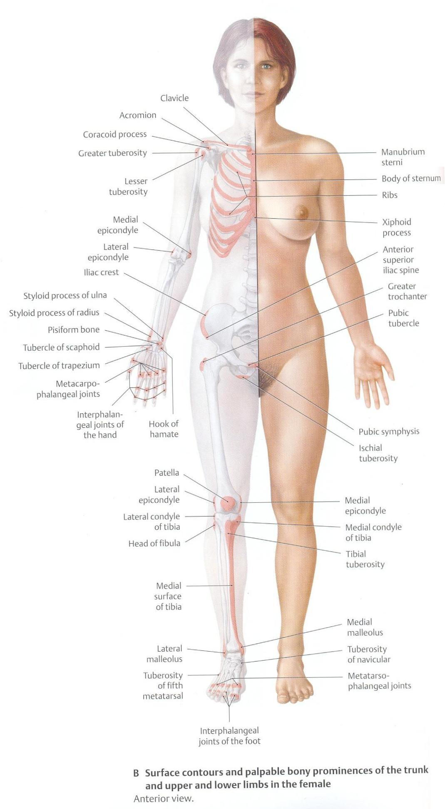
Anatomy
ANATOMICAL POSITION
Standing up right
Looking straight towards horizon
Upper limbs hanging by the side of body
Palms facing forwards
Lower limbs are parallel with toes pointing forwards

Slide 10
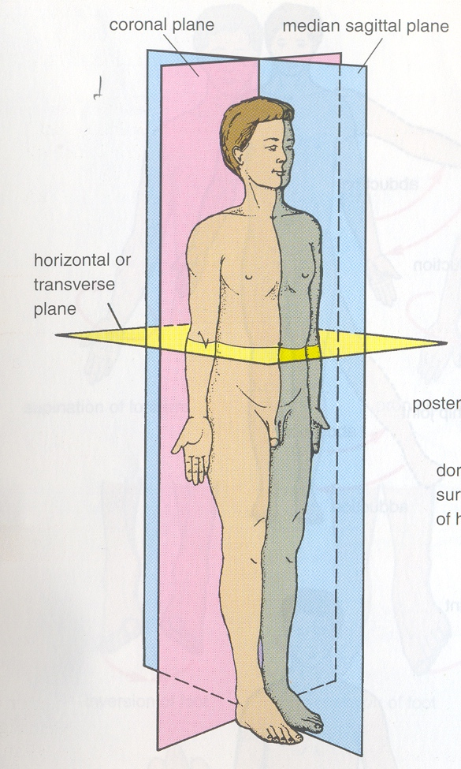
Anatomy
TERMS OF PLANES
MID SAGITTAL (Median Plane):
A vertical plane dividing the body into right and left equal halves.
SAGITTAL:
A vertical plane which is parallel to the sagittal plane.

Slide 11
Anatomy
TERMS OF PLANES
CORONAL PLANE
(Frontal Plane):
A vertical plane which is at right angles to the median plane dividing the body into an anterior and a posterior part.
TRANSVERSE PLANE:
A plane at right angles to the sagittal / coronal plane dividing the body into an upper and lower part.

Slide 12
TERMS OF PLANES
HORIZONTAL PLANE: A plane parrallel to the ground.
OBLIQUE PLANE: Any plane other than of aforementioned planes.

Slide 13
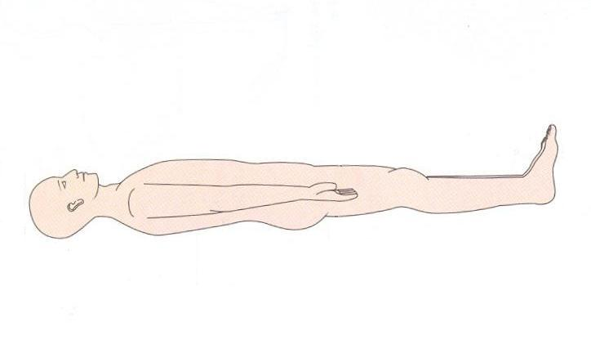
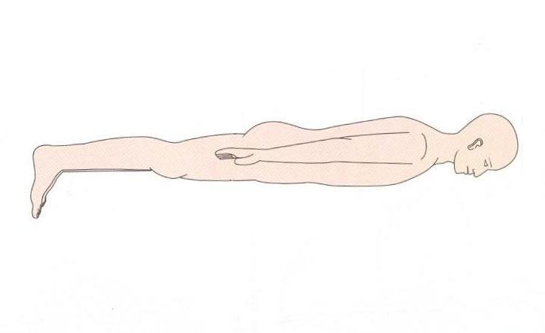
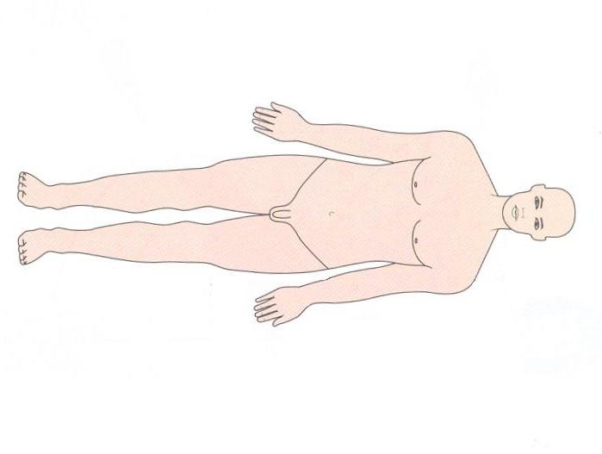
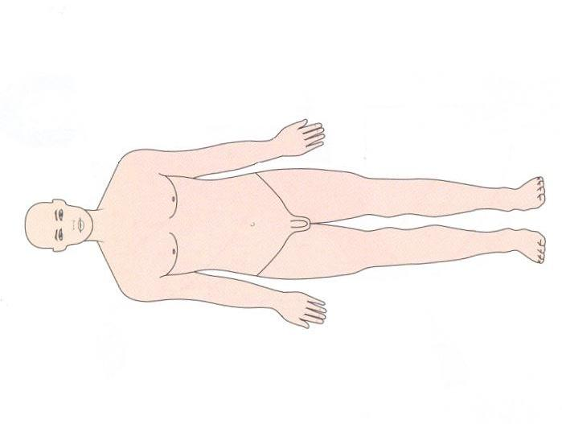
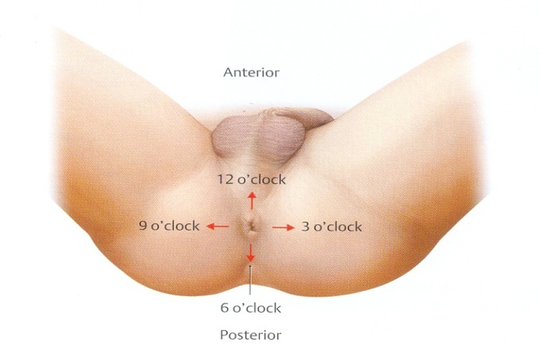
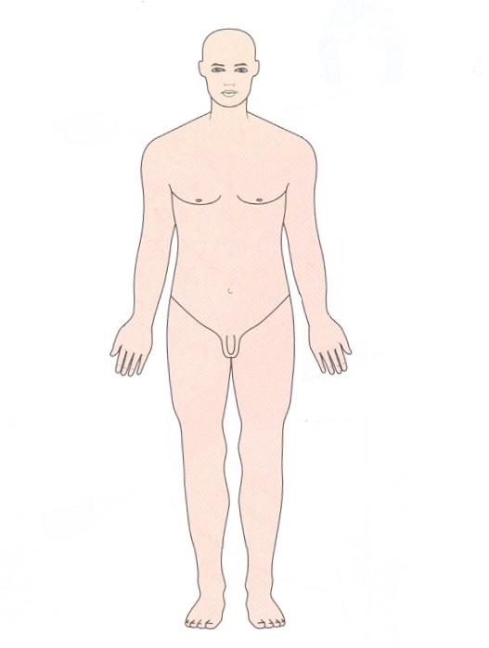
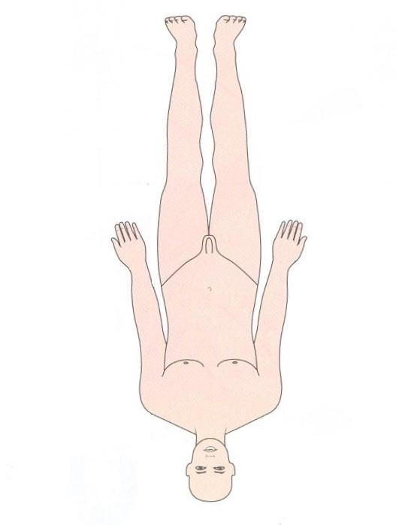
Anatomy
TERMS OF POSTURE
Supine
Prone
Left Lateral
Right Lateral
Lithotomy
Erect
Upside
Down

Slide 14
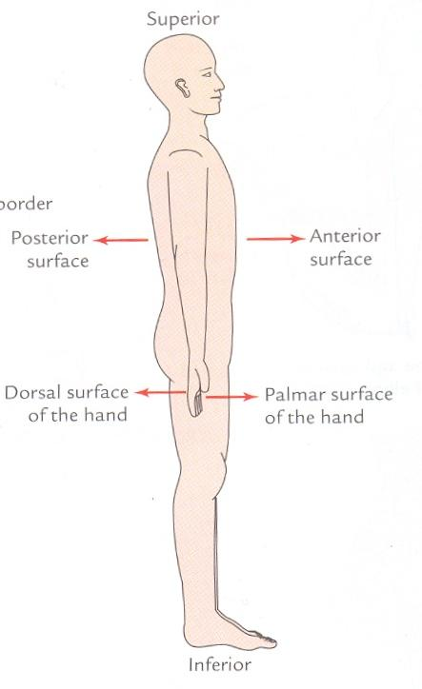
Anatomy
TERMS OF POSITION
Anterior = Ventral
Intermediate = Middle
Posterior = Dorsal

Slide 15
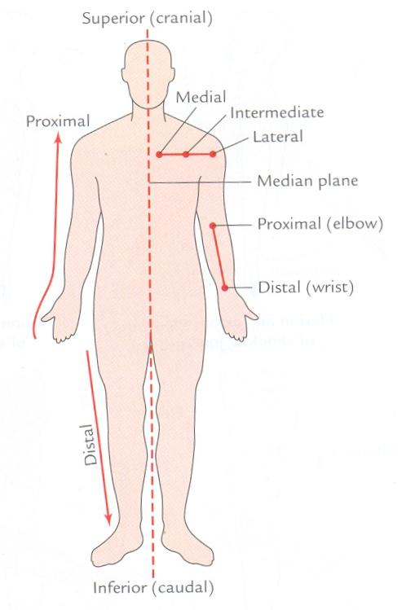
Anatomy
TERMS OF POSITION
Lateral
Intermediate
Medial
Median

Slide 16
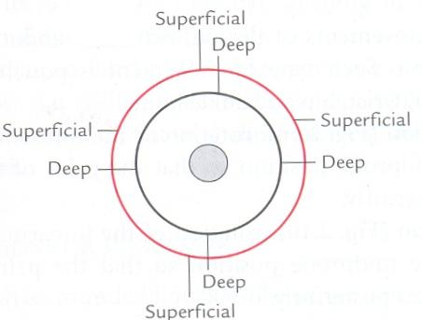
Anatomy
OTHER TERMS
For Solid organs:
-Superficial
-Deep
For Hollow organs:
-Interior
-Exterior
For indicating the side:
-Ipsilateral
-Contralateral

Slide 17
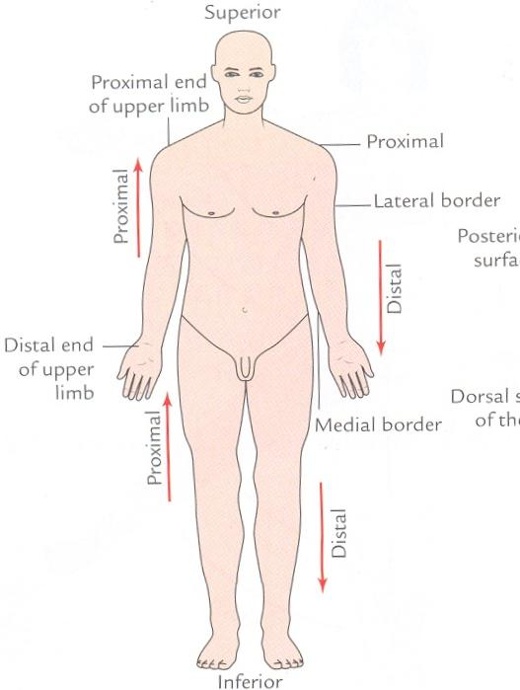
Anatomy
TERMS OF POSITION
Superior = Cephalic
Inferior = Caudal

Slide 18
Anatomy
TERMS FOR LIMBS
Proximal
Distal
Radial
Ulnar
Tibial
Fibular
Preaxial border
Postaxial border

Slide 19
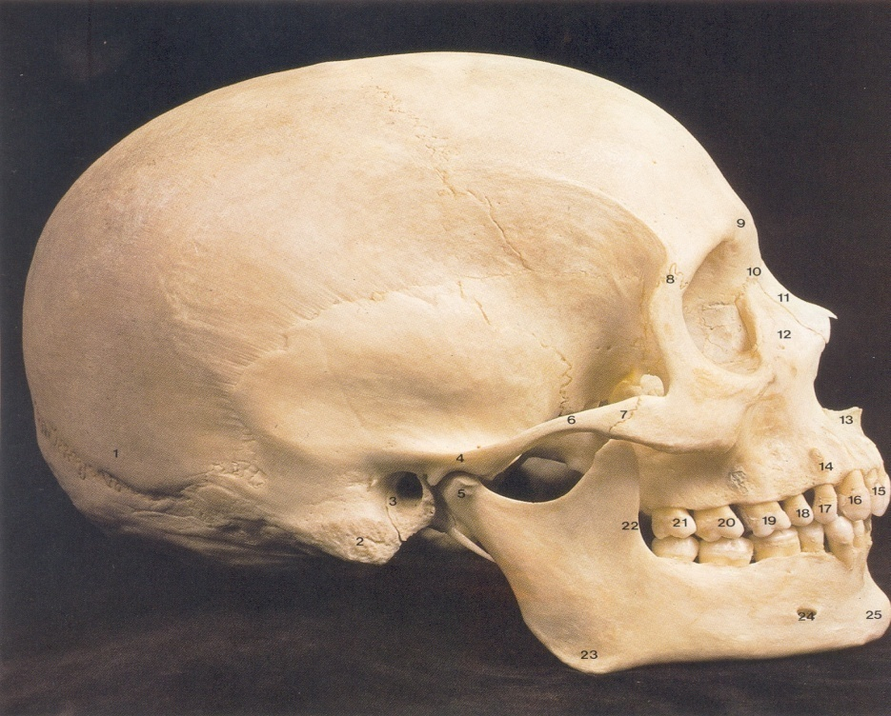
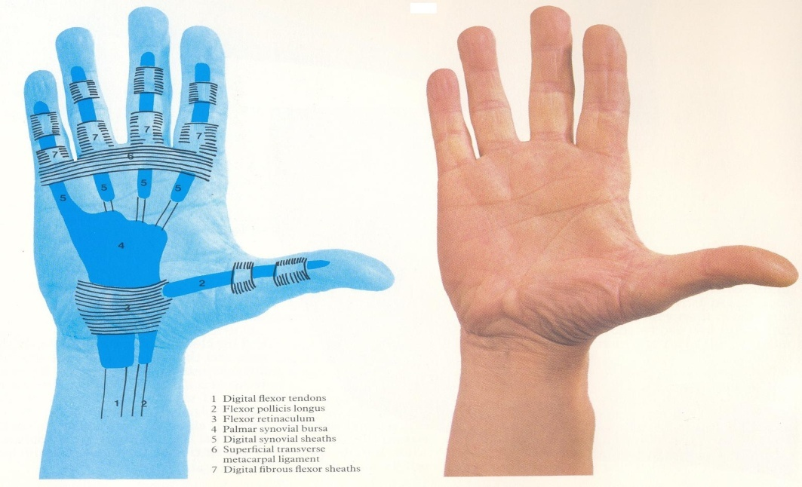
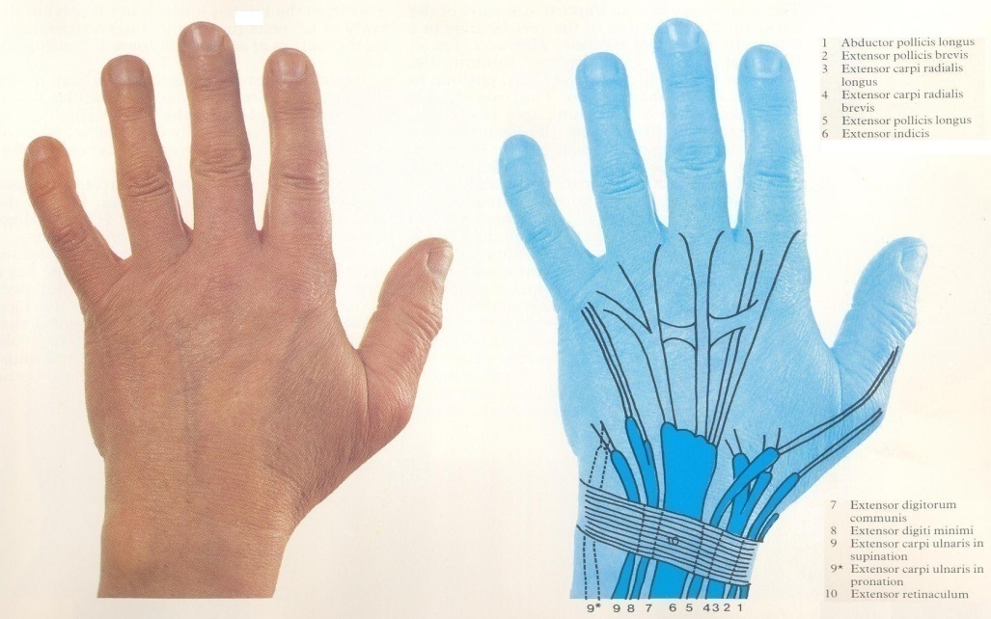
Anatomy
TERMS OF POSITION
Skull - Inferior surface is called as Base
Hand - Posterior surface - Dorum of Hand
- Anterior surface - Palmar surface

Slide 20
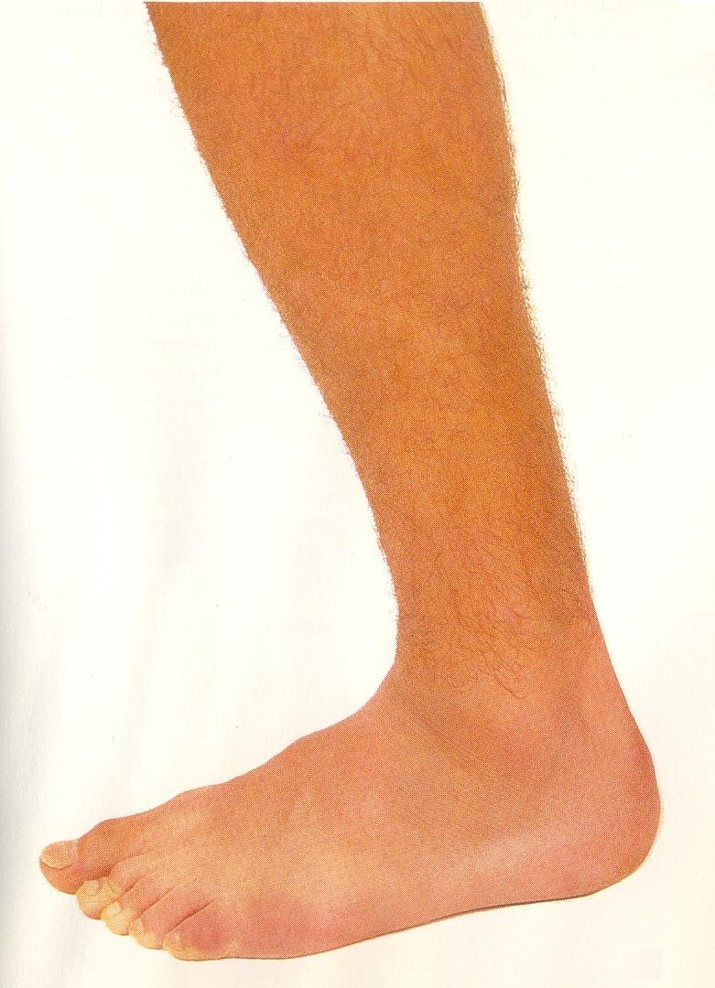
Anatomy
TERMS OF POSITION
Foot
- Superior surface -
Dorsum of Foot
- Inferior Surface -
Plantar Surface

Slide 21
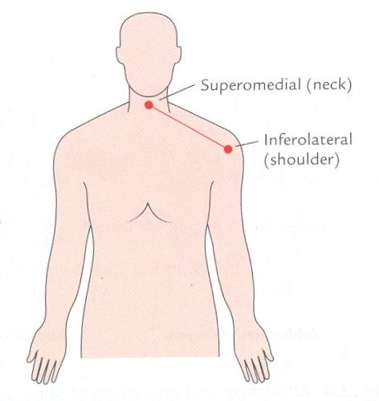
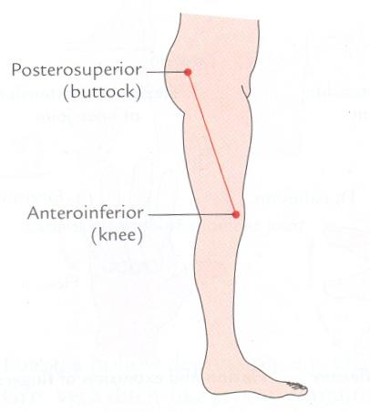
Anatomy
TERMS OF POSITION
Combination of Terms:
- Supero medial
- Infero lateral
- Postero superior
- Antero inferior

Slide 22
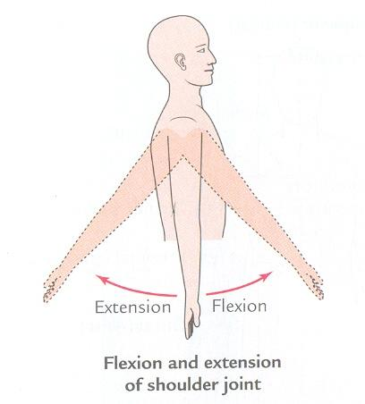
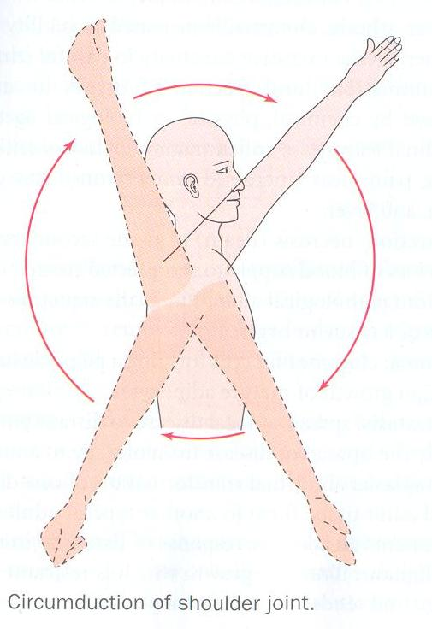
Anatomy
TERMS OF MOVEMENT
Flexion:
- Moving part is carried forwards
- Movement on the transverse axis
Extension:
-Moving part is carried backwards
- Movement on the transverse axis.
Circumduction:
-Moving part forms the base of a cone

Slide 23
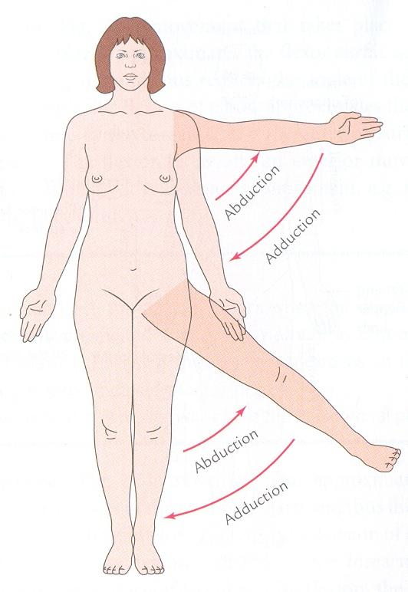
Anatomy
TERMS OF MOVEMENT
Abduction:
-Moving part is carried away from the body/reference line.
- Movement on antero – posterior axis.
Adduction:
-Moving part is carried towards the body /reference line.
-Movement on antero–posterior axis.

Slide 24
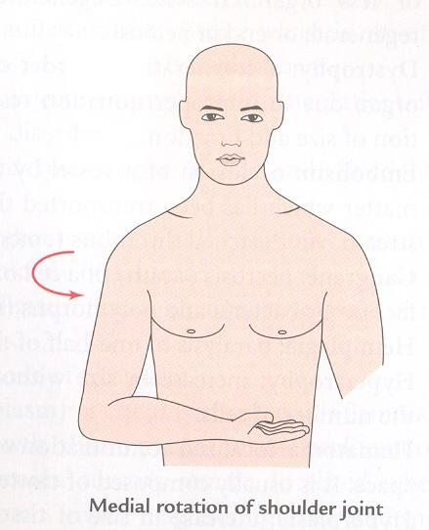
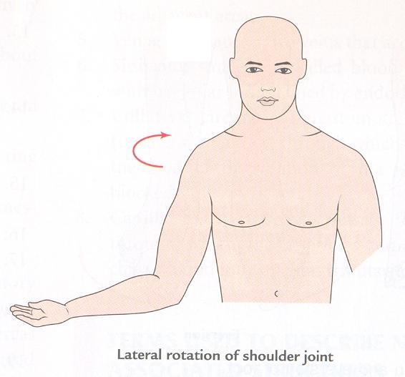
Anatomy
TERMS OF MOVEMENT
Medial Rotation –
-Moving part is rotated towards the mid line.
-Movement on vertical axis.
Lateral Rotation –
-Moving part is rotated away from the mid line.
-Movement on vertical axis.

Slide 25
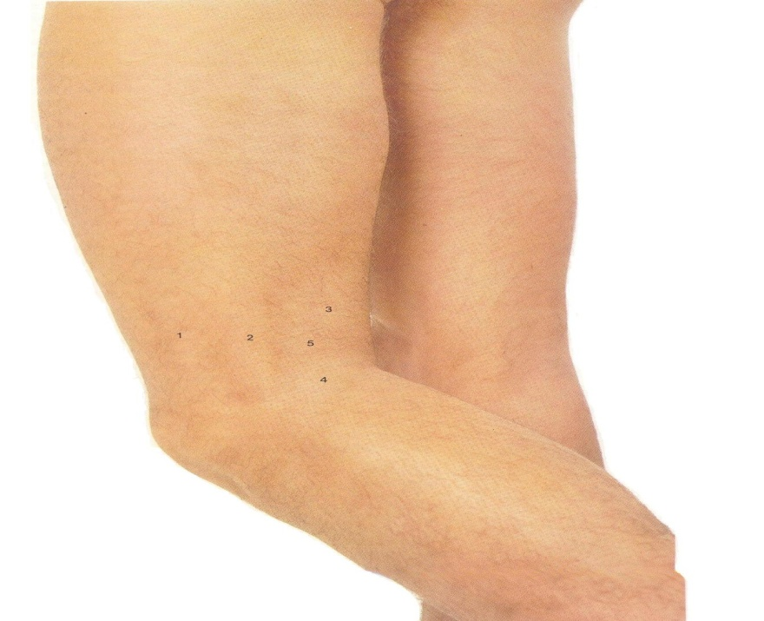
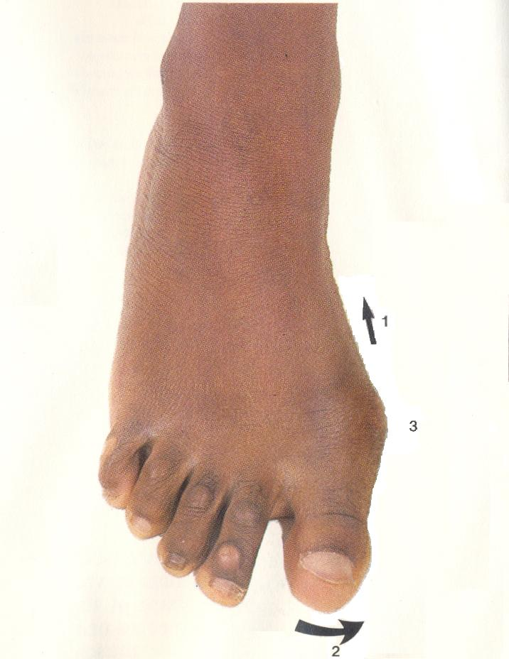
Anatomy
SPECIAL TERMS OF MOVEMENT
LEG:
Flexion – A movement on knee joint in which leg is carried backwards.
Extension – A movement on knee joint in which leg is carried forwards.
TOES:
Abduction – Toes move away from the long axis of 2nd toe.
Adduction – Toes move towards long axis of the 2nd toe.

Slide 26
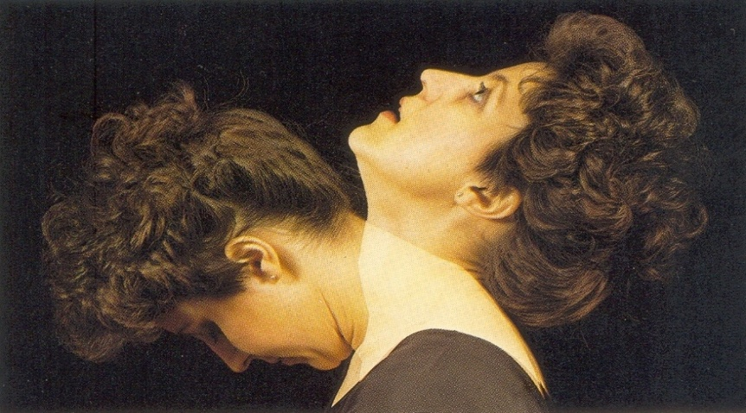
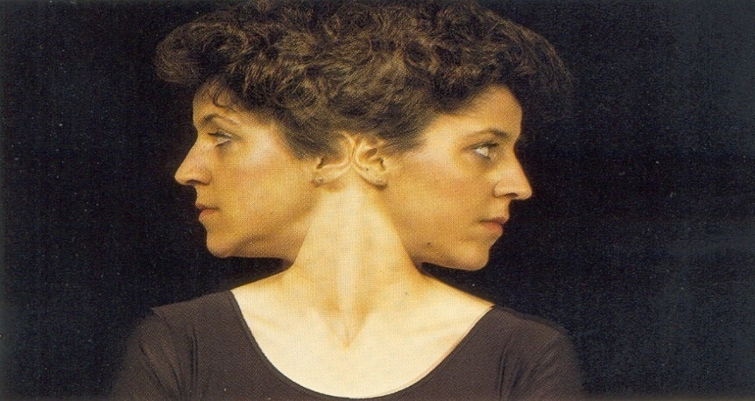
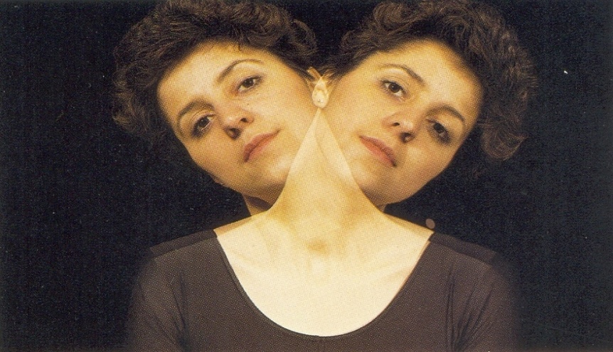
Anatomy
SPECIAL TERMS OF MOVEMENT
NECK:
- Flexion
- Extension
ROTATION:
- Right
- Left
- LATERAL FLEXION
- Right
- Left

Slide 27
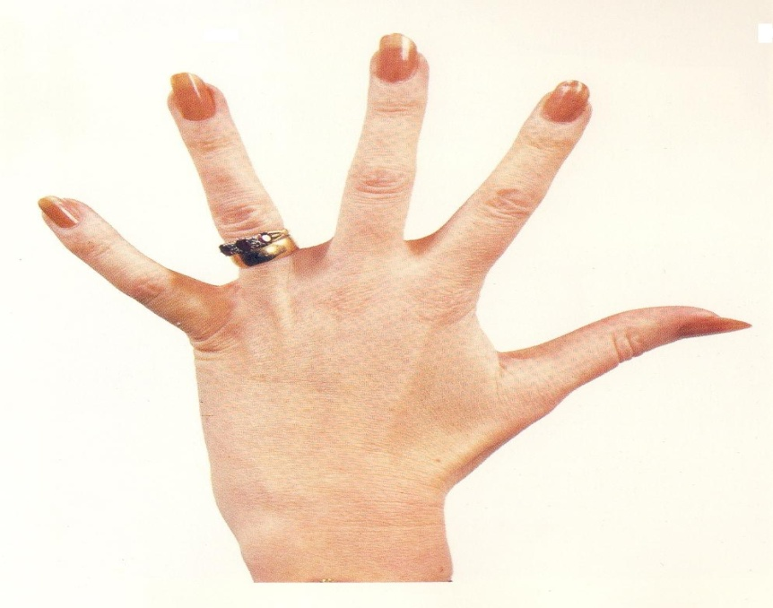
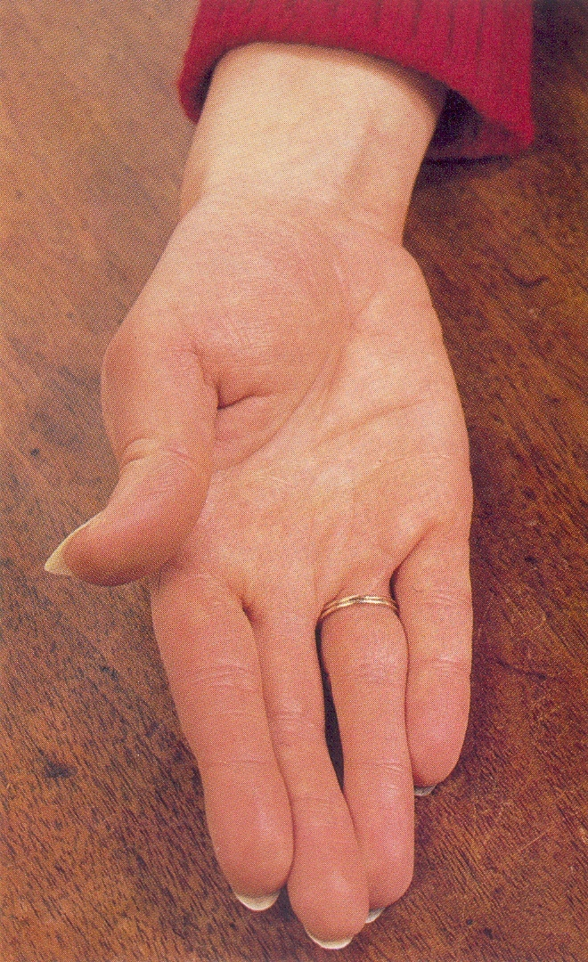
Anatomy
SPECIAL TERMS OF MOVEMENT
FINGERS:
ABDUCTION – Fingers move away from the long axis of middle finger.
ADDUCTION – Fingers move towards the long axis of middle finger.

Slide 28
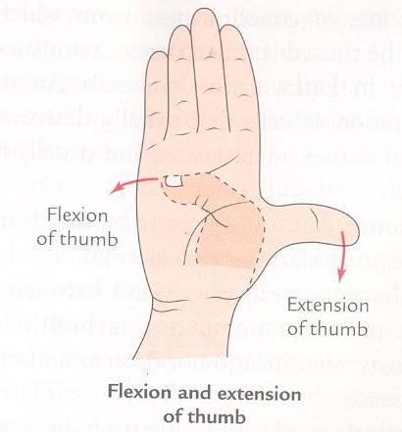
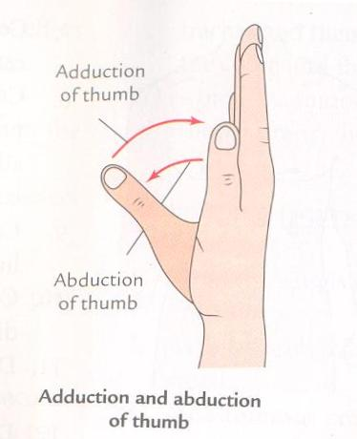
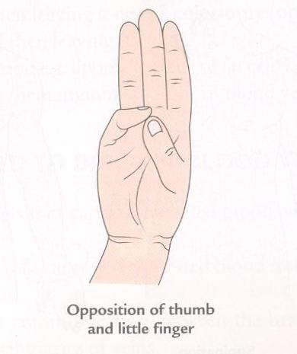
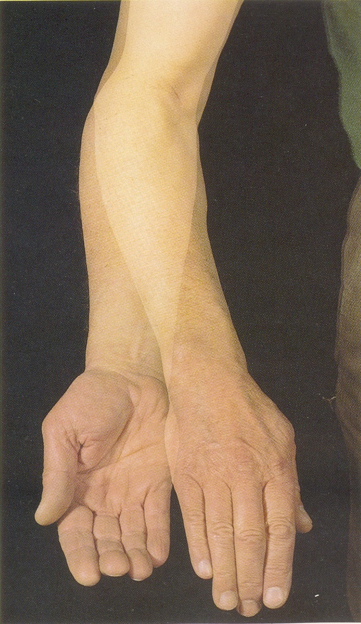
Anatomy
SPECIAL TERMS OF MOVEMENT
Thumb:
Flexion
Extension
Abduction
Adduction
Opposition
Forearm:
Pronation – Forearm is rotated that the palm faces towards ground.
Supination – Forearm is rotated that the palm faces above.
Mid Prone Position

Slide 29
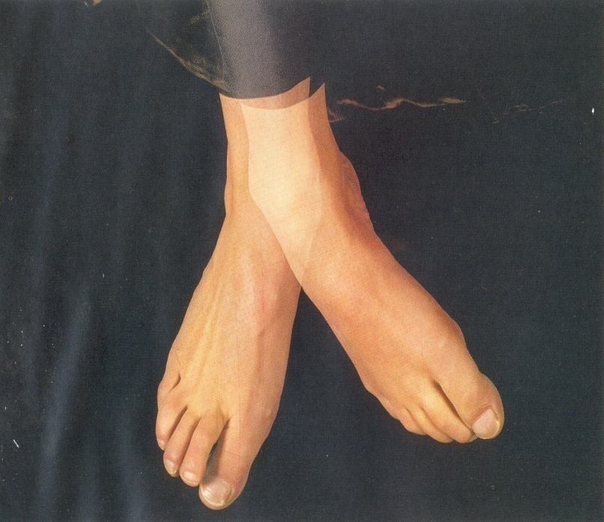
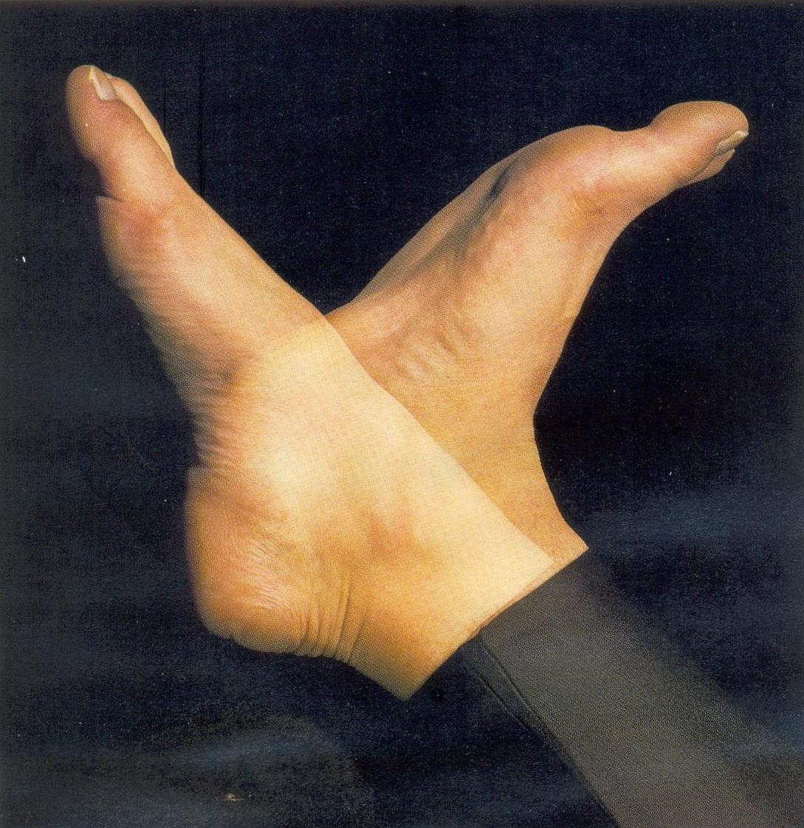
Anatomy
SPECIAL TERMS OF MOVEMENT
FOOT –
Inversion – Sole of the foot faces medially.
Eversion – Sole of the foot faces laterally.
Dorsiflexion – A movement of foot in which the dorsal surface of foot comes closure to the front of leg.
Plantarflexion – A movement of foot in which the dorsal surface of foot goes away from the front of leg.

Slide 30
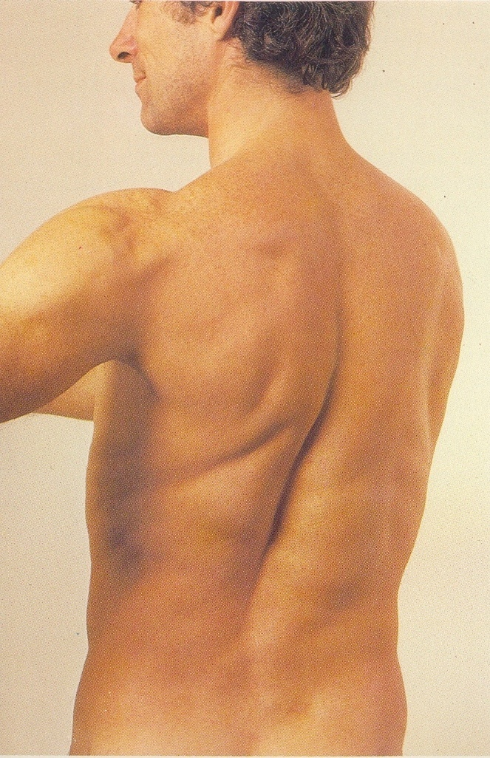
Anatomy
SPECIAL TERMS OF MOVEMENT
Trunk-
Flexion
Extension
Rotation- Left

Slide 31
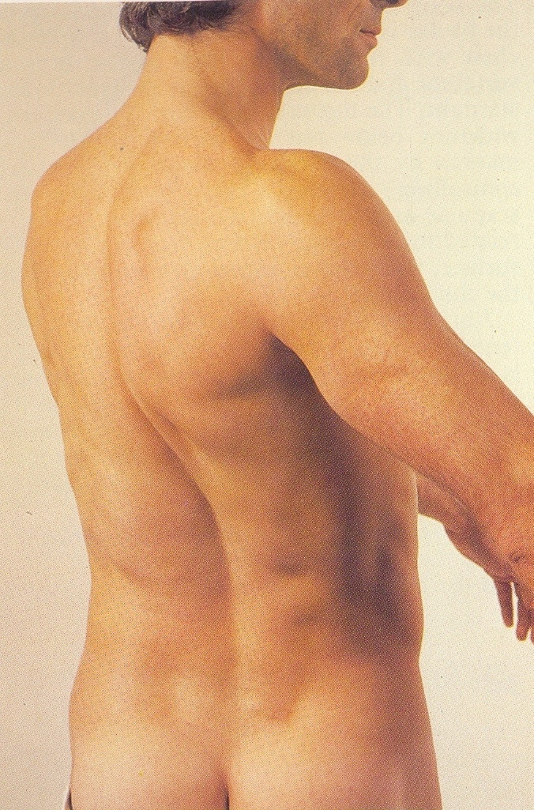
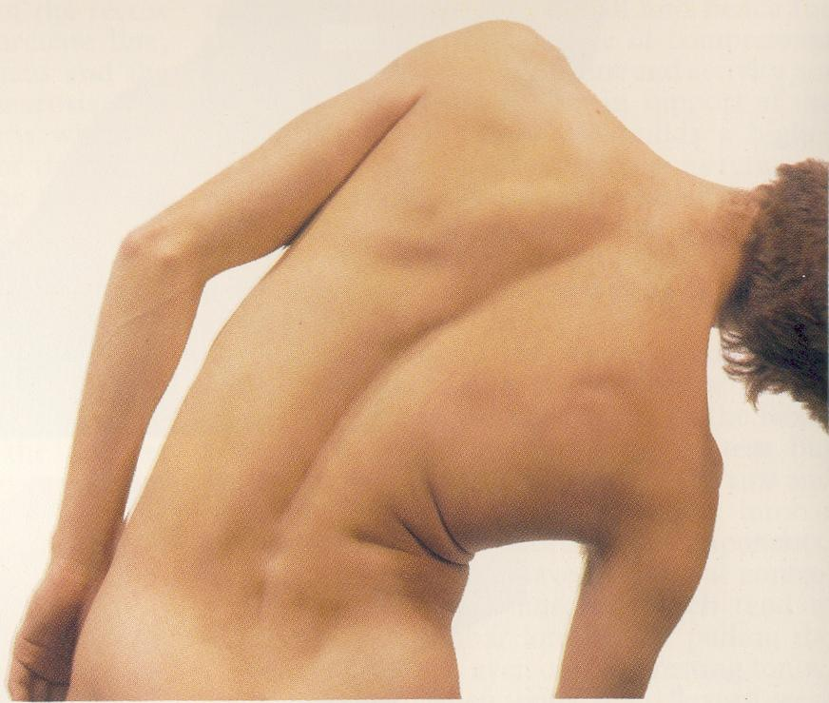
Anatomy
SPECIAL TERMS OF MOVEMENT
Rotation - Right
Lateral Flexion
- Right
- Left

Slide 32
REFERENCES
Cunningham’s Manual of Practical Anatomy, Vol.1.
Grant’s Method of Anatomy, 11th Edition.
Vishram Singh. General Anatomy, 1st Edition.

Slide 33
MCQs
1. Who is the Father of Anatomy:
Galen
Herophilus
Vesalius
Hippocrates

Slide 34
MCQs
2. The meaning of term anatomy is:
To analyze
To observe
To cut up
To make

Slide 35
MCQs
3. The sectional plane that divides the body into anterior and posterior portions is:
Transverse plane
Sagittal plane
Coronal plane
Oblique plane

Slide 36
MCQs
4. Lying down position with the face directed down is called as:
Supine
Prone
Anatomical
Lithotomy

Slide 37
MCQs
5. During flexion of the arm, the arm moves:
Upwards
Downwards
Medial
Lateral

