Slide 1
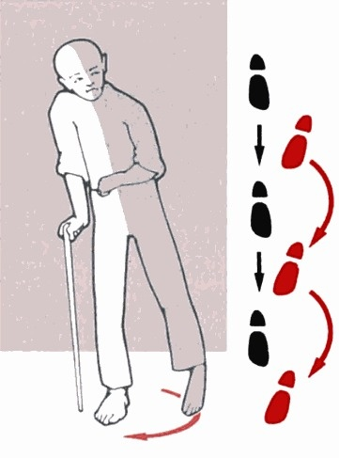
Hemiplegia
By mbbsppt.com

Slide 2
Hemiplegia
paralysis of one side of the body due to pyramidal tract lesion at any point from its origin in the cerebral cortex down to the 5th cervical segment.

Slide 3
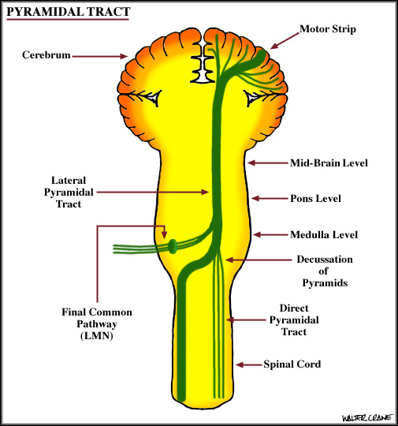

Slide 4
Causes
Vascular causes
Infective
Neoplastic
Demyelinations
Traumatic
Congenital
Hysterical

Slide 5
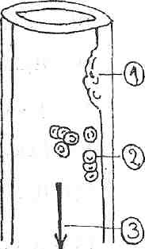
Vascular causes
A) Thrombotic:
Vessels wall diseases.
Blood diseases.
Circulation diseases.

Slide 6
B) Embolic
The source of embolus may be:-
Heart
Distal vessels
Rare sources:
Lung
Bones
C) Haemorrhagic
Intracerebral
Subarachnoid
Subdural or extradural

Slide 7
The causes of intracranial haemorrhage are:
Hypertension
Rupture of an intracranial aneurysm angioma
Hemorrhagic blood diseases
Trauma to the head

Slide 8
Causes of stroke in Young
Malaria
Head injury
OCP and anticoagulant therapy
Hyper viscosity syndrome
Intracranial neoplasm
Accelerated atherosclerosis (DM and nephrotic syndrome)
Procoagulant state
Cerebral abscess, tuberculoma
Encephalitis

Slide 9
CLINICAL PICTURE
Onset & Course:
Acute onset & regressive course (vascular, infective & traumatic lesions).
Gradual onset & progressive course (neoplastic lesions).
Remittent & relapsing course (multiple sclerosis)
Post epileptic, TIA, hysterical.

Slide 10
Symptoms & Signs
1) Acute lesions: the clinical picture passes through 2 stages:
Stage of flaccidity: due to neuronal shock.
Stage of spasticity: this is. the stage of established hemiplegia.
Face earliest, followed by lower limb, upper limb. Finger does not recover
2) Gradual lesions: the hemiplegia passes directly to the stage of spasticity.

Slide 11
STAGE OF FLACCID PARALYSIS
SHOCK STAGE:
Aphasia
Hypotonia
Plantar response absent
Retention of urine
Jerks usually absent

Slide 12
STAGE OF SPASTIC PARALYSIS
Paralysis of one side of the body.
Hypertonia (spasticity) of the paralyzed muscles of clasp-knife type
Exaggerated deep reflexes
Lost superficial reflexes
Positive Babinski sign
Gait

Slide 13
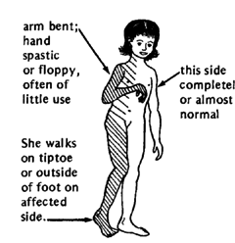
Clinical picture
Flaccid stage.
Spastic stage.

Slide 14
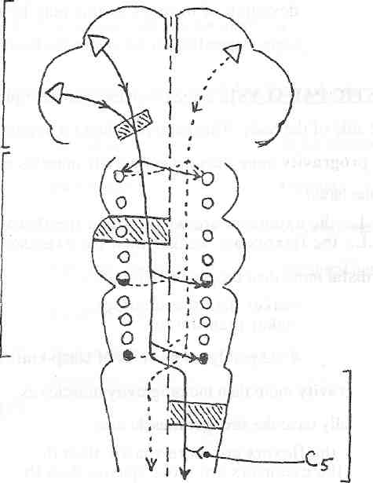
According to the site of the lesion
Cerebral
Brain stem
Spinal

Slide 15
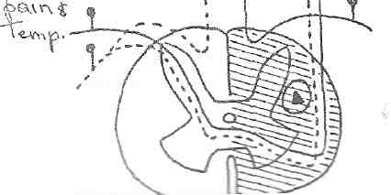
1) Spinal Cord
At the level of the lesion
Pain &Tem
Deep sensation
Below the level of lesion
Touch

Slide 16
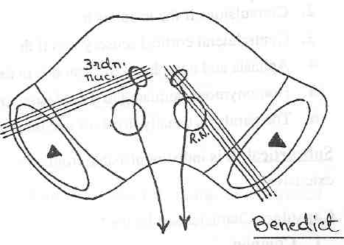
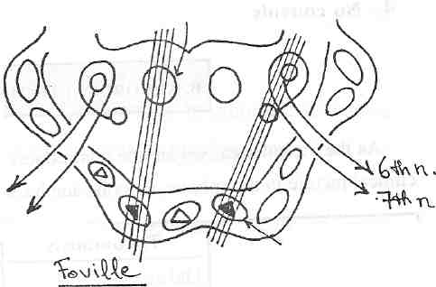
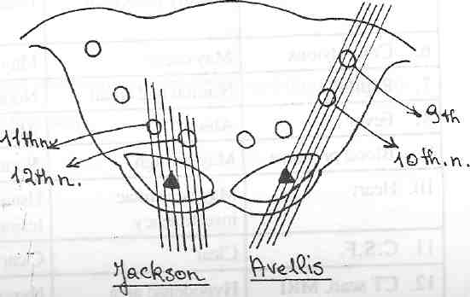
2) Brain stem
Mid-brain lesion
Pontine lesions
M.L.B
Weber:
3rd nerve involvement with contralateral hemiplegia
Millard-Gubler:
6th nerve ± 7th nerve with contralteral hemiplegia
Medullary lesions
Avellis:
10th nerve involvement with contralteral hemiplegia

Slide 17
3) Cerebral
Cortical: monoplegia, jacksonian fit, flexor & extensor of both limbs equally involved.
Subcorical: monoplegia, tactile impairment, postural sensibility & discrimination of affected limb.
Capsular: complete hemiplegia, cranial nerve involvement.

Slide 18
C.P. according to cause of lesion
Hemorrhage | Embolism | Thrombosis | Feature
Commonly old age | Any age | Old age | Age
Dramatic | Sudden (seconds) | Rapid (hours) | Onset
Absent | Absent | T.I.As | Prodromata
Common | Absent | Absent | Vomiting
Lost with deepening coma | Usually preserved | Usually preserved | Consciousness

Slide 19
Frequent | May occur | May occur | Convulsions
Dilated and irreactive | Normal and equal | Normal and equal | Pupils
Present | absent | absent | Fever
Usually high | high | May be high | Blood pressure
Left ventricular hypertrophy | Usually valvular lesion | May be cardiac insufficiency | Heart
Bloody, ↑ tension Hyperdense | Clear Hypodense | Clear Hypodense | CSF CT scan, MRI

Slide 20
MANAGEMENT OF HEMIPLEGIA
Diagnosis
TLC, DLC, ESR
Lipid profile
Sugar
ECG
X-ray
CT scan
Carotid angiography
2D ECHO
Lupus anticoagulant
Anti-cardiolipin antibody

Slide 21
MANAGEMENT OF HEMIPLEGIA
1) GENERAL
Care of the skin
Care of respiration
Care of nutrition and fluid balance
Care of the urinary bladder
Care of the bowels

Slide 22
2) Symptomatic Treatment
Cerebral dehydrating
Antiemetics
Tranquilizers and sedatives
Muscle relaxants
Vitamins and tonics .

Slide 23
3) Physiotherapy
Proper positioning of the hemiplegic side.
Passive, active assisted, active exercises.
. To minimize contractures
. To strength muscles
Antispastic methods to control spasticity.
Gait and balance training.
By mbbsppt.com

Slide 24
4)Specific Treatment
1) Cerebral Thrombosis:
A) Care of Blood Pressure
Hypotensive drugs---------if B.P is above 200/120.
Captopril--------25to50 t.d.s
Vasopressor drugs-----------if B.P is very low.
B) Anti platelets
Aspirin: single dose 75-300mg daily
Ticlopidine:250 mg twice daily

Slide 25
C) Anticoagulants:
Method :
Heparin
Warfarin
- Monitor the dose using the prothrombin time.

Slide 26
D) Other drugs may be used:
Nootropil
Trental
Atorvastatin
Cerebral Vasodilators

Slide 27
Brain Tumors:
Surgical removal.
Deep X-rays therapy.

Slide 28
By mbbsppt.com

