Slide 1
HEPATITIS C BY MBBSPPT.COM

Slide 2
PROBLEM STATEMENT
The virus was first identified in the year 1989 as a major cause of parenterally transmitted non-A, non-B (PT-NANB) hepatitis.
-WHO estimates that 3% of the world population are infected with HCV and 170 million are carriers.
-In India HCV antibodies have been found in 2% voluntary blood donors.

Slide 3
EPIDEMIOLOGICAL DETERMINANATS
AGENT FACTORS : Causative agent hepatitis C virus (single stranded RNA virus)
Virus occurs in the host blood for probably months to years.
HOST FACTORS : More common in adults
ENVIRONMENTAL FACTORS : No specific environment.
Throughout the year.
MODE OF TRANSMISSION : parenterally
INCUBATION PERIOD : 40-120 days

Slide 4
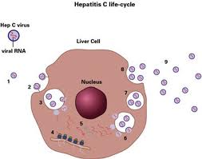

Slide 5
CLINICAL COURSE: low grade fever insidious in onset, chronic hepatitis
COMPLICATIONS : liver cirrhosis or liver cancer
LABORATORY DIAGNOSIS : Elevated levels of aminotransferase for 1-6 months and elevated IgM level.
RIBA (Recombinant Immunoblot Assay)
test is used to confirm anti-HCV positive results. Patients with acute PT-NANB hepatitis and are anti-HCV negative should be tested again 6 months later .
ABSOLUTE CONFIRMATION TEST : PCR to detect HCV RNA.

Slide 6
PREVENTION AND CONTROL
In India, screening for HCV in blood banks was made mandatory from July 1, 1997.
- Interferon is the only effective drug , but the treatment is extremely expensive and side effects and chances of remission are high.

Slide 8
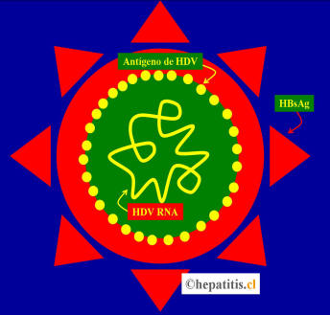

Slide 9
HEPATITIS D
PROBLEM STATEMENT: Highest prevalence in Italy, the Middle East, Central Asia and South America
EPIDEMIOLOGICAL DETERMINANTS
AGENT FACTOR : Hepatitis D virus but causes infection only in the presence of HBV as HBV provides an HBsAg envelop for HDV
HOST FACTOR : People infected with HBV
MODE OF TRANSMISSION : perinatal
INCUBATION PERIOD : 2-12 weeks
PREVENTION AND CONTROL
Vaccinating HBV susveptible people with hepatitis B vaccine , however vaccination does not protect hepetitis B carriers from superinfection by HDV.

Slide 10
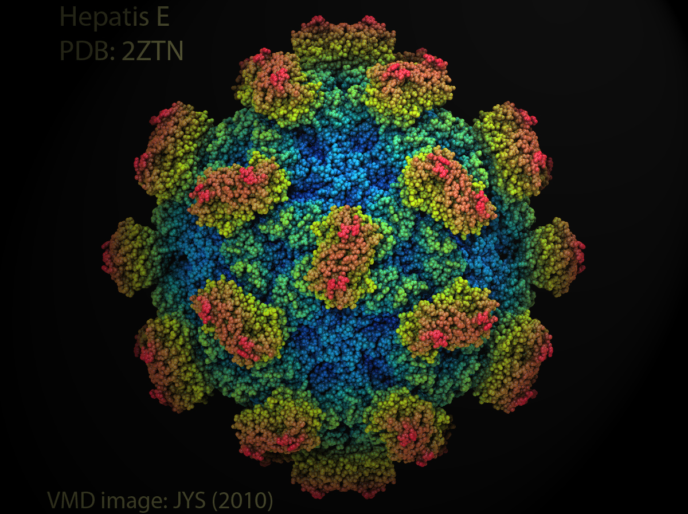

Slide 11
HEPATITIS E
PROBLEM STATEMENT: Highest prevalence in Asia and North-Africa. Discovered in 1980. first major epidemic in New Delhi in winter 1995-96.
EPIDEMIOLOGICAL DETERMINANTS
AGENT FACTOR : caused by hepatitis E virus a 29-nm to 32-nm RNA virus.
HOST FACTOR : Mainly young adults 15-40 yrs. Induces a fulminating form of acute disease in pregnant women. It is responsible for abortions, intrauterine deaths and high perinatal mortality.
MODE OF TRANSMISSION : water borne disease.
INCUBATION PERIOD : 2-9 weeks

Slide 12
CLINICAL COURSE : self limiting, lasts for several weeks and no chronic disease.
COMPLICATION : in pregnant women
PREVENTION AND CONTROL
Diagnosis is made by the level of anti-HEV antibodies in the serum.
Travellers to highly endemic areas are recommended to take the usual elementary food hygiene
Precautions. No specific treatment only supportive measures are given.

Slide 13
HEPETITIS G
It was discovered in 1996. Hepatitis G is a newly discovered form of liver
inflammation caused by hepatitis G virus (HGV),
a distant relative of thehepatitis C virus.
HGV, also called hepatitis GB virus, was first described early in 1996. Little is known about the frequency of HGVinfection, the nature of the illness, or how to prevent it. What is known is that transfused blood containing HGV hascaused some
cases of hepatitis. For this reason, patients with haemophilia and other bleeding conditions who requirelarge amounts of blood or blood products are at risk of hepatitis G.

Slide 14
Thank You

