Slide 1
Hydatid Cyst
BY MBBSPPT.COM

Slide 2
Introduction
Zoonotic Disease
Causative Agents:
Echinococcus Granulosus (Cystic Echinococcus)
Echinococcus Multilocularis (Alveolar Echinococcus)

Slide 3
Organism
Only 2-8 mm long
Usually comprises of-
Scolex: With Four Suckers And 2 Circular Rows of Hooks
Neck
Immature Proglottid
Mature Proglottid
Gravid Proglottid

Slide 4
Life Cycle
Definitive Host: Dog & Other Canine
Intermediate Host: Sheep, Cattle, Camel
Human: Accidental Host
Infective Stage: Egg (Gravid Proglottid)
Man is a Dead End Host

Slide 5
Life Cycle

Slide 6
Life Cycle
Gravid segment splits – releases eggs
When ingested by human – embryo escape from egg- invade intestinal mucosa – enter portal venous circulation – enter into liver , lung
Larvae develop – fluid filled unilocular cysts
Daughter cysts(brood capsules) develop from inner germinal layer
New larvae (protoscolices) develop in large numbers in brood capsule
Cysts expand slowly over a period of time

Slide 7
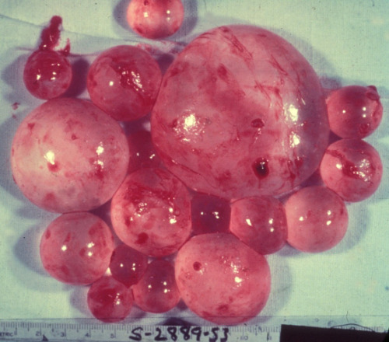
Cyst Structure
At gross examination, the vesicles resemble a bunch of grapes
Sites of hydatid cyst: liver (65%), lungs(25%), muscle, spleen, kidney, heart, bones, brain etc.
Hydatid cysts – Slow growing: 2-3cm/yr

Slide 8
Hydatid Cyst

Slide 9
Cyst Structure
The Hydatid Cyst has 3 layers:
(a) the outer pericyst - composed of modified host cells that form a dense and fibrous protective zone;
(b) the middle laminated membrane - acellular, allows the passage of nutrients
(c) the inner germinal layer, where the scolices (the larval stage of the parasite) and the laminated membrane are produced.

Slide 10
Clinical Features
Mostly Asymptomatic
Cysts larger than 5 cm in diameter – Pressure Symptoms
Most common symptoms –
Pain Abdomen
Vomiting
Dyspepsia
Jaundice in 10 % of pts- Biliary Tract Obstruction

Slide 11
Clinical Features
Bacterial infection of cysts – present as pyogenic liver abscess
Rupture can result in disseminated echinococcosis & anaphylactic reaction
Most frequent sign is hepatomegaly / palpable mass

Slide 12
Clinical Features
Alveolar echinococcosis:
Asymptomatic incubation period of 5-15yrs
Slow development of tumor like lesion in liver (usually)
Weight Loss, Pain Abdomen, General Malaise, Signs of Hepatic Failure.

Slide 13
Pulmonary Hydatid Cyst
Mostly Incidental finding – small cysts remain asymptomatic
Mediastinal cysts may erode adjacent structures – causing bone pain / airflow limitation
Symptoms occur mostly after rupture of the cyst (spontaneous, trauma, infection)
Calcification is rare in pulmonary cysts

Slide 14
Pulmonary Hydatid Cyst
Symptoms:
Sudden onset of cough, fever
If contents are expelled in airway – expectoration of clear salty tasting fluid containing fragments of hydatid membrane and scolices may occur
Sudden collapse – in complicated cysts

Slide 15
Investigations
Routine blood investigation are nonspecific – 25% eosinophilia.
Raised bilirubin
Indirect hemagglutination test and ELISA are the most widely used methods for detection of anti-Echinococcus IgG antibodies.
False positive results- Schistosomiasis and nematode infestations - not specific for diagnosing hydatidosis.

Slide 16
Investigations
Immunoelectrophoresis:
Depends on the formation of specific arc of precipitation ( called arc 5 ) which is highly specific and can be used to exclude cross-reactions caused by noncestode parasites
ELISA is useful in follow-up to detect recurrence
Casoni’s intradermal test

Slide 17
Imaging
Plain X-Ray
Ultrasound
CT
MRI

Slide 18
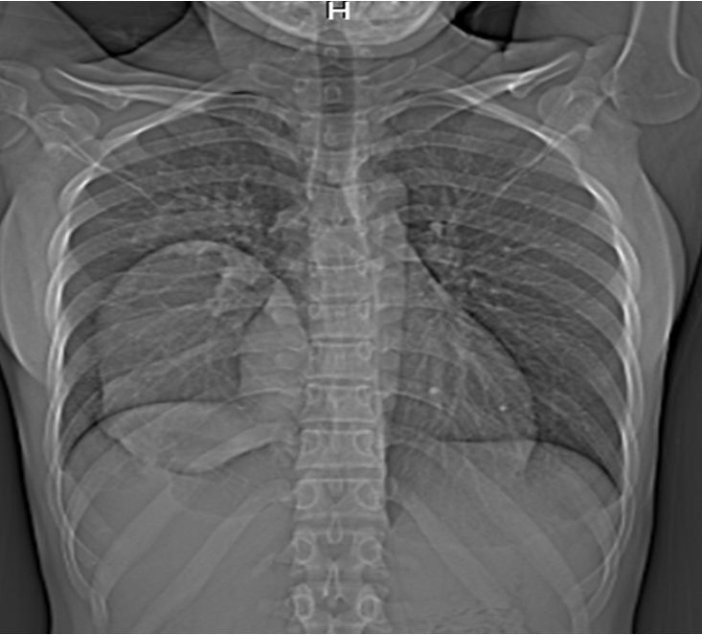
Imaging
Plain X-Ray
Findings are nonspecific & non revealing
Thin rim of calcification delineating a cyst is suggestive of an echinococcus cyst.

Slide 19
Imaging
Ultrasound
Primary dx & diagnostic accuracy of 90%
Usual findings:
Solitary cyst – features suggestive include dependent debris (hydatid sand) moving freely with change in position; presence of wall calcification
Water lily sign – separation of membranes due to collapse of germinal layer
Daughter cysts – most characteristic sign with cyst in a cyst – cart wheel / honeycomb cyst

Slide 20
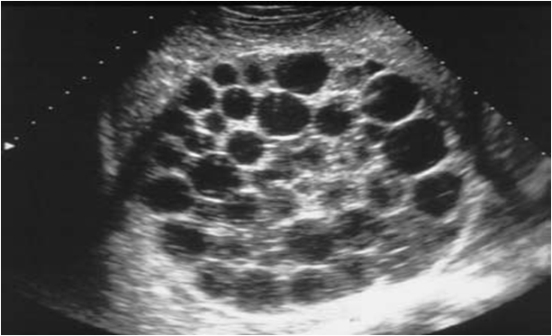
Imaging
Ultrasound
Multiple Xysts – Multiple cysts with normal intervening parenchyma

Slide 21
Imaging
Ultrasound

Slide 22
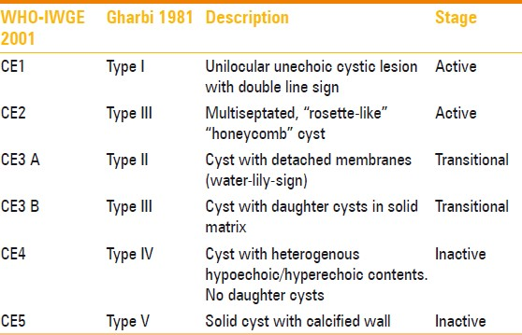
Imaging
GHARBI classification

Slide 23
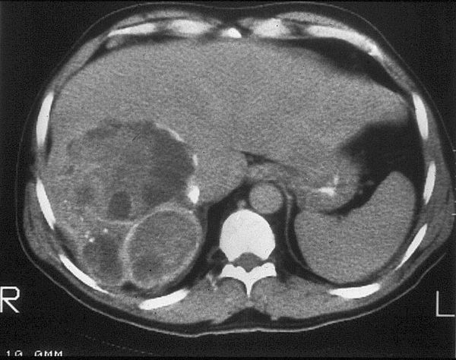
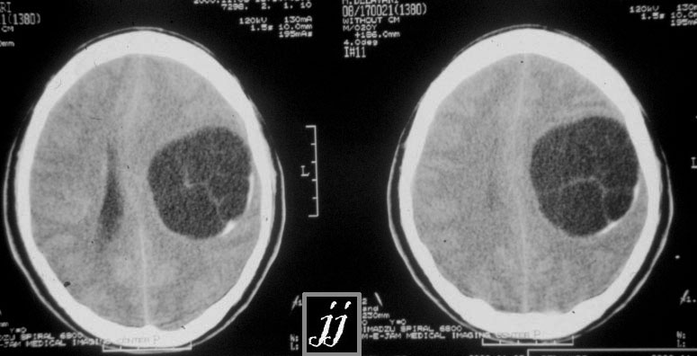
Imaging
CT SCAN
Highest sensitivity of imaging 98%
Best to detect number, size, location of cysts

Slide 24
Imaging
Other imaging techniques
Angiography
Direct cholangiography
Immunoscintigraphic
MRI – no real advantage over CT

Slide 25
Treatment
Available options:
Medical
PAIR
Endoscopic
Surgical
T/T of choice is surgery

Slide 26
Treatment
MEDICAL T/T:
Mebendazole(3-6 months orally in dosages of 40-50 mg/kg/d) &
Albendazole (10-15 mg/kg/d orally 3-6 months with intervals of 14 days )
Praziquantel: Most active and rapid scolicidal agent but it has poor effect on germinal layer so it is of choice for prophylaxis in pre and post operative period in order to prevent secondary implantation of spilled protoscoleces.

Slide 27
Treatment
MEDICAL:
Indications: primary liver or lung cysts that are inoperable (because of location or medical condition), and peritoneal cysts.
Contraindications: Early pregnancy, bone marrow suppression, chronic hepatic disease, large cysts with the risk of rupture, and inactive or calcified cysts

Slide 28
Treatment
PAIR (puncture, aspiration, injection, re-aspiration)
Indications:
> 5cm (ty 1)
cysts with detachment of membranes , daughter cysts
multiple cysts in segment I, II, and III of the liver
relapse after surgery or chemotherapy
patients refusing surgery

Slide 29
Treatment
Contraindications:
Early pregnancy
lung cysts, inaccessible cysts, superficially located cysts (risk of spillage)
type II honeycomb cysts, type IV cysts
cysts communicating with the biliary tree (risk of sclerosing cholangitis from the scolecoidal agent)
Inactive/ calcified cysts

Slide 30
Complications of PAIR
Hemorrhage
Mechanical damage to other tissue
Infections
Allergic reaction or anaphylactic shock
Persistence of daughter cysts
Sudden intracystic decompression leading to biliary fistulas

Slide 31
Treatment
Scolicidal Agents :
95 % alcohol
Hypertonic saline
Betadine
3% H2O2

Slide 32
Treatment
SURGICAL:
Indications:
Large liver cysts with multiple daughter cysts
Superficially Located Single Liver Cysts That May Rupture (Traumatically or Spontaneously).
Liver Cysts With Biliary Tree Communication or Pressure Effects on Vital Organs or Structures.
Infected Cysts
Cysts In Lungs, Brain, Kidneys, Eyes, Bones

Slide 33
Treatment
SURGICAL:
Contraindications:
General contraindications to surgical procedures (eg, extremes of age, pregnancy, severe preexisting medical conditions)
Multiple Cysts in Multiple Organs
Cysts That are Difficult to Access
Dead Cysts; Calcified Cysts; and Very Small Cysts

Slide 34
Treatment
Surgical procedures:
Conservative
Marsupialisation
Capittonage
Partial pericystectomy
Radical
Pericystectomy – cyst and surrounding compressed liver tissue
Hepatic resections – lobectomy, partial hepatectomy…only surical therapy in E.multilocularis, as the margins are ill defined

Slide 35
Treatment
Laproscopic:
Special instrument has been developed
Perforator - Grinder – Aspirator apparatus
Advantage – it doesn’t get blocked by daughter cysts and laminated membranes

Slide 36
Treatment
Complications of surgery
Biliary leakage
Mortality rate is 0.9 – 3.6 %
Recurrence 11 %

Slide 37
Thank You!

