Slide 1
HYPERSENSITIVITY REACTIONS
BY MBBSPPT.COM

Slide 2
INTRODUCTION
Inappropriate and damaging immune response is termed Hypersensitivity
‘Anaphylaxis’ termed by Richet (1913)
Either Humoral or Cell-mediated
Initial contact with Ag – priming/sensitizing dose
Subsequent contact – Shocking dose
Allergy (Priquet-1905) – Altered state of reactivity to antigen

Slide 3
CLASSIFICATION
Based on time required by sensitized host to develop clinical reactions upon exposure to the shocking dose of the antigen
Immediate type
Delayed type

Slide 4
CLASSIFICATION
Feature | Immediate type | Delayed type
Onset & duration | Appears and recedes rapidly | Appears slowly and lasts longer
Immune response | Ab.-mediated | Cell-mediated
Desensitisation | Easy but short lived | Difficult but long lasting
Induction | Antigen by any route | Intradermally or by skin contact

Slide 5
CLASSIFICATION
Coomb’s and Gel classification (1963)
IgE mediated (type I) hypersensitivity
Antibody-mediated cytotoxic (type II)
Immune complex-mediated (type III)
Delayed type-DTH (type IV)

Slide 6
IgE-MEDIATED HYPERSENSITIVITY (type I)
Exposure to allergen
Activates TH2 cells
Stimulates B-cells
IgE secreting plasma cells
Bind to IgE specific Fc receptors on mast cells
2nd exposure to allargen
Crosslinking of bound IgE
Muscle contraction
Increased vascular permeability
Increased vasodilation
Release of active mediators

Slide 7
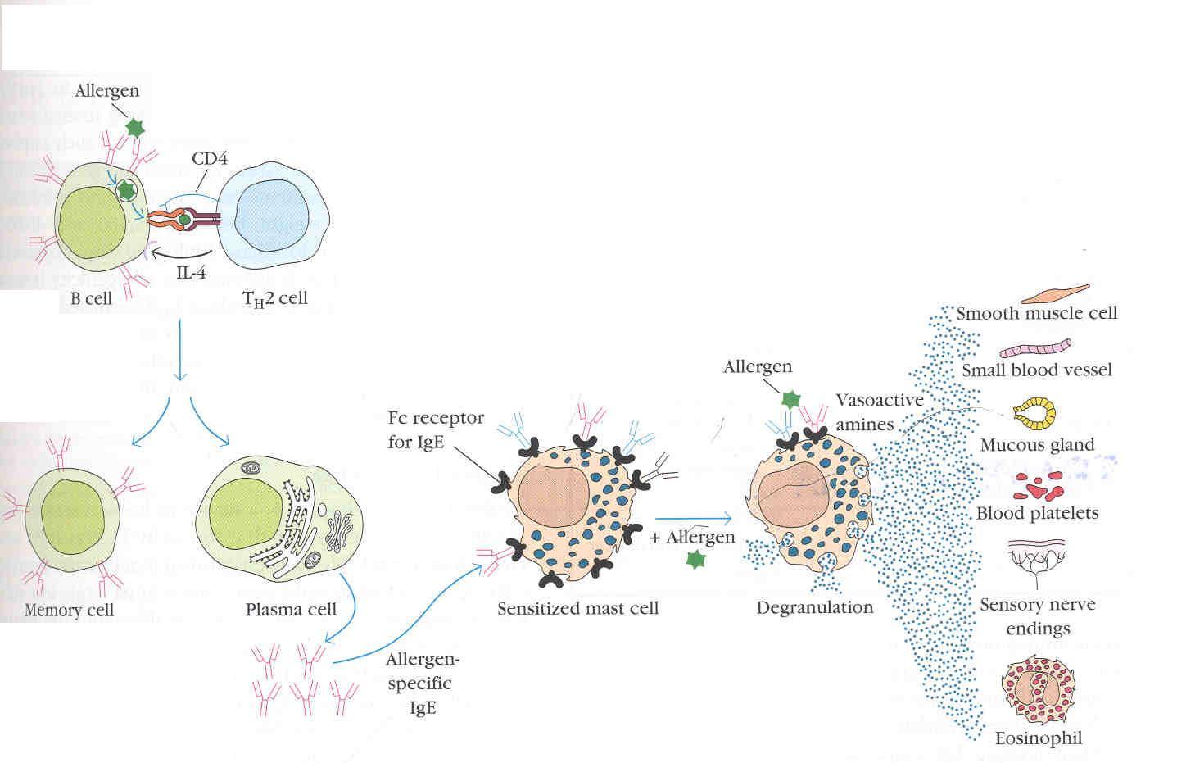
IgE-MEDIATED HYPERSENSITIVITY (type I)

Slide 8
ALLARGENS ASSOSIATED WITH IgE-MEDIATED HYPERSENSITIVITY
Proteins – Foreign serum, vaccines
Plant pollens – Rye grass, Ragweed
Foods– Nuts, Seafoods, Eggs & milk
Insect products – Bee, Ant & Wax venom
Drugs – Penicillin’s, Sulfonamides
Animal hairs, dander, latex etc.

Slide 9
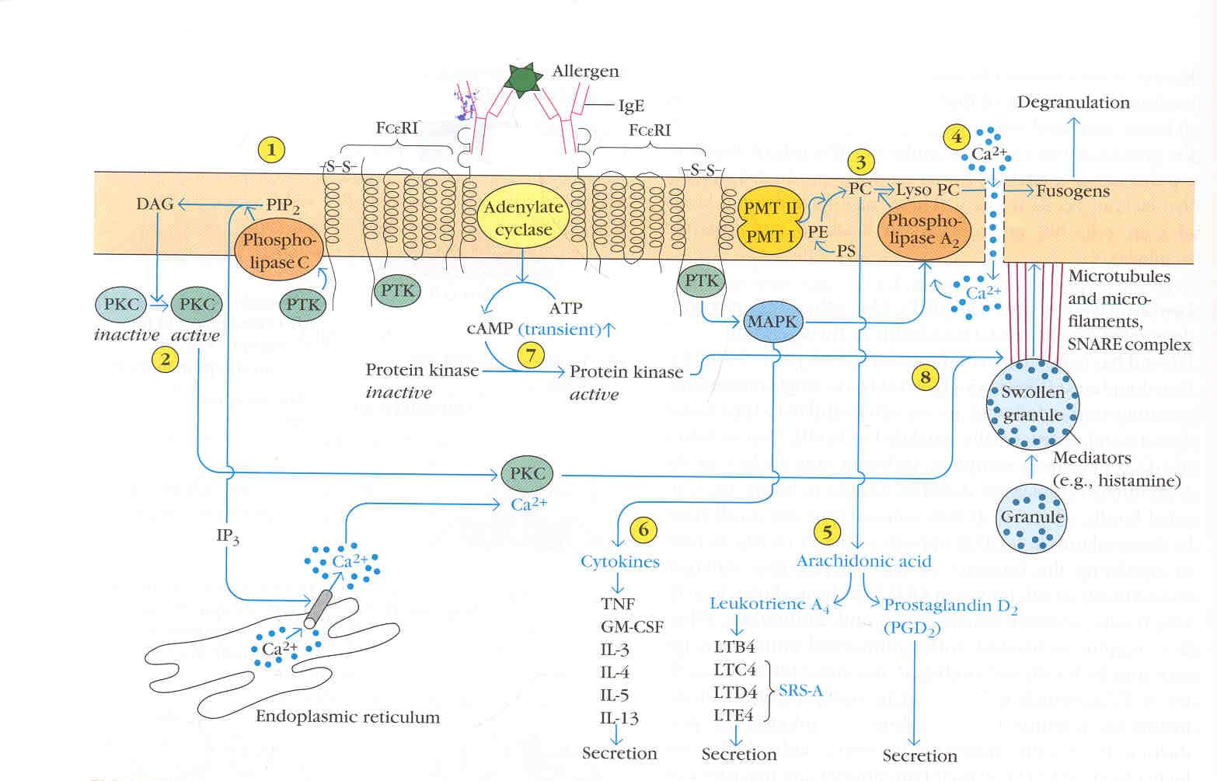
BIOCHEMICAL EVENTS IN MAST CELL DEGRANULATION

Slide 10
PRINCIPLE MEDIATORS - PRIMARY
Histamine | Increased vascular permeability, smooth muscle contraction, vasodilatation
Serotonin | Increased vascular permeability, smooth muscle contraction,vasoconstriction
ECF-A | Chemotaxis
NCF-A | Chemotaxis
Proteases | Mucus secretion, degradation of blood vessel basement membrane

Slide 11
PRINCIPLE MEDIATORS -SECONDARY
PAF | Platelet aggregation & degranulation, smooth muscle contraction
Leukotriens (SRS-A) | Increased vascular permeability, sustained smooth muscle contraction
Prostagalandins | Platelet aggregation, vasodilatation, smooth muscle contraction
Bradykinins | Increased vascular permeability, smooth muscle contraction
Cytokines | Systemic anaphylaxis, Increased IgE production

Slide 12
TYPES OF ANAPHYLAXIS
Systemic anaphylaxis
Shock and fatal state
Onset within minutes
Allergen induced directly into the blood stream
Animal model-guinea pig
Epinephrine-is drug of choice
Clinical manifestations:
-labored respiration
-decreased BP
-contraction muscles of GIT and bladder
-bronchial constriction

Slide 13
ANTIGENS RELATED TO SYSTEMIC ANAPHYLAXIS
Antigen trigger the reaction in Guinea pig:
- Egg albumin
Antigen trigger the reaction in humans:
-venom from bee
-Wasp
-hornet and stings
Drugs: penicillin
insulin
antibiotics
Foods: sea foods and nuts

Slide 14
Localized hypersensitivity – ATOPY (out of place or strangeness)
Tendency to manifest localized hypersensitivity reaction is inherited &multigenic.
First introduced by coca(1923)
Specific to target tissue or organ
Common antigens causing atopy
-Pollen
-House dust
-foods

Slide 15
Localized hypersensitivity - ATOPY
Mechanism:
atopens+cell bound IgE antibodies of mast cell
Ag-Ab complex
Release mediators
Localized hypersensitivity

Slide 16
ALLERGIC RHINITIS
Known as hay fever
Inhalation due to common air born allergens
Localized vasodilations, and increased capillary permeability
Watery exudation
Sneezing
Coughing

Slide 17
FOOD ALLERGY
Allergen cross linking of IgE on mast cells
Smooth muscle contraction and vasodilation-GIT
Symptoms:
Vomiting or diarrhea
Mast cell degranulation along the Gut-allergen enters blood streams
Asthmatic attack
Atopic urticaria

Slide 18
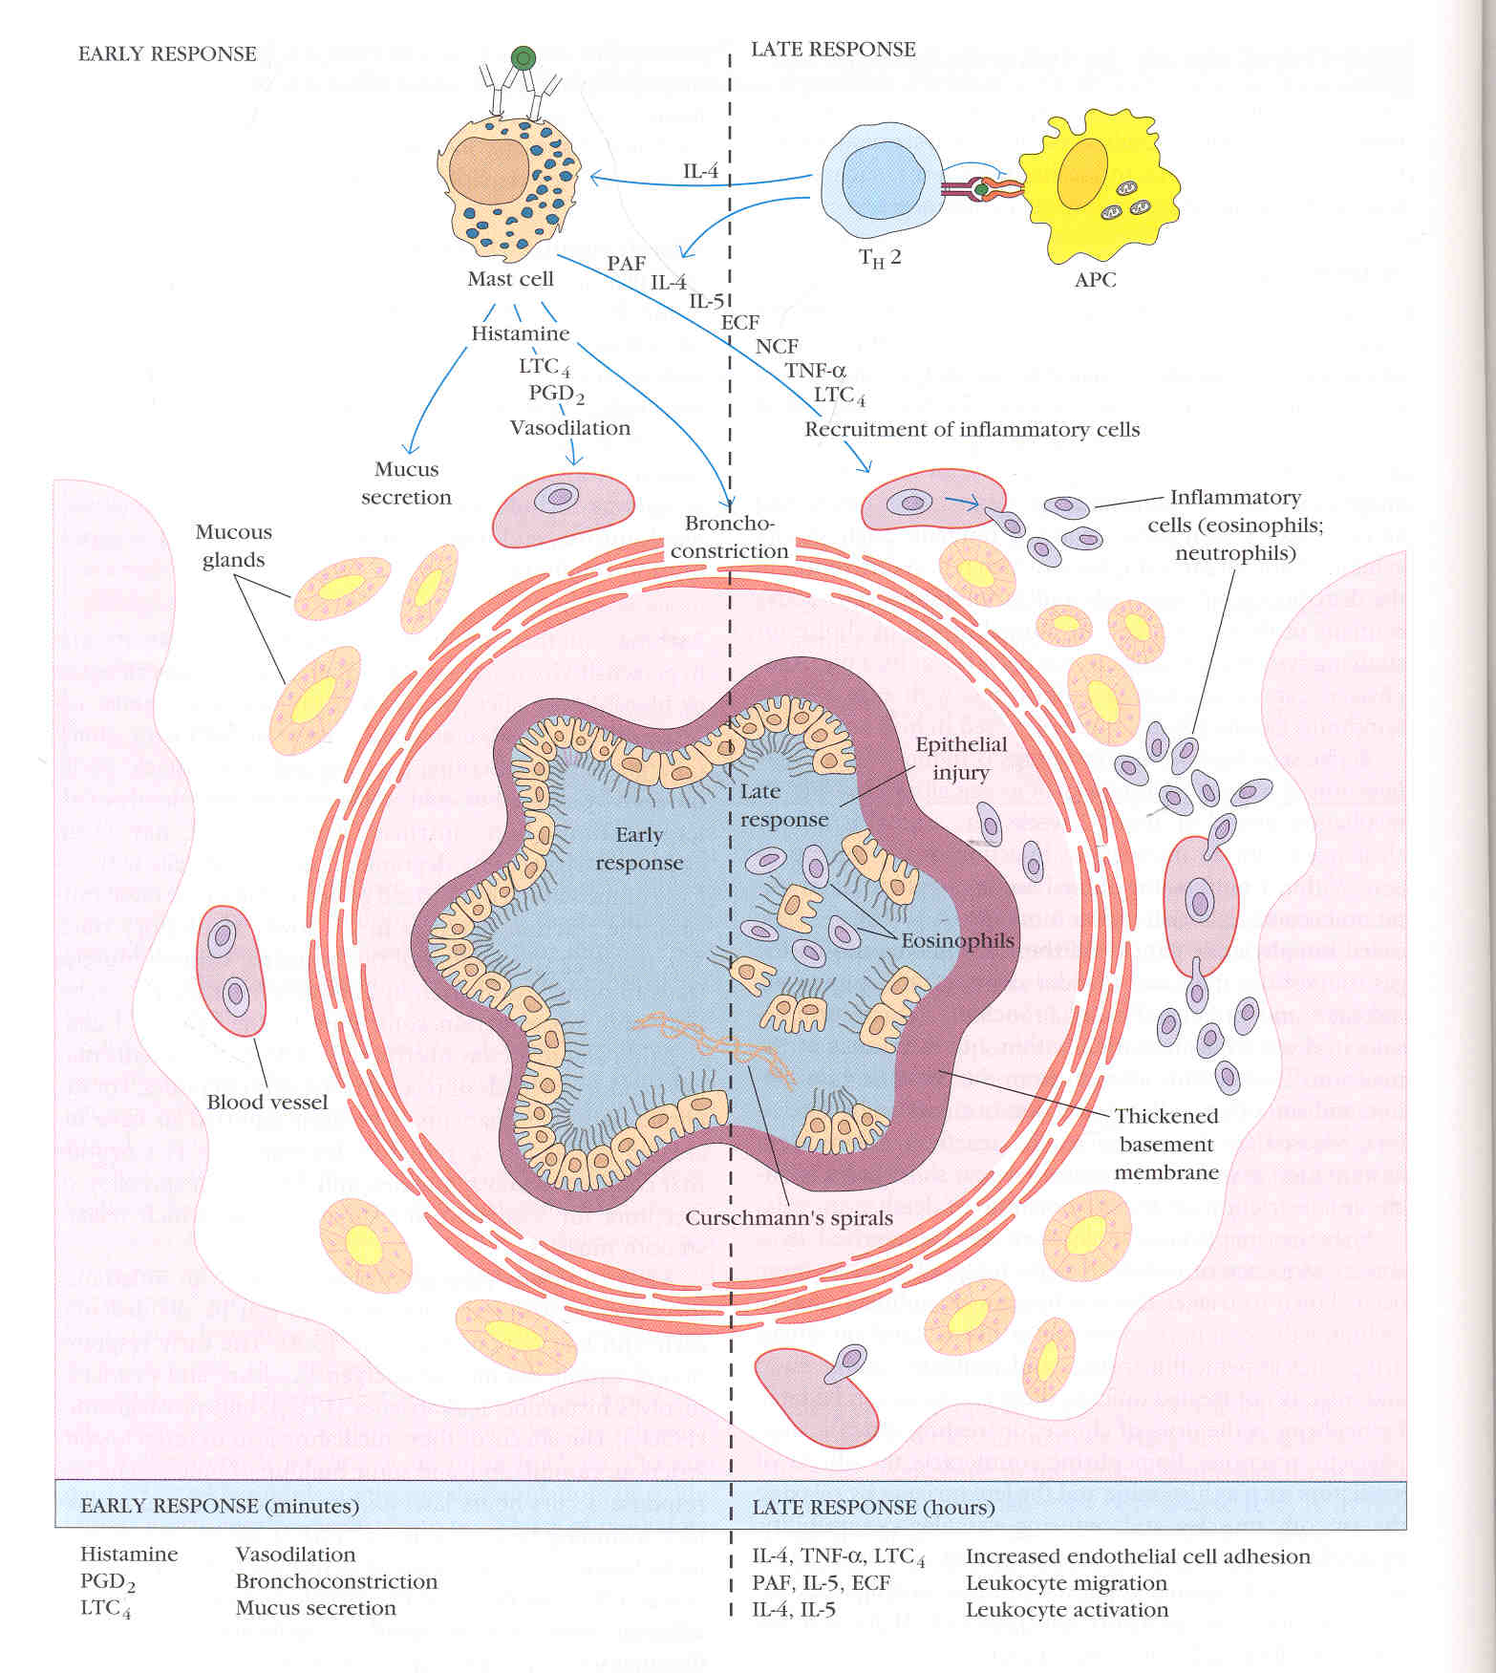
Early and Late inflammatory responses in Asthma

Slide 19
ATOPIC DERMATITIS (ALLERGIC ECZEMA)
Inflammatory disease of skin
Observed most frequently in infancy and young children
Serum IgE level increased
Skin eruption
Erythematous filled with pus

Slide 20
Detection of Type1 hypersensitivity
Skin testing
Advantage
inexpensive
allow screening for large no. of allergens at one time
Disadvantages
sensitised in rare cases
less commonly induced systemic anaphylactic shock

Slide 21
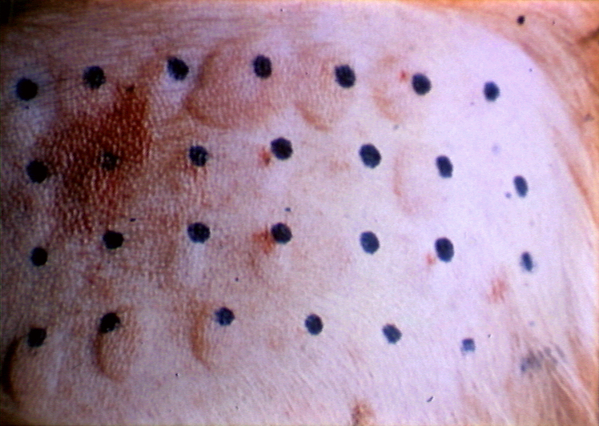
SKIN TESTING

Slide 22
Detection Of Type1 Hypersensitivity
Serum IgE determination
Radio immuno sorbent test (RIST)
Radio allergo sorbent test (RAST)

Slide 23
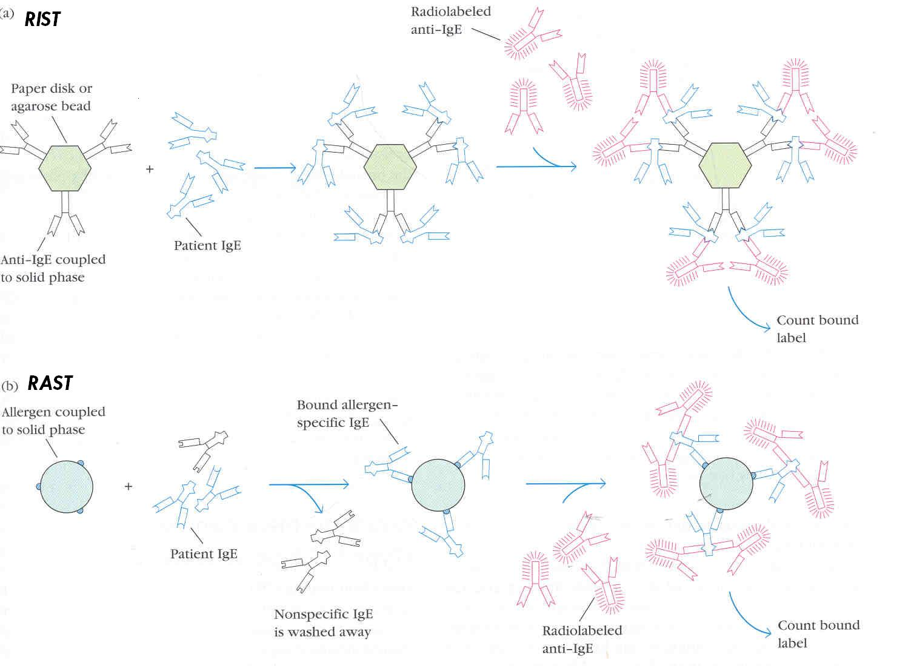
Serum IgE determination

Slide 24
Treatment
Immunotherapy:
With repeated injections of increasing doses of allergens (Hyposensitizations)
- DNA vaccine
- Adjuvant
Humanized monoclonal anti-IgE -Omalizumab-first anti Ig antibody approved in US in 2003.

Slide 25
Drug therapy
DRUGS
Anti histamins
Cromolyn sodium
theophylline
Epinephrine
Cortisone
ACTION
Block H1 and H2 receptor
Block calcium Influx
Increased cyclic AMP level
Stimulate cyclic AMP production
Reduces histamine levels

Slide 26
ANTIBODY-MEDIATED CYTOTOXIC (type II) HYPERSENSITIVITY
Mediated By IgG, rarely IgM
Ab. Binds to Ag. On cell surface
Phagocytosis of cell through opsonic or immunoadherence
Cytotoxic - NK cells
Lysis –Activated complement system
Transfusion reactions
Hemolytic disease of new born
Drug induced hemolytic anemia

Slide 27
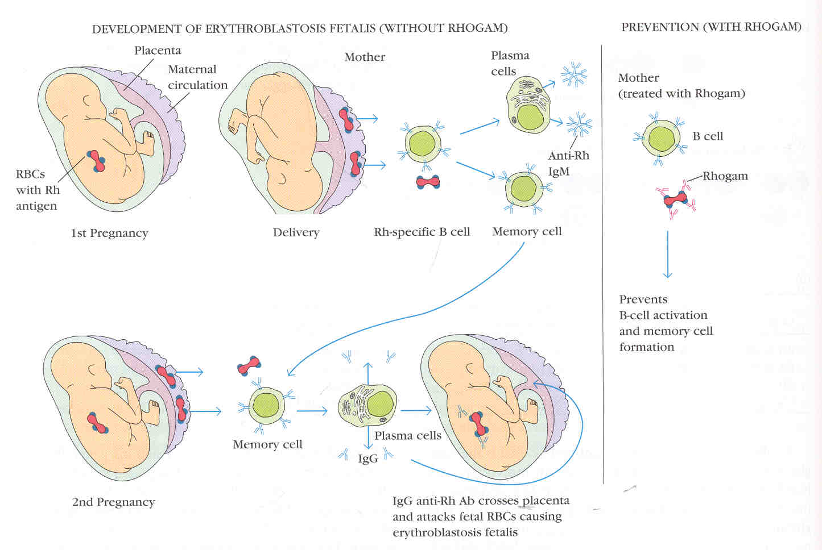
Haemolytic disease of newborn

Slide 28
Detection & Treatment
Coomb’s test (Direct antiglobulin test)
Foetal RBCs + Coomb’s reagent
Incubate
Maternal IgG bound to Foetal RBC
Cells agglutinate with Coomb’s reagent
Treatment in foetus
Intrauterine blood exchange transfusion (every 10-21 days)
Exposed to low levels of UV light
Treatment in mother
Plasmapheresis
Treated with anti-Rh Abs or Rhogam

Slide 29
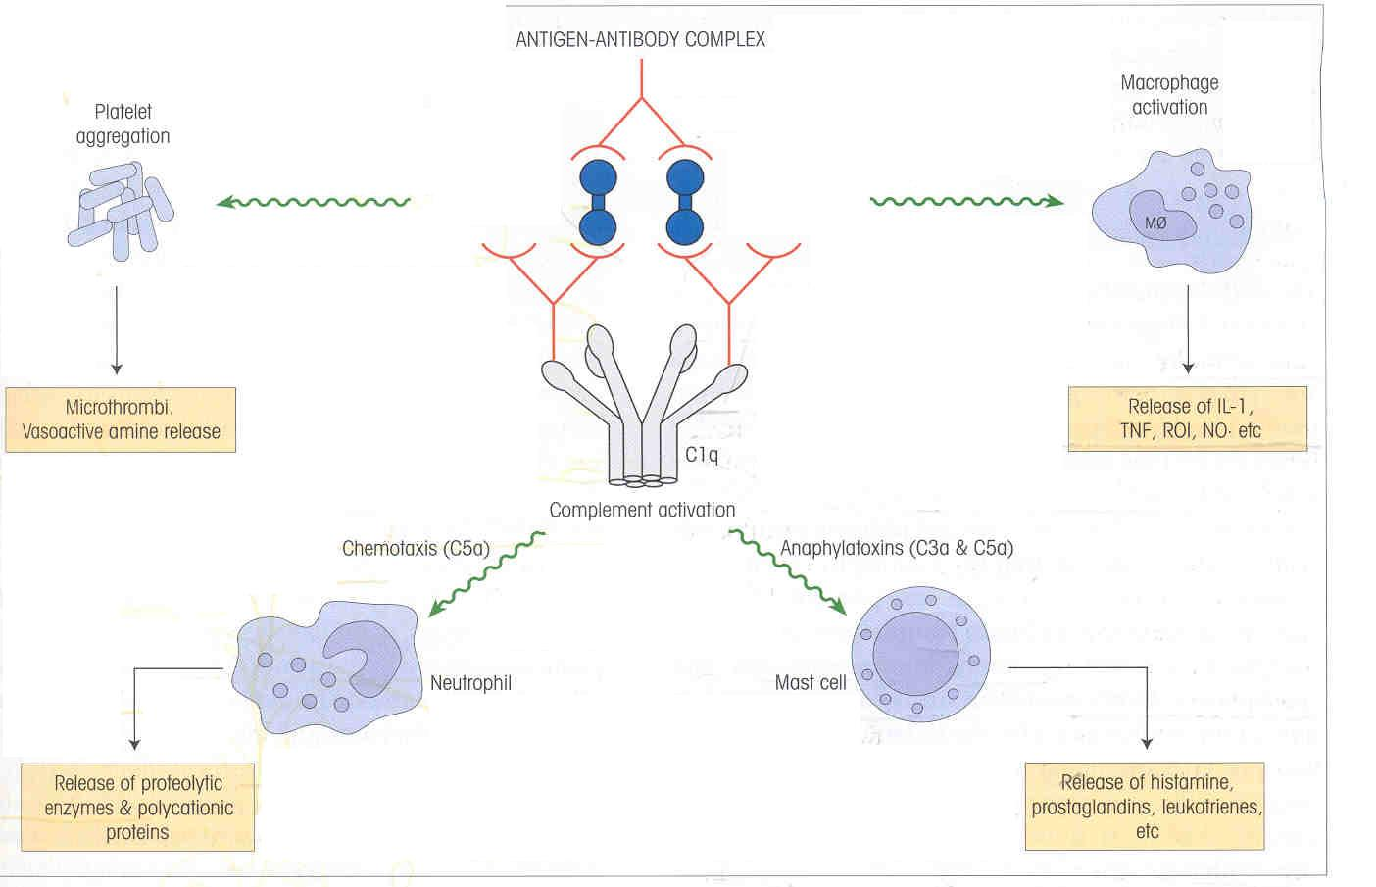
IMMUNE COMPLEX MEDIATED (type III) HYPERSENSITIVITY

Slide 30
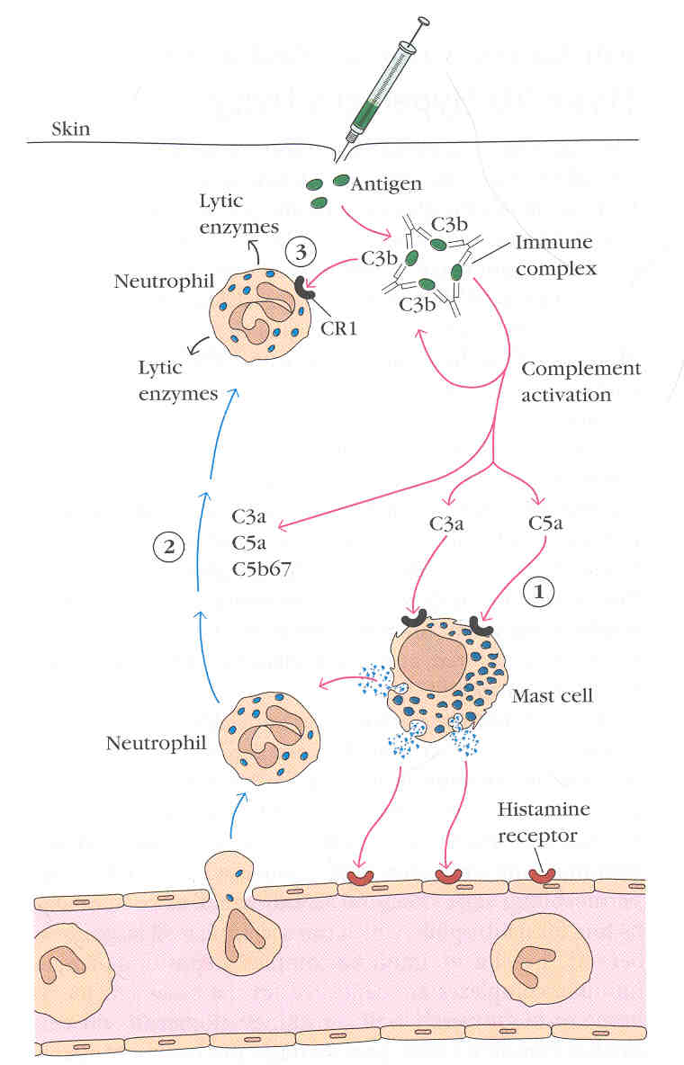
ARTHUS REACTION (localized)
Due to relative
Antibody excess

Slide 31
SERUM SICKNESS (Generalized)
Due to relative antigen excess
Anti toxins – Anti-tetanus or Anti-diphtheria serum
Antibiotic treatment and certain vaccinations
Symptoms
Tissue damage at various sites
Fever
Weakness
Generalized vasculitis
lymphadenopathy

Slide 32
DELAYED TYPE HYPERSENSTIVITY (type IV)
Mechanism:
1. Sensitization phase
Proliferate TH cells
Initial contact with antigen
Cytokine Secreted
Differentiate into TH1cells

Slide 33
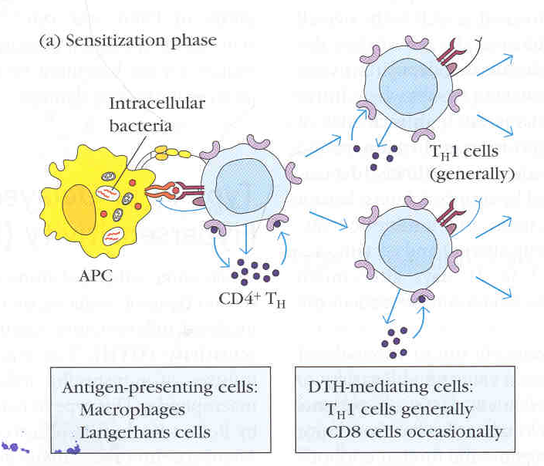

Slide 34
DELAYED TYPE HYPERSENSTIVITY (type IV)
2) Effector Phase
Sensitized TH1 Cells
Secrete cytokine and chemokines
Activate Macrophage and inflammatory cells
Perpetuating DTH response

Slide 35
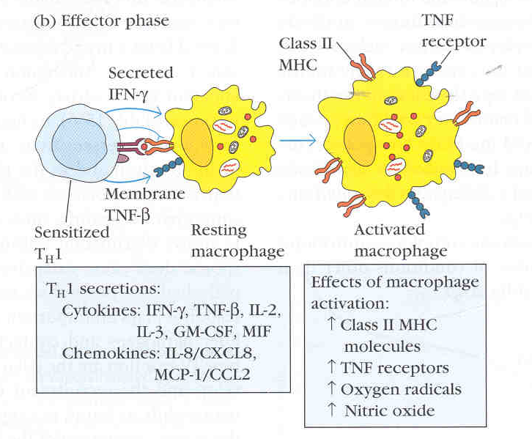

Slide 36
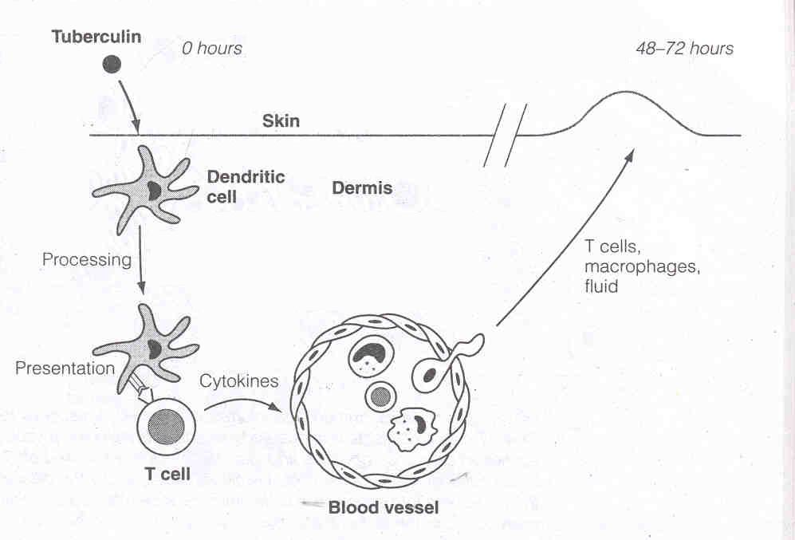
TUBERCULIN TYPE REACTION

Slide 37
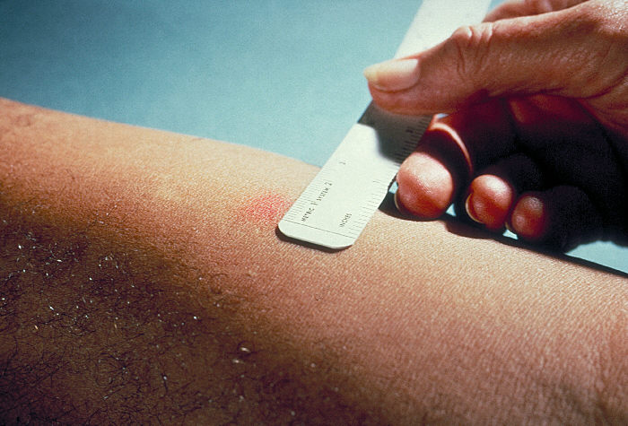
TUBERCULIN TYPE REACTION

Slide 38
CONTACT DERMATITIS TYPE REACTIONS
Simple chemicals/substance act as haptens
Absorption through skin
Combines with skin proteins and becomes antigenic
Fat soluble
Portal of entry through sebaceous gland
Langerhans cells
Regional lymph modes
Sensitized T lymphocytes
Subsequent exposure to agent
senstized lymphocytes
release lymphokines
Superficial inflammation of skin

Slide 39
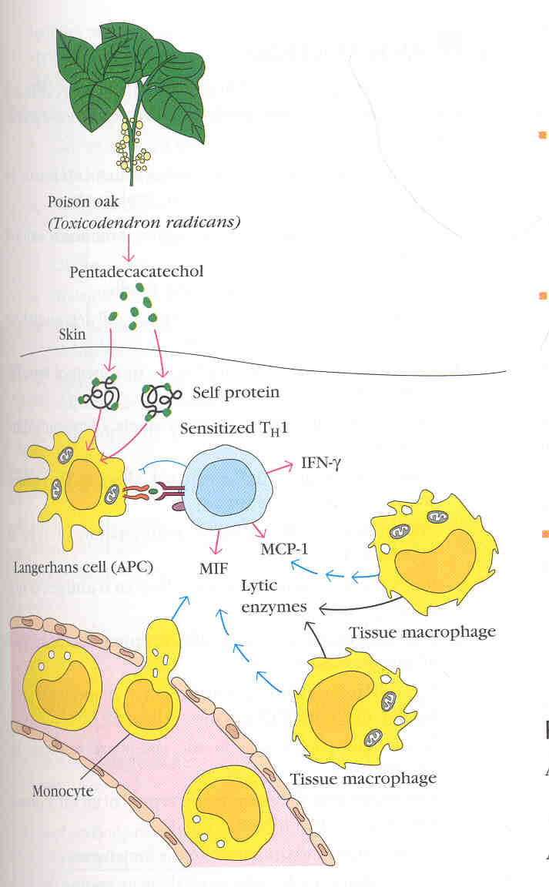
CONTACT DERMATITIS TYPE REACTIONS

Slide 40
DETECTION OF TYPE IV HYPERSENSITIVITY
Tuberculin test
Lepromin tests
Frei test
Histoplasmin test
Patch test

Slide 41
STIMULATORY TYPE REACTION (type V)
Modified of Type II hypersensitivity Reactions
Cell proliferation and differentiation instead of inhibition or killing
Auto antibodies directed to hormone receptor molecules &function in a stimulatory fashion
Abs to TSH receptor result over activity of thyroid(Graves disease).

Slide 42
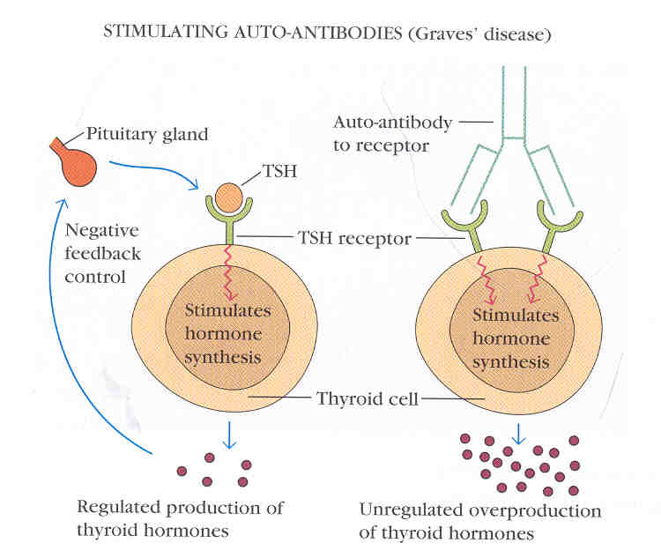
STIMULATORY TYPE REACTION (type V)

Slide 43
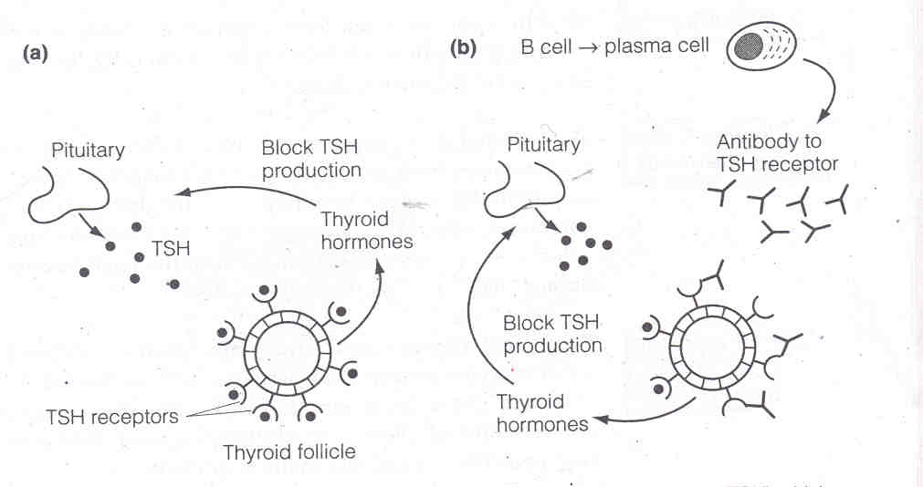
STIMULATORY TYPE REACTION (type V)

Slide 44
SUMMARY
Type I | Type II | Type III | Type IV | Type V
IgE mediated | IgG/IgM mediated | Immune complex mediated | Cell mediated | Ab.-mediated
Ag induces cross linking | Ab directed against cell surface | Ag-Ab complexes in various tissues | Sensitized TH1 cells release cytokines | Cell surface
Systemic & Localized anaphylaxis | Erythroblastosis Foetalis, Blood transfusion reactions | Arthus reaction, Serum sickness, SLE | Tubercular lesions, Contact dermatitis | Grave’s disease

Slide 45
THANK YOU

