Slide 1
IMMUNE THROMBOCYTOPENIC PURPURA MBBSPPT.COM

Slide 2
Thrombocytopenia defined as platelets count of less than 150×10³ per µl
Platelets count between 30-50×10³ per µl rarely manifests as purpura
A count from 10-30×10³ per µl may cause bleeding with minimal trauma
A platelet count less than 5×10³ µl may cause spontaneous bleeding

Slide 3
Primary immune thrombocytopenic purpura (ITP) , autoimmune disorder characterized by low platelet count, typically in an otherwise healthy individual
It is defined as isolated thrombocytopenia with no clinically apparent associated conditions or other cause of thrombocytopenia.
As no specific criteria establish the diagnosis, ITP diagnosed by excluding other causes of thrombocytopenia

Slide 4
ITP is an organ specific autoimmune disorder in which antibody coated or immune complex coated platelets are destroyed prematurely by reticuloendothelial system resulting in thrombocytopenia
However, recent data confirm that platelets production is also impaired.

Slide 5
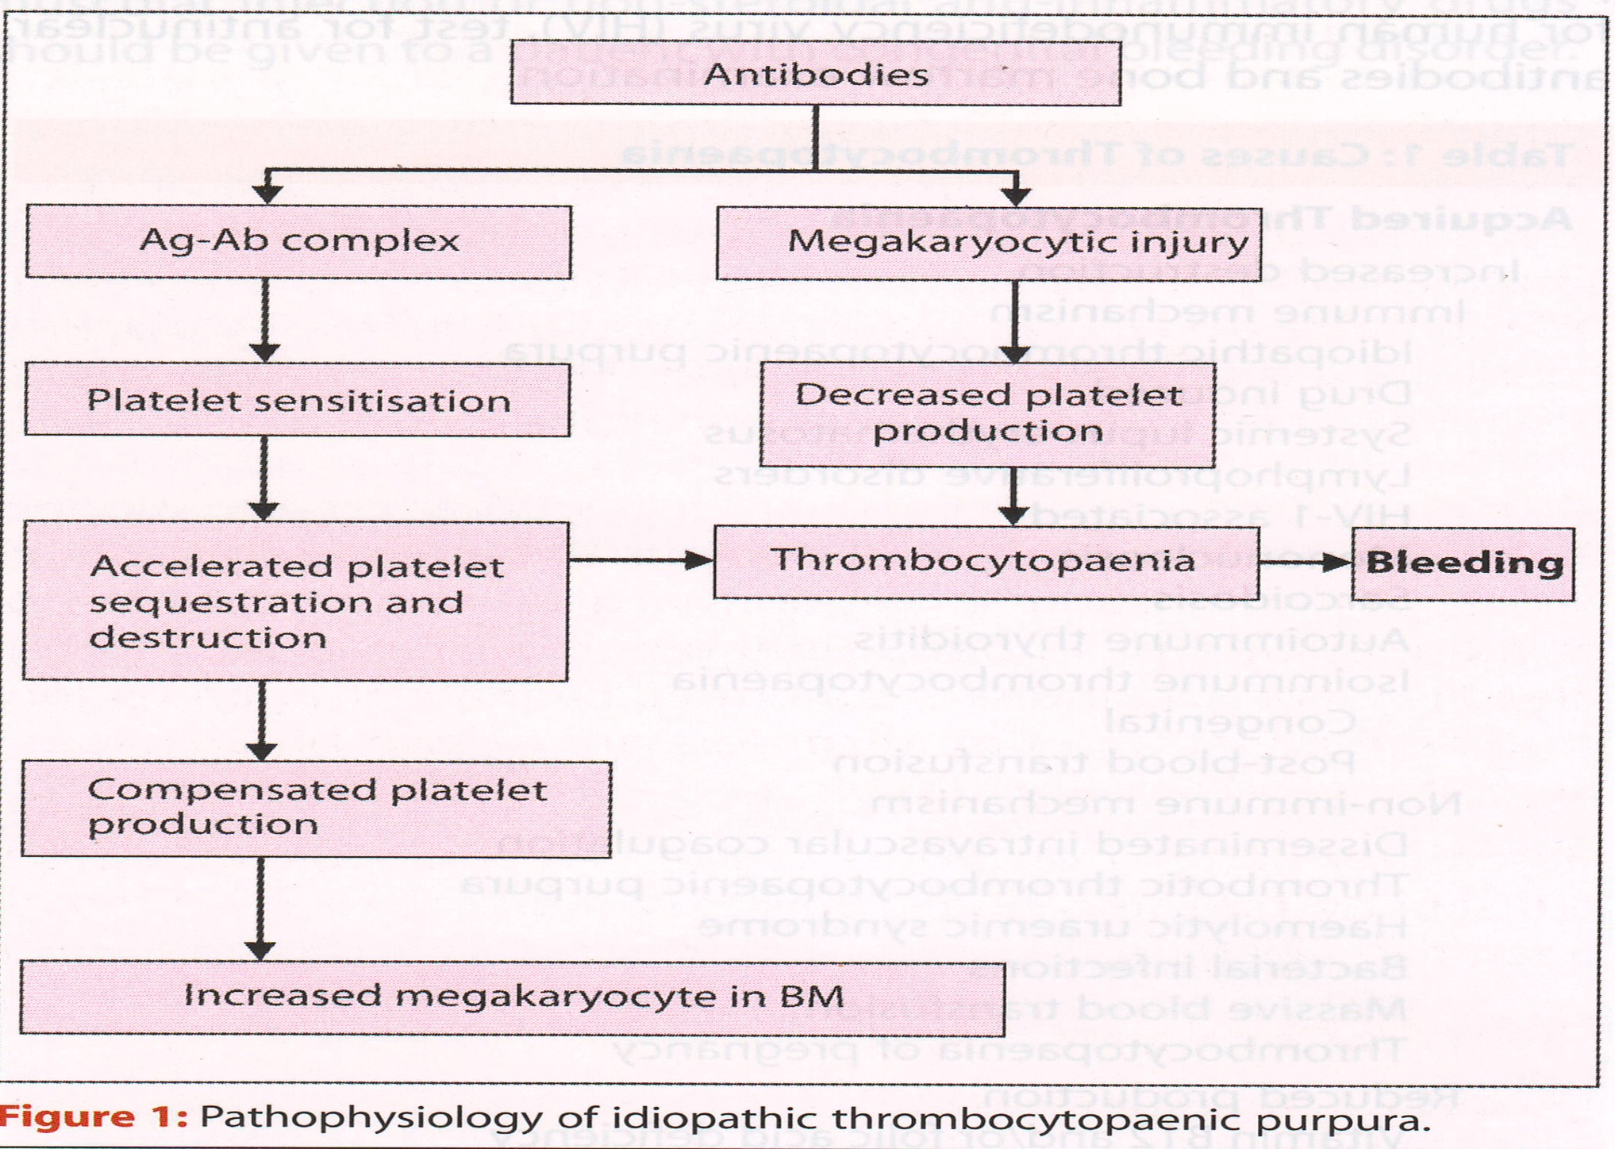

Slide 6
Immune thrombocytopenic purpura may have acute or insidious onset.
Adult ITP usually has insidious onset and chronic course
Many cases are diagnosed incidentally on routine bloods counts
The clinical course, highly variable ranging from asymptomatic to life threatening bleeding

Slide 7
ITP in Children and Adults
Children Adults
Peak age incidence (yrs) 2-6 >50
Sex incidence (M:F) 1:1 1:1.7
Onset Acute Insidious
Preceding infection Common Unusual
Platelet count (×10⁹) often<20 often >20
Usual duration 2-4 wk years
Spontaneous remission % >80 2
Chronic disease 24 43

Slide 8
Clinical Features
In adults onset insidious
Many patients asymptomatic
The commonest symptoms -petechiae and bruising
Most patients with ITP usually do not experience clinically important bleeding unless the count very low<5-10×10⁹ l

Slide 9
Diagnosis
ITP diagnosed by excluding other causes of thrombocytopenia
It is based on history, examination, CBC, PBF.
Spleen rarely palpable(<10%)
If spleenomegaly present, may be suggestive of some other disorders e.g., portal htn

Slide 10
Secondary ITP Associated with Underlying Condicitions
◆ SLE  lymphoproliferative disorders
◆ APLS  Infections
◆ Grave’s Ds HIV, Epstein Barr virus
◆ Sarcoidosis Hepatitis C, Varicella-zoster virus
Cytomegalo cirus, Helicobacter pylori

Slide 11
Testing to rule out these causes should be performed as clinically indicated
Forty present of patients with ITP test +ve for ANA or APLA without having underlying autoimmune syndrome
Bone marrow aspiration/biopsy indicated to exclude secondary causes, particularly in older patients
Documenting presence of antibodies against platelets not needed.

Slide 12
Management
Current treatment approach primarily aimed at preventing or minimizing platelet destruction.
Various therapies used early in treatment of ITP are:
¤ Corticosteroids ¤ Intravenous immune globulin
¤ Anti –D immune globulin ¤ Splenectomy

Slide 13
Who should be treated ?
Not all patients with ITP require treatment
The goal of treatment is to provide safe platelet count with minimum treatment related morbidity

Slide 14
Determinants of Need to Treat Adult chronic ITP
Presence of active bleeding
Platelet count – very low
Additional risk factors for bleeding- uraemia, poorly controlled HTN, fever, infections, alcoholism, peptic ulcer disease, aneurysms, chronic liver disease

Slide 15
Emergency Treatment
Three group of patients require emergency treatment:
Those with internal bleeding
Those with widespread mucocutaneous bleeding
Those needing emergency surgery

Slide 16
Appropriate Emergency Treatment
IVIg: 1gm/kg/day × 2days
IV methyl prednisolone : 1gm/day × 3days
Platelet transfusion: 2u/hr or 6 units ever 6hrs

Slide 17
Safe Platelets count in adults
Procedure Platelet count (×10⁹l)
Dentistry >10
Extractions >30
Regional dental block >30
Minor surgery >50
Vaginal delivery >50
Major Surgery >80
Spinal or epidural anesthesia >80

Slide 18
Treatment Categories in chronic Adult ITP
1. Presence of active bleeding Must
(irrespective of platelet count)
2. Platelet count less than 10,000/cumm Should
and no active bleeding
3. Platelet 10,000-30,000/cumm May
and not active bleeding
4. Platelet count >30,000/cumm #No
And no active bleeding
# Exceptions being major surgery and obstetric delivery

Slide 19
Initial Treatment
If life not threatened, corticosteroids form the standard initial treatment
IVIg given only to those patients who are unresponsive to corticosteroids
Anti – D Ig another alternative to IVIg provided blood group Rh (D) +ve and intact spleen

Slide 20
Corticosteroids
Approxmatly, 66% of patients show partial or complete response to steroids
Prednisolone, methyl prednisolone, dexamethasone oral or IV, duration of full dose 2-6 weeks, taper steroid after 4 wks
High early relapse rate (within 6 months), there after a slower but continuous relapse rate up to 6 yrs

Slide 21
Steroids impair the clearance of antibody-coated platelets by tissue macrophages
Inhibit antibody production
Steroids have direct effect on vascular integrity
Increase platelet production by inhibiting phagocytosis of platelets by intramedullary macrophages

Slide 22
Intravenous Immunoglobulin (IVIg)
Effective in 85% of patients, with 65% achieving normal platelets count
Platelets counts start increasing within a day and peak achieved by seventh day
Effect duration 4 weeks
Infusions should be given slowly over several hours

Slide 23
IVIg works by blocking Fc receptors on reticuloendothelial cells, suppressing antibody production and binding

Slide 24
Anti –D immunoglobulin
Anti –D Ig is effective only in Rh (D) +ve, non splenectomised cases
Standard dose - 50-75 mg/kh × 1day
Effect noticed after 72 hr, not useful for emergency cases
Repeated doses may be effective

Slide 25
Splenectomy
Splenectomy standard and traditional second line treatment for adult ITP, when steroids fail
75% of patients undergoing splenectomy achieve complete remission

Slide 26
Other second line treatment
Patients who fail 1st line therapies/splenectomy can benefit from Azathiopurine, vinka alkaloids, cyclosporin A, mycophenolate mofetil,dapsone, danazol, cyclophophamide.
Thrombopoietic agents are a new tool in treatment of ITP, acting towards improving platelets production

Slide 27
Thank yOU

