Slide 1

IMMUNODEFICIENCY DISEASES
BY MBBSPPT.COM

Slide 2
Immunodeficiency
Primary
Secondary

Slide 3
What is Immunodeficiency?
A failing of one or more of the body’s defensive mechanisms resulting in morbidity or mortality.
Any part of the immune system can be deficient cells, proteins, signalling mechanisms…….
The body is susceptible to infection by organisms that meet with little or no resistance.

Slide 4
Primary or Congenital Immunodeficiency
Ataxia-telangiectasia
Chediak-Higashi syndrome
combined immunodeficiency disease
complement deficiencies
DiGeorge syndrome
hypogammaglobulinemia
Job syndrome

Slide 5
Secondary Immunodeficiency:
  Infection
  Renal failure, or protein losing enteropathy
  Leukaemia or Lymphoma
  Myeloma
  Extremes of age
  Certain Drug Therapies

Slide 6
Clinical Features Associated with Immunodeficiency
Feature frequently present and highly suspicious:
Chronic infection
Recurrent infection (more than expected)
Unusual microbial agents
Incomplete clearing of infection
Incomplete response to treatment

Slide 7
  Feature Moderately Suspicious
  Diarrhea (chronic)
  Growth failure
  Recurrent abscesses
  Recurrent osteomyelitis

Slide 8
Classification of Immunodeficiencies:
Antibody deficiencies
Cellular deficiencies
Phagocytic disorders
Complement deficiencies

Slide 9

Antibody (B cell) ID
X- linked agammaglobulinemia
Selective IgA deficiency
IgG Subclasses deficiency
Hyper – IgM
CVID

Slide 10
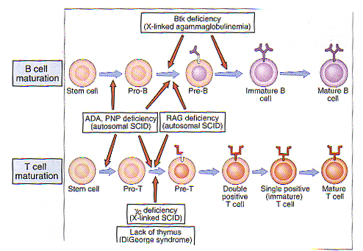

Slide 11
What is XLA?
First immunodeficiency described.
Defect on the X chromosome
affecting the Btk gene.
Results in an absence or severe
reduction in B lymphocytes and
hence immunoglobulin of all types.

Slide 12
Clinical Findings
Symptoms appear at 6-9 months of age (after loss of maternal Ig)
Sites of infection: mucous membranes, ear (otitis media), lungs (bronchitis/pneumonia), blood (sepsis), gut (Giardia, or enterovirus), skin, eyes, meningitis.
Also seen: joint problems, kidney
problems, neutropenia, malignancy
in older patients.

Slide 13
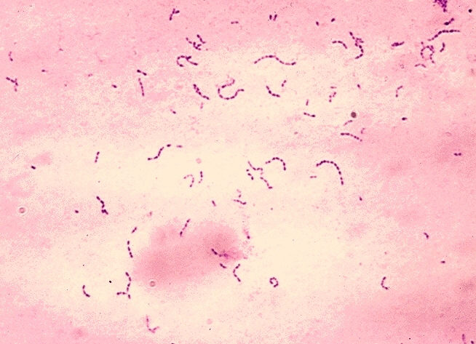
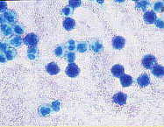
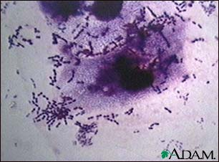
Patients with XLA repeatedly acquire infections with extracellular pyogenic organisms such as:
Hemophilus
Pneumococus
streptococus

Slide 14

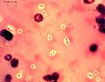
Susceptibility to encapsulated Bacteria
H Influenzae
S pneumoniae

Slide 15
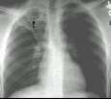
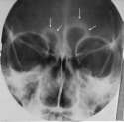

Sinusitis
Pneumonia
Otitis Media

Slide 16
The Btk Gene
Located on the X chromosome.
Without Btk pre-B cells fail to develop into mature B cells.

Slide 17
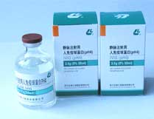
Intravenous Immunoglobulin (IVIG)

Slide 18
Selective IgA Deficiency
Selective IgA deficiency is the most common ID disorder.
Pathogenesis : block in B cell differentiation is due to intrinsic B cell defect .

Slide 19
IgA Deficiency
Clinical feature: Recurrent sinopulmounary infection, Gastrointestinal disorders, Allergy, Cancer and Autoimmune disease.
Serum IgA<5mg/dl but normal IgM and IgG
Immunopathogenesis :arrest in the B cell differentiation.

Slide 20
Overview of B-Cell Development

Slide 21
Selective IgG subclass deficiency
Total serum IgG levels are normal
One or more subclasses are below normal.
IgG3 deficiency is the most common subclass in adults.
IgG2 deficiency associated with IgA deficiency in children.
Pathogenesis: abnormal B cell differentiation.
Some individual have recurrent bacterial infection.

Slide 22
Common Variable Immunodeficiency
CVID

Slide 23
CVID has an almost equal sex distribution

Slide 24
CVID is characterized by hypogammaglobulinemia
CVID has a tendency to autoantibody formation

Slide 25
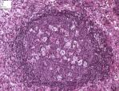
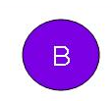
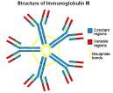
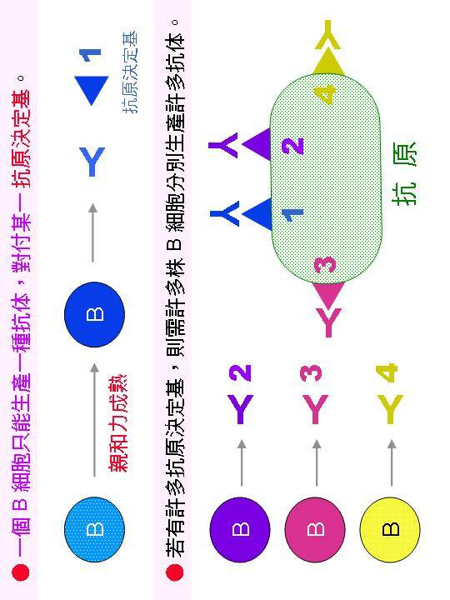
CVID
Normal lymphoid follicle
Normal number of circulating B cell
Hypogammaglobulinemia

Slide 26
CVID Abnormalities
CVID is a heterogenous group of disorders with intrinsic B-cell defect or a B-cell dysfunction related to abnormal T-cell B-cell interaction.
In 10-20% of families another member may have selective IgA def.

Slide 27
CVID Cont.
Pathogenesis: defect in differentiation into Ig secreting plasma cells .
Reduction production of cytokines
Increased apoptosis in B and T cells.
Defect in CD27 and CD134 ligand, important in promoting into plasma cells

Slide 28
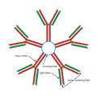
Hyper IgM Syndrome

Slide 29
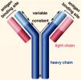
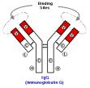

IgG↓
Serum levels of immunoglobulin in Hyper IgM syndrome
IgM ↑↑
IgA↓
IgE↓

Slide 30
Hyper IgM syndrome
Defect in CD40 ligand
CD40 ligand
T cell
CD40
B cell
Ig Class
switch
T cell deficiency

Slide 31
Cell mediated ( T cell)Immunodeficiency
Evaluation of cell- mediated immunity
Total lymphocyte count
DTH
Lymphocyte response
Total T cell using Anti-CD3
CD4 and CD8 subset
Cytokine production
Cell mediated ( T cell)Immunodeficiency
DiGeorge Syndrome

Slide 32
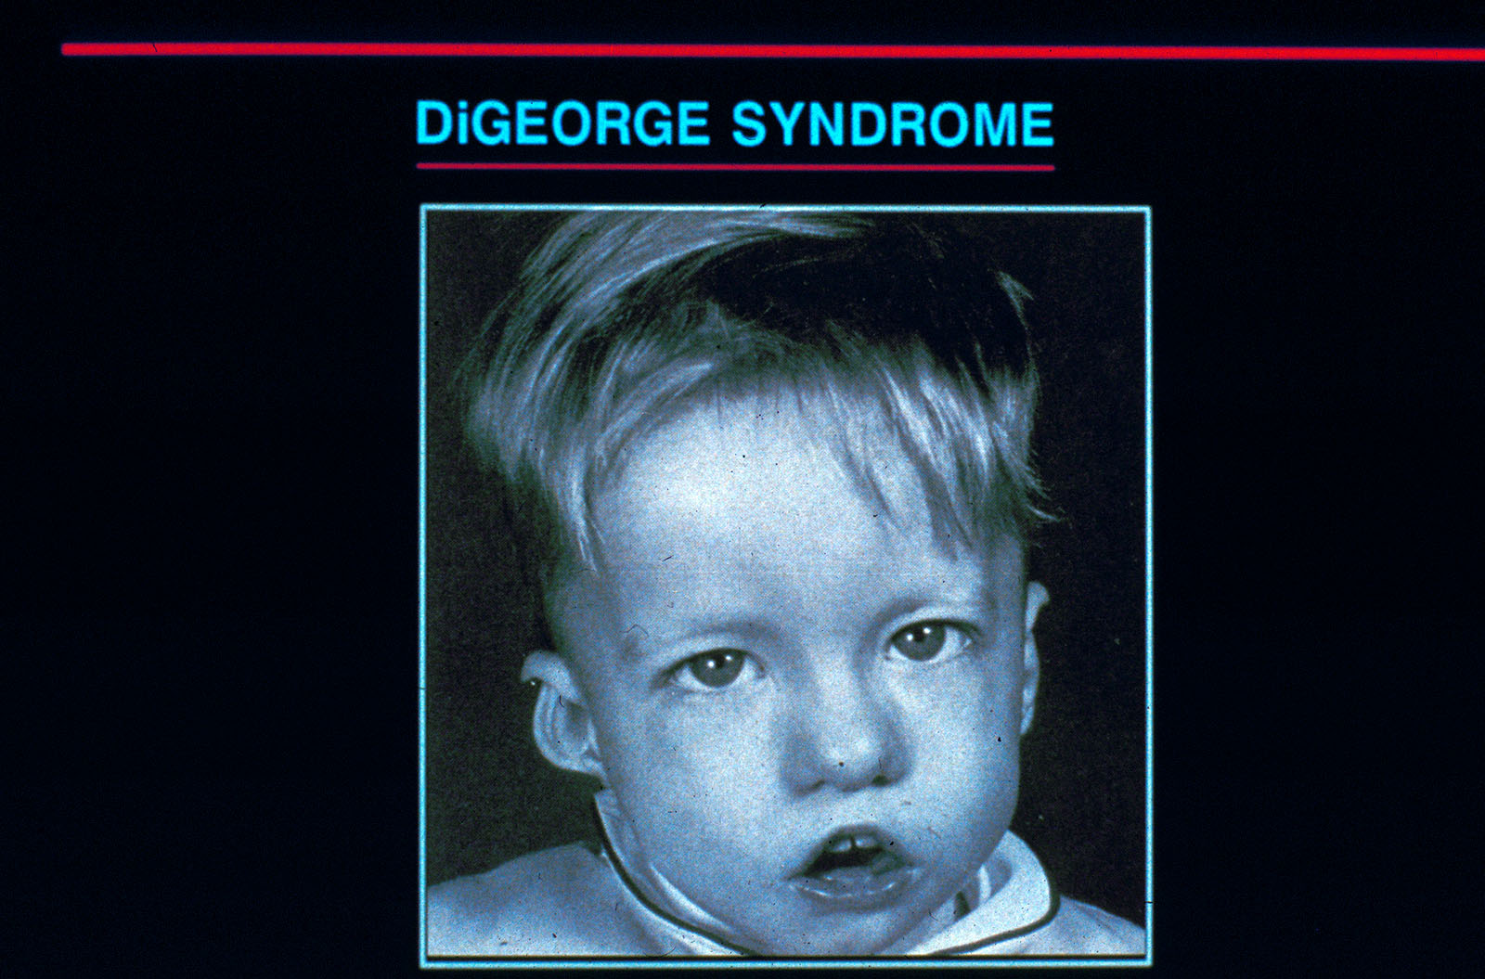
DiGeorge Syndrome

Slide 33
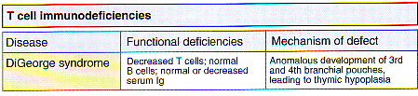

Slide 34
DiGeorge Syndrome
    Defective development in thymus and parathyroid that
    develop from third and fourth Pharyngeal pouch
Thymic hypoplasia leading to variable immunodeficiency.
Other features:
Characteristic faces
Abnormal calcium homeostasis

Slide 35
Combined Immunodeficiencies:
Severe combined immunodeficiency (SCID)
Ataxia-Telangiectasia syndrome (AT)
Wiskott -Aldrich syndrome (WAS)

Slide 36
Common Features of Severe Combined Immunodeficiency (SCID)
Failure to thrive
Onset of infections in the neonatal period
Opportunistic infections
Chronic or recurrent thrush
Chronic rashes
Chronic or recurrent diarrhea
Paucity of lymphoid tissue

Slide 37
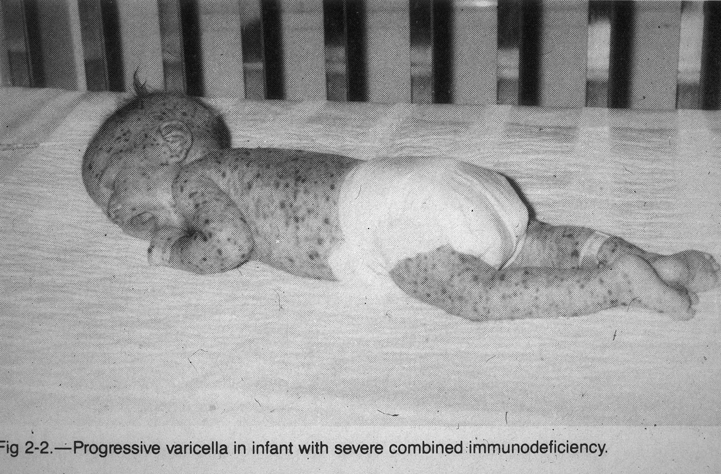
X-linked ID with absent T, NK and Ig synthesis

Slide 38
WISKOTT-ALDRICH SYNDROME
X-linked
Eczema ,thrombocytopenia ,bacterial infection (polysaccharide antigen)
Cell surface glycoproteins reduced ;CD43
(or sialophorin) normally on Lymph .neut . Mac and Platele.
These alterations interfere with migration of Leuk. to inflammation sites.

Slide 39
ATAXIA-TELANGIECTASIA
Autosomal recessive
Abnormal gait (ataxia)
Vascular malformations (telangiectasia), neurologic defects and tumors
ID may affect T&B cells
IgA and IgG2 deficiency.
T cell function is variably depressed.
Gene responsible on chromosome 11

Slide 40
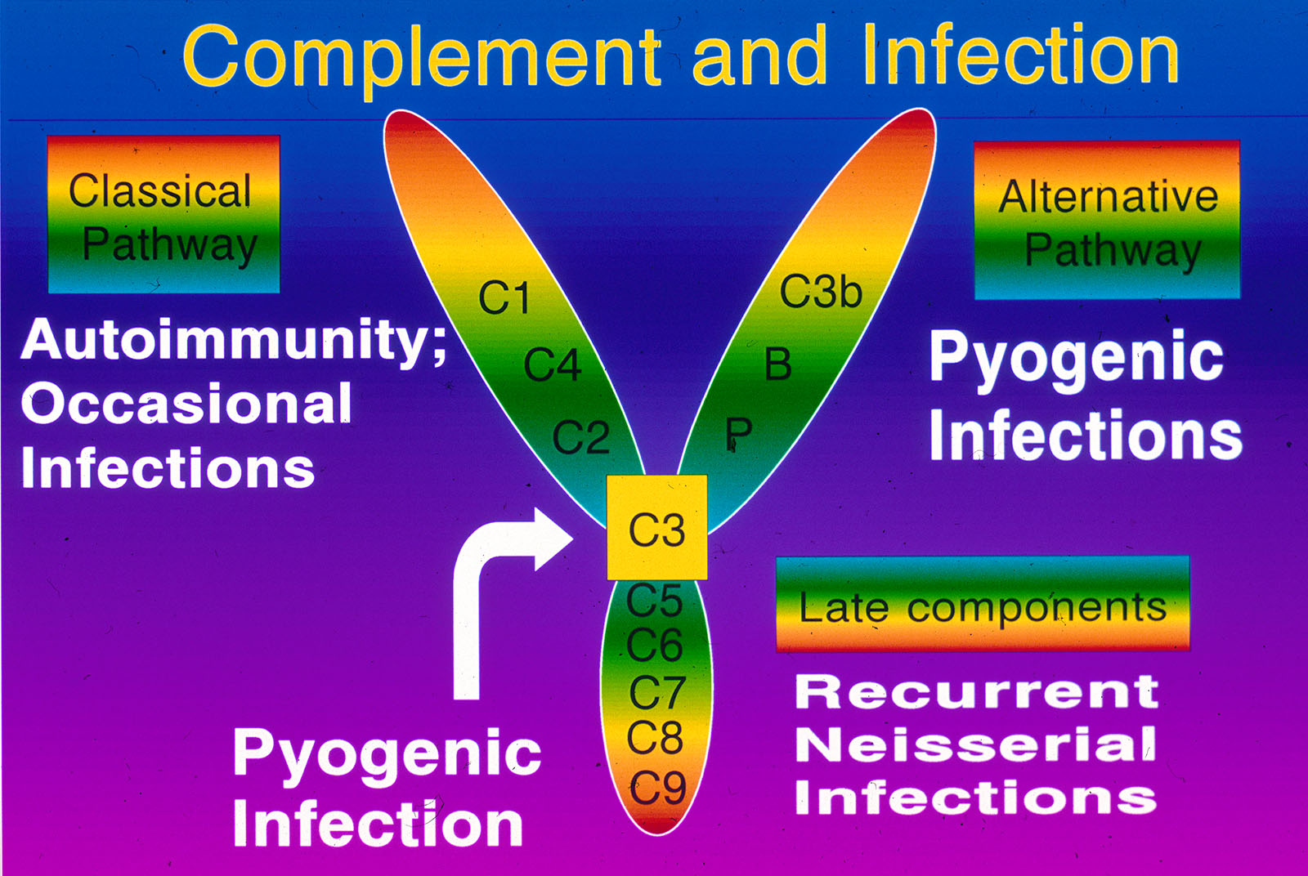

Slide 41
Phagocyte Deficiencies:
Chronic granulomatous disease (CGD)
Leukocyte adhesion deficiency (LAD I)
Chediak- Higashi syndrome
IL-12 / IFNγ pathway deficiencies
Chronic or cyclic neutropenia

Slide 42
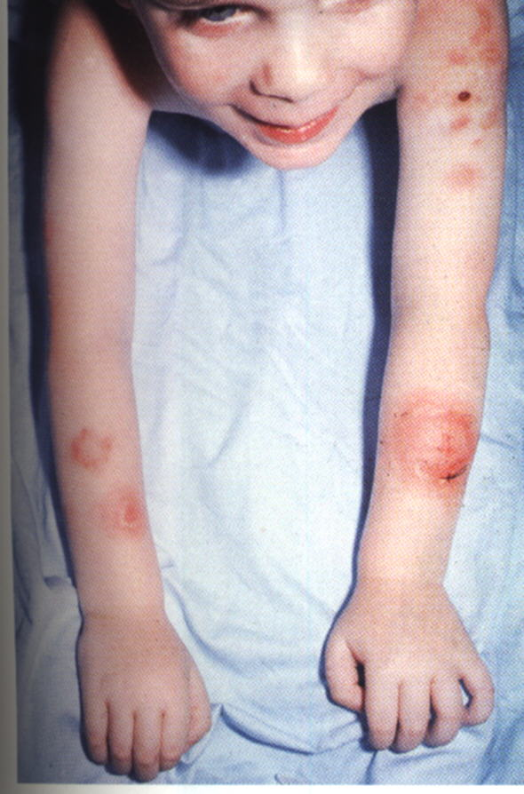
CGD patient with skin
infections due to Serratia marcescens

Slide 43


Slide 44
Thank You

