Slide 1
INDIRECT STANDARDIZATION BY MBBSPPT.COM

Slide 2
What is Standardization ?
Standardization, is a method for overcoming the effect of confounding variables in epidemiological research.
In epidemiological studies we often compare the incidence of disease or mortality between two or more populations. However, the comparison of crude mortality or morbidity rates is often misleading because the populations being compared may differ significantly with respect to certain characteristics, such as age or sex, that will affect the overall rate of morbidity or mortality

Slide 3
Types of Standardization
Direct
Indirect

Slide 4
INDIRECT STANDARDIZATION
commonly used when age-specific rates are unavailable.
In this method, instead of taking one population structure as standard and applying sets of rates to it to estimate expected events, a set of rates from a standard population is applied to each of the observed populations.

Slide 5
INDIRECT STANDARDIZATION
Divided into 2 forms
Standardized mortality ratio (SMR)
Other Standardization techniques

Slide 6
STANDARDIZED MORTALITY RATIO
SMR = Observed Deaths X 100
Expected Deaths
It is a ratio of the total number of deaths that occur in the study group to the number of deaths that would have been expected to occur if that study group had experienced the death rates of a standard population.

Slide 7
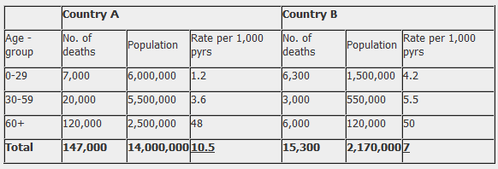
EXAMPLE

Slide 8
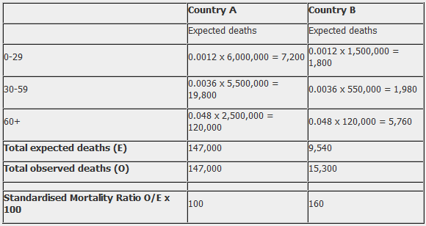
From table the SMR is calculated as 160, which means that the number of observed deaths in Country B is 60% higher than the number we would expect if Country B had the same mortality experience as Country A.

Slide 9
Advantage over direct method
Permits adjustment of age and other factors where age specific rates are unavailable.
Only the number of people in each age group in the study population and the age specific rates of the standard population is needed
Can also be used to calculate disease occurrence instead of death

Slide 10
Other Standardization Techniques
A more complicated method of indirect adjustment that yields absolute age adjustment rate, involves the calculation of an index death rate and a standardizing factor for each population of interest
Life table : an age-adjusted summary of current all-causes mortality
Regression techniques : efficient means of standardization
Multivariate analysis : a computer which using regression or other methods can standardize or several variables simultaneously

Slide 11
Thank You

