Slide 1
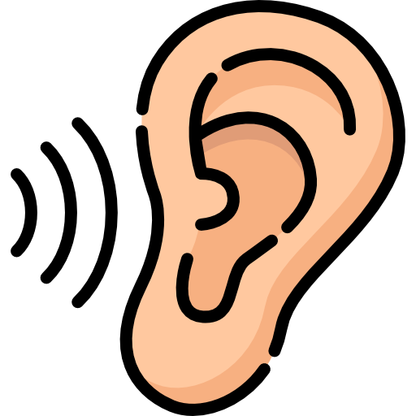
INNER Ear
BY MBBSPPT.COM

Slide 2
Inner ear
There are two inner ear labyrinths, one inside the other, the membranous labyrinth contained within the bony labyrinth.
The bony labyrinth consists of:
A central chamber called the vestibule,
The three semicircular canals, and
The spirally coiled cochlea.

Slide 3
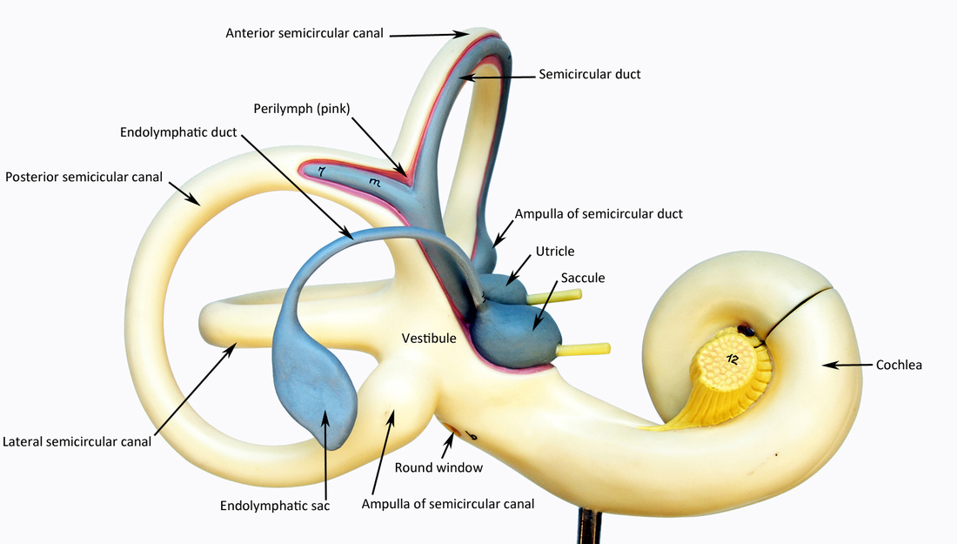

Slide 4
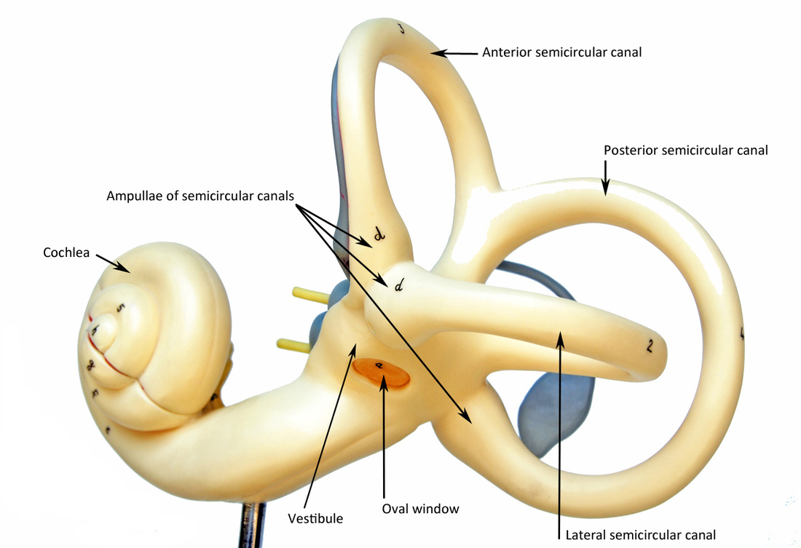

Slide 5
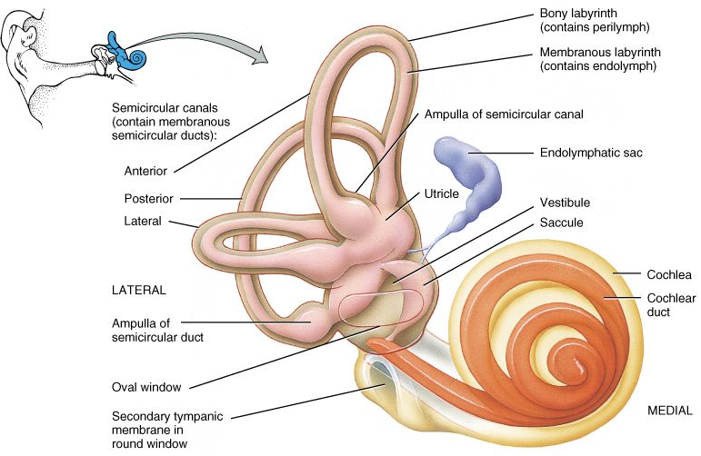

Slide 6
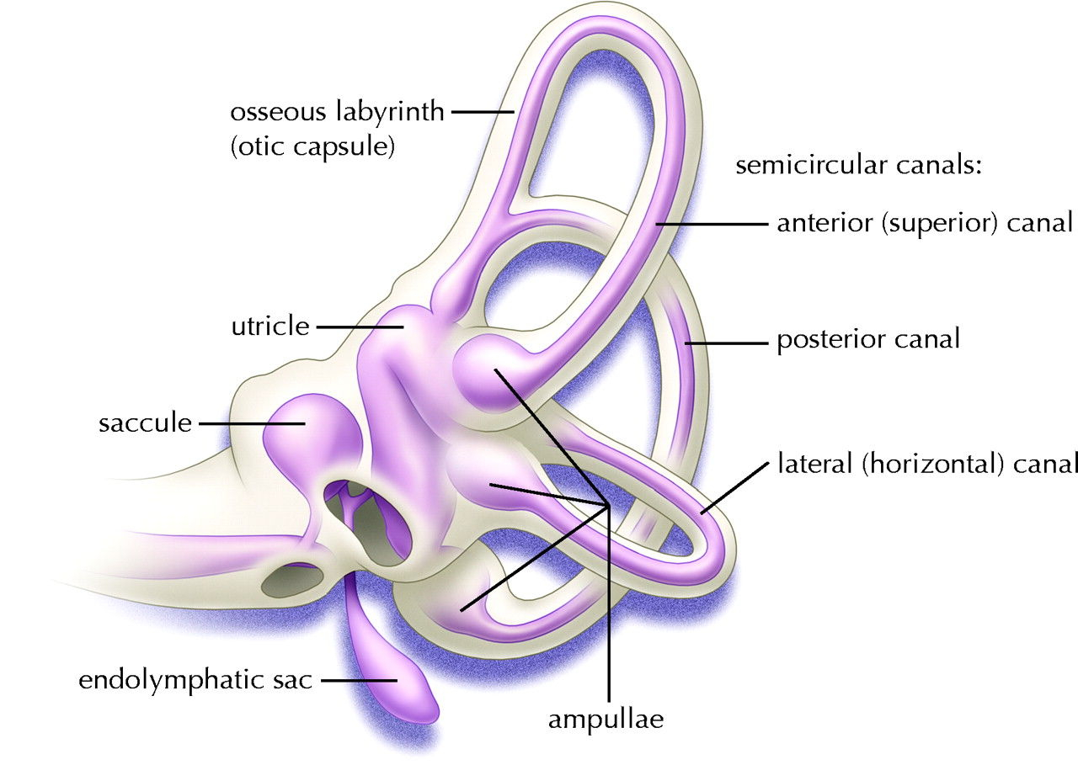
Internal Ear
Osseous labyrinth: a complex system of cavities in the substance of the petrous bone.
Membranous labyrinth: filled with endolymph, bathed in perilymph.

Slide 7
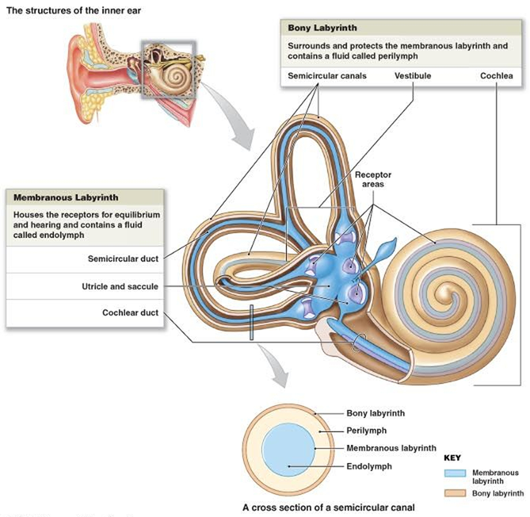

Slide 8
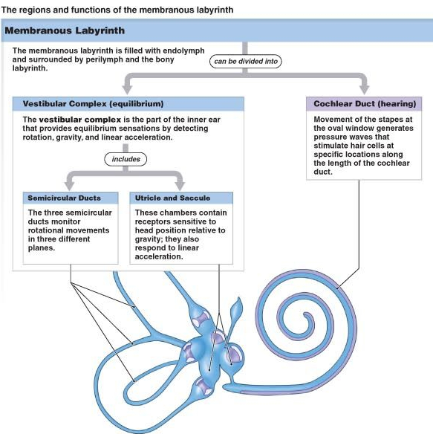

Slide 9
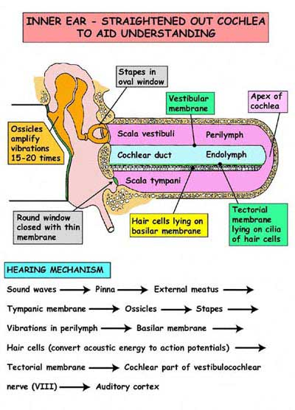
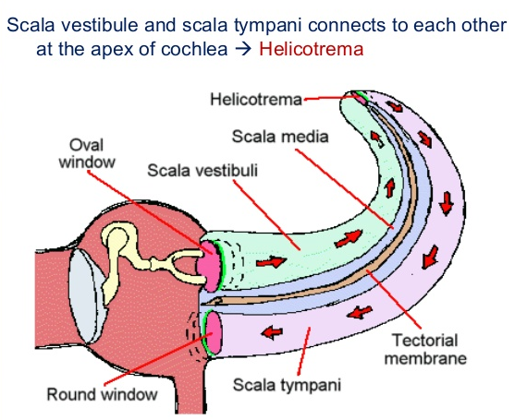

Slide 10
Bony Labyrinth
The bony labyrinth consists of three parts:
the vestibule,
the semicircular canals, and
the cochlea.
These are cavities situated in the substance of dense bone.
They are lined by endosteum and contain a clear fluid, the perilymph, in which is suspended the membranous labyrinth.

Slide 11
The vestibule
The central part of the bony labyrinth lies posterior to the cochlea and anterior to the semicircular canals. In its lateral wall are the fenestra vestibuli, which is closed by the base of the stapes and its annular ligament, and the fenestra cochleae, which is closed by the secondary tympanic membrane.
Lodged within the vestibule are the saccule and utricle of the membranous labyrinth.

Slide 12
Semicircular canals
The three semicircular canals: superior, posterior, and lateral open into the posterior part of the vestibule.
Each canal has a swelling at one end called the ampulla. The canals open into the vestibule by five orifices, one of which is common to two of the canals.
Lodged within the canals are the semicircular ducts.
The superior semicircular canal is vertical and placed at right angles to the long axis of the petrous bone.
The posterior canal is also vertical but is placed parallel to the long axis of the petrous bone.
The lateral canal is horizontal and lies in the medial wall of the aditus to the mastoid antrum, above the facial nerve canal.

Slide 13
The cochlea
The cochlea resembles a snail shell.
It opens into the anterior part of the vestibule.
It consists of a central pillar, the modiolus, around which a hollow bony tube makes two and-one-half spiral turns. Each successive turn is of decreasing radius, making the whole structure conical.
The apex faces anterolaterally and the base faces posteromedially.
The first basal turn of the cochlea is responsible for the promontory seen on the medial wall of the middle ear.

Slide 14
The modiolus
The modiolus has a broad base, which is situated at the bottom of the internal acoustic meatus.
It is perforated by branches of the cochlear nerve. A spiral ledge, the spiral lamina, winds around the modiolus and projects into the interior of the canal and partially divides it.
The basilar membrane stretches from the free edge of the spiral lamina to the outer bony wall, thus dividing the cochlear canal into the scala vestibuli above and the scala tympani below.
The perilymph within the scala vestibuli is separated from the middle ear by the base of the stapes and the anular ligament at the fenestra vestibuli. The perilymph in the scala tympani is separated from the middle ear by the secondary tympanic membrane at the fenestra cochleae.

Slide 15
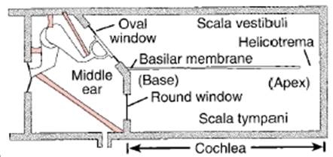

Slide 16
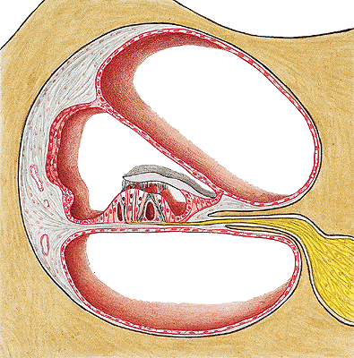
Vestibular/Reissner membrane
Scala vestibuli
Tectorial membrane
Cochlear duct/scala media
Scala tympani
Reticular membrane
8th nerve

Slide 17
Membranous Labyrinth
The membranous labyrinth is lodged within the bony labyrinth. It is filled with endolymph and surrounded by perilymph.
It consists of:
The utricle.
Saccule, both are lodged in the bony vestibule;
The three semicircular ducts, which lie within the bony semicircular canals; and
The duct of the cochlea, which lies within the bony cochlea.
All these structures freely communicate with one another.

Slide 18
The utricle & The saccule
The utricle is the larger of the two vestibular sacs. It is indirectly connected to the saccule and the ductus endolymphaticus by the ductus utriculosaccularis.
The saccule is globular and is connected to the utricle. The ductus endolymphaticus, after being joined by the ductus utriculosaccularis, passes on to end in a small blind pouch, the saccus endolymphaticus. This lies beneath the dura on the posterior surface of the petrous part of the temporal bone.
Located on the walls of the utricle and saccule are specialized sensory receptors, which are sensitive to the orientation of the head to gravity or other acceleration forces.

Slide 19
The semicircular ducts
The semicircular ducts, although much smaller in diameter than the semicircular canals, have the same configuration.
They are arranged at right angles to each other so that all three planes are represented.
Whenever the head begins or ceases to move, or whenever a movement of the head accelerates or decelerates, the endolymph in the semicircular ducts changes its speed of movement relative to that of the walls of the semicircular ducts.
This change is detected in the sensory receptors in the ampullae of the semicircular ducts.

Slide 20
The duct of the cochlea
The duct of the cochlea is triangular in cross section and is connected to the saccule by the ductus reuniens.
The highly specialized epithelium that lies on the basilar membrane forms the spiral organ of Corti and contains the sensory receptors for hearing.

Slide 22
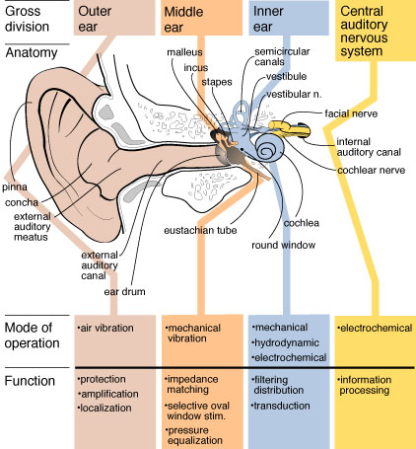

Slide 23
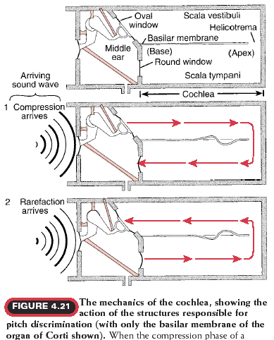

Slide 24
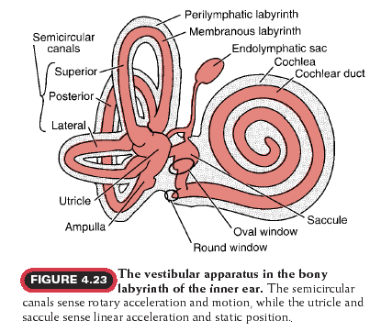

Slide 27
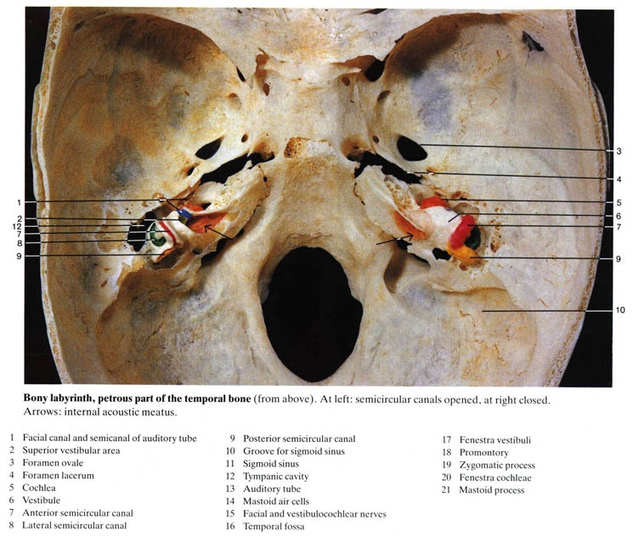

Slide 28
Motion Sickness
The maculae of the membranous labyrinth are primarily static organs, which have small dense particles (otoliths) embedded among hair cells.
Under the influence of gravity, the otoliths cause bending of the hair cells, which stimulate the vestibular nerve and provide awareness of the position of the head in space; the hairs also respond to quick tilting movements and to linear acceleration and deceleration.
Motion sickness results from discordance between vestibular and visual stimulation.

Slide 29
Dizziness and Hearing Loss
Injuries of the peripheral auditory system cause three major symptoms:
Hearing loss (usually conductive hearing loss),
Vertigo (dizziness) when the injury involves the semicircular ducts, and
Tinnitus (buzzing or ringing) when the injury is localized in the cochlear duct.
Tinnitus and hearing loss may result from lesions anywhere in the peripheral or central auditory pathways.

Slide 30
Menier Syndrome
Meniere syndrome is related to blockage of the cochlear aqueduct and is characterized by recurrent attacks of tinnitus, hearing loss, and vertigo.
These symptoms are accompanied by a sense of pressure in the ear, distortion of sounds, and sensitivity to noises.
A characteristic sign is ballooning of the cochlear duct, utricle, and saccule caused by an increase in endolymphatic volume.

Slide 31
Otic Barotrauma
Injury caused to the ear by an imbalance in pressure between ambient (surrounding) air and the air in the middle ear is called otic barotrauma.
This type of injury usually occurs in fliers and divers.

Slide 32
Thank You

