Slide 1
Intercostal Muscles
BY MBBSPPT.COM

Slide 2
Intercostal Muscles
The space between adjacent ribs is called “intercostal space”.
Within each intercostal space, the intercostal muscles are arranged in three layers that pass between adjacent ribs.
External Layer:
External intercostal
Middle Layer:
Internal intercostal
Inner layer(Transeverse thoracic group):
Subcostalis
Innermost Intercostal
Transeverse thoracis

Slide 3
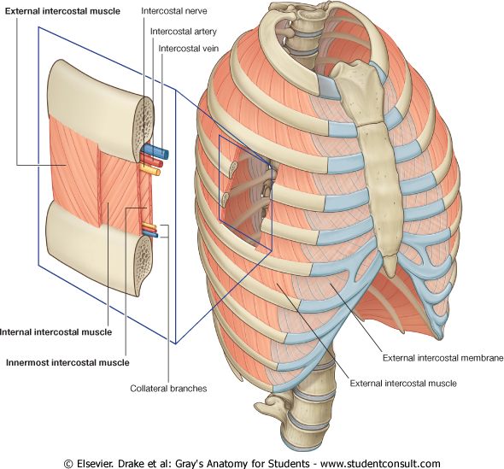

Slide 4
Intercostal Muscles
There are five muscles that make up the thoracic cage;
3 Intercostals
External ,
Internal and
Transeverse thoracis group that includes
Subcostals ,
Innermost (intercostales intimi) ,
Transversus thoracis (sternocostalis).
These muscles act to change the volume of the thoracic cavity during respiration.
There are some other muscles that do not comprise the thoracic wall, but do attach to it. These include the pectoralis major, minor, serratus anterior and the scalene muscles.

Slide 6
External Intercostals
There are 11 pairs of external intercostal muscles.
They run inferoanteriorly from the rib above to the rib below, and are continuous with the external oblique of the abdomen.
The fibers travel downwards, forwards, and medially from the inferior border of the rib above towards the superior border of the rib below. .
Attachments:
Originate at the lower border of the rib, inserting into the superior border of the rib below.

Slide 8
Anterior (external) Intercostal Membrane
The muscles extend around the thoracic wall from the regions of the tubercles of the ribs to the costal cartilages, where where it is substituted by a thin connective tissue aponeurosis called the anterior (external) intercostal membrane.

Slide 9
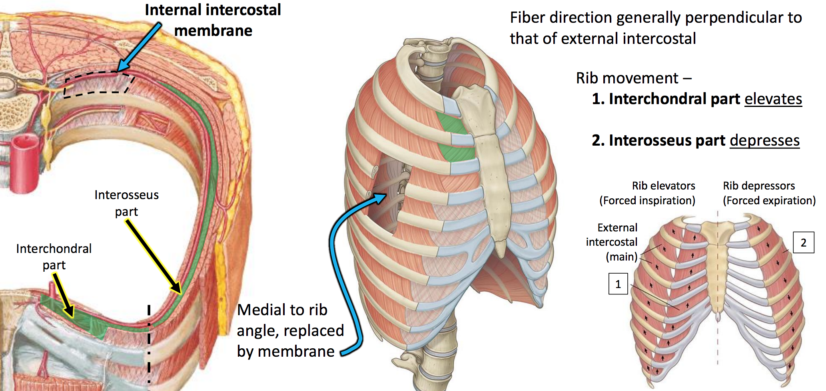

Slide 10
External Intercostal
Actions:
Elevates the ribs, increasing the thoracic volume.
Innervation:
Intercostal Nerves (T1-T11).
Artery Supply:
Intercostal Artery

Slide 11
Muscle | Superior attachment | Inferior attachment | Function
External intercostal | Inferior margin of rib above | Superior surface of rib below | Most active during inspiration; supports intercostal space; moves ribs superiorly
Internal intercostal | Lateral edge of costal groove of rib above | Superior surface of rib below deep to the attachment of the related external intercostals | Most active during expiration; supports intercostal space; moves ribs inferiorly
Innermost intercostal | Medial edge of costal groove of rib above | Internal aspect of superior surface of rib below | Acts with internal intercostals muscles
Subcostales | Internal surface (near angle) of lower ribs | Internal surface of second or third rib below | May depress ribs
Transversus thoracis | Lower margins and internal surfaces of cocostal cartilages of second to sixth ribs | Inferior aspect of deep surface of body of sternum, xiphoid process and costal cartilages ribs IV-VII | Depresses costal cartilages

Slide 12
Internal Intercostals
These flat muscles lie deep to the external intercostals.
There are eleven muscles on each side.
Like the external intercostals, they run from the rib above to the one below, but in an opposite direction (inferoposteriorly).
They are continuous with the internal oblique muscle of the abdominal wall.
Attachments: Originates from the lateral edge of the costal groove and inserts into the superior surface of the rib below.

Slide 13
Internal Intercostal
Among the cartilages of the true ribs they begin anteriorly at the sternum in the intercostal spaces, as well as at the anterior extremities of the cartilages of the false ribs, and extend backward till the angles of the ribs;
They are continuous towards the vertebral column by thin aponeuroses called the posterior intercostal membranes.

Slide 14
Internal Intercostal
Actions:
The interosseous part reduces the thoracic volume by depressing the ribcage, and the interchondral part elevates the ribs.
Innervation:
Intercostal nerves (T1-T11).
Artery Supply:
The internal intercostals are circulated by the intercostal artery.

Slide 15
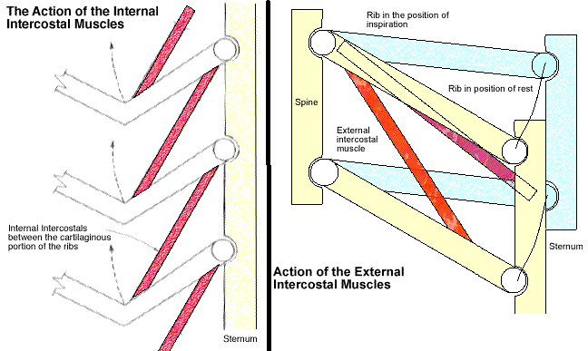

Slide 16
The posterior (internal) intercostal membrane
The internal intercostal muscle forms the intermediate layer.
From the sternum the muscle extends backward in front to the angles of the ribs behind, where the muscle is replaced by an aponeurosis, the posterior (internal) intercostal membrane.

Slide 17
The Transversus Thoracis Group
Of the three groups of muscles in this layer:
The innermost intercostals (intercostales intimi) line the rib cage at the side.
The subcostalis are at the back, and
The transversus thoracis at the front.
They cross more than one intercostal space.

Slide 18
The Subcotalis
Lying in the paravertebral gutter are the subcostal muscles attached to the inner surfaces of ribs.
They are separated from the posterior border of the innermost intercostals by a space across which the Intercostal nerves and vessels are in contact with the parietal pleura.

Slide 19
Subcostalis
The subcostalis muscles are found in the inferior portion of the thoracic wall.
They comprise of thin slips of muscle, which run from the internal surface of one rib, to second and third ribs below. The direction of the fibres parallels that of the innermost intercostal.
Attachments: These originate from the inferior surface of the lower ribs, near the angle of the rib. They then attach to the superior border of the rib 2 or 3 below.
Actions: Share the action of the internal intercostals

Slide 20
Innermost Intercostals
The innermost intercostal muscles (intercostales intimi) are attached to the inner surfaces of ribs on the lateral part of the thoracic wall.
These muscles are the deepest of the intercostal muscles, and are similar in structure to the internal intercostals.
They are separated from the internal intercostals by the intercostal neurovascular bundle and are found in the most lateral portion of the intercostal spaces.

Slide 21
Innermost Intercostals
Attachments: Originates from the medial edge of the costal groove and inserts into the superior surface of the rib below.
Actions: The interosseous part reduces the thoracic volume by depressing the ribcage, and the interchondral part elevates the ribs.
Innervation: Intercostal nerves (T1-T11)

Slide 23
Transversus Thoracis
Transversus thoracis arises from the posterior surface of the lower part of the sternum, whence digitations diverge on each side to the second to the sixth costal cartilages.
This muscle was formerly called sternocostalis.
The transversus thoracis group is the best inclusive name for all three muscles of the inner layer because it conforms with the transversus abdominis muscle.

Slide 25
Transversus Thoracis
These muscles of the thoracic cage are continuous with transversus abdominis inferiorly.
Attachments: From the posterior surface of the inferior sternum to the internal surface of costal cartilages 2-6.
Actions: Weakly depress the ribs.
Innervation: Intercostal nerves (T1-T11).

Slide 28
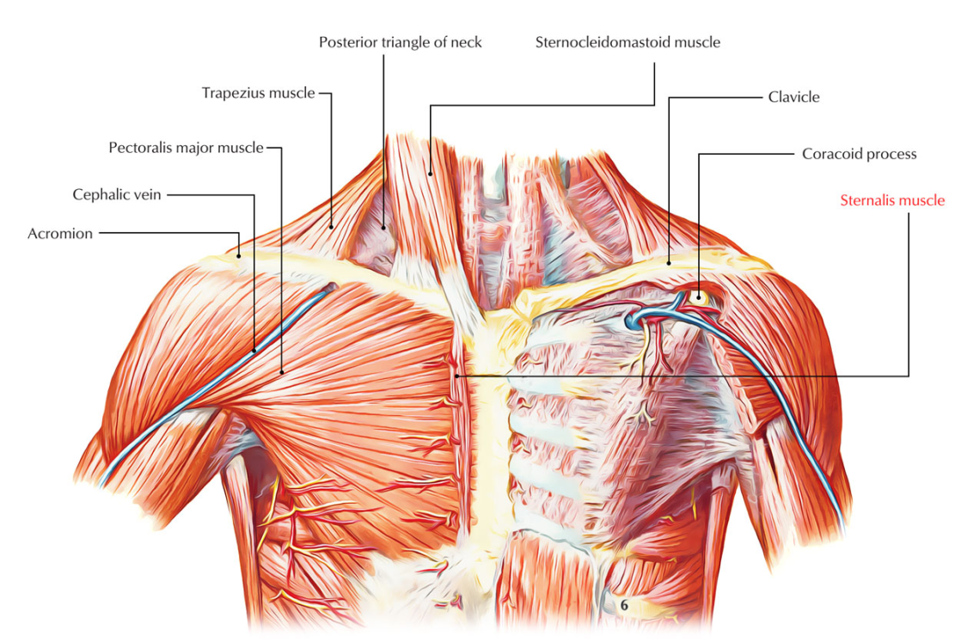
Sternalis
The sternalis is a long thin muscle which expands via the sternocleidomastoid to the rectus abdominis accompanying the sternum.
Compared to bilateral variant the sternalis occurs twice as unilateral variant and develops the same in male and female patients.

Slide 30
THANK YOU

