Slide 1
Intercostal Space
BY MBBSPPT.COM

Slide 3
Intercostal Space
The Intercostal space (ICS) is the space in between the two adjacent ribs.
There are 11 intercostal spaces on each side, each intercostal space is numbered for the rib superior to it.
Every space consists of:
Intercostal muscles .
Neurovascular bundle.

Slide 4
Intercostal Space
In each space, the vein is the most superior structure and is thus highest in the costal groove.
The nervovascular bundle is in such a an order that vein is at the top, then the artery and then the nerve and they are generally not guarded by the groove.
For that reason, the nerve is the structure which is in most danger when objects perforate the upper part of an intercostal space.
Small collateral branches of the major intercostal nerves and vessels are often found above the inferior rib below.
(Mnemonic: VAN).

Slide 5
Intercostal Space
Deep to the intercostal spaces and ribs, and separating such structures from the underlying pleura, is a layer of loose connective tissue, know as endothoracic fascia, which consists of variable amounts of fat.
Superficial to the spaces are deep fascia, superficial fascia, and skin.
Muscles related to the upper limbs and back overlap the spaces.

Slide 6
Intercostal Space
Typical INTERCOSTAL SPACE:
3rd, 4th, 5th & 6th spaces are typical intercostal spaces.
Atypical INTERCOSTAL SPACE:
1st , 2nd and 7th to 12th are atypical intercostal spaces.
This diffentiation depends upon the blood supply and nerve supply of the intercostal spaces.

Slide 7
Intercostal Space

Slide 8
Anterolateral View

Slide 9
Intercostal Spaces: Anterolateral View

Slide 10
Transverse Section

Slide 11
Contents of a Typical Intercostal Space
Intercostal Muscles
Intercostal Nerves
Intercostal Arteries
Intercostal Veins
Intercostal Lymph Vessels

Slide 12
Contents of a Typical Intercostal Space
INTERCOSTAL MUSCLES
External intercostal,
Internal intercostal and
Innermost intercostal (intercostalis intimus).

Slide 13
Intercostal Nerves
The 12 pairs of thoracic spinal nerves innervates the thoracic wall. When they leave, the intervertebral foramina they split into anterior and posterior rami.
The anterior primary rami of upper 11 thoracic spinal nerves (T1-T11) are named intercostal nerves as they course via the intercostal spaces.
The anterior primary ramus of the 12th thoracic spinal nerve runs in the abdominal wall inferior to the 12th rib, therefore it is known as subcostal nerve.

Slide 14
Distinct features The intercostal nerves
They are segmental in character unlike the anterior primary rami from other regions of spinal cord.
In the posterior part of intercostal space, the intercostal nerve is located between the pleura and posterior intercostal membrane.
In greater part of intercostal space, it is located between the internal intercostal and intercostalisintimus muscles.

Slide 17
Classification of Intercostal Nerves
1. Typical intercostal nerves
(3rd, 4th, 5th, and 6th).
The typical intercostal nerves are those which remain confined to their own intercostal spaces.
2. Atypical intercostal nerves
(1st, 2nd, 7th, 8th, 9th, 10th, and 11th).
The atypical spinal nerves extend beyond the thoracic wall and partly or entirely supply the other regions

Slide 18
Special features of some atypical Intercostal Nerves
First Intercostal nerve:
The first intercostal nerve joins the brachial plexus through a branch.
Equivalent to the lateral cutaneous branches of remaining intercostal nerves.
Another exception with the first intercostal nerve is that there is no anterior cutaneous branch.
It is also very small as compared to the remaining nerves.

Slide 19
Special features of some atypical intercostal nerves
Second Intercostal Nerve:
It joins the medial cutaneuos nerve of the arm by a branch called the intercostobrachial nerve.
This branch is equivalent to the lateral cutaneuos branch of the remaining nerves. In this way the second intercostal nerve supplies not only the second intercostal space, but also the skin of the armpit and the upper medial side of the arm.

Slide 20
Special features of some atypical intercostal nerves
The 7th to 11th intercostal nerves:
After giving rise to lateral cutaneous branches (lower five intercostal nerves) cross the costal margin posteriorly into the neurovascular plane of the abdominal wall, which they supply.
They now become the thoracoabdominal nerves of the anterior abdominal wall.
Their anterior cutaneous branches pierce the rectus sheath, becoming cutaneous close to the median plane.

Slide 21
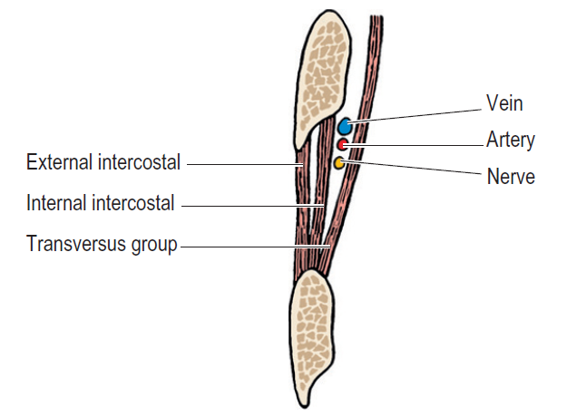
Vertical section through an intercostal space.

Slide 22
Branches
(a) Rami communicantes: Every nerve interacts with all the corresponding thoracic ganglion by white and gray rami communicantes.
(b) Muscular branches: All these are small tender branches from the nerve, which supply intercostal muscles and serratus posterior and superior.
(c) Collateral branch: It appears in the posterior part of the intercostal space near the angle of the rib and runs in the lower part of the space along the upper border of the rib below in exactly the same neurovascular plane.
It supplies intercostal muscles, parietal pleura, and periosteum of the rib.
(d) Lateral cutaneous branch: It appears in the posterior part of the intercostal space near the angle of the rib and accompanies the key nerve for some distance, then pierces the muscles of the lateral thoracic wall along the midaxillary line.
It divides into anterior and posterior branches to supplies the skin on the lateral thoracic wall.
(e) Anterior cutaneous branch: It is the terminal branch of the nerve, which comes on the side of the sternum.
It splits into medial and lateral branches and supplies the skin on the very front of the thoracic wall.

Slide 23
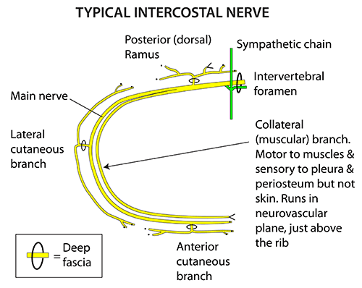

Slide 24
Arterial supply of the Thoracic Wall
The arterial supply to the thoracic wall derives from:
Thoracic aorta, through the posterior intercostal and subcostal arteries.
Subclavian artery, through the internal thoracic and supreme intercostal arteries.
Axillary artery, through the superior and lateral thoracic arteries.
With the exception of the 10th and 11th intercostal spaces, each intercostal space is supplied by three arteries:
A large posterior intercostal artery (and its collateral branch)
A small pair of anterior intercostal arteries.

Slide 25
Intercostal Arteries
The thoracic wall has rich blood supply. It is provided by the posterior and anterior intercostal arteries.
Each intercostal space contains one posterior and two anterior intercostal arteries (upper and lower).
Posterior Intercostal Arteries:
Usually one posterior intercostal artery in each intercostal space
The 1st & 2nd arteries descend to reach their spaces.
The 3rd & 4th arteries ascend to reach their spaces.
Anterior Intercostal Arteries:
Usually two anterior intercostal arteries in each of upper 9 intercostal space.
No antrior intercostal artery in last two(10 & 11) intercostal spaces.

Slide 26
Ipsilateral pairs of anterior intercostal arteries
These supply the anterior parts of the upper 9 intercostal spaces.
Pass laterally in the intercostal space.
Of the first 2 intercostal spaces lie between the parietal pleura and the internal intercostal muscles.
Supplying the 3rd to 6th intercostal spaces are separated from the pleura by slips of the transverse thoracic muscle.
Of the 7th to 9th intercostal spaces derive from the musculophrenic arteries, also branches of the internal thoracic arteries.
Supply the intercostal muscles.
Are absent from the inferior two intercostal spaces which are supplied only by the posterior intercostal arteries and their collateral branches.

Slide 27
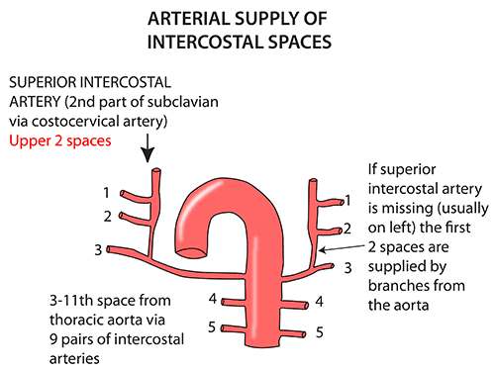

Slide 28
The posterior Intercostal Arteries
Of the 1st and 2nd intercostal spaces arise from the supreme (superior) intercostal artery, a branch of the costocervical trunk of the subclavian artery.
Of the 3rd to 11th intercostal spaces (and the subcostal arteries of the subcostal space) arise posteriorly from the thoracic aorta.
Because the aorta is slightly to the left of the vertebral column, the right 3rd to 11th intercostal arteries have a longer course than those on the left side.
The right arteries cross the vertebrae and pass posterior to the esophagus, thoracic duct, azygos vein, and the right lung and pleura.

Slide 30
Intercostal Veins
The number of intercostal vein corresponds to the number of intercostal arteries, i.e.,
Each intercostal space contains:
Two anterior intercostal veins and
One posterior intercostal vein.
Their tributaries correspond to the branches of the arteries

Slide 31
The Intercostal Veins

Slide 32
Plane of neurovascular bundle in the Intercostal space
The neurovascular bundle being composed of intercostal nerve and vessels is located between the internal intercostal and innermost intercostal muscles, i.e., between the intermediate and deepest layers of muscles.
They may be ordered in the following sequence from above downwards:
Intercostal Vein. V
Intercostal Artery. A
Intercostal Nerve. N

Slide 33
Sites of Eruption of Cold Abscess on The Body Wall
Pus from the tuberculous thoracic vertebra/vertebrae (Pott’s disease) tends to track along the neurovascular plane of the space and might point at 3 sites of development of cutaneous branches of the thoracic spinal nerve, viz.
Just lateral to the sternum.
In the midaxillary line.
Lateral to the erector spinae muscle.

Slide 34
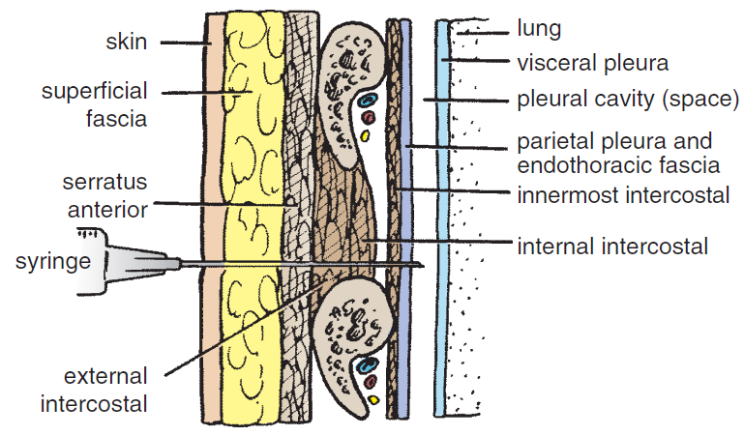

Slide 36
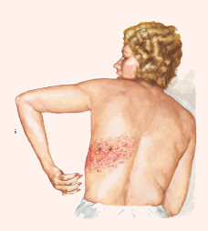
Herpes Zoster
In herpes zoster (shingles) involving the thoracic spinal ganglia, the cutaneous vesicles appear in the dermatomal area of distribution of intercostal nerve. It’s an incredibly debilitating state.

Slide 37
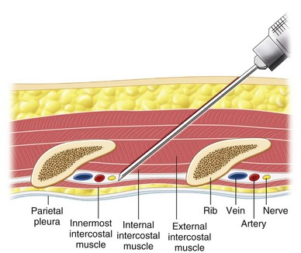
Intercostal Nerve Block
Intercostal nerve block is given to make local anesthesia in one or more intercostal spaces by injecting the anesthetic agent around the nerve trunk near its origin, i.e., just lateral to the vertebra.

Slide 38
Thoracotomy
The traditional thoracotomy (postero- lateral) is performed along the 6th rib.
The neurovascular bundle is shielded from injury by lifting the periosteum of the rib.
Considering the position of neurovascular bundle in the intercostal space, it is safe to add the needle, a little above the upper border of the rib below.

Slide 39
THANK YOU!

