Slide 1
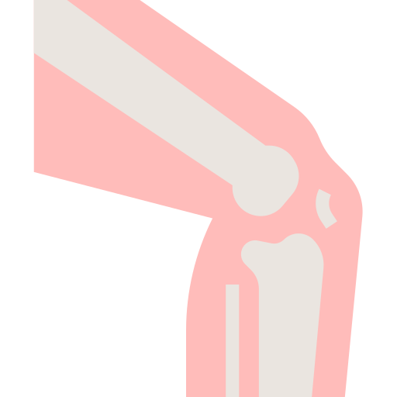
KNEE JOINT
BY MBBSPPT.COM

Slide 2
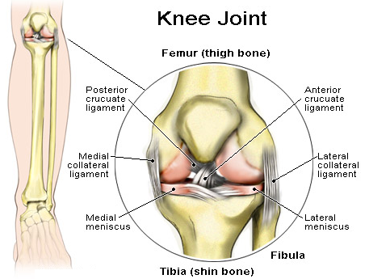

Slide 3
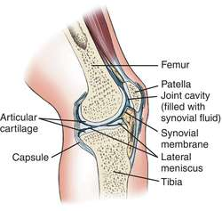
Knee Joint
The Knee Joint is a synovial joint, the largest in the body and most complex joint.
It is a modified hinge joint.
In addition to flexion and extension a small amount of rotation of the leg is possible in the flexed position of the knee.
It is a compound joint that includes two condylar joints between the femur and the tibia and a sellar (saddle) joint between the patella.
Lateral Femorotibial Joint
Medial Femorotibial Joint
Femoropetellar Joint

Slide 4
Articulating surfaces
Tibiofemoral:
The medial condyles of the femur
The lateral condyles of the femur
Articulating with the tibial condyles.
Patellofemoral:
The anterior and distal part of the femur articulating with the patella.

Slide 5
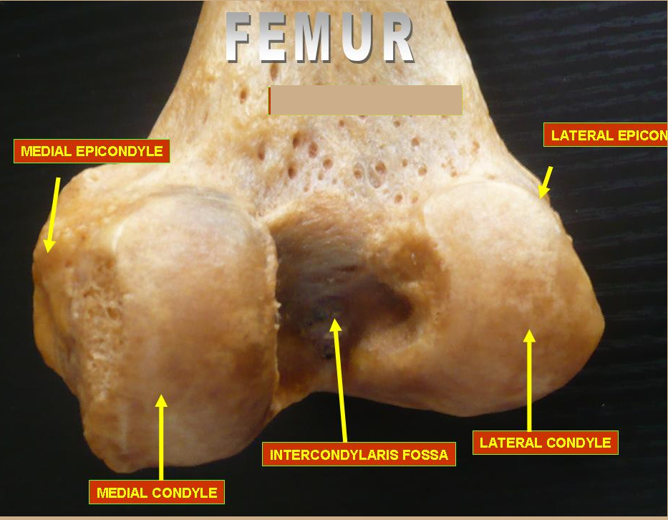

Slide 6
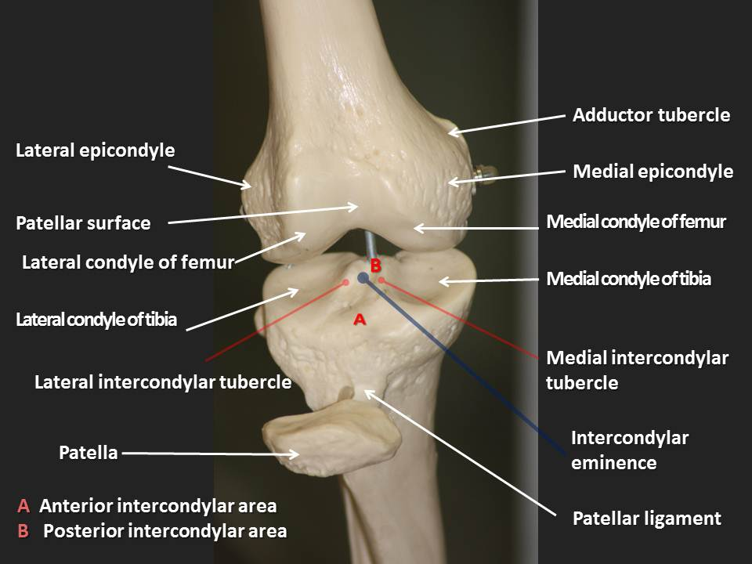

Slide 7
Lower end of the femur
Lateral Condyle
It is stouter and more powerful in relation to the medial condyle (outer is strouter, inner is thinner).
Its medial surface creates the lateral boundary of intercondylar fossa.
A groove below and behind the lateral epicondyle gives connection to popliteus in its anterior part.
Medial Condyle
Its lateral surface creates medial boundary of intercondylar fossa.
About 1 cm is longer than medial condyle of the femur.
The patellar surface of the lower end of femur V-shaped & saddle-shaped. Its lateral portion is wider and extends to a higher level in relation to the medial portion, corresponding to articular outermost layer of the patella.

Slide 8
Intercondylar Fossa (Notch)
It is a deep notch, which divides 2 condyles posteriorly.
It is restricted posteriorly above by intercondylar path.
It presents medial and lateral walls and floor.
Medial wall of the fossa gives attachments to the upper end of posterior cruciate ligament in its anteroinferior part.
Lateral wall of the fossa gives connection to the upper end of anterior cruciate ligament in its posterosuperior part.
Mnemonic: LAMP = Lateral condyle gives connection to Anterior cruciate ligament and Medial condyle to Posterior cruciate ligament.

Slide 9
superior surface of the tibia
The upper end of the tibia is markedly expanded from side to side, to form two large condyles which overhang the posterior surface of the shaft.
The upper end includes:
A medial condyle,
A lateral condyle,
An intercondylar area.

Slide 10
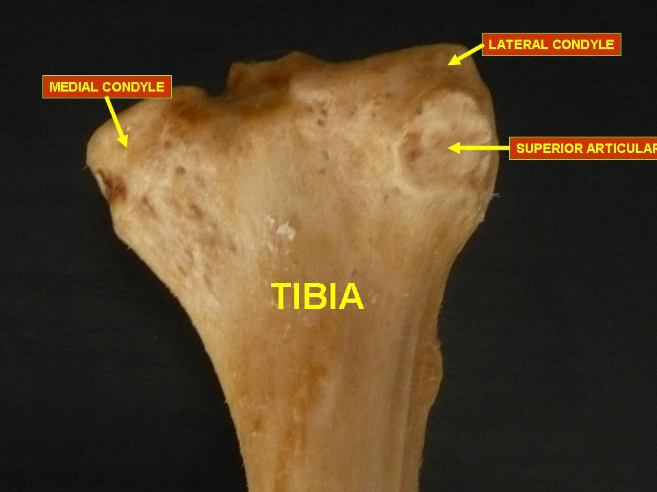

Slide 11
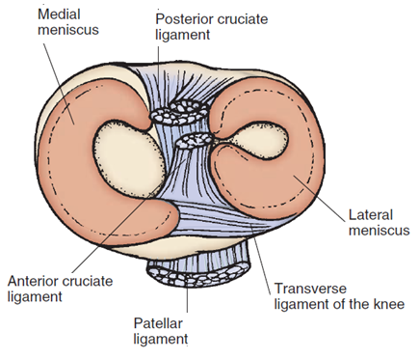
Upper End of the tibia

Slide 12
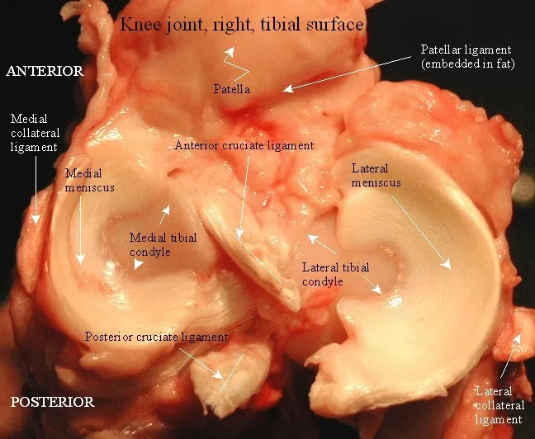

Slide 13
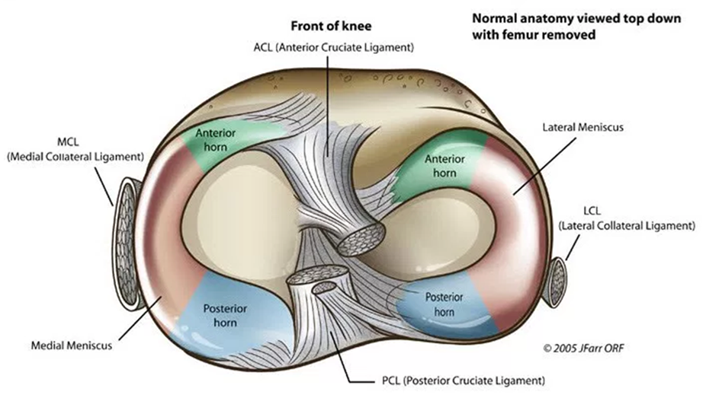

Slide 14
Tibial plateau
The condyles form a flat surface, known as the tibial plateau.
This structure articulates with the femoral condyles to form the major articulation of the knee joint.

Slide 15
The tibial condyles
Medial condyle (two main feature):
Surface on the medial condyle is oval (long axis anteroposterior) in conformity with the medial femoral condyle and meniscus.
The peripheral flattened part is covered by the fibrocartilaginous plate, the medial meniscus.
Lateral condyle (two main feature):
The lateral surface is a little smaller and more nearly circular, in conformity with the lateral femoral condyle and meniscus.
It has a smaller facet for the head of fibula.
It is separated from the femur by the lateral meniscus.

Slide 16
Posterior Surface of the patella
The large articular area is divided mainly by a vertical ridge into a bigger lateral and a smaller medial area to fit with the mutual articular surfaces of the femur.
The vertical ridge itself takes up the groove on the patellar surface of femoral lower end.
Larger lateral articular area is located in contact with the lateral femoral condyle.

Slide 17
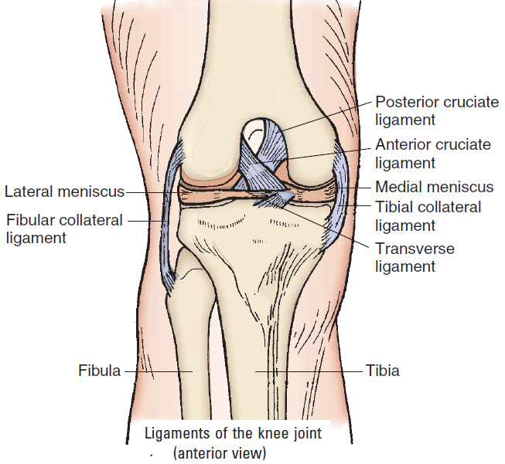

Slide 18
Intercondylar Area
1. It is the rough area on the superior surface of the upper end of tibia between the articular surfaces of 2 condyles.
2. The middle of intercondylar area is narrow and marked by an elevation referred to as intercondylar eminence.
This consists of two tubercles and a roughened area.
This area is the main site of attachment for the ligaments and the menisci of the knee joint.
The tibial intercondylar tubercles fit into the intercondylar fossa of the femur.
3. From before backwards, the intercondylar area gives attachments to 6 structures.
Cont.

Slide 19
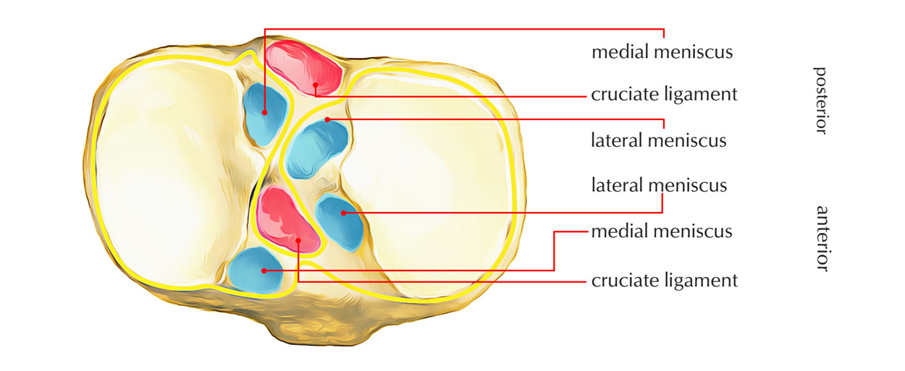
Intercondylar Area
The condyles form a flat surface, known as the tibial plateau. This structure articulates with the femoral condyles.

Slide 20
Intercondylar Area
The intercondylar area gives attachments to 6 structures:
Anterior horn of Medial meniscus.
Anterior Cruciate ligament.
Anterior horn of Lateral meniscus.
Posterior horn of Lateral meniscus.
Posterior horn of Medial meniscus.
Posterior Cruciate ligament.

Slide 21
Joint capsule
The joint capsule consists of the external fibrous layer and the internal synovial membrane.
The fibrous layer is thin, except for the thickened parts that make up the intrinsic ligaments of the knee.
It encapsulates the knee joint while at the same time making adjustment for the important structures.
It is attached about 0.5-1 cm beyond the articular margins on femur and tibia both.

Slide 22
Joint capsule attachments
On Femoral Side
It is deficient anteriorly, where it is replaced by the quadriceps femoris, the patella and the ligamentum patellae.
Posteriorly, it is attached to the intercondylar line.
Laterally, it encloses the origin of the popliteus.
On Tibial Side
Anteriorly descends along the margins of the condyles to tibial tuberosity, where it is deficient.
Posteriorly, it is attached to the intercondylar ridge which limits the attachment of the posterior cruciate ligament.
Posterolaterally, there is a gap behind the lateral condyle for passage of the tendon of the popliteus.

Slide 23
The capsule
The capsular ligament is weak but is strengthened by:
Anteriorly – medial and lateral patellar retinacula which are extensions from the vastus medialis and lateralis.
Laterally by the iliotibial tract.
Medially by expansions from the tendons of the Sartorius and semimembranosus.
Posteriorly, by the oblique popliteal ligament.

Slide 24
Gaps in capsule of knee joint
The capsule has two constant gaps:
One for the suprapatellar bursa
Another for the exit of the tendon of the popliteus.
Sometimes there are gaps that communicate with the bursae deep to the medial head of the gastrocnemius , and deep to the semimembranosus.

Slide 25
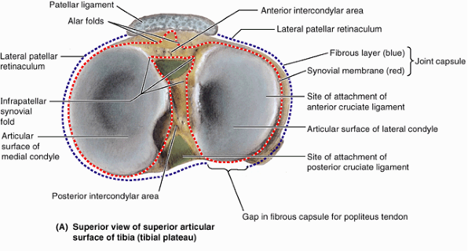

Slide 26
The synovial membrane
The synovial membrane of the knee joint lines the capsule, except posteriorly where it is reflected forwards by the cruciate ligaments, forming a common covering for both ligaments.
In front, it is absent from the patella. Above the patella, it is prolonged upwards for 5 cm or more as the suprapatellar bursa. Below the patella, it covers the deep surface of the infrapatellar pad of fat, which separates it from the patellar ligament.
A median fold, the infrapatellar synovial fold, extends backwards from the fat pad to the intercondylar fossa of the femur. An alar fold diverges on each side from the median fold to reach the lateral edges of the patella.
*The synovial membrane does not cover the surfaces of the menisci. RJL page 139.

Slide 27
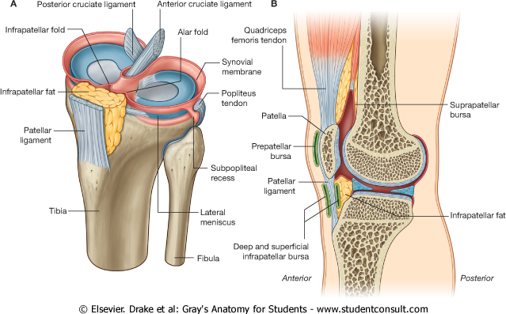

Slide 28
Connecting structures
Extracapsular (capsule of knee joint):
Medial (tibial) collateral ligament
Lateral (fibular) collateral ligament
Ligamentum patellae
Oblique popliteal ligament
Intracapsular ligament:
Anterior Cruciate Ligament
Posterior Cruciate Ligament
Medial Meniscus
Lateral Meniscus

Slide 29
The cruciate ligaments of the knee
There are the anterior cruciate ligament (ACL) and the posterior cruciate ligament (PCL).
These ligaments are two strong, rounded bands that extend from the head of the tibia to the intercondyloid notch of the femur.
The ACL is lateral and the PCL is medial.
The PCL is larger and stronger than the ACL.
These form a cross arrangement(X) as these are named as.

Slide 30
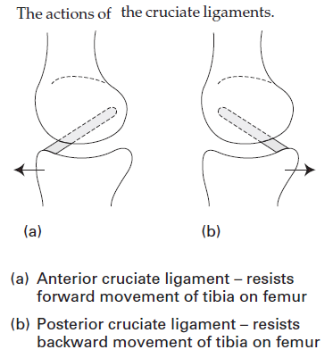

Slide 31
Cruciate Ligaments
Anterior Cruciate Ligament | Posterior Cruciate Ligament
Lies outside the synovial cavity of the joint but inside the knee joint capsule. | Lies outside the synovial cavity but within the fibrous joint capsule.
Arises from the anterior intercondylar area of the tibia and passes upward, backward, and laterally to insert into the medial surface of the lateral femoral condyle. | Arises from the posterior intercondylar area of the tibia and passes upward, forward, and medially to insert into the lateral surface of the medial femoral condyle.
Prevents forward sliding of the tibia on the femur (or posterior displacement of the femur on the tibia) and prevents hyperextension of the knee joint. | Prevents backward sliding of the tibia on the femur (or anterior displacement of the femur on the tibia) and limits hyperflexion of the knee.
Is slightly longer than the posterior cruciate ligament. | Is shorter, straighter, and stronger than the anterior cruciate ligament.
Is taut during extension of the knee and is lax during flexion. (The small, more anterior band is taut during flexion.) | Is taut during flexion of the knee and is lax during extension. (The small posterior band is lax during flexion and taut during extension.)
*Anterior Cruciate Ligamentum may be torn when the knee is hyperextended.

Slide 32
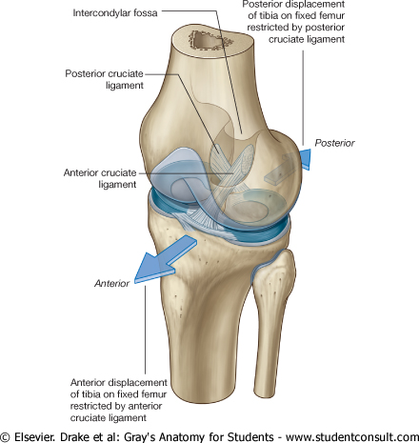

Slide 33
Menisci
Menisci (semilunar cartilages) are flattened crescent-shaped discs inside the knee joint (one medial, one lateral), wedged between the articular surfaces (condyles) of the femur and the tibia and thickest at the periphery.
Medial meniscus
Lateral meniscus
Each meniscus has:
Two ends, both attached to the tibia
Two borders – Outer border is thick, convex and fixed to the fibrous capsule, inner border is thin, concave and free.
Two surfaces – The upper surface is concave for articulation with the femur. The lower surface is flat and rests on the peripheral two thirds of the tibial condyle. The peripheral thick part is vascular. The inner part is avascular and is nourished by synovial fluid.

Slide 34
Medial Meniscus | Lateral Meniscus
Lies outside the synovial cavity but within the joint capsule.* | Lies outside the synovial cavity but within the joint capsule.*
C-shaped (i.e., forms a semicircle) and is attached to the medial collateral ligament and interarticular area of the tibia. | Nearly circular, acts as a cushion, and facilitates lubrication.
Acts as a cushion or shock absorber and lubricates the articular surfaces by distributing synovial fluid in a windshield-wiper manner. | Separated laterally from the fibular (or lateral) collateral ligament by the tendon of the popliteal muscle and aids in forming a more stable base for the articulation of the femoral condyle.
Transverse Ligament
■ Binds the anterior horns (ends) of the lateral and medial semilunar cartilages (menisci).
*The synovial membrane does not cover the surfaces of the menisci. RJL page 139.

Slide 35
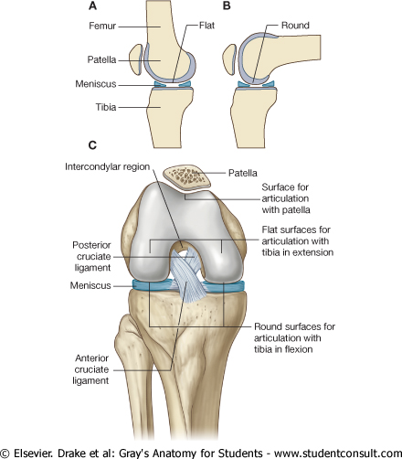

Slide 36
Movements of the minisci
Minisci are moved passively by displacement between tibial & femoral condyles.
Minisci are moved actively as a result of their attachments to muscles and ligaments.
Minisci are pushed anteriorly as knee extends.
Minisci are pushed posteriorly during flexion.
During axial rotation minisci follow movements of femoral condyles.

Slide 37
Extracapsular Ligaments
Medial (Tibial) Collateral Ligament | Is a broad band that extends from the medial femoral epicondyle to the medial tibial condyle. ■ Is firmly attached to the medial meniscus, and its attachment is of clinical significance because injury to the ligament results in concomitant damage to the medial meniscus. ■ Prevents medial displacement of the two long bones and thus abduction of the leg at the knee. ■ Becomes taut on extension and thus limits extension and abduction of the leg.
Lateral (Fibular) Collateral Ligament | Is a rounded cord that is separated from the lateral meniscus by the tendon of the popliteus muscle and also from the capsule of the joint. ■ Extends between the lateral femoral epicondyle and the head of the fibula. ■ Becomes taut on extension and limits extension and adduction of the leg.

Slide 38
Extracapsular Ligaments
Patellar Ligament (Tendon) | Is a strong flattened fibrous band that is the continuation of the quadriceps femoris tendon. Its portion may be used for repair of the anterior cruciate ligament. ■ Extends from the apex of the patella to the tuberosity of the tibia.
Arcuate Popliteal Ligament | Arises from the head of the fibula, arches superiorly and medially over the tendon of the popliteus muscle on the back of the knee joint, and fuses with the articular capsule.
Oblique Popliteal Ligament | Is an oblique expansion of the semimembranosus tendon and passes upward obliquely across the posterior surface of the knee joint from the medial condyle of the tibia. ■ Resists hyperextension of the leg and lateral rotation during the final phase of extension.
Popliteus Tendon | Arises as a strong cord-like tendon from the lateral aspect of the lateral femoral condyle and runs between the lateral meniscus and the capsule of the knee joint deep to the fibular collateral ligament.

Slide 39
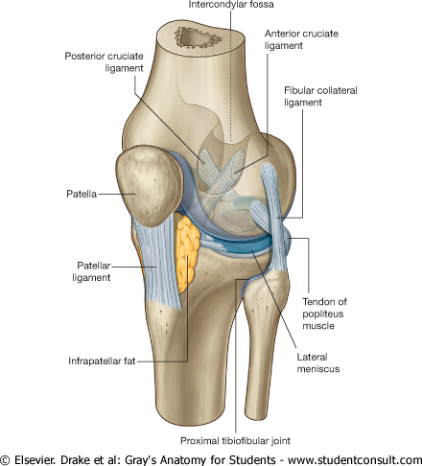

Slide 40
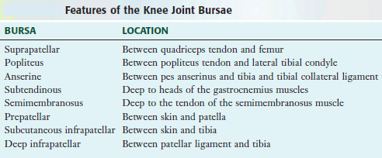

Slide 41
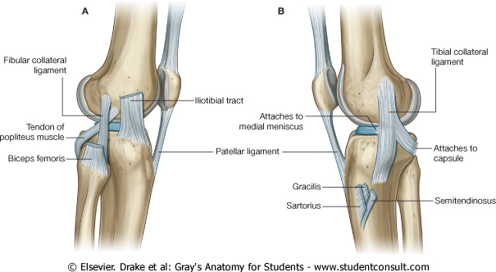

Slide 42
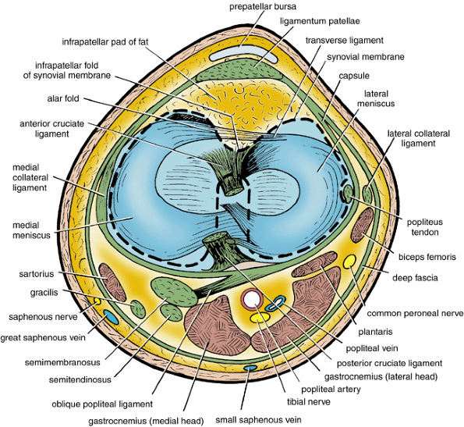

Slide 43
Relations
Anteriorly | The prepatellar bursa
Posteriorly | The popliteal vessels; Tibial and common peroneal nerves; Lymph nodes; and The muscles that form the boundaries of the popliteal fossa, namely, the semimembranosus, the semitendinosus, the biceps femoris, the two heads of the gastrocnemius, and the plantaris
Medially | Sartorius, gracilis, and semitendinosus muscles
Laterally | Biceps femoris and common peroneal nerve

Slide 44
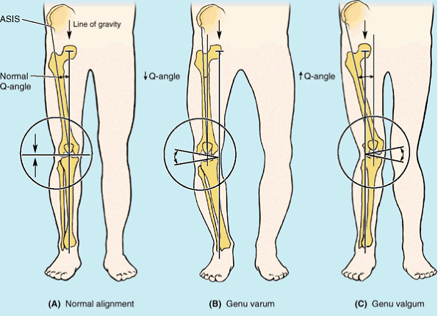

Slide 46
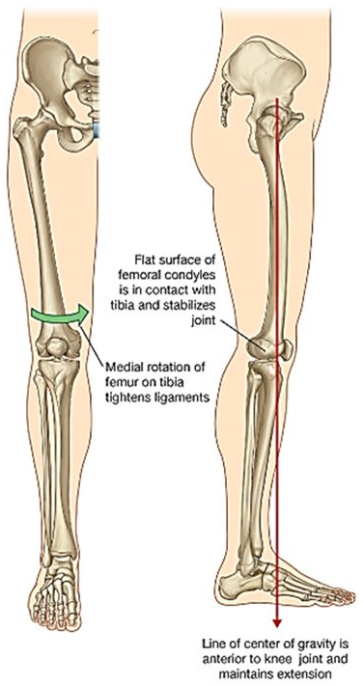
Locking mechanism
When standing, the knee joint is 'locked'.
One component of the locking mechanism is a change in the shape and size of the femoral surfaces that articulate with the tibia:
*The joint surfaces become larger and more stable in extension.
Another component of the locking mechanism is medial rotation of the femur on the tibia during extension.
Medial rotation and full extension tighten all the associated ligaments.
Another feature that keeps the knee extended when standing is that the body's center of gravity is positioned along a vertical line that passes anterior to the knee joint.
The popliteus muscle unlocks the knee by initiating lateral rotation of the femur on the tibia.

Slide 47
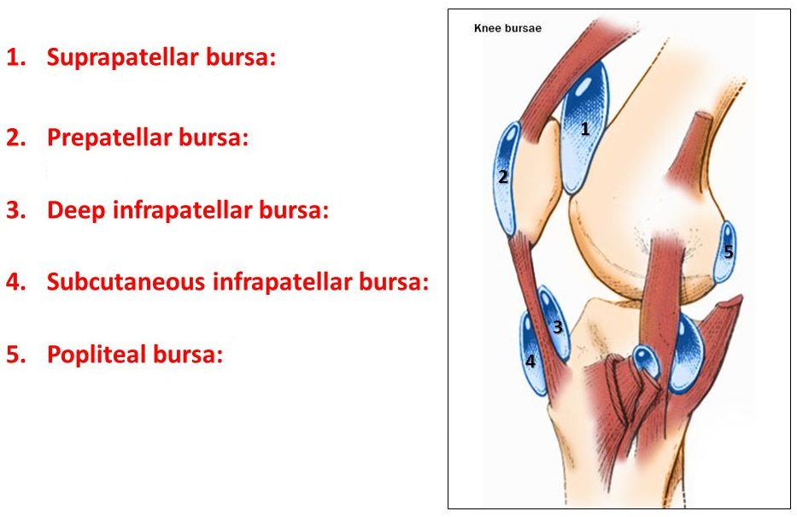
Bursae around knee joint

Slide 48
Bursae around knee joint
Bursae | Locations | Comments
Suprapatellar | Between femur and tendon of quadriceps femoris | Held in position by articularis genu muscles; communicates freely with (superior extension of) synovial cavity of knee joint
Popliteus | Between tendon of popliteus and lateral condyle of tibia | Opens into synovial cavity of knee joint inferior to lateral meniscus
Anserine | Separates tendons of sartorius, gracilis, and semitendinosus from tibia and tibial collateral ligament | Area where tendons of these muscles attach to tibia; resembles a goose's foot (L. pes anserinus)
Gastrocnemius | Deep to proximal attachment of tendon of medial head of gastrocnemius | An extension of synovial cavity of knee joint
Semimembranosus | Between medial head of gastrocnemius and semimembranosus tendon | Related to distal attachment of semimembranosus
Subcutaneous prepatellar | Between skin and anterior surface of patella | Allows free movement of skin over patella during movements of leg
Subcutaneous infrapatellar | Between skin and tibial tuberosity | Helps knee withstand pressure when kneeling
Deep infrapatellar | Between patellar ligament and anterior surface of tibia | Separated from knee joint by infrapatellar fat pad

Slide 50
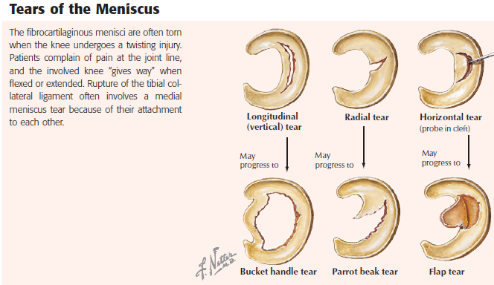

Slide 51
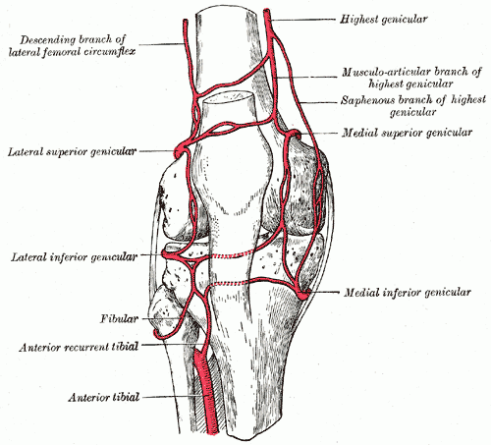
Blood Supply of Knee Joint
The knee joint is supplied by the anastomosis around it which is formed by contribution from:
Five genicular branches of the popliteal artery
Descending genicular branch of the femoral artery
Descending branch of the lateral circumflex femoral artery
Two recurrent branches of the anterior tibial artery
Circumflex fibular branch of the posterior tibial artery.
The anastomosis supplies the patella, the femoral and tibial condyles, bone marrow, articular capsule, and synovial membrane.

Slide 52
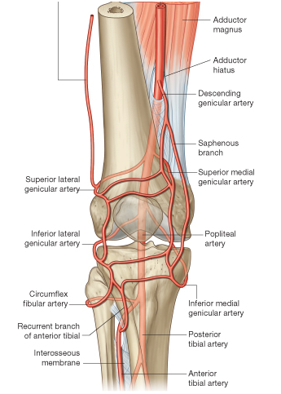

Slide 53
The venous system of the knee joint
The venous system of the knee joint is primarily composed of the popliteal and femoral veins. These veins simply run with their corresponding arteries and drain deoxygenated blood from the arterial anastomosis.

Slide 54
Nerve Supply of Knee Joint
Femoral nerve, through its branches to the vasti, especially the vastus medialis.
Sciatic nerve, through the genicular branches of the tibial and common peroneal nerves.
Obturator nerve through its posterior division.
Infrapatellar branch of the saphenous nerve provides cutaneous sensation to the medial anterior aspect of the knee.
Peripatellar plexus is composed of branches from anterior cutaneous branches of the femoral nerve and the lateral femoral cutaneous nerve to provide cutaneous sensation to the rest of the knee.

Slide 55
Lymphatic drainage of Knee joint
The lymphatic drainage of knee joint is to popliteal nodes.
Most of the lymph vessels accompany the genicular arteries.
The popliteal nodes drain into the inguinal group of lymph node.

Slide 56
Stability of Knee Joint
Structurally, the knee is a week joint because the articular surfaces are not congruent. The tibial condyles are too small and shallow to hold the large, convex, femoral condyles in place. The femoropatellar articulation is not inherently stable because shallow articular surfaces, and because of the outward angulation between the long axis of thigh and of the leg.
Stability to the joint is imparted by
Cruciate ligaments – maintain anteroposterior stability.
Collateral ligament – maintain side to side stability.
Capsule thickenings as note before.
Iliotibial tract plays an important role in stabilizing the knee.
Patellar retinacula.

Slide 57
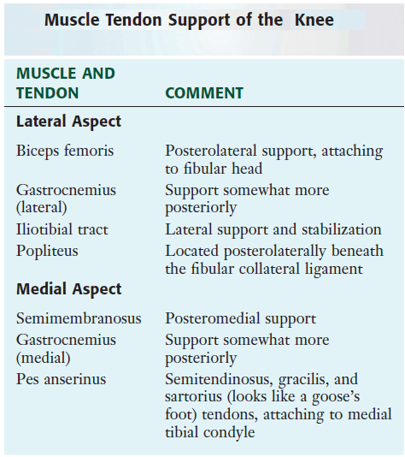

Slide 58
Thank You

